Slide 2
BusConnects Cork
Sustainable Transport Corridors
Community Forum
Sustainable Transport Corridor E – Ballincollig to City
Sustainable Transport Corridor F – Bishopstown to City

Slide 3
Introductions
Chairperson Simon Nugent
NTA Hugh Creegan, Deputy CEO
Con Kehely, Head of BusConnects Cork
Arup Niall Harte, Associate Director
Clifford Killeen, Senior Engineer

Slide 4
Agenda
Introductions (completed)
Running of meetings
Overview of BusConnects Cork
Emerging Preferred Routes
Questions – Comments - Discussion

Slide 5
Forum Objectives & Terms of Reference
Two-way communication –Serve as a two-way communication channel between the NTA and local communities
Information Flow – Allow provision of information and updates throughout the duration of the project
Answer questions - Provide answers to concerns and issues raised
Listen – Listen to suggestions on how to improve the proposals, hear constructive ideas and viable alternatives
Resolve – Enable and support the resolution of local issues in a timely manner

Slide 6
Running of Meeting
We will endeavor to finish the meeting on time
Please turn mobile phones to silent or off
Chairperson will call on contributors in turn
State your name and the name of the group you represent
To allow maximum participation, please keep contributions short

Slide 7
Overview of BusConnects Cork

Slide 8
What is BusConnects Cork
BusConnects Cork is a €600 million investment in Cork’s sustainable transport system, to be implemented by 2030 under the Government’s National Development Plan
Its objective is to transform the bus system to make it more useful to more people and, in parallel, deliver safe cycling facilities on key corridors
BusConnects Cork is a central part of the Cork Metropolitan Area Transport Strategy (CMATS), which set out an ambitious vision to deliver an integrated and sustainable transport system for the region.
CMATS incorporates an enhanced commuter rail system (Cork Commuter Rail Programme), a new east-west light rail line (Luas Cork) and a transformed bus system (BusConnects Cork) inclusive of safe cycling facilities.
Together with the other elements of CMATS, BusConnects Cork will enable Cork to become an even more dynamic, connected and internationally competitive city

Slide 10
Why do we need BusConnects Cork
The population of Cork is projected to grow by 50-60% by 2040 – that means more people movement
Without a better public transport system and cycling network to cater for that growth, traffic congestion will increase and become more widespread and severe – doing nothing is not an option
Currently a low percentage of people use the bus system because it doesn’t meet their needs. To make the system better, we have to remove the vehicles from traffic congestion in order to make buses more reliable, more punctual and faster. That means bus lanes or other system of bus priority.
We want people to have access to a very good public transport system plus safe cycling facilities while still retaining car capacity for the many people who will still need to use their cars
But the constrained street layouts across the city make it very challenging to deliver that ambition

Slide 11
Cork - A Climate Neutral City by 2030
The European Commission has selected Cork to become one of Europe’s first climate neutral cities by 2030.
Under the EU’s Cities Mission programme, Cork is now identified as one of 100 cities who will lead the way on climate action and smart cities across Europe.
The objectives of the EU programme are to achieve 100 climate-neutral and smart European cities by 2030 and to ensure these cities act as testbeds for innovation in climate action enabling all European cities to follow suit by 2050.
Given the significance of the transport sector in relation to climate change, reducing transport emissions will be a key component in achieving that vision for Cork by 2030
Through enabling more people to use public transport, cycling and walking, the development and delivery of BusConnects Cork will be essential to achieve that climate neutral city ambition

Slide 12
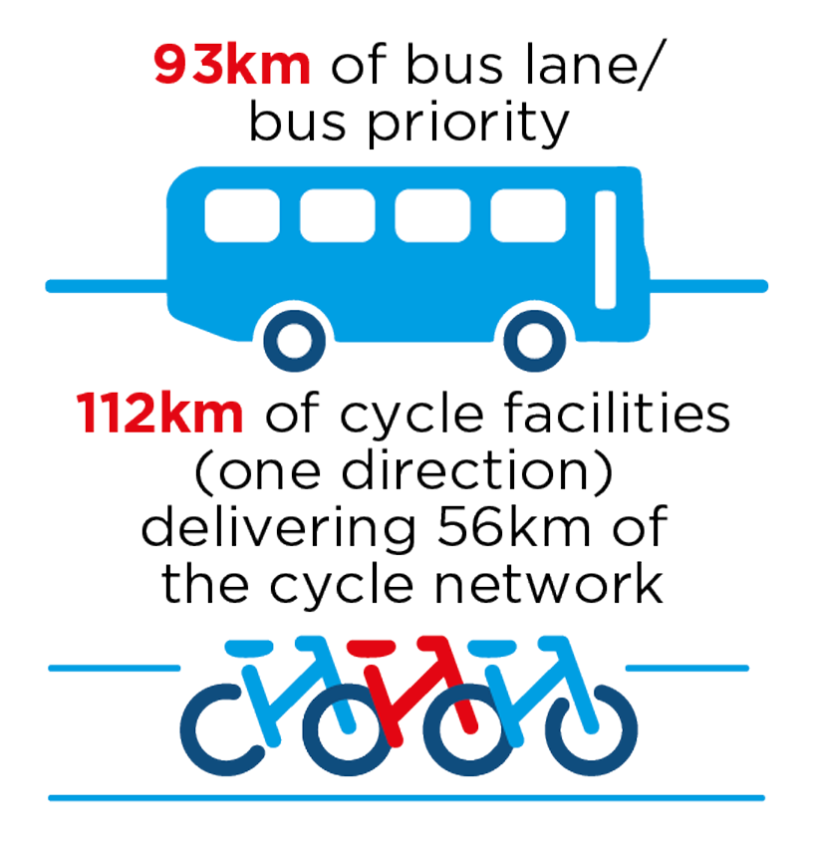
Sustainable Transport Corridors - Where are we?
We have published details of the 12 proposed Sustainable Transport Corridors, each designed with the aim of making the bus system operate more efficiently and to encourage more people to cycle by enhancing cycling infrastructure, in addition to providing local streetscape enhancements.
Currently, there are only 14 km of bus lanes provided in Cork. Under the proposed sustainable transport corridors, there will be approximately 93 km of bus lanes or other bus priority in addition to 112 km of cycle facilities (one direction) delivering 56 km of the Cork cycle network.
These are proposals for consultation – they are not final plans.
With good feedback and positive engagement those proposals can evolve and be refined. But those revisions and refinements have to achieve the overall objective of significantly improving the bus system and the cycle network.
The first round of public consultation commenced at the end of June and runs to 3rd October. We will then review the feedback received and identify beneficial changes that we can make to the proposals. We will then have a second round of public consultation based on the revised proposals.

Slide 13
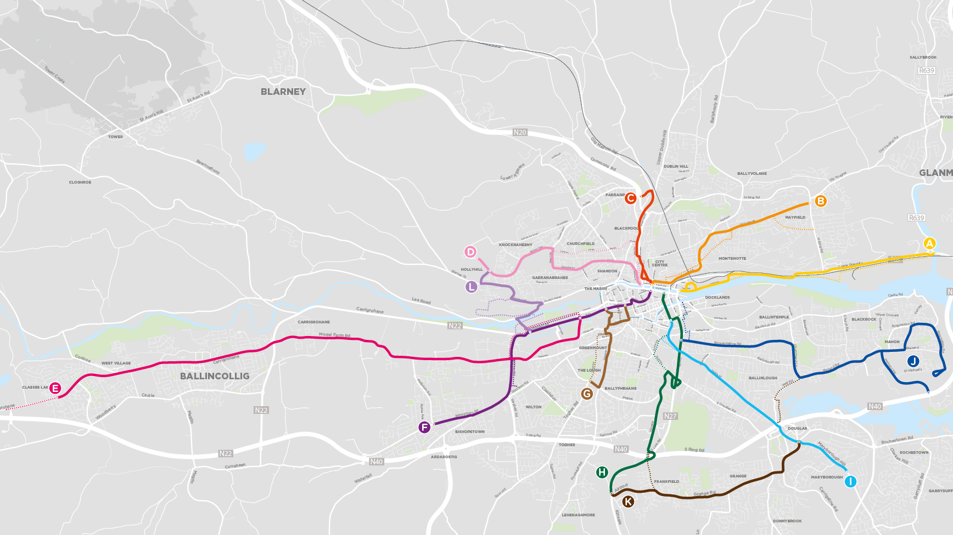

Slide 14
Overview
of
Sustainable Transport Corridor E:
Ballincollig to City

Slide 15
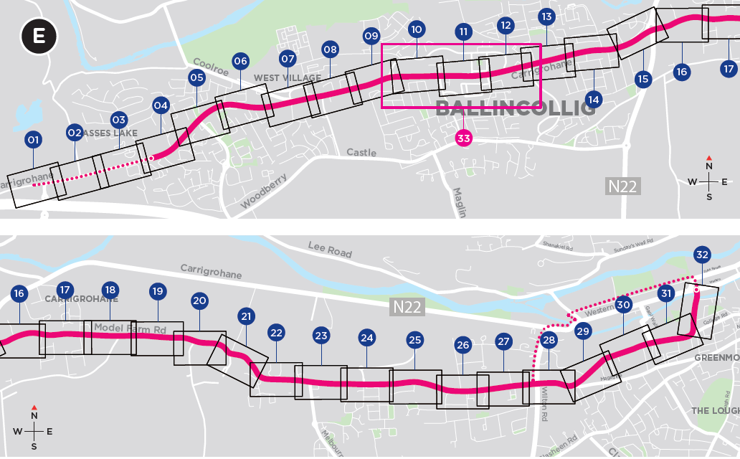
Sustainable Transport Corridor E - Ballincollig to City

Slide 16
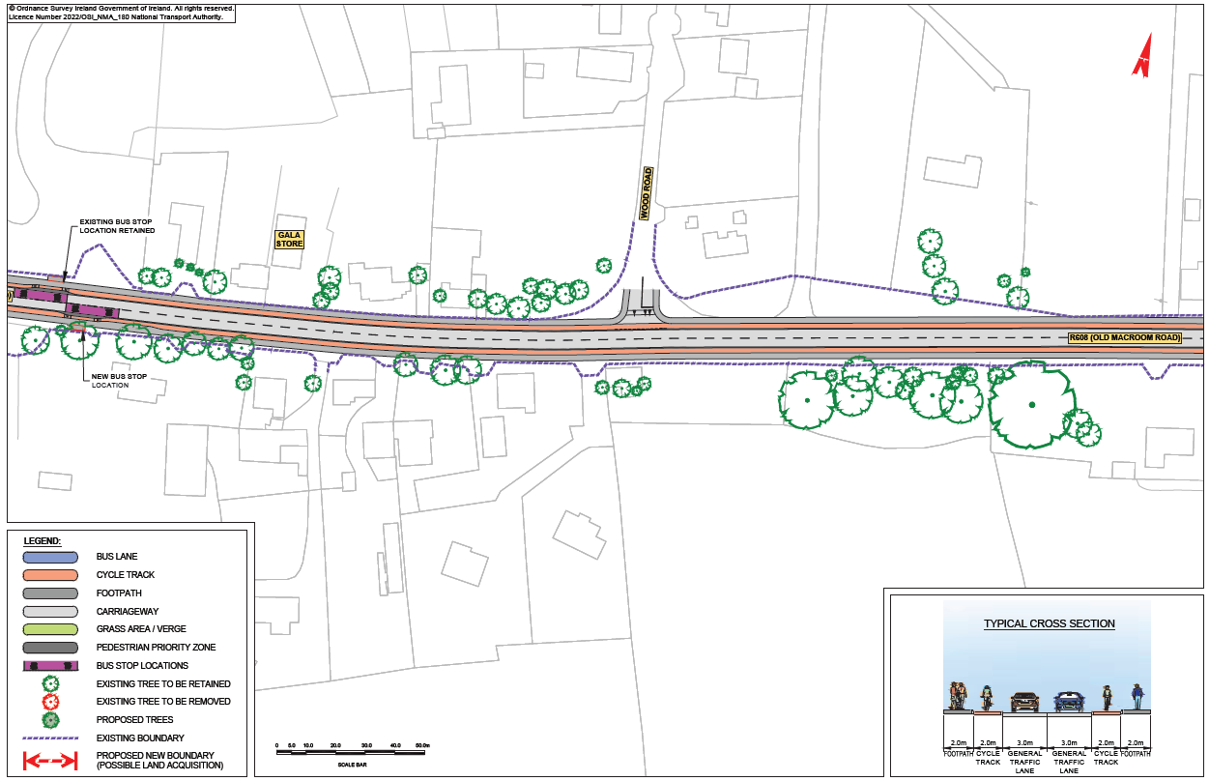
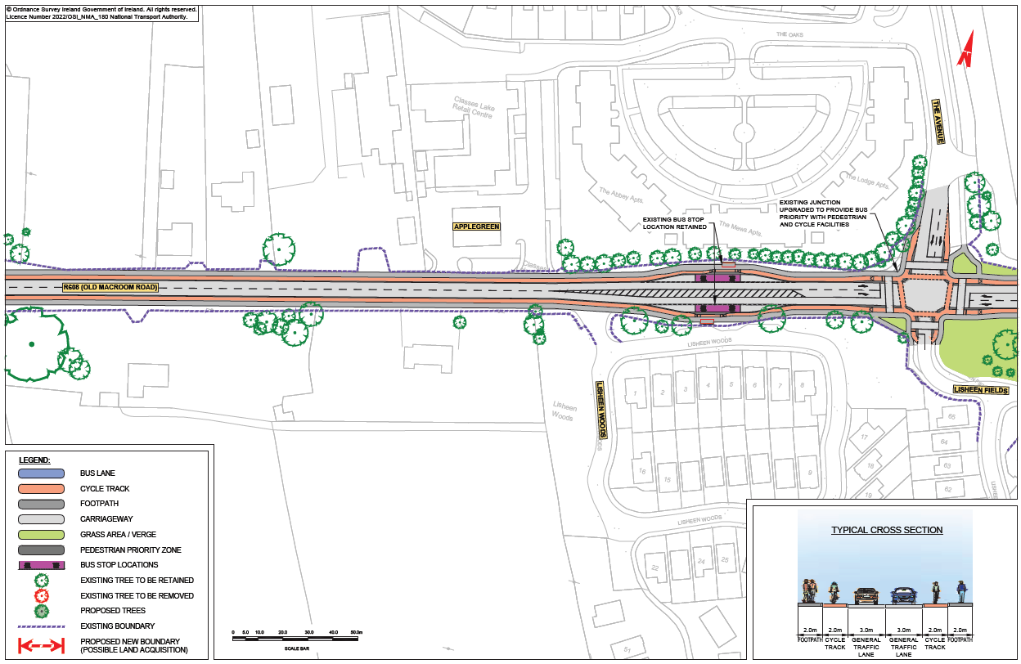
STC E - Classis

Slide 17
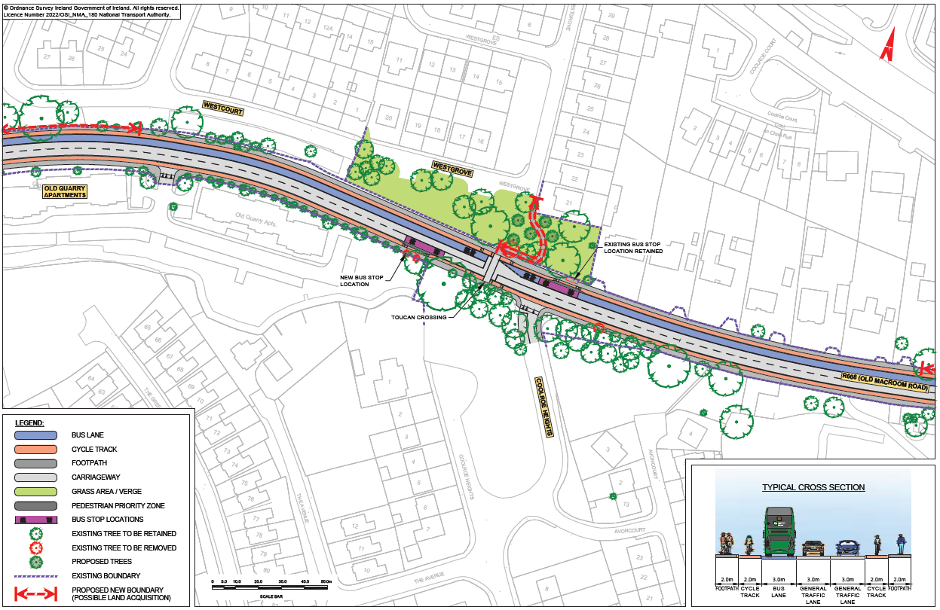
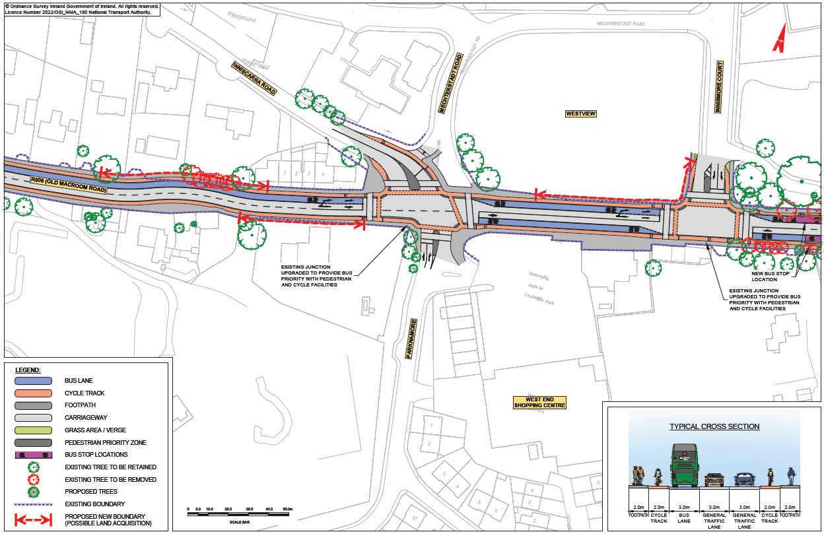
STC E – Inniscarra Road Junction

Slide 18
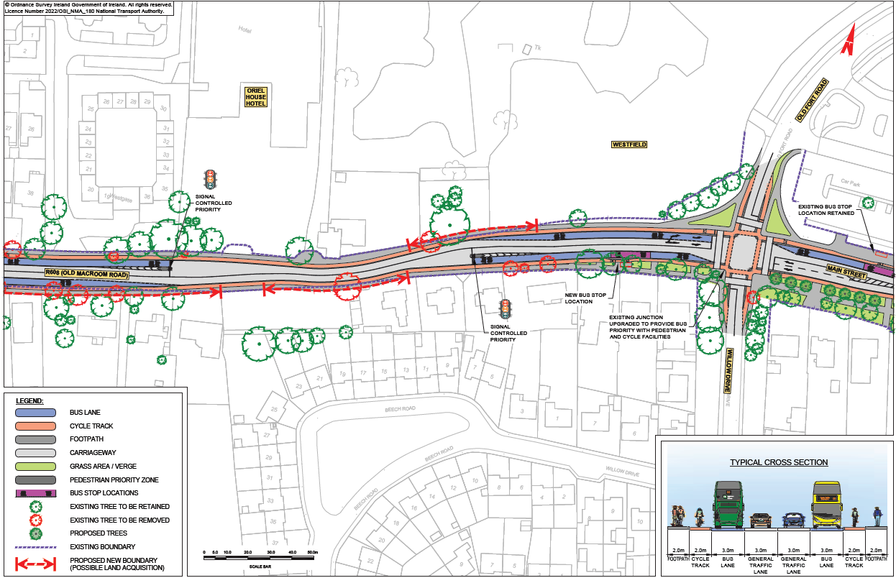
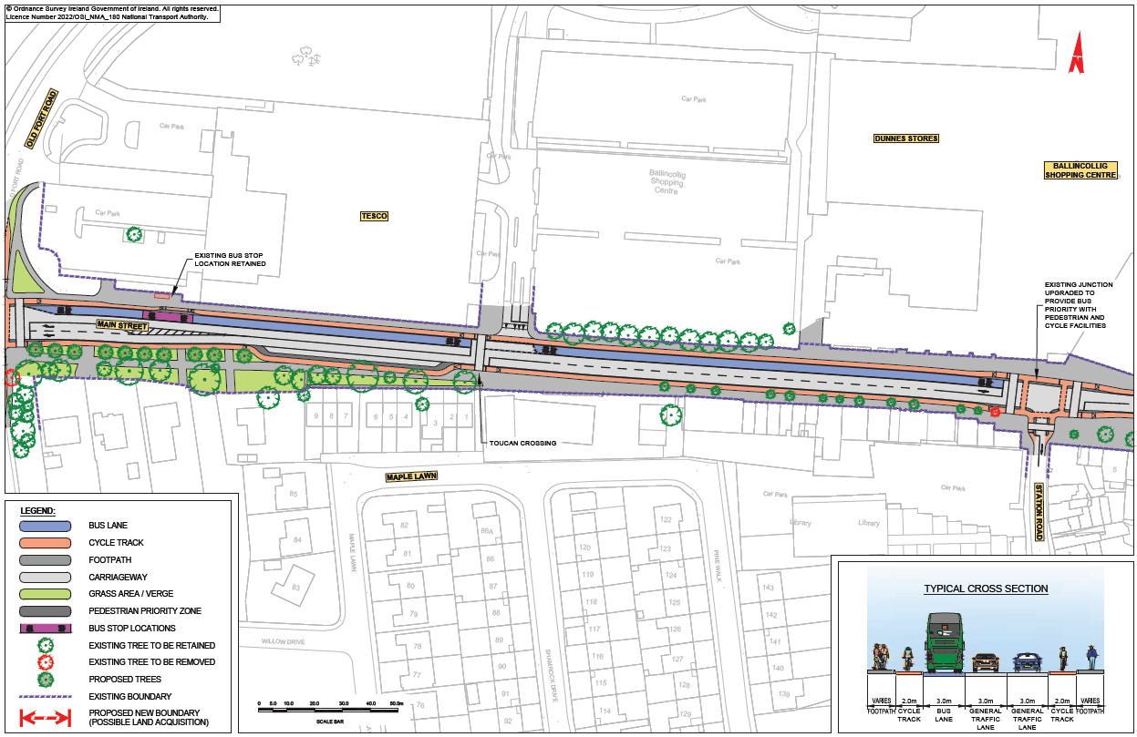
STC E – Old Fort Road

Slide 19
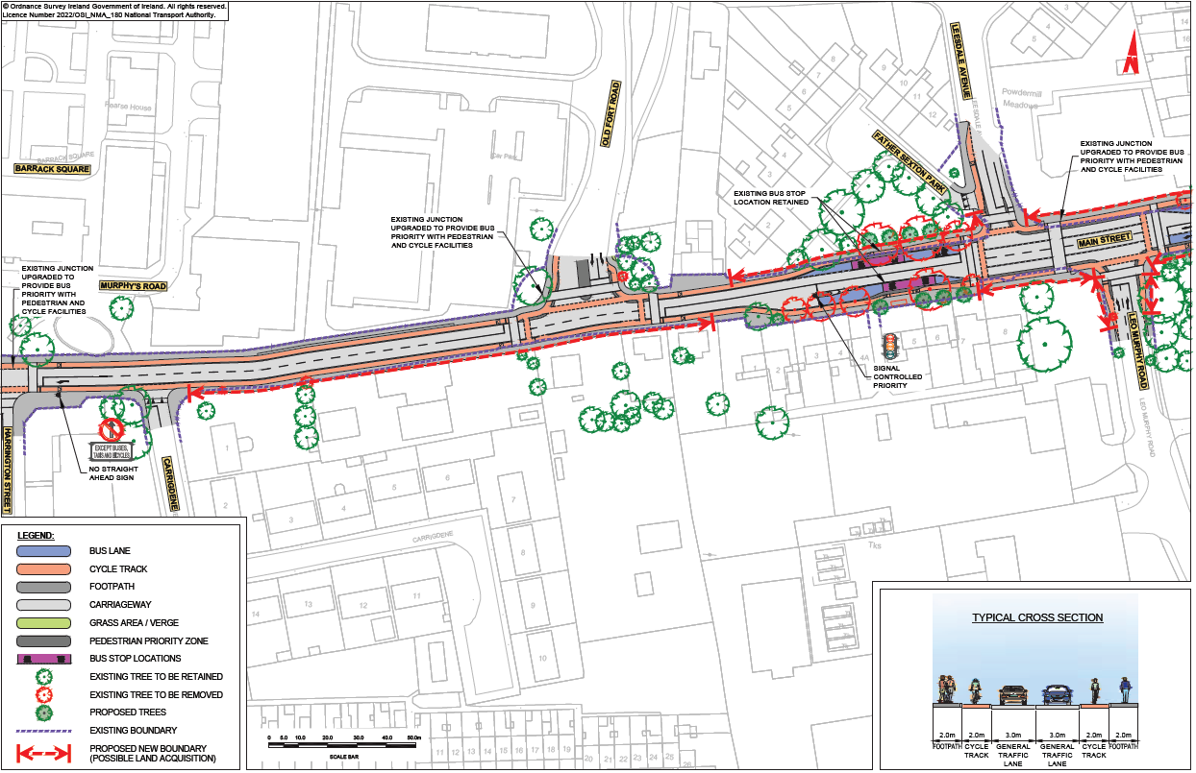
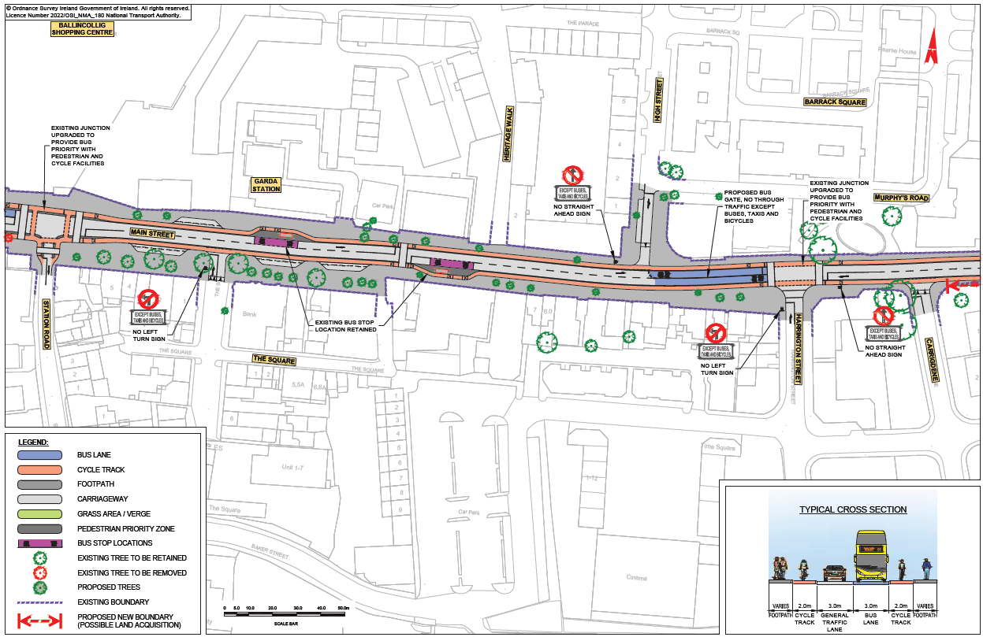
STC E – Ballincollig Main Street

Slide 20
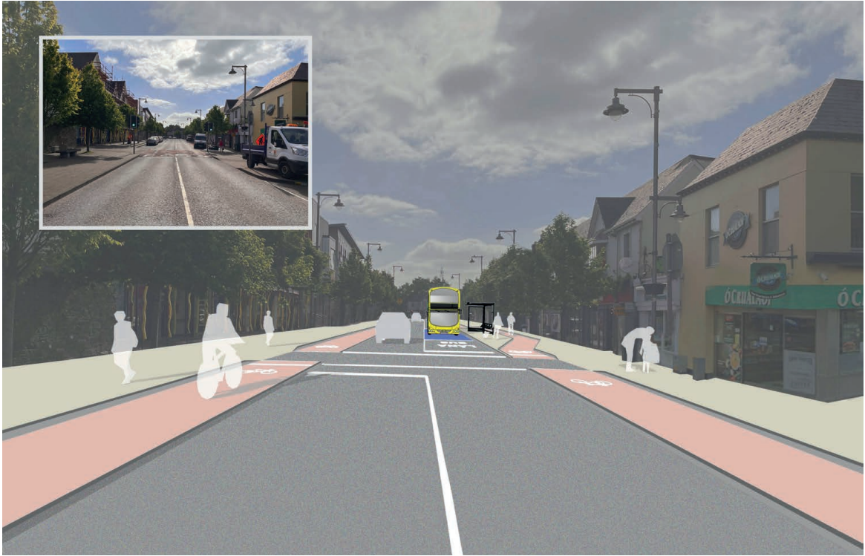
STC E – Ballincollig Town Centre

Slide 21
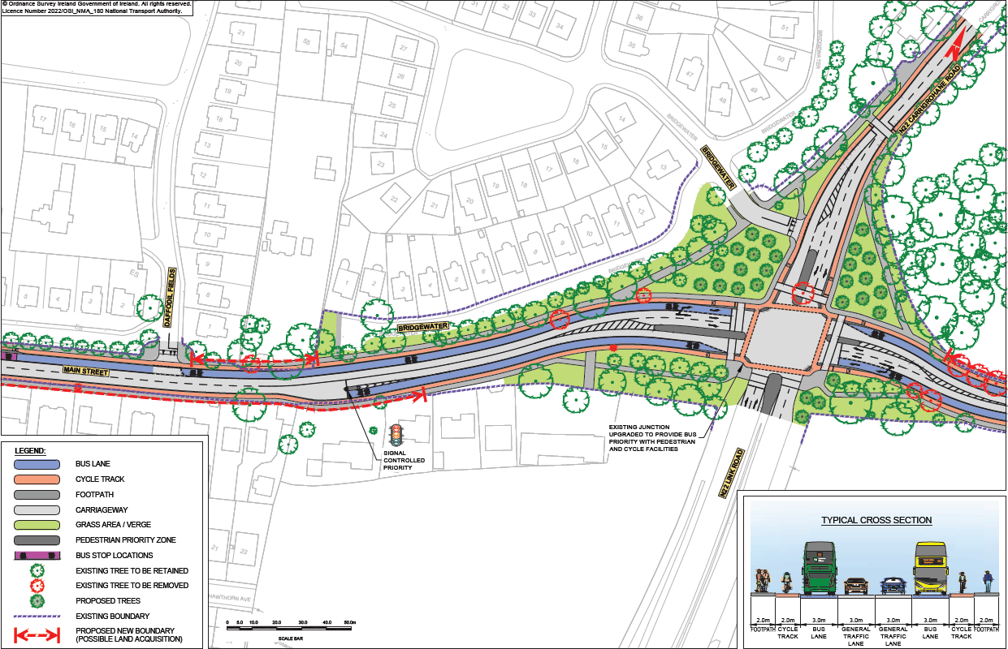
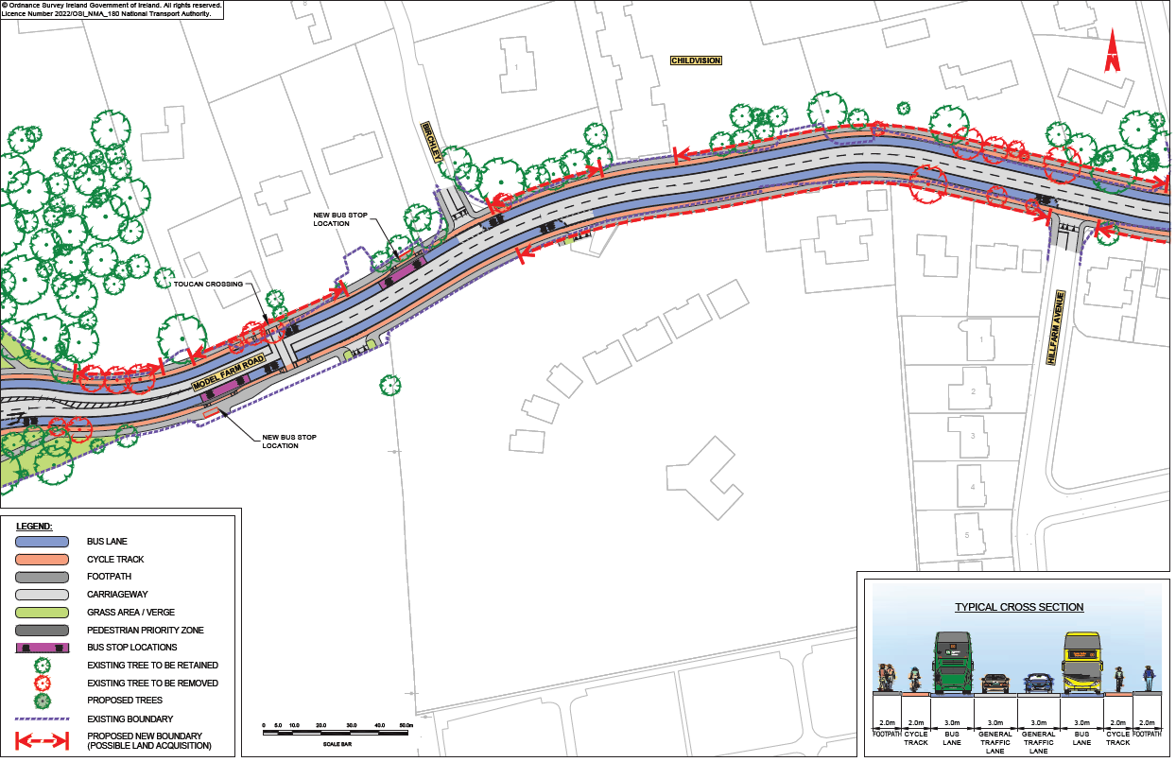
STC E – Poulavane Junction (Roundabout)

Slide 22
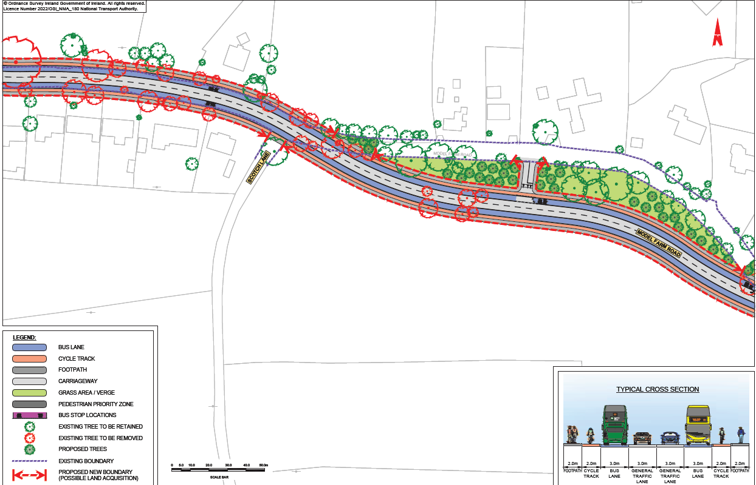
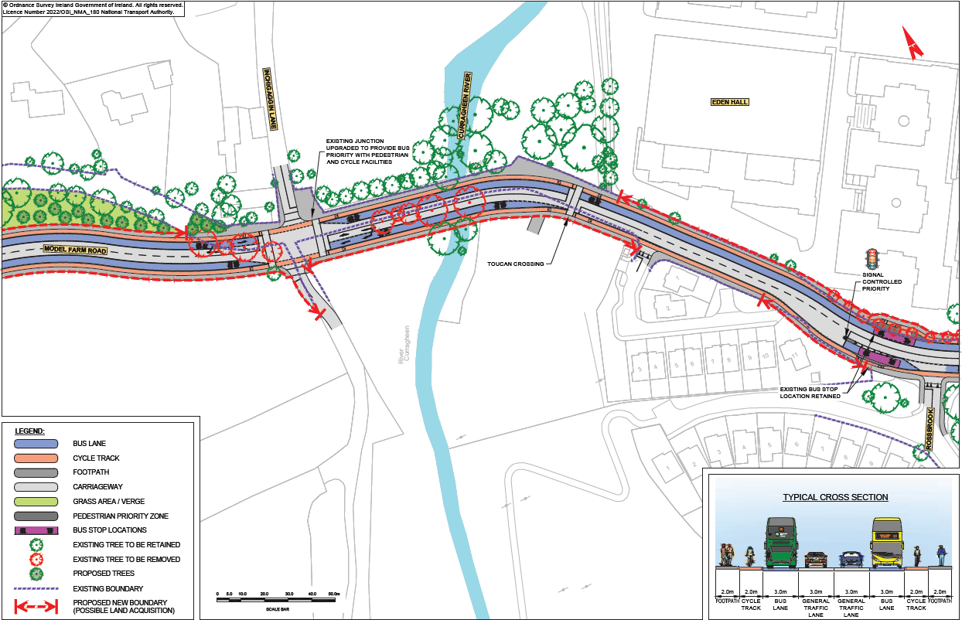
STC E – Inchigaggin Lane

Slide 23
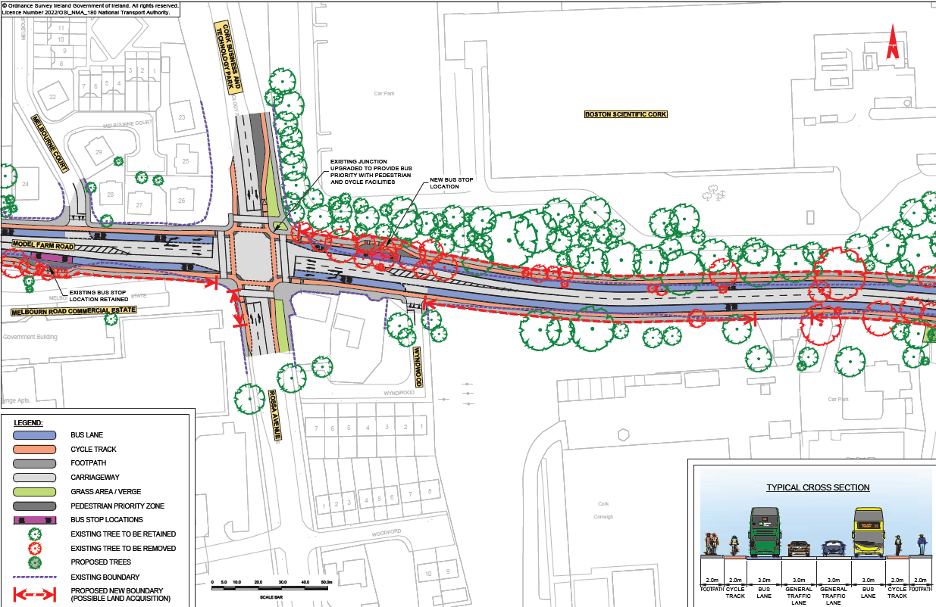
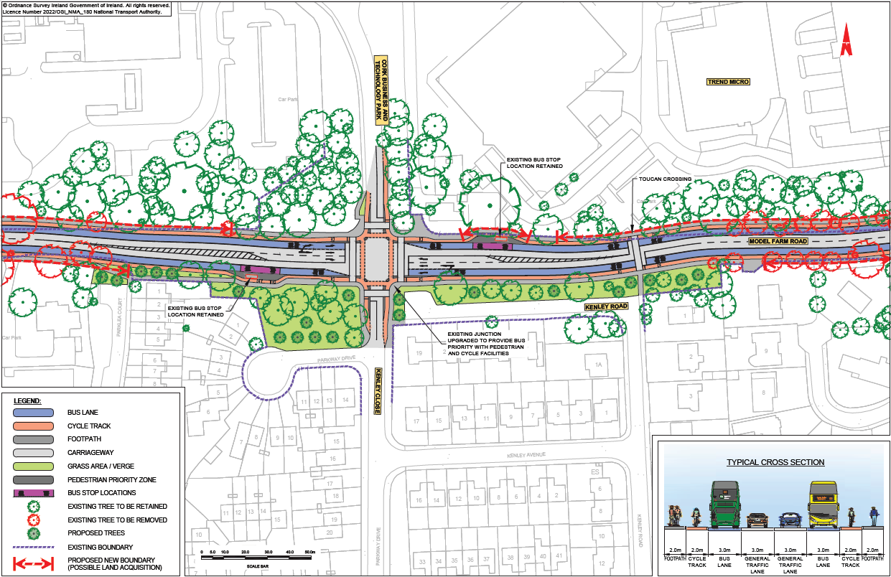
STC E – Rossa Avenue – Technology Park

Slide 24
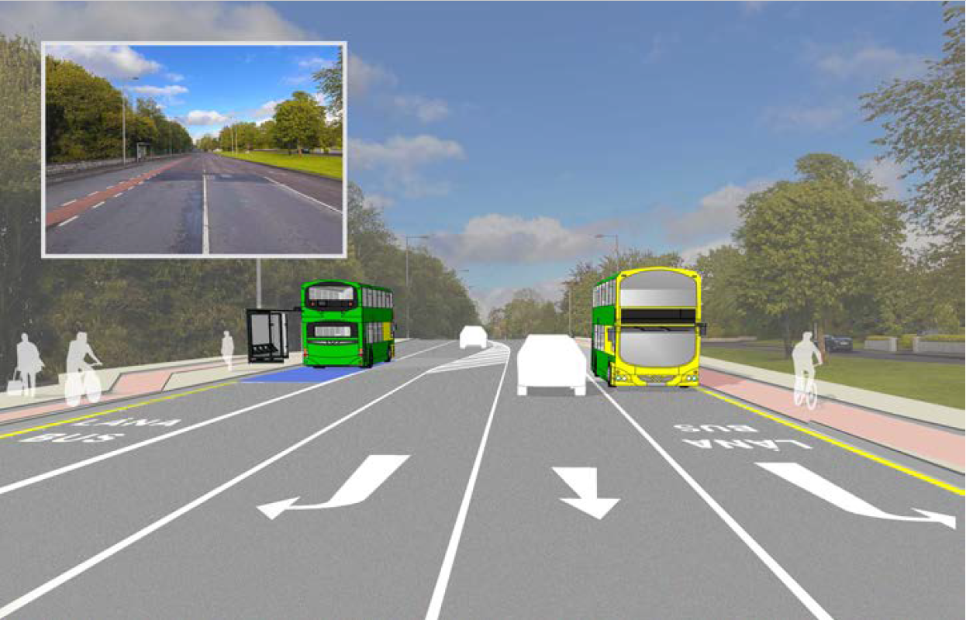
STC E – Rossa Avenue – Technology Park

Slide 25
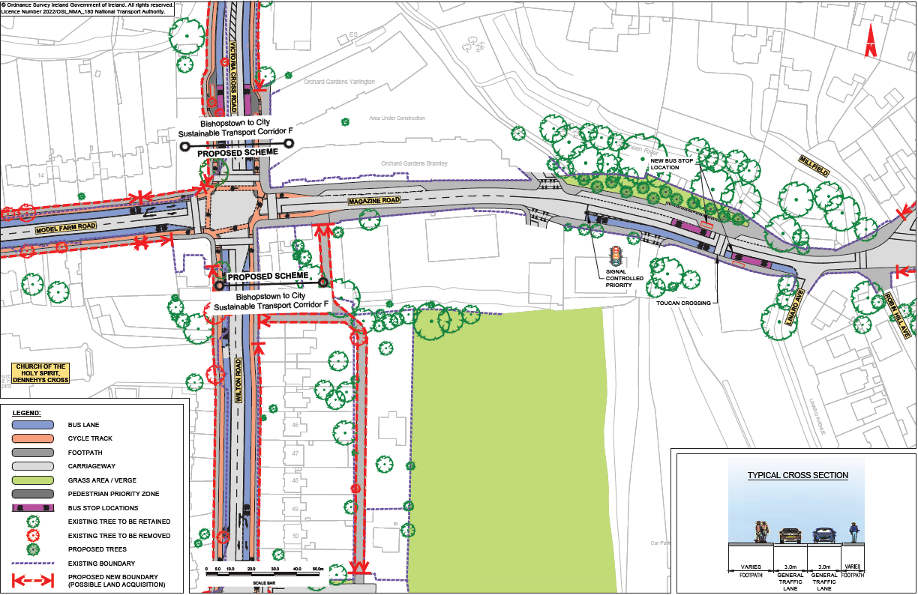
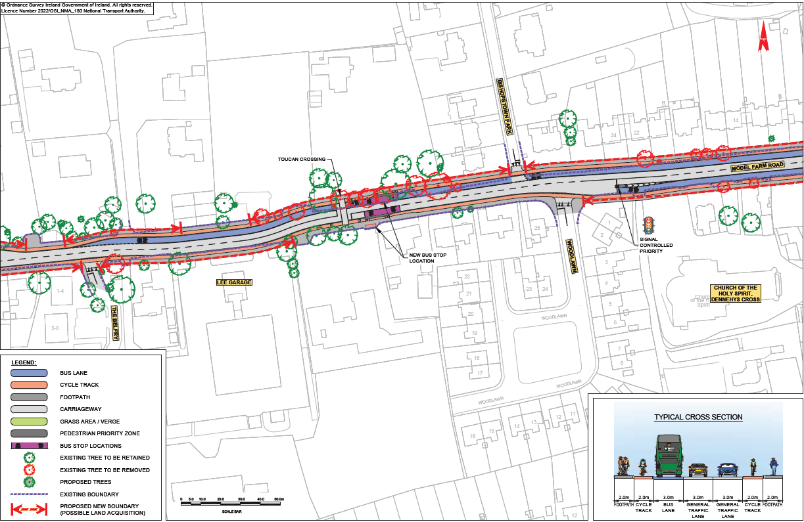
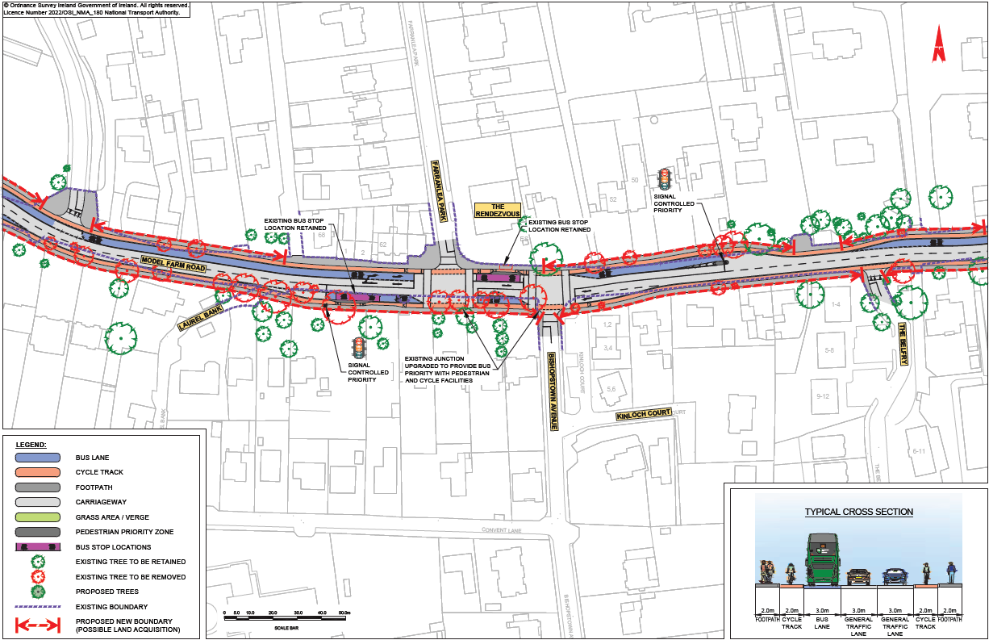
STC E – Dennehy’s Cross

Slide 26
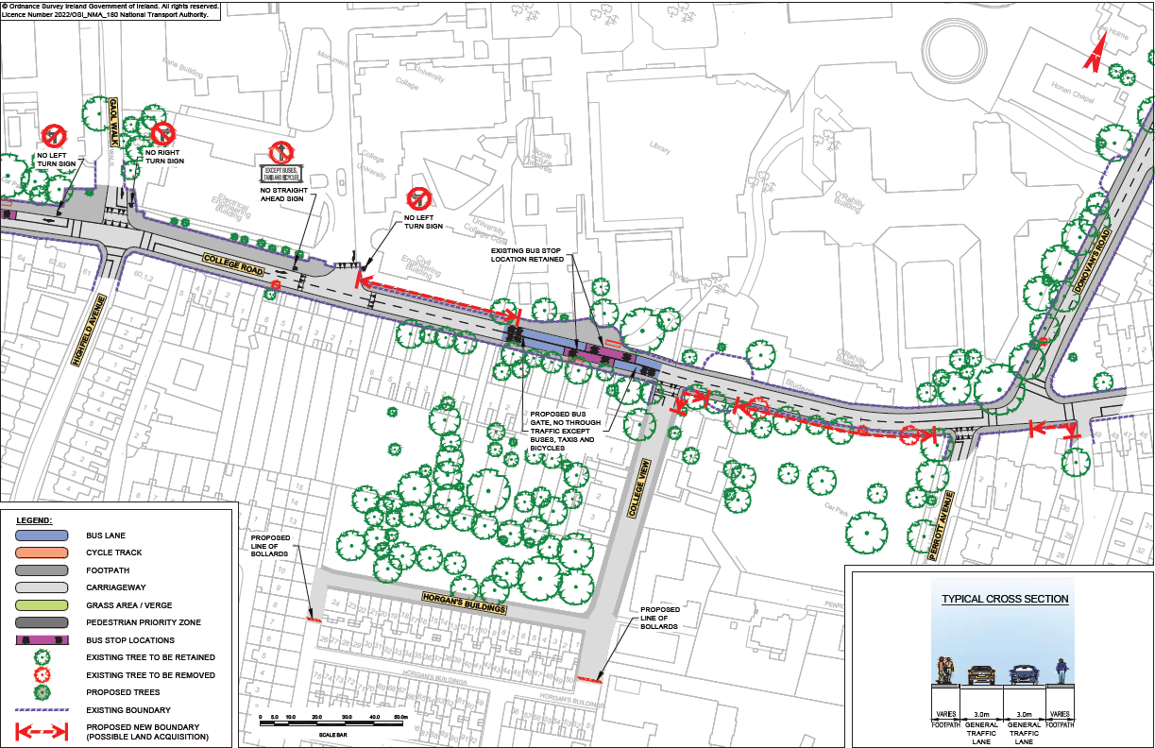
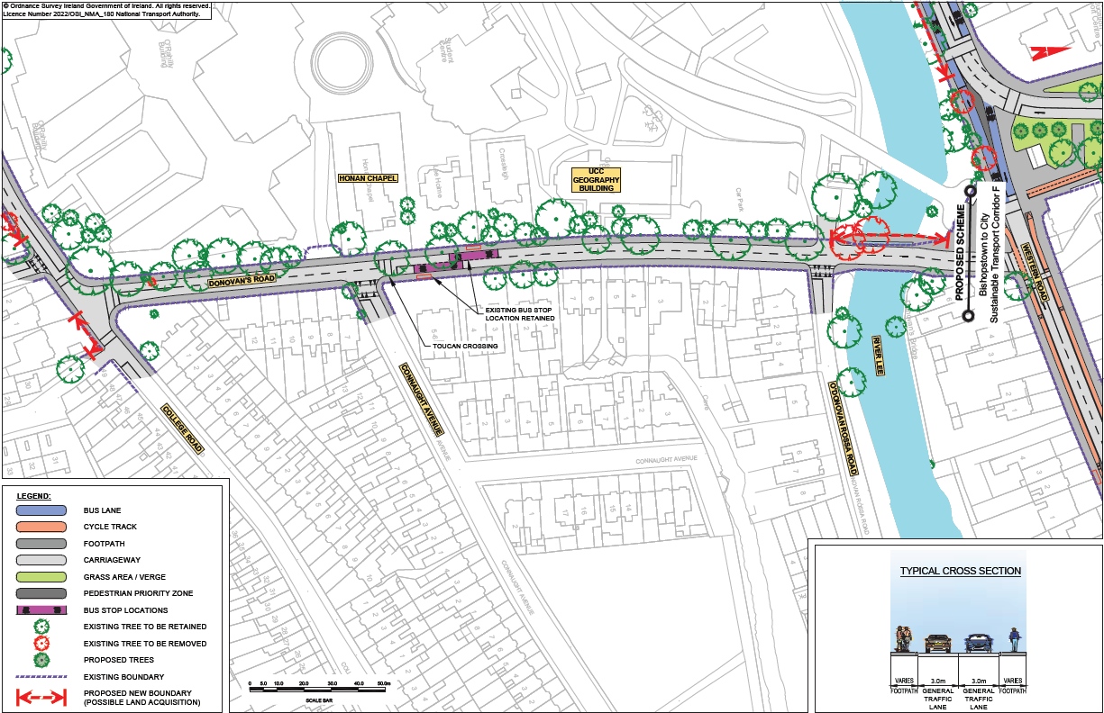
STC E – College Road / O’Donovan’s Road

Slide 27
Overview
of
Sustainable Transport Corridor F:
Bishopstown to City

Slide 28
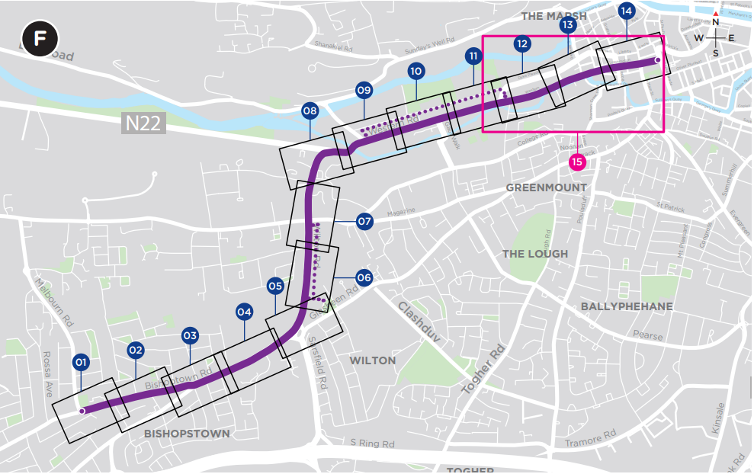
Sustainable Transport Corridor F - Bishopstown to City

Slide 29
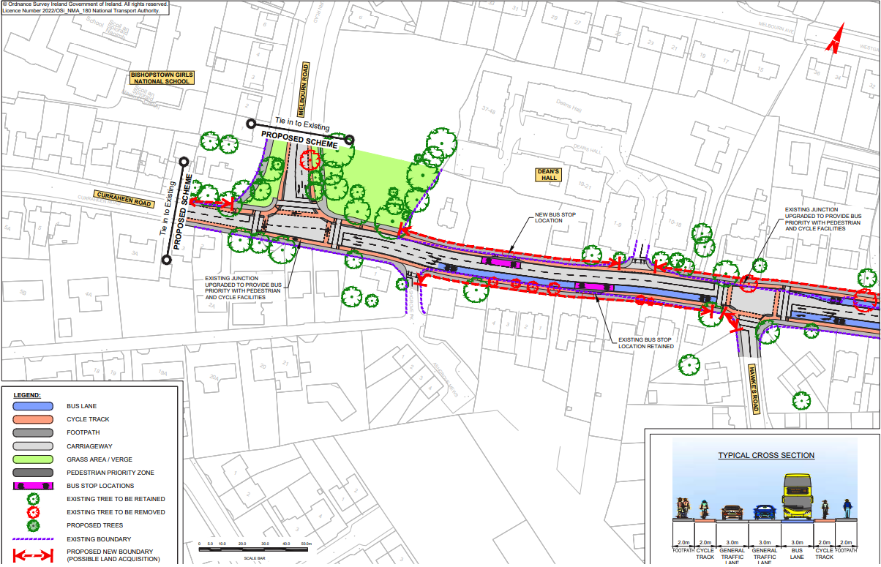
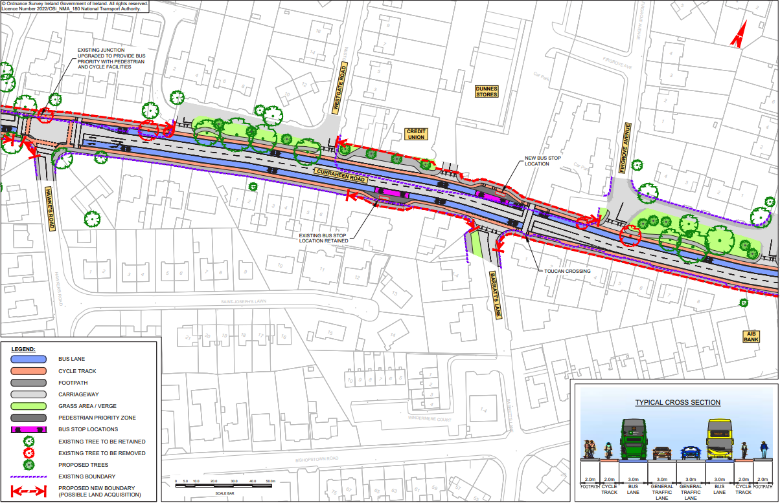
STC F – Curraheen Road

Slide 30
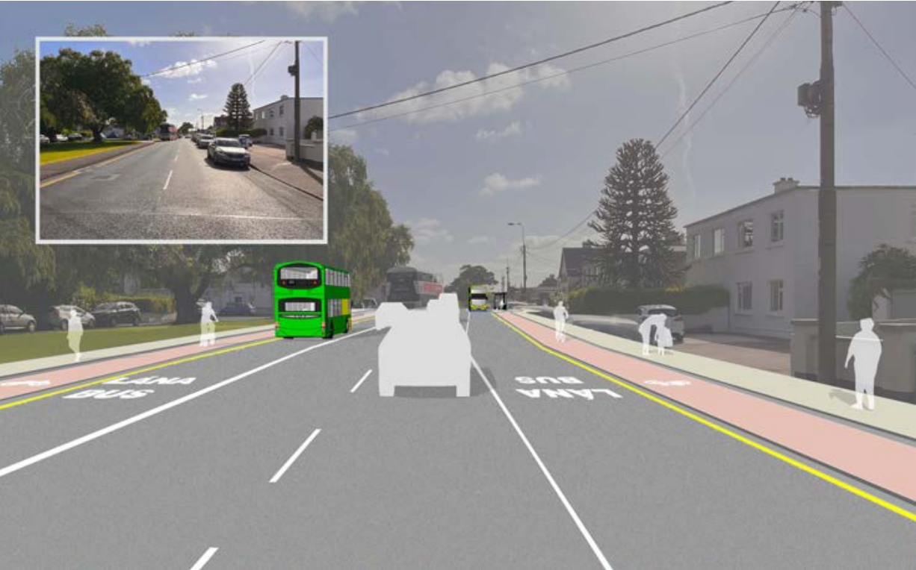
STC F – Curraheen Road

Slide 31
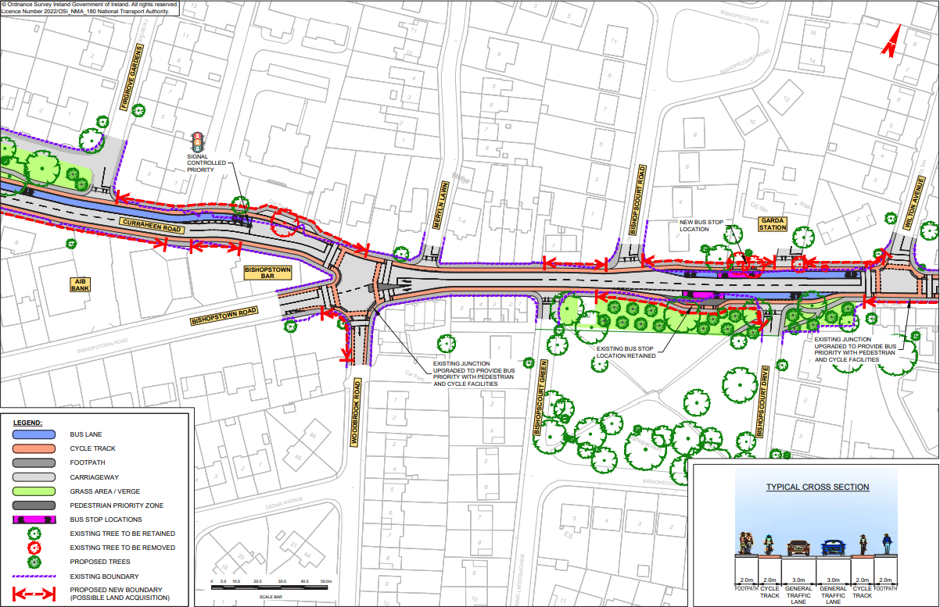
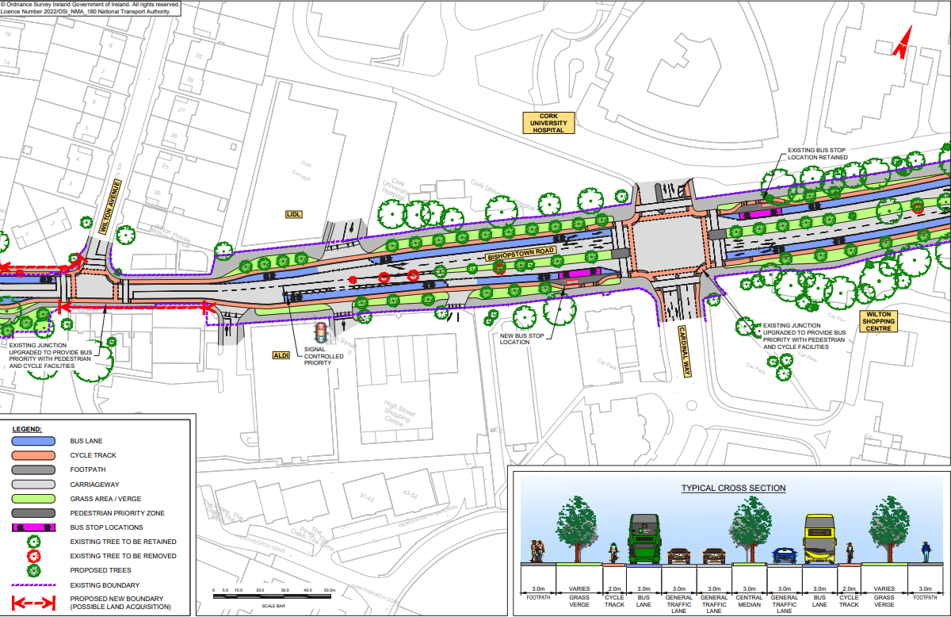
STC F – Bishopstown Road

Slide 32
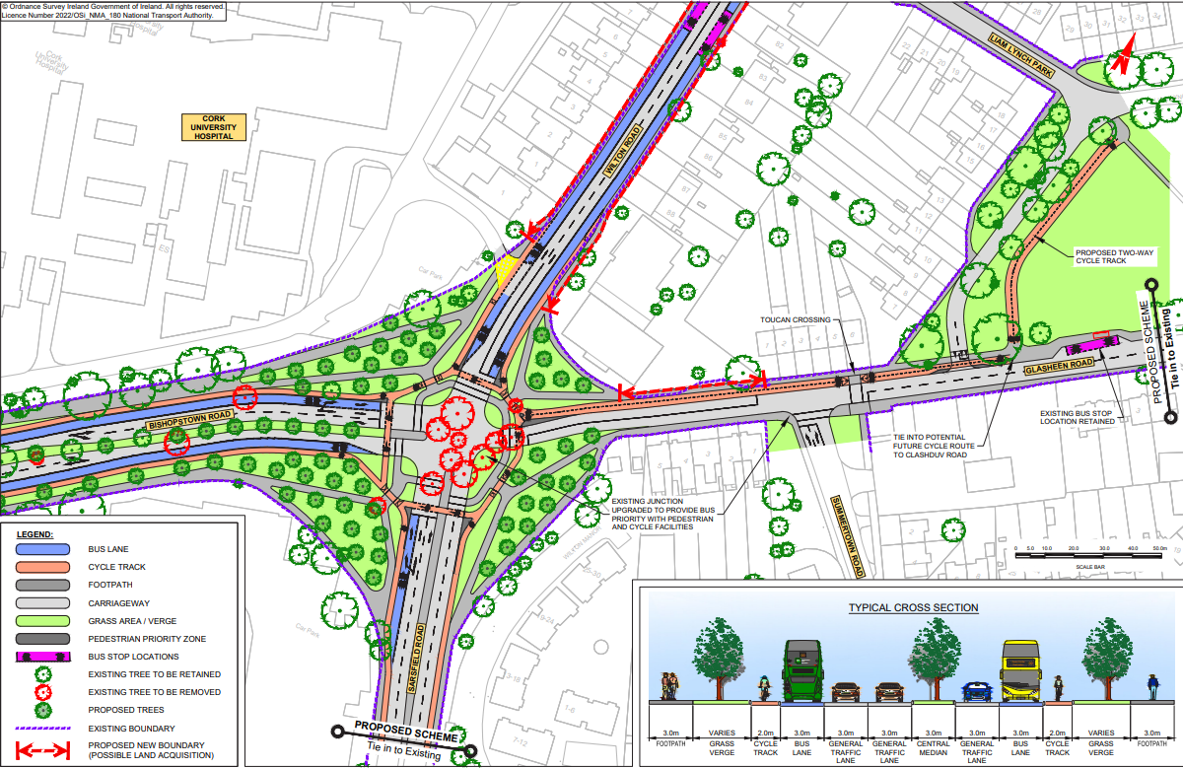
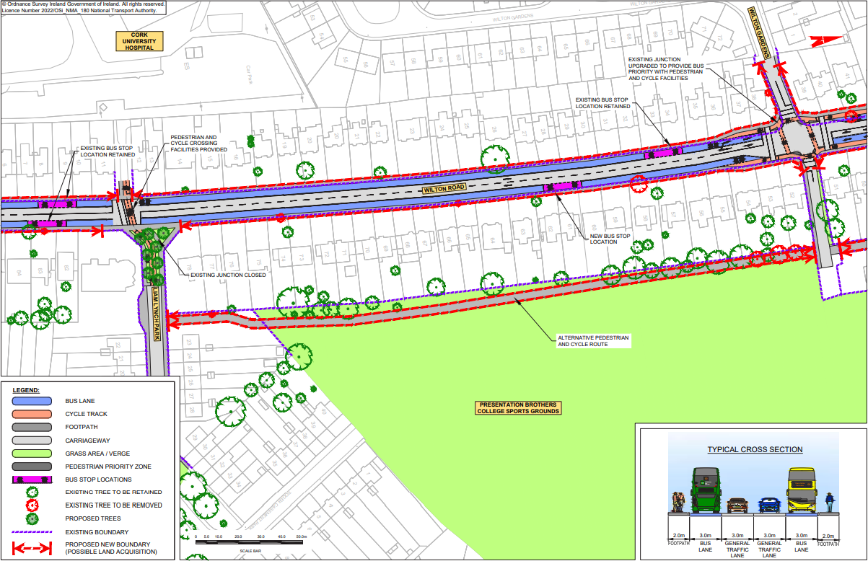
STC F – Wilton Road

Slide 33
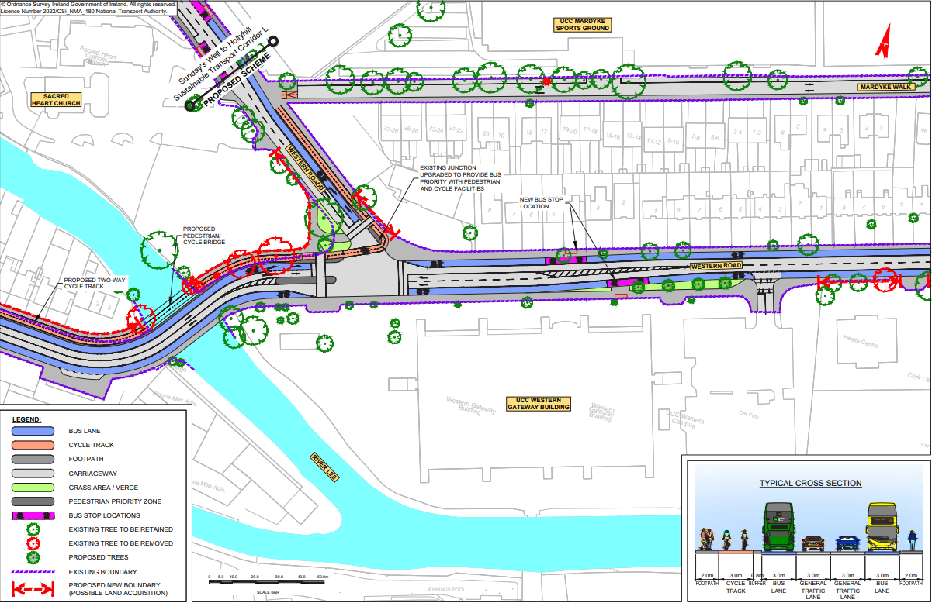
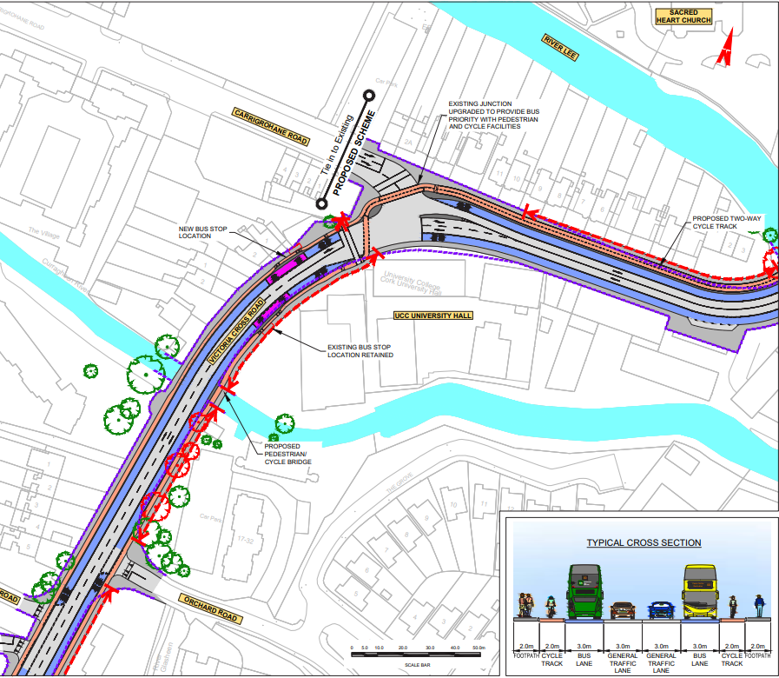
STC F – Victoria Cross / Sacred Heart

Slide 34
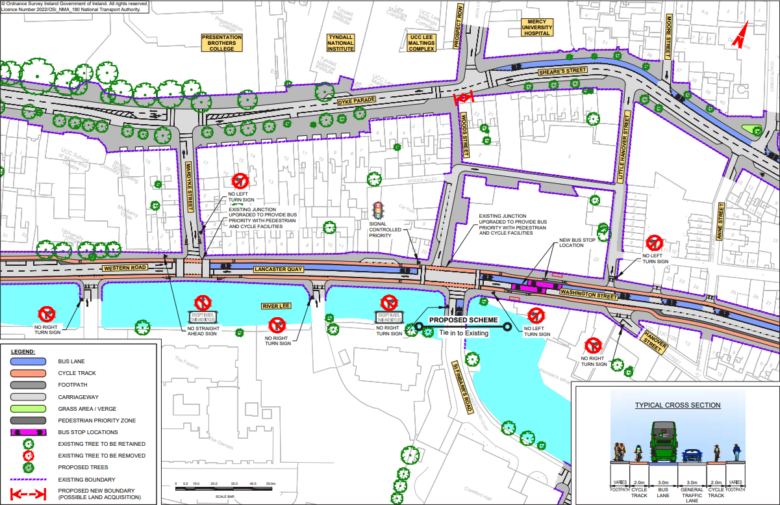
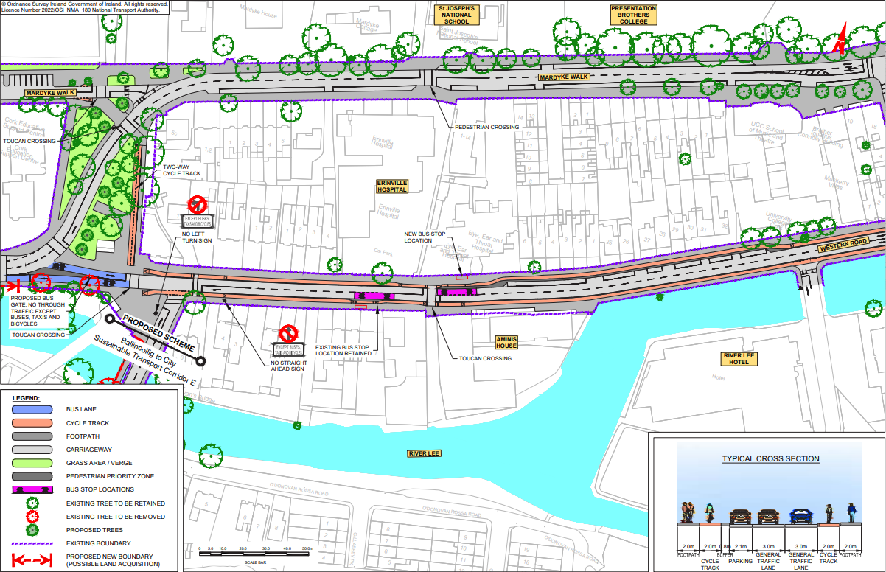
STC F – Western Road / Mardyke Walk

Slide 35
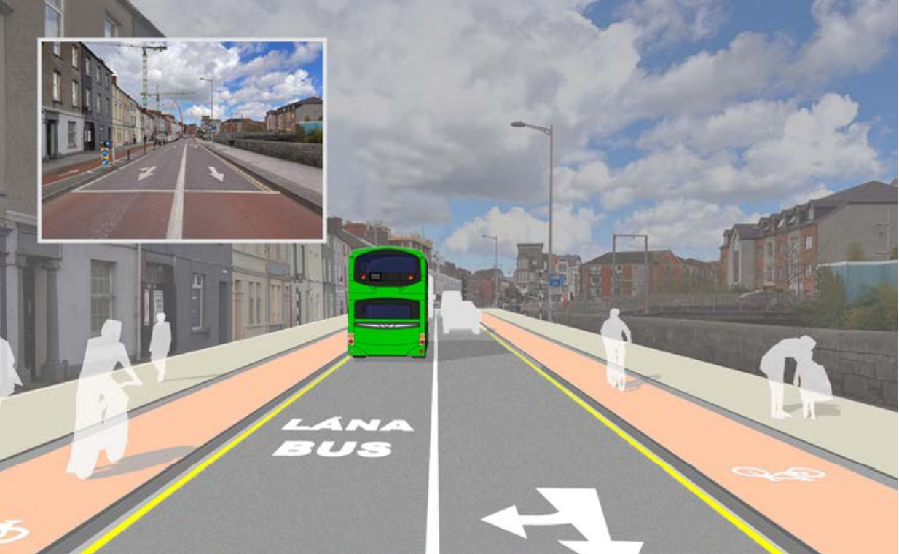
STC F – Lancaster Quay

Slide 36
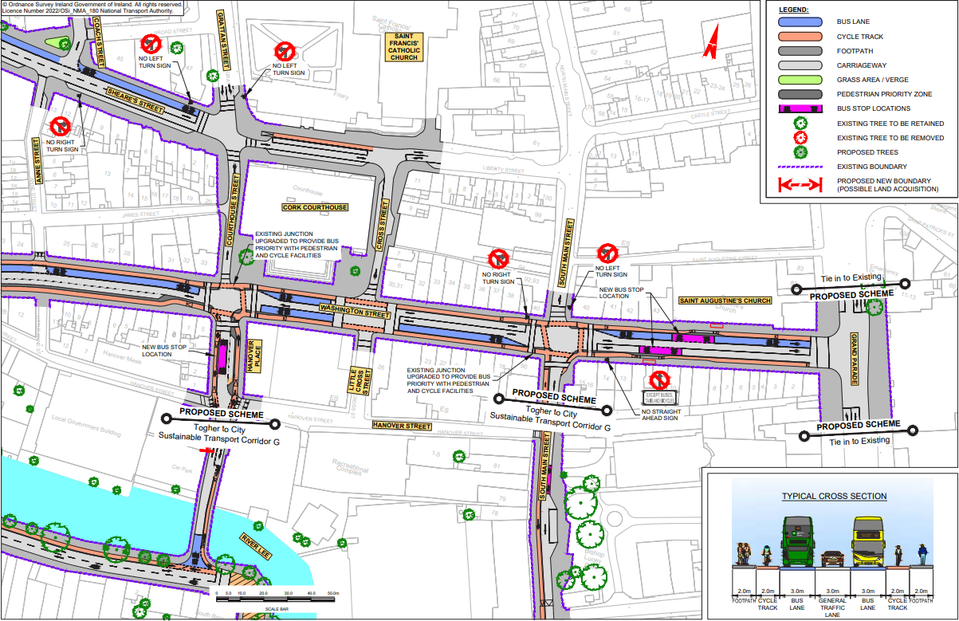
STC F – Washington Street / Sheares Street

Slide 37
How to make a submission:
Online: https://consult.nationaltransport.ie
Email: CorkStc@busconnects.ie
Post:
Cork Sustainable Transport Corridors Project,
National Transport Authority,
Suite 358, 1 Horgan’s Quay,
Waterfront Square,
Cork, T23 PPT8
Cork Sustainable Transport Corridors Project,
National Transport Authority,
Dún Scéine,
Harcourt Lane,
Dublin 2, D02 WT20
General queries Freephone: 1800 303 653
Closing date for submissions: 03 October 2022

Slide 38
Questions
Comments
Discussion

Slide 39
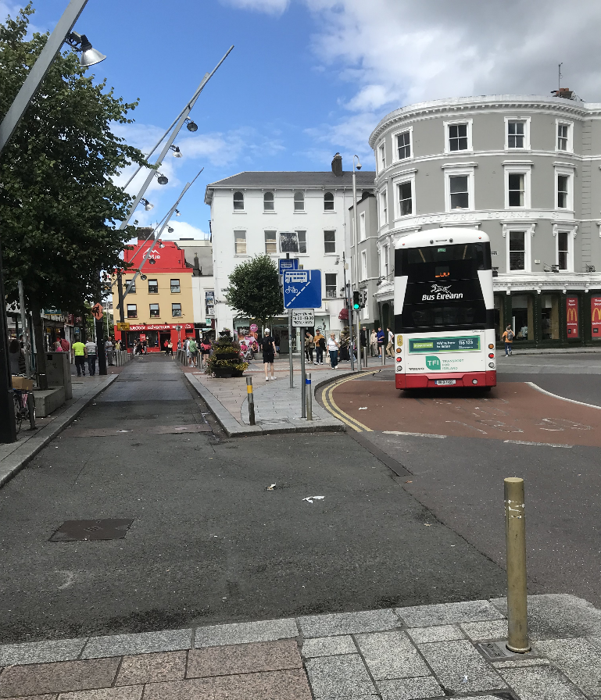
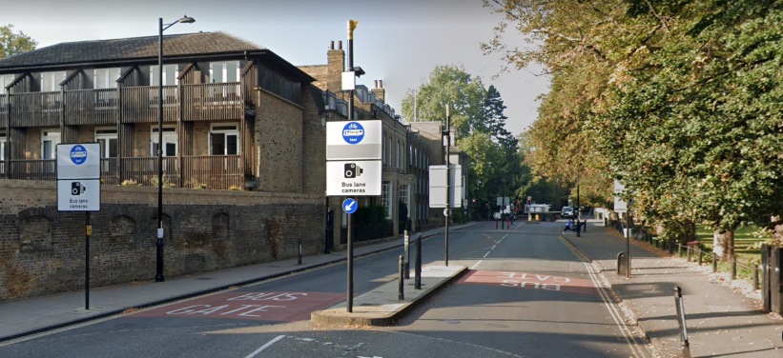
What is a Bus Gate?
A “bus gate” is a short section of road that is marked as a bus lane, meaning only buses, cyclists, taxis and emergency vehicles can use that section of road.
Cars are able to drive up to the bus gate on either side, but are not permitted to continue through the bus gate.
Camera enforcement is often installed at bus gates to ensure compliance.

Slide 40
Bus Gates

