Slide 2
BusConnects Cork
Sustainable Transport Corridors
Third Public Consultation
Community Forum – Tuesday 28th Nov 2023
Sustainable Transport Corridor A – Dunkettle to City
Sustainable Transport Corridor B – Mayfield to City
Sustainable Transport Corridor C – Blackpool to City

Slide 3
Introductions
Independent Chairperson Simon Nugent
NTA Hugh Creegan, Deputy CEO
Con Kehely, Head of BusConnects Regional Cities
Terry Brennan, Senior Communications Manager
Jacobs Bruce Slattery, Director

Slide 4
Running of Meeting
We will endeavor to finish the meeting on time
Please turn mobile phones to silent or off
Chairperson will call on contributors in turn
State your name and the name of the group you represent
To allow maximum participation, please keep contributions short

Slide 6
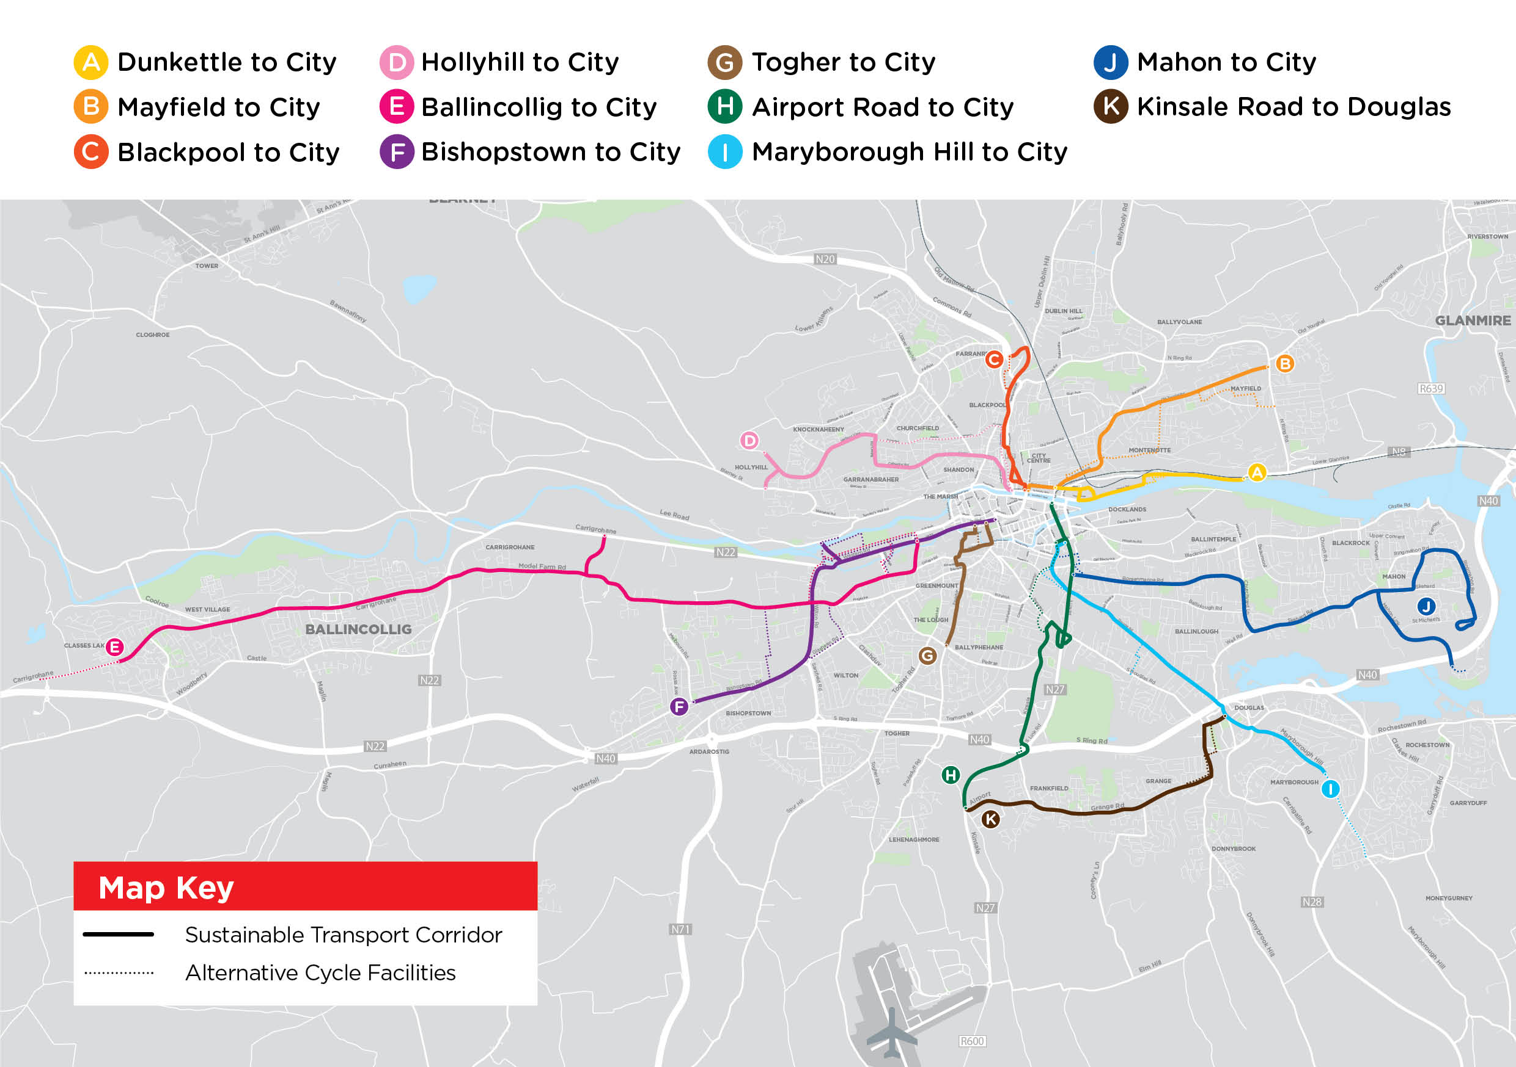

Slide 7
STC A Dunkettle to City:
Key Changes from Preferred Route Published in March 2023

Slide 8
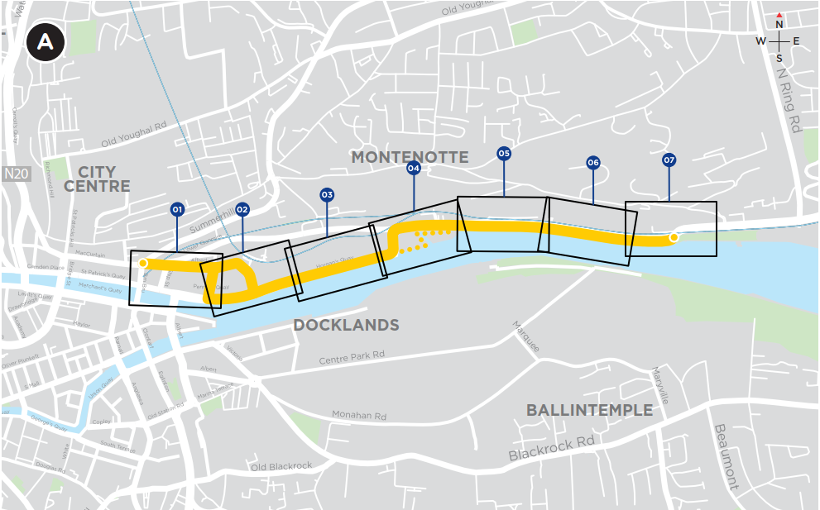
Sustainable Transport Corridor A - Dunkettle to City
Key Changes:
New bus-rail interchange added with bus, cycle and pedestrian access from Alfred Street
Design development at a number of junctions

Slide 9
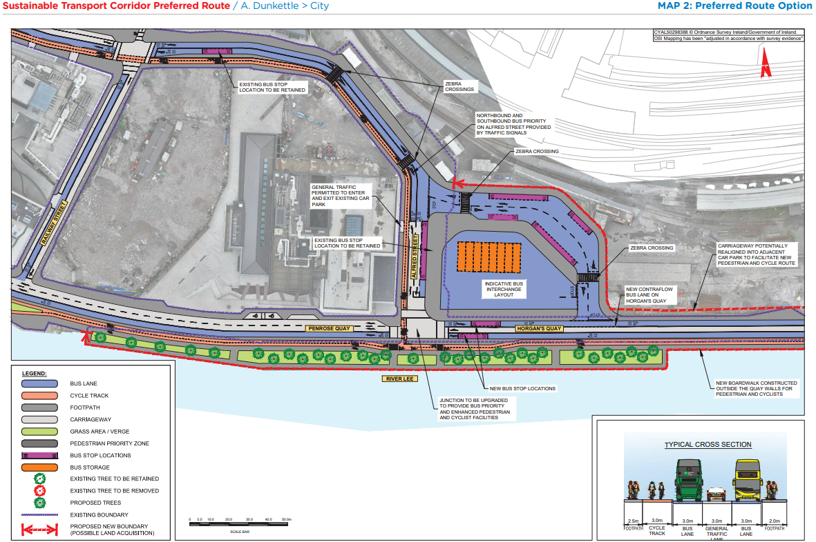
STC A Preferred Route Option (PRO) November 2023

Slide 10
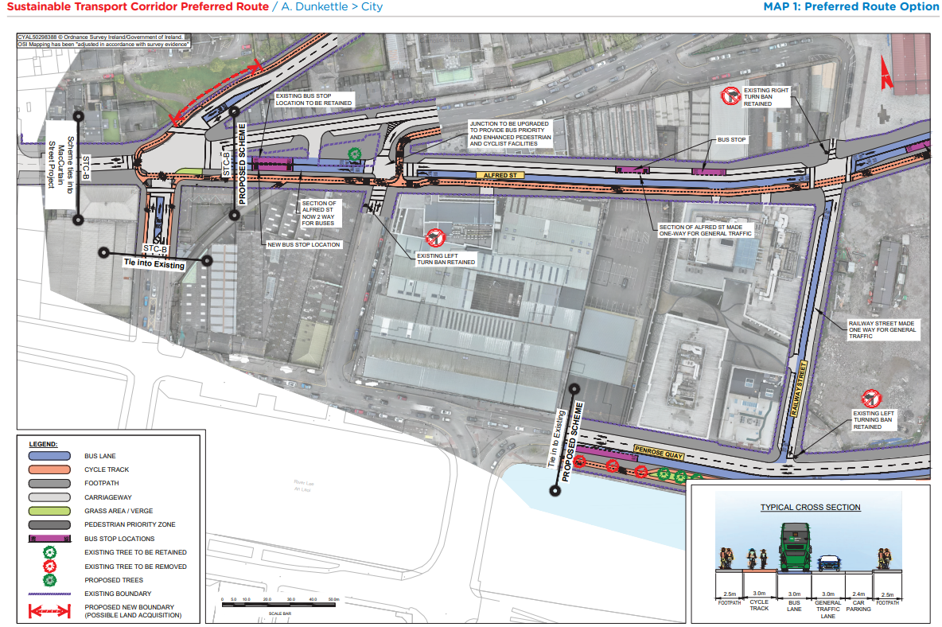
STC A Preferred Route Option (PRO) November 2023

Slide 11
STC B Mayfield to City:
Key Changes from Preferred Route Published in March 2023

Slide 12
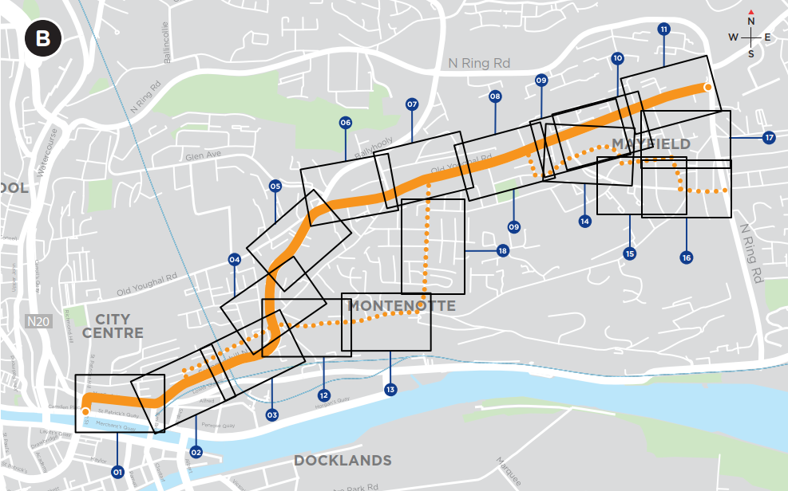
Sustainable Transport Corridor B - Mayfield to City
Key Changes:
Proposed cycle tracks on Colmcille Avenue replaced by a quiet street cycle route on nearby streets
Signal control added at the junction of Murmont Lawn
Proposed right turn ban onto Middle Glanmire Road at St Luke’s Cross omitted

Slide 13
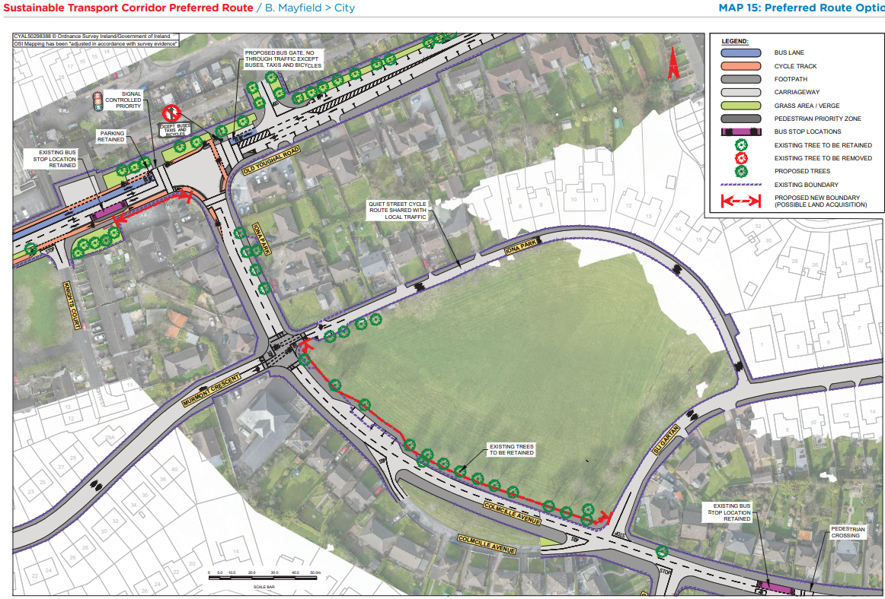
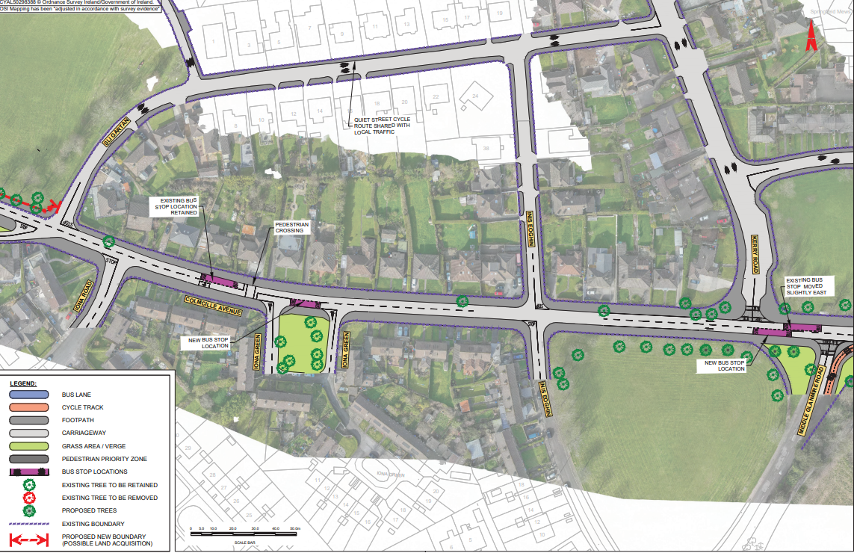
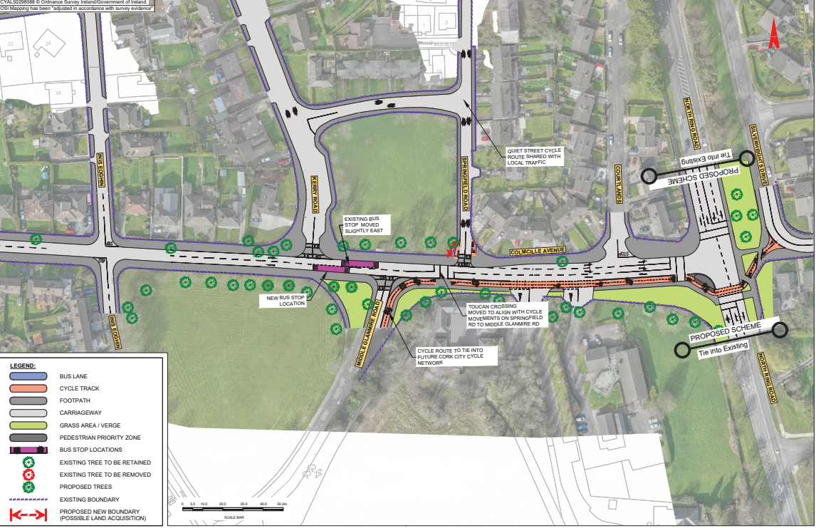
STC B Preferred Route Option (PRO) November 2023

Slide 14
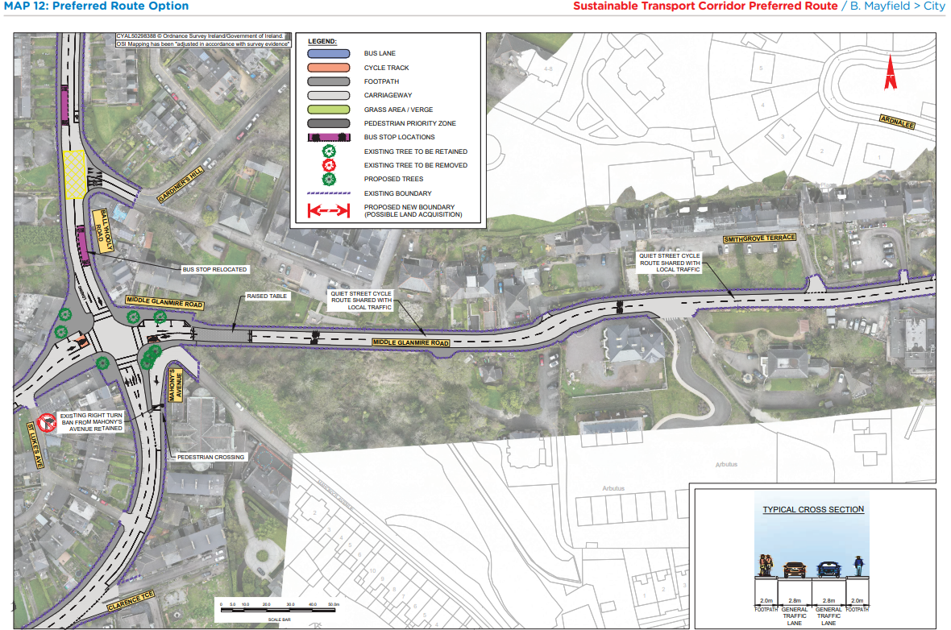
STC B Preferred Route Option (PRO) November 2023

Slide 15
STC C Blackpool to City:
Key Changes from Preferred Route Published in March 2023

Slide 16
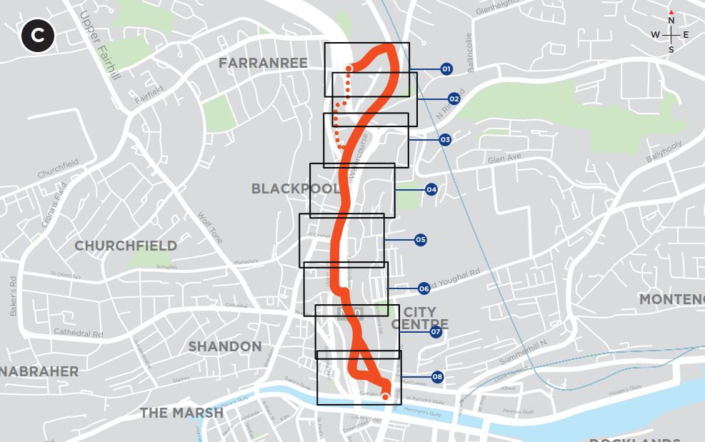
Sustainable Transport Corridor C - Blackpool to City
Key Changes:
Bus gate at Dublin Street to be replaced by signal priority and traffic management measures on Dublin Hill
Proposed bus gates at Watercourse Road, to be replaced by traffic access restrictions
Changes to the lane configurations on the N20 and Cathedral Walk
Addition of Orchard Court off-line cycle route

Slide 17
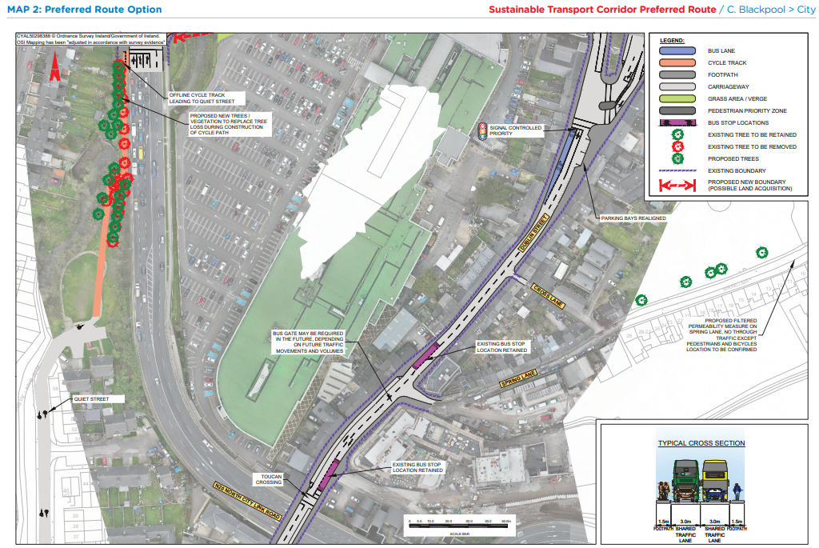
STC C Preferred Route Option (PRO) November 2023

Slide 18
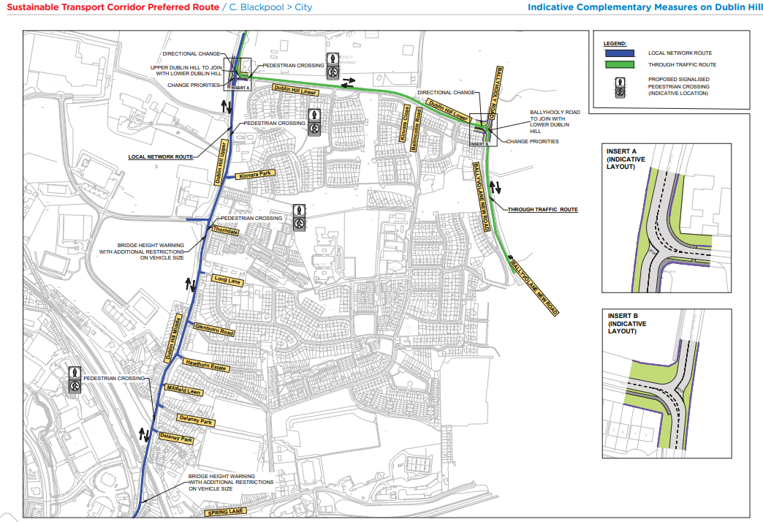
STC C Preferred Route Option (PRO) November 2023

Slide 19
STC C Preferred Route Option (PRO) November 2023

Slide 20
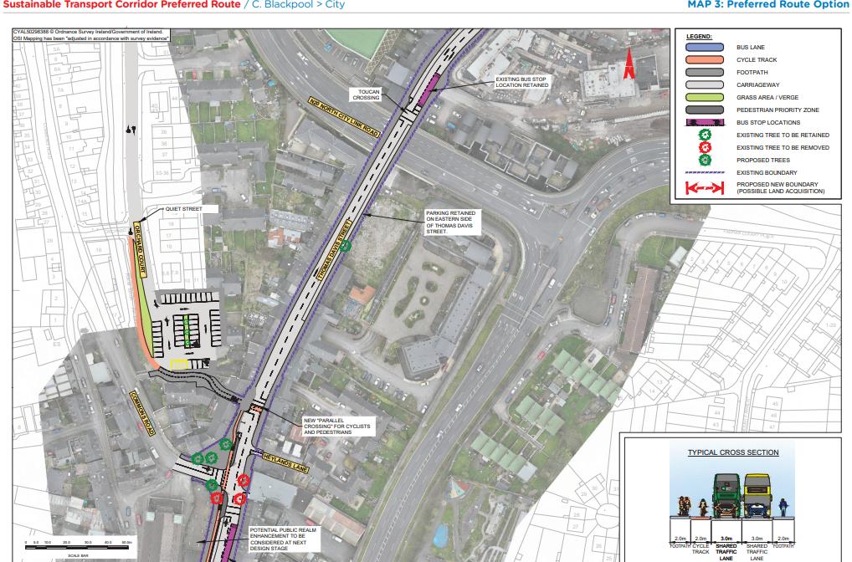
STC C Preferred Route Option (PRO) November 2023

Slide 21
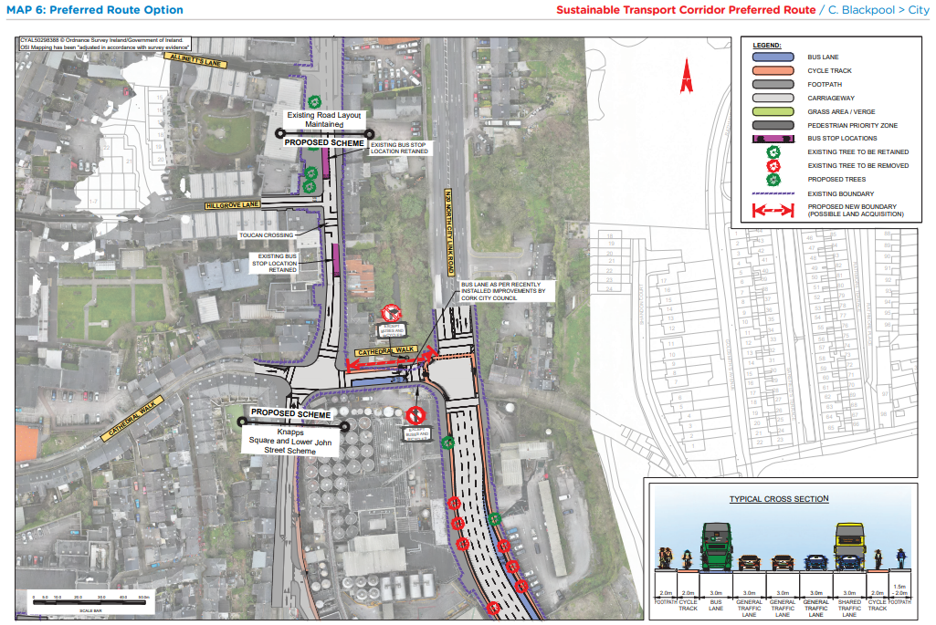
STC C Preferred Route Option (PRO) November 2023

Slide 22
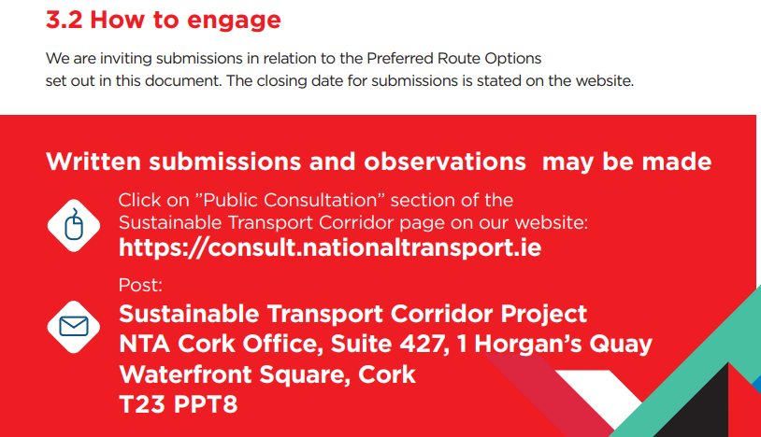
BusConnects Cork Third Round of Public Consultation

Slide 23
Deadline for Submissions Monday 18th December 2023 www.busconnects.ie/cork

