Slide 2
BusConnects Cork
Sustainable Transport Corridors
Third Public Consultation
Community Forum – Friday 1st Dec 2023
Sustainable Transport Corridor D – Hollyhill to City

Slide 3
Introductions
Independent Chairperson Simon Nugent
NTA Hugh Creegan, Deputy CEO
Con Kehely, Head of BusConnects Regional Cities
Terry Brennan, Senior Communications Manager
Jacobs Stuart Nicol, Director

Slide 4
Running of Meeting
We will endeavor to finish the meeting on time
Please turn mobile phones to silent or off
Chairperson will call on contributors in turn
State your name and the name of the group you represent
To allow maximum participation, please keep contributions short

Slide 6
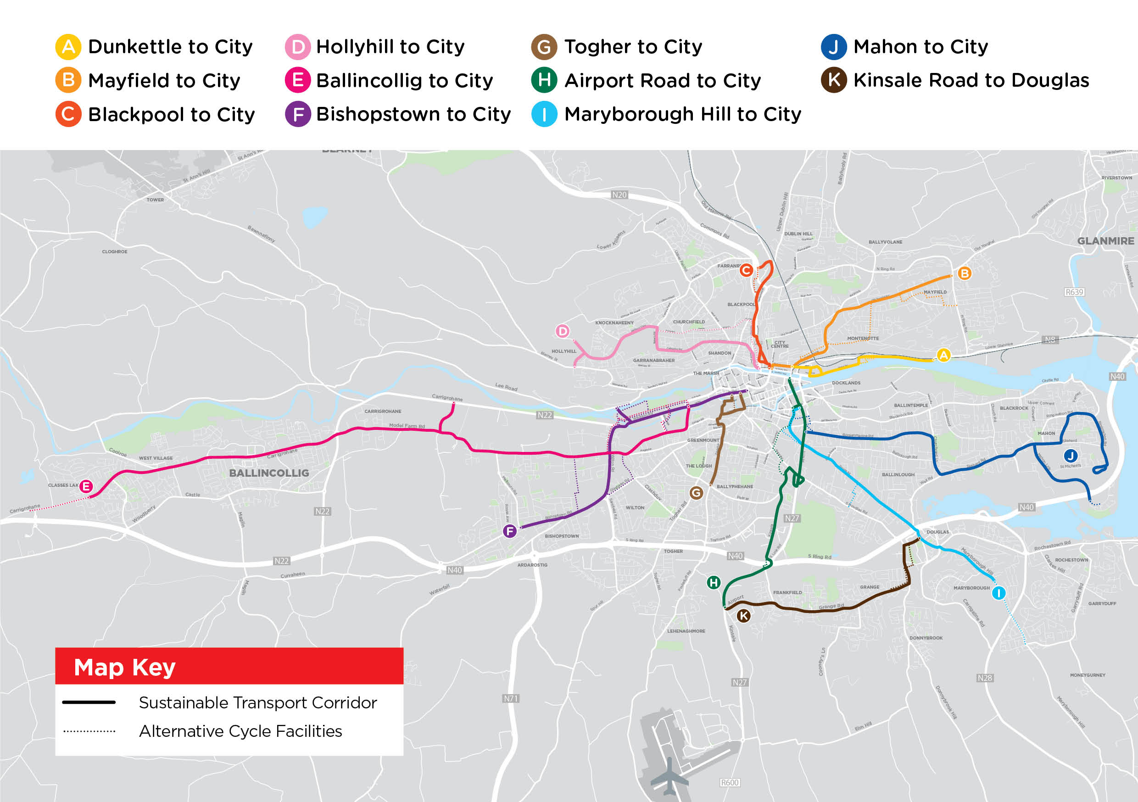

Slide 7
STC D Hollyhill to City:
Overview of Preferred Route

Slide 8
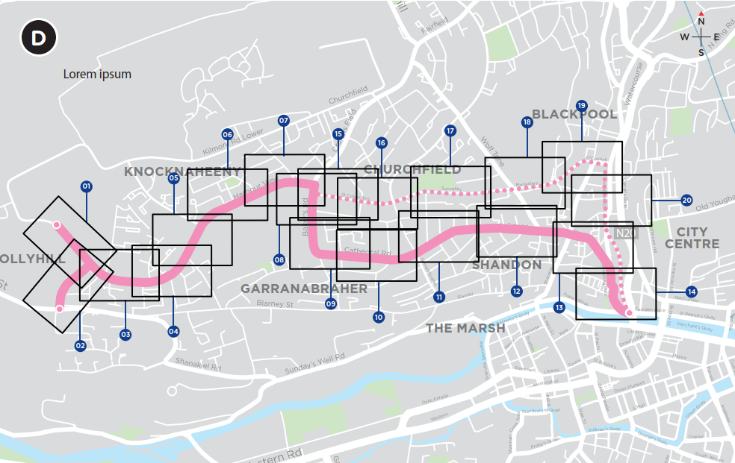
Sustainable Transport Corridor D - Hollyhill to City
Bus Priority:
Dedicated bus lanes on Tadhg Barry Road, Harbour View Road and Baker’s Road as far as the junction with St. Mary’s Health Campus.
Cathedral Road, Cathedral Street, Roman Street, Upper John Street, John Redmond Street and Mulgrave Road are physically constrained. A series of bus priority traffic signals at key junctions and a bus gate proposed along this section.

Slide 9
Sustainable Transport Corridor D - Hollyhill to City
Cycle Facilities:
Dedicated cycle tracks on Tadhg Barry Road, Harbour View Road and Baker’s Road as far as the junction of Baker’s Road and St. Colmcille’s Road.
Dedicated cycle tracks are provided on St. Colmcille’s Road, Sunvalley Drive, North Monastery Road and O’Connell Street as far as the junction of O’Connell Street and Watercourse Road.

Slide 10
STC D Hollyhill to City:
Key Changes from Preferred Route Published in March 2023

Slide 11
Sustainable Transport Corridor D - Hollyhill to City
Key Changes:
Updated layout at Harbour View Road & Baker’s Road junction
Bus gate removed from Wolfe Tone Street and now proposing traffic restriction at Shandon Street junction

Slide 12
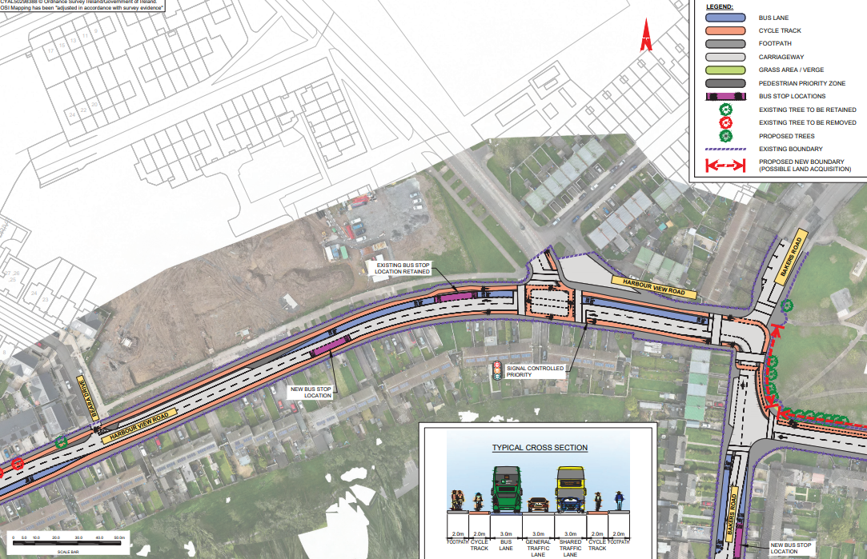
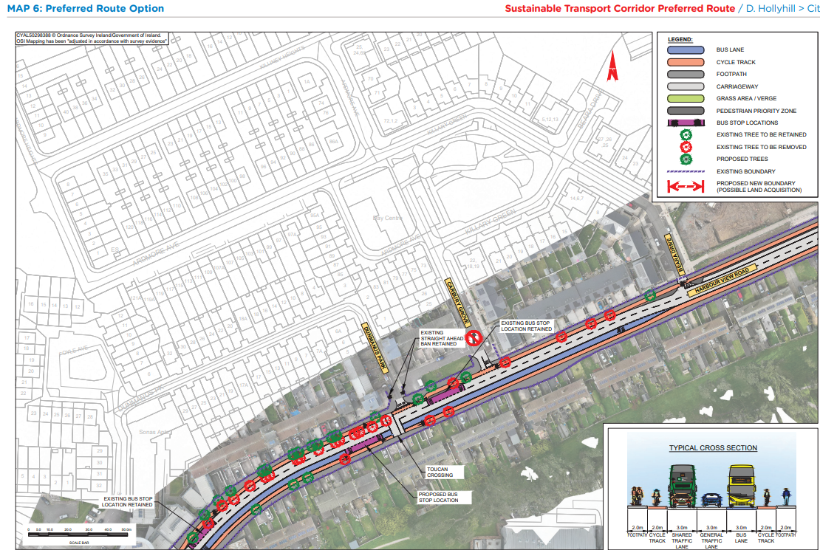
STC D Preferred Route Option (PRO) November 2023

Slide 13
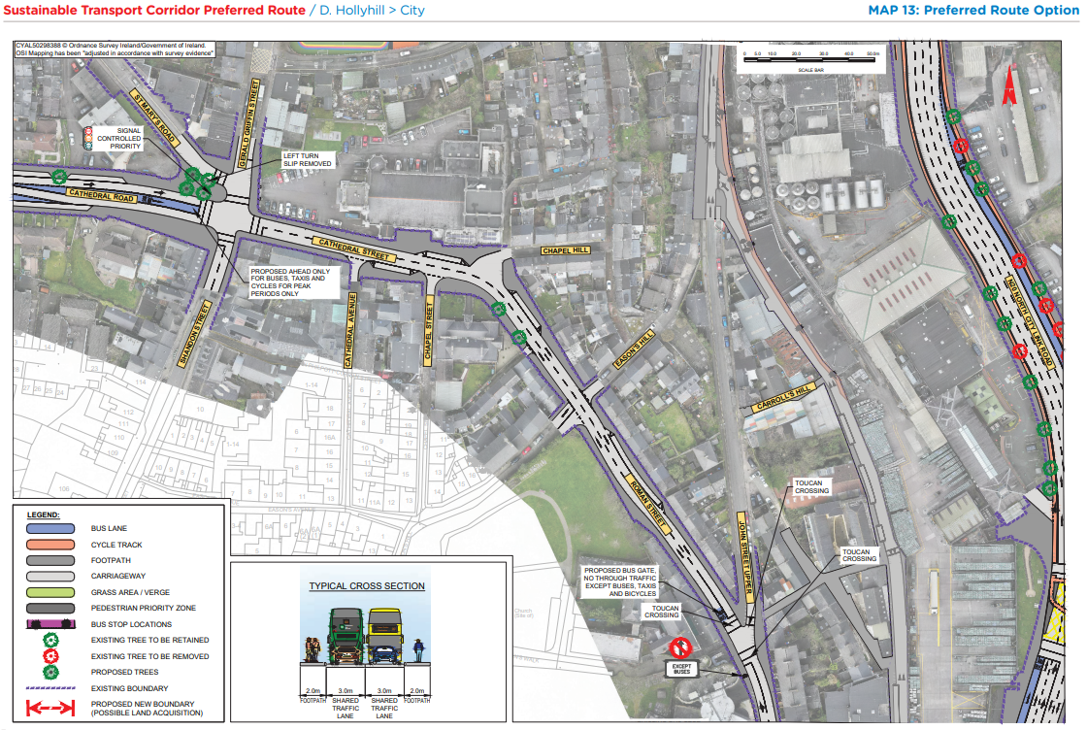
STC D Preferred Route Option (PRO) November 2023

Slide 14
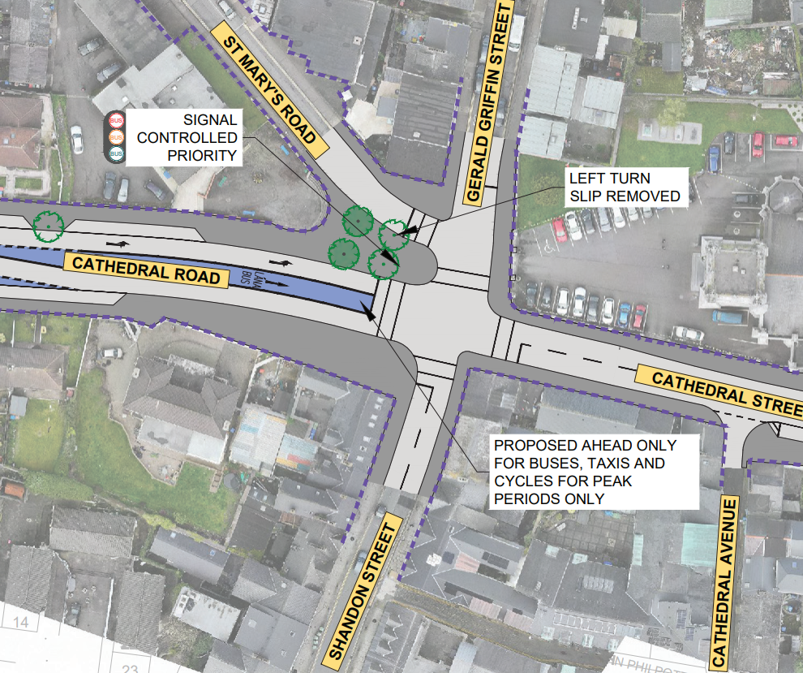
STC D Preferred Route Option (PRO) November 2023

Slide 15
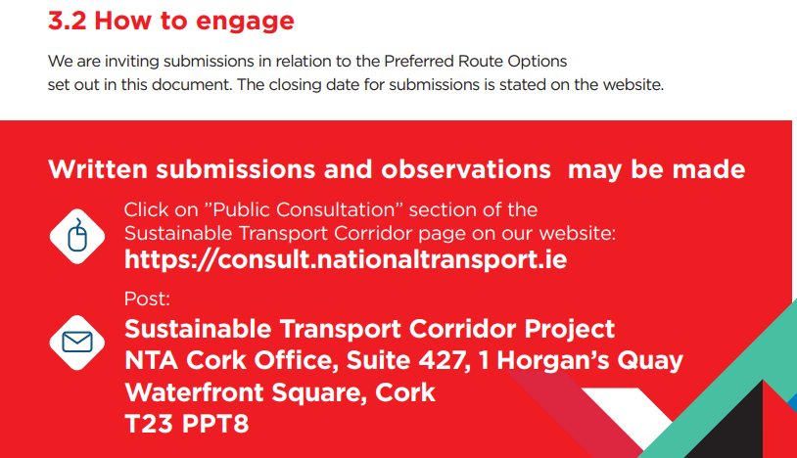
BusConnects Cork Third Round of Public Consultation

Slide 16
Deadline for Submissions Monday 18th December 2023 www.busconnects.ie/cork

