Slide 2
BusConnects Cork
Sustainable Transport Corridors
Third Public Consultation
Community Forum – Monday 4th Dec 2023
Sustainable Transport Corridor E – Ballincollig to City
Sustainable Transport Corridor F – Bishopstown to City

Slide 3
Introductions
Independent Chairperson Simon Nugent
NTA Hugh Creegan, Deputy CEO
Con Kehely, Head of BusConnects Regional Cities
Terry Brennan, Senior Communications Manager
ROD Deirdre Neff, Principal Engineer

Slide 4
Running of Meeting
We will endeavor to finish the meeting on time
Please turn mobile phones to silent or off
Chairperson will call on contributors in turn
State your name and the name of the group you represent
To allow maximum participation, please keep contributions short

Slide 6
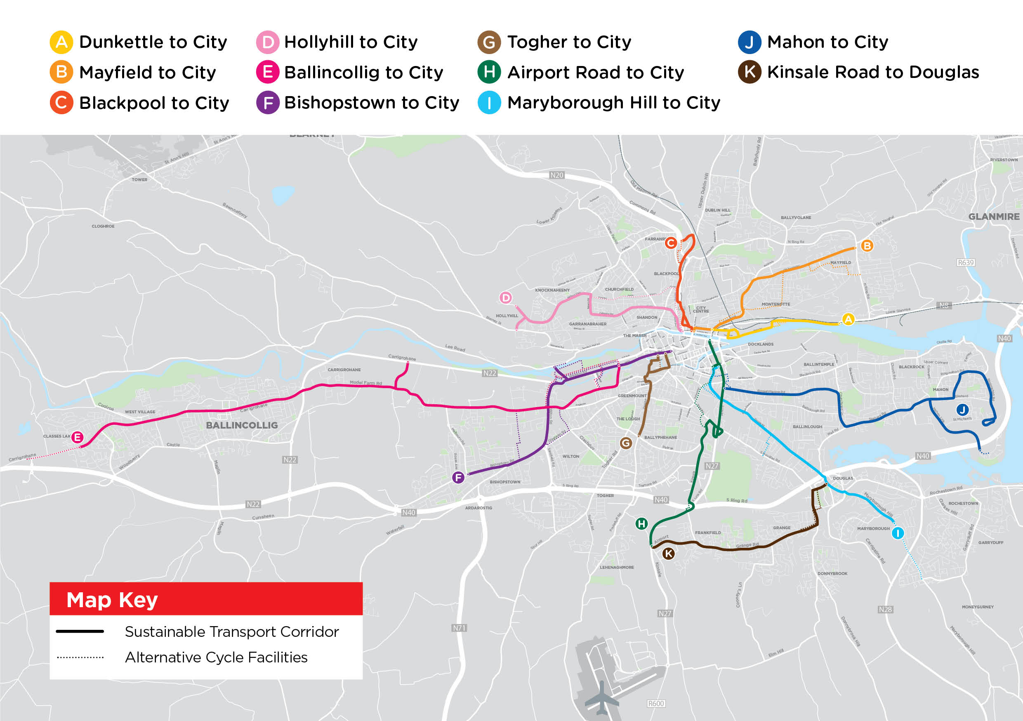

Slide 7
STC E Ballincollig to City:
Key Changes from Preferred Route Published in March 2023

Slide 8
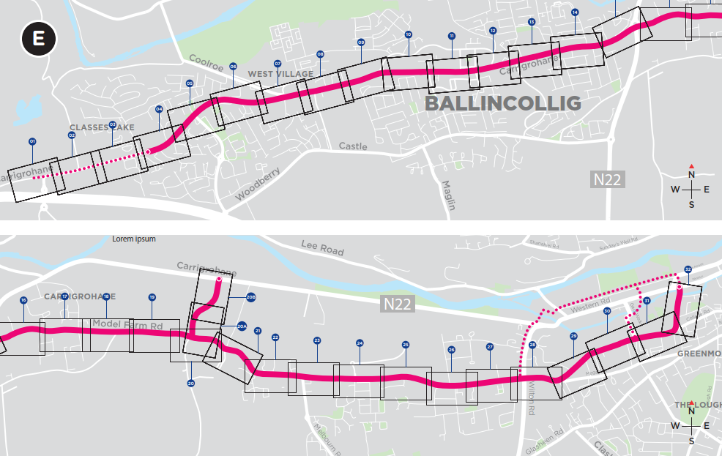
Sustainable Transport Corridor E - Ballincollig to City
Recap:
Bus priority - mix of dedicated Bus Lanes, Signal Controlled Priority and Bus Gates.
Dedicated cycle facilities are provided from the N22 junction at Ovens Rd to Dennehy’s Cross where the cycle facilities diverge onto the facilities provided along STC F.
Key Changes:
Design development at a number of junctions - filter lanes etc.

Slide 9
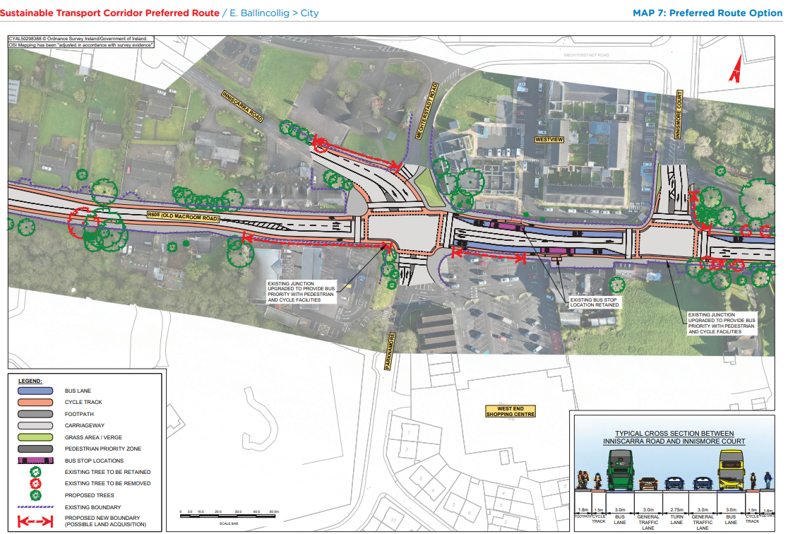
STC E Preferred Route Option (PRO) November 2023

Slide 10
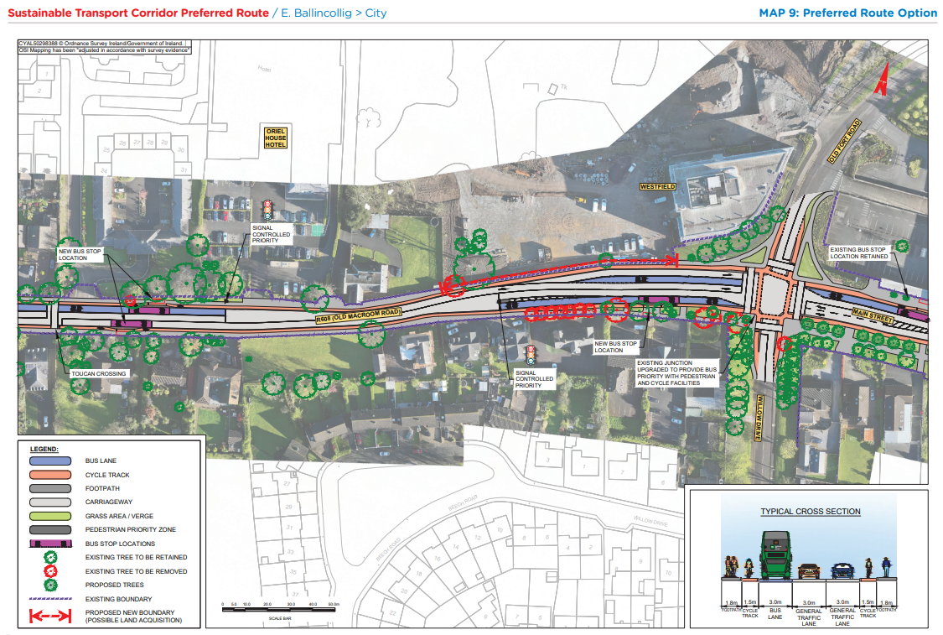
STC E Preferred Route Option (PRO) November 2023

Slide 11
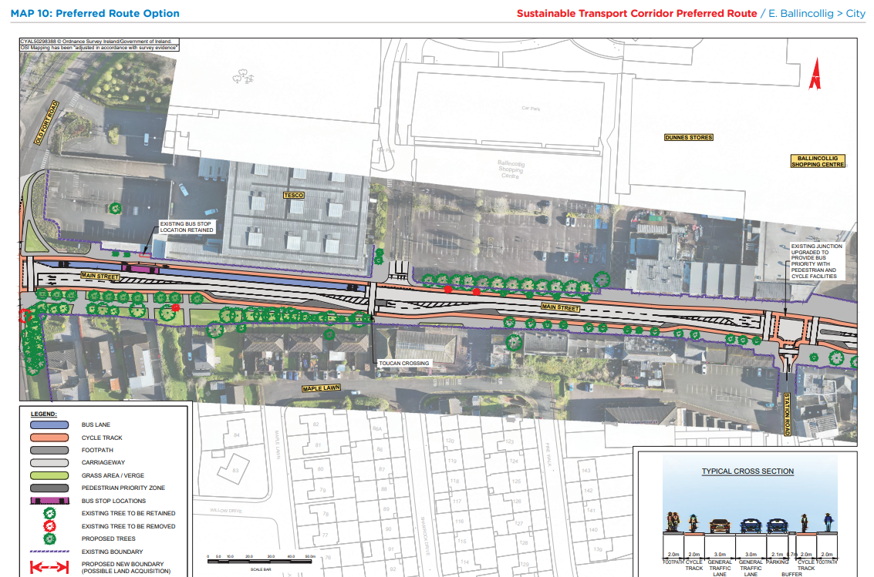
STC E Preferred Route Option (PRO) November 2023

Slide 12
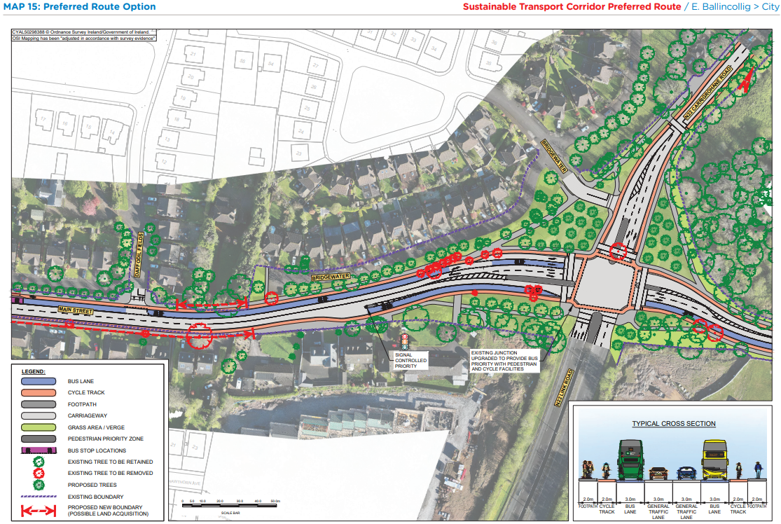
STC E Preferred Route Option (PRO) November 2023

Slide 13
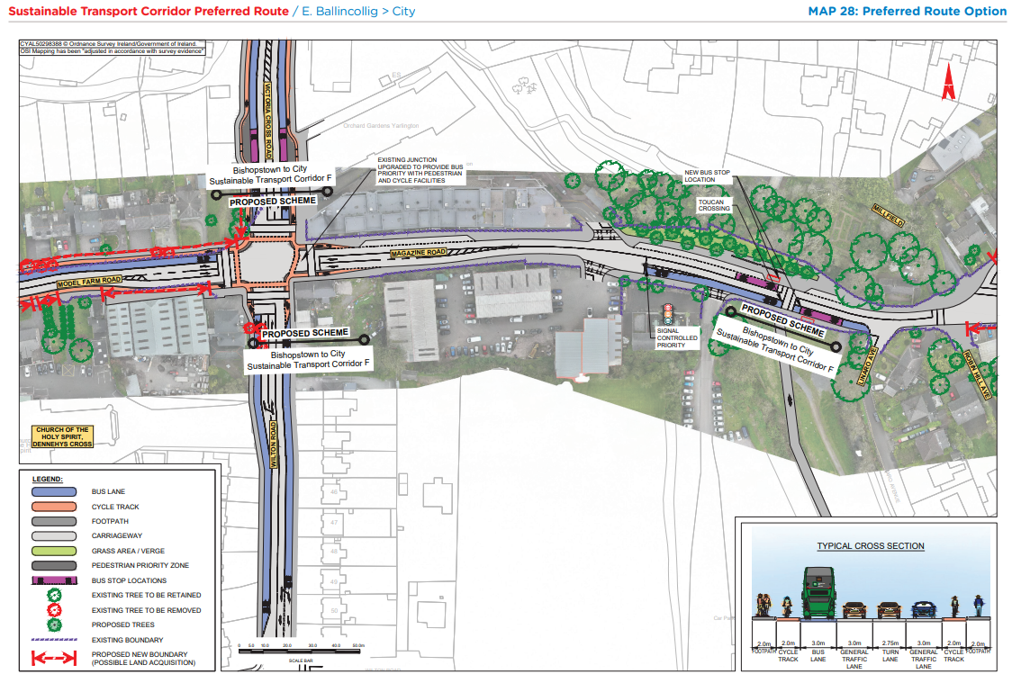
STC E Preferred Route Option (PRO) November 2023

Slide 14
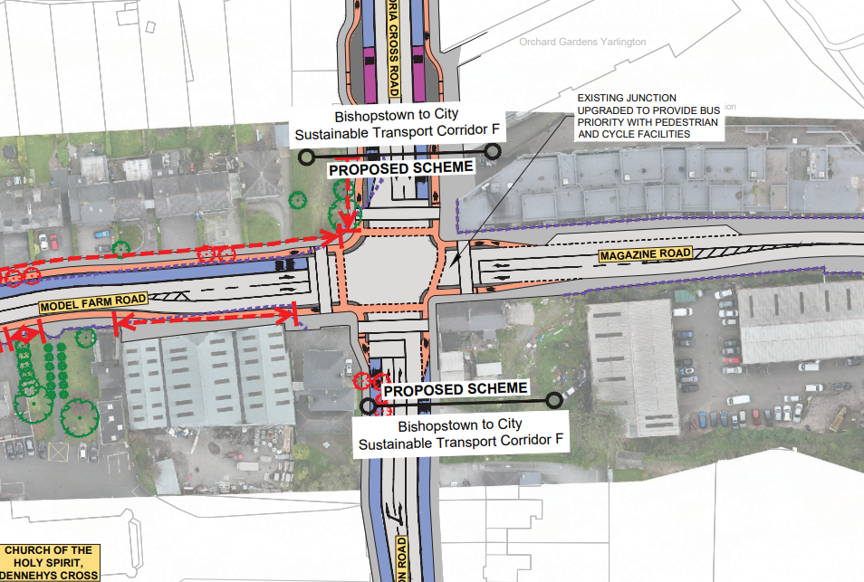
STC E Preferred Route Option (PRO) November 2023

Slide 15
STC F Bishopstown to City:
Key Changes from Preferred Route Published in March 2023

Slide 16
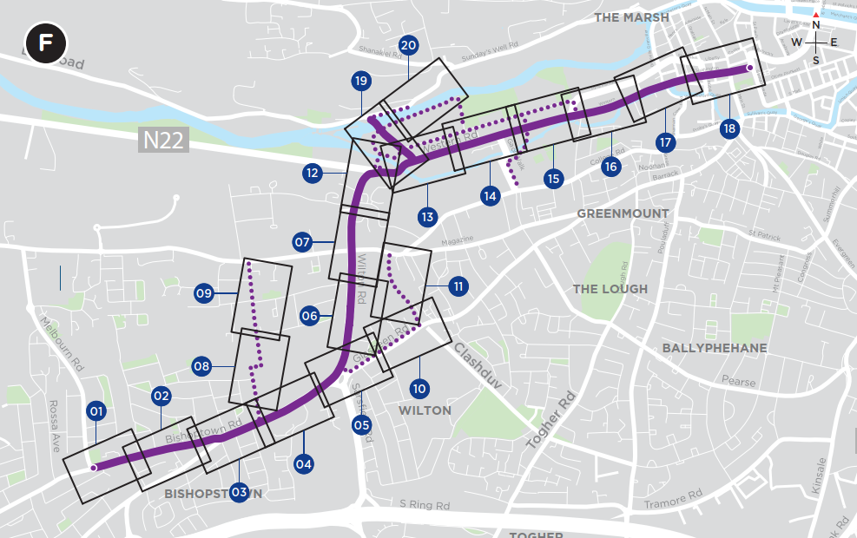
Sustainable Transport Corridor F - Bishopstown to City
Recap:
Bus priority - mix of dedicated bus lanes/SCP, Bus Gates and turning restrictions.
Bus Gates proposed outside UCC Gates.
Wilton Roundabout to be changed to a signalised junction.
Dedicated cycle tracks or alternative off corridor cycle facilities along full corridor.
Key Changes:
Inbound bus lane on Curraheen Road replaced with Peak PM left turn ban at Melbourn Rd junction. Section of outbound bus lane between Melbourn Road and Hawkes Road omitted.
Design development at junctions.

Slide 17
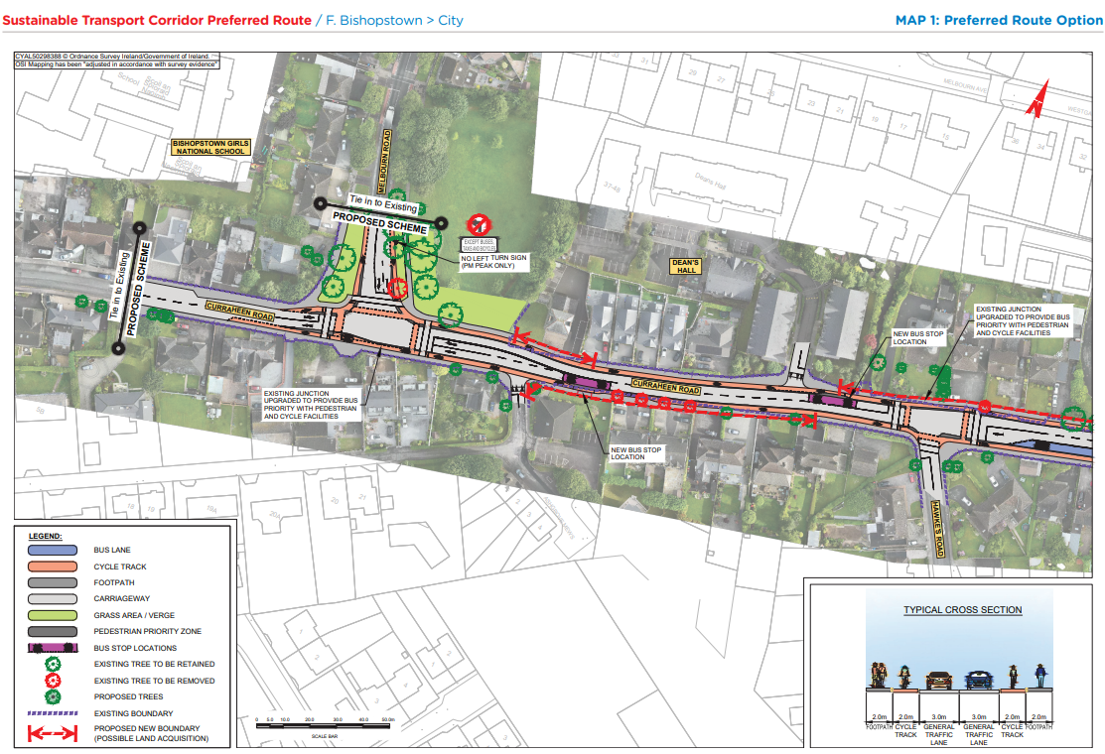
STC F Preferred Route Option (PRO) November 2023

Slide 18
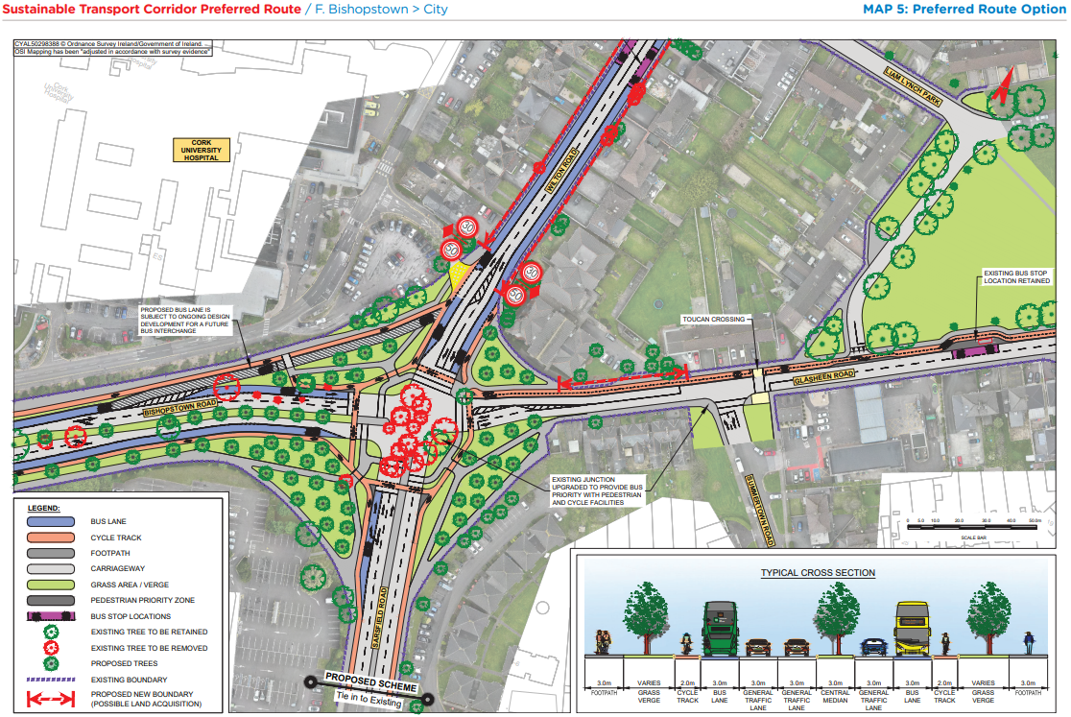
STC F Preferred Route Option (PRO) November 2023

Slide 19
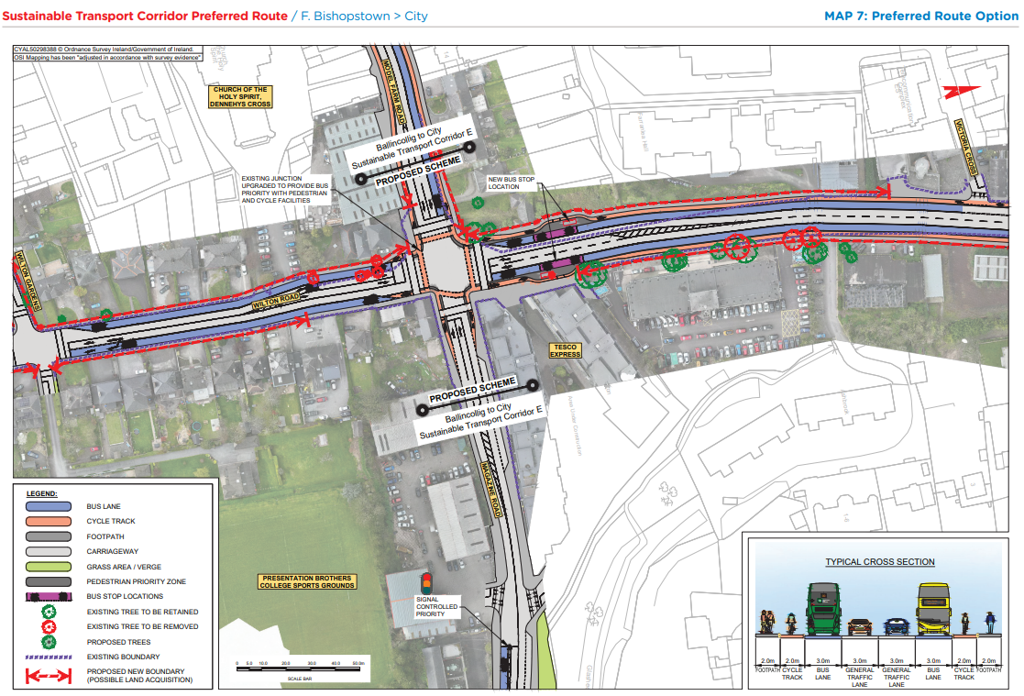
STC F Preferred Route Option (PRO) November 2023

Slide 20
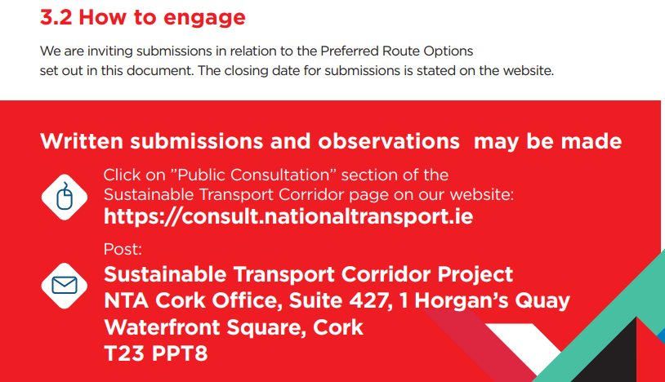
BusConnects Cork Third Round of Public Consultation

Slide 21
Deadline for Submissions Monday 18th December 2023 www.busconnects.ie/cork

