Slide 2
BusConnects Cork
Sustainable Transport Corridors
Third Public Consultation
Community Forum – Thursday 30th Nov 2023
Sustainable Transport Corridor G – Togher to City
Sustainable Transport Corridor H – Airport Road to City
Sustainable Transport Corridor K – Kinsale Road to Douglas

Slide 3
Introductions
Independent Chairperson Simon Nugent
NTA Hugh Creegan, Deputy CEO
Con Kehely, Head of BusConnects Regional Cities
Terry Brennan, Senior Communications Manager
Aecom Eoin O’Mahony, Regional Director
ROD Eoin O’Cathain, Director

Slide 4
Running of Meeting
We will endeavor to finish the meeting on time
Please turn mobile phones to silent or off
Chairperson will call on contributors in turn
State your name and the name of the group you represent
To allow maximum participation, please keep contributions short

Slide 6
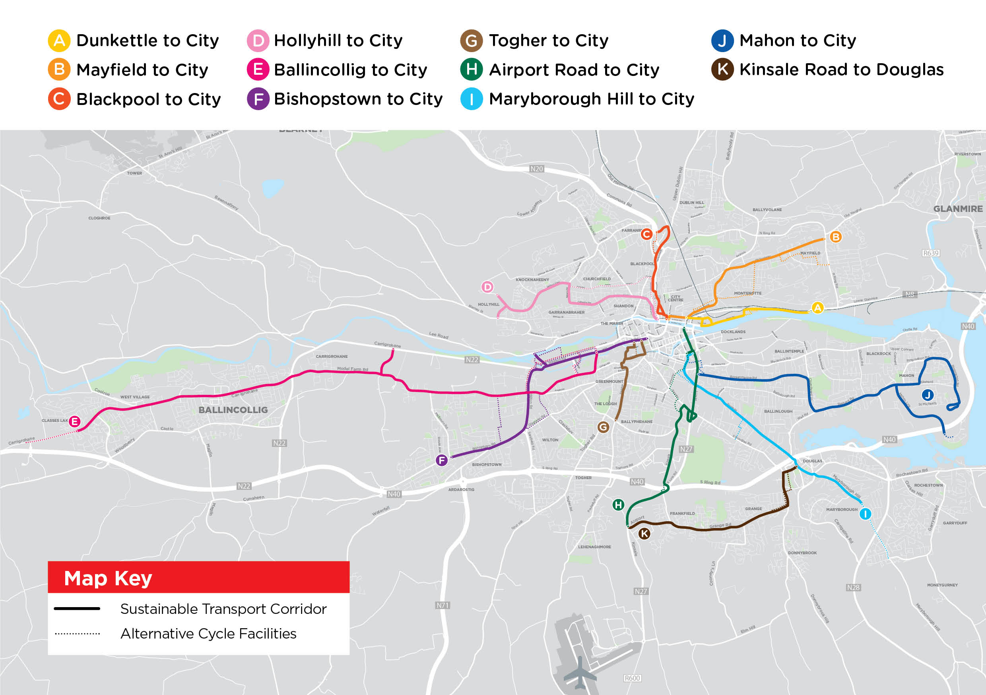

Slide 7
STC G Togher to City:
Key Changes from Preferred Route Published in March 2023

Slide 8
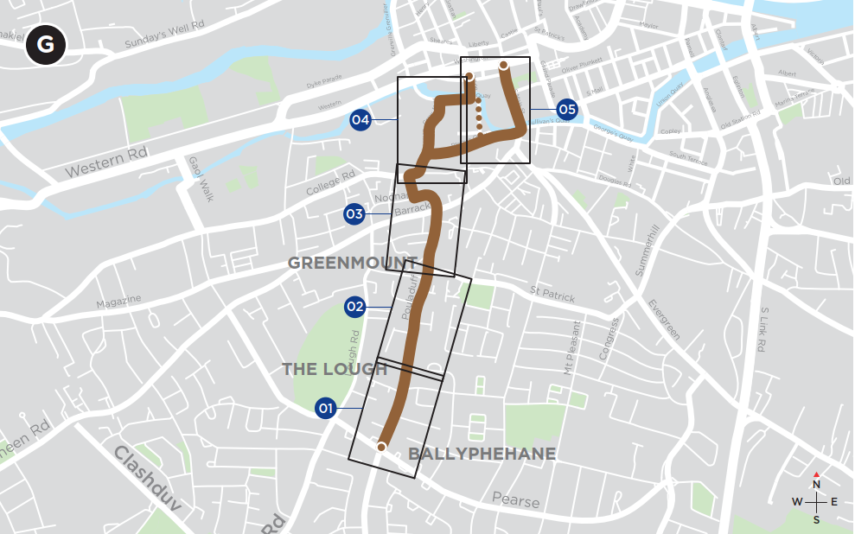
Sustainable Transport Corridor G - Togher to City
Key Changes:
The removal of parking on Noonan Road is no longer proposed. The inbound bus lane previously proposed has been omitted.
The section of inbound bus lane previously proposed on Sharman Crawford Street is no longer proposed.
The bus gate previously proposed on Clarke’s Bridge is no longer proposed.

Slide 9
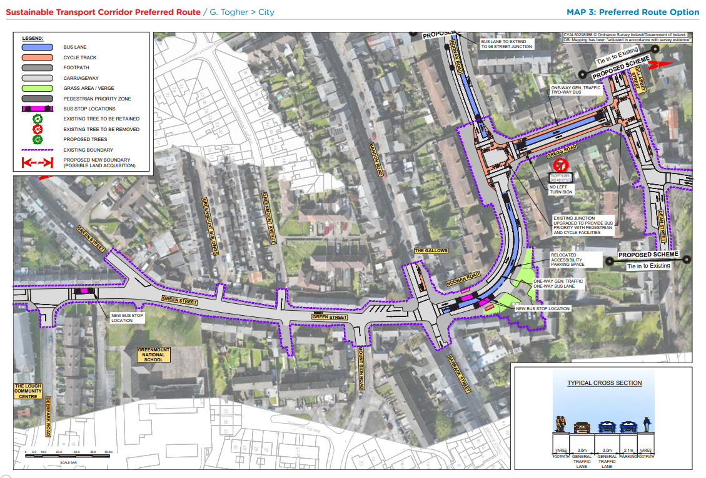
STC G Preferred Route Option (PRO) November 2023

Slide 10
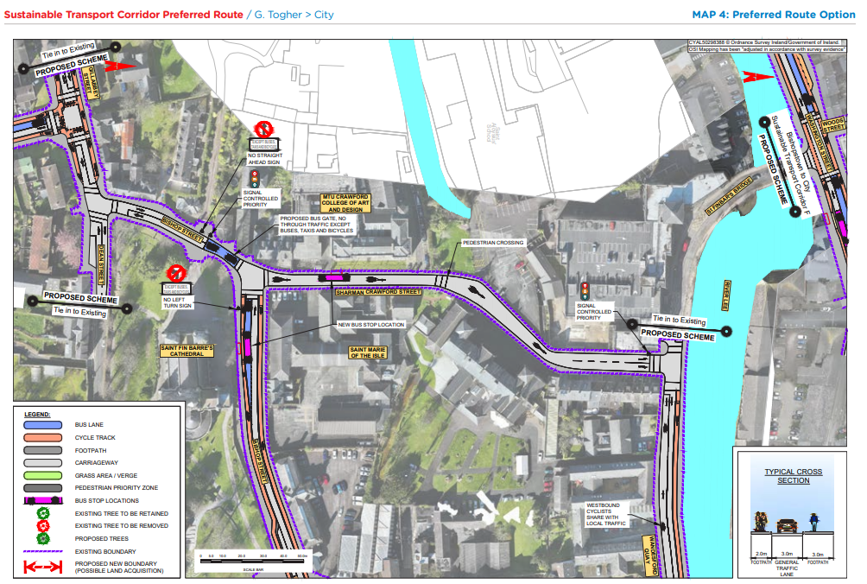
STC G Preferred Route Option (PRO) November 2023

Slide 11
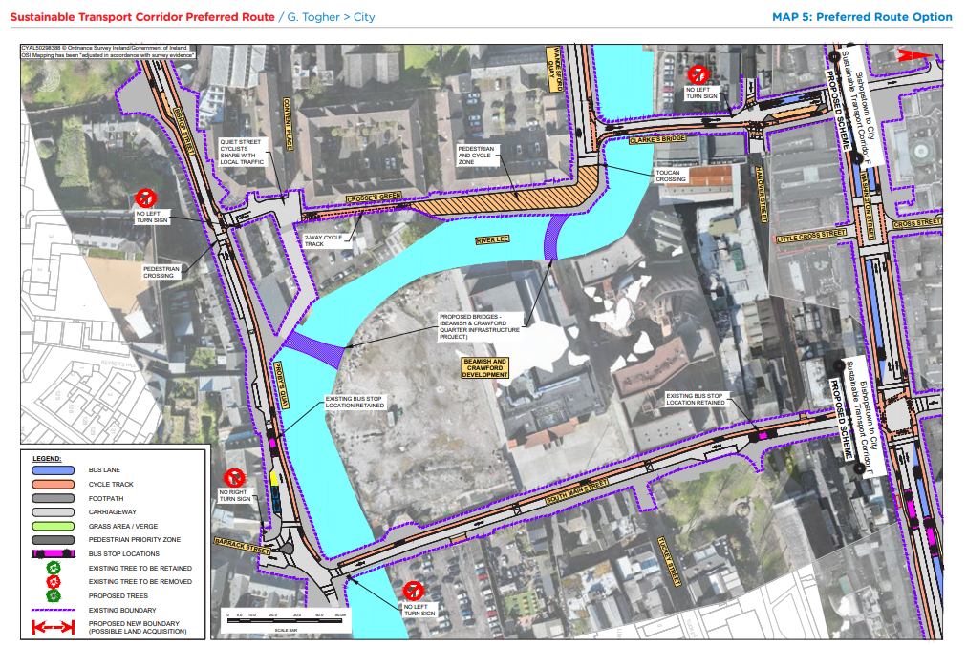
STC G Preferred Route Option (PRO) November 2023

Slide 12
STC H Airport Road to City:
Key Changes from Preferred Route Published in March 2023

Slide 13
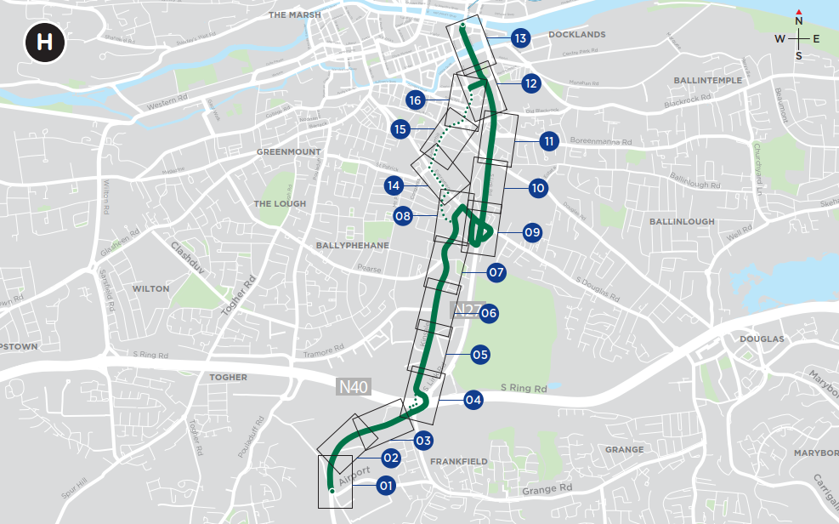
Sustainable Transport Corridor H - Airport to City
Key Changes:
At Kinsale Road, Curragh Road and Pearse Road Junction, a dedicated right turn lane has been incorporated in the design on the northern arm of Curragh Road. A dedicated left turn lane on the western arm of Pearse Road is proposed together with changes to the footpath and cycle lanes layouts to maintain functionality and enhance pedestrian and cycle environment of this junction.
Two-way cycle track on Evergreen Rd. moved to southern side.
Cross section along N27 Sth Link Rd modified to fit within existing footprint.

Slide 14
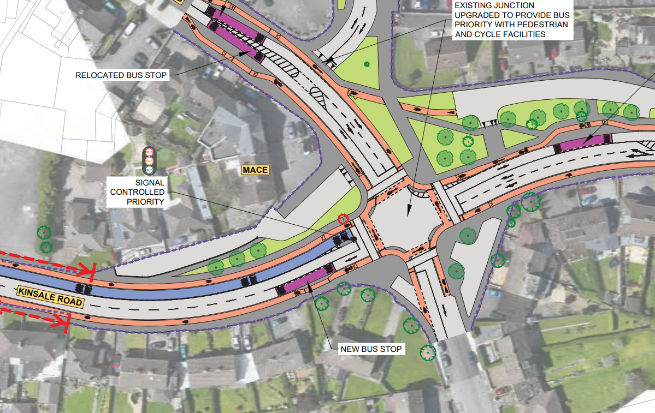
STC H Preferred Route Option (PRO) November 2023

Slide 15
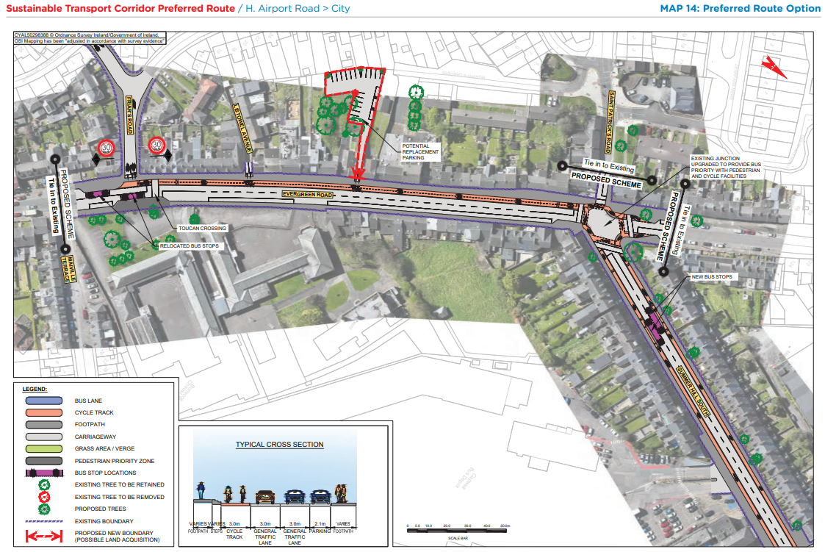
STC H Preferred Route Option (PRO) November 2023

Slide 16
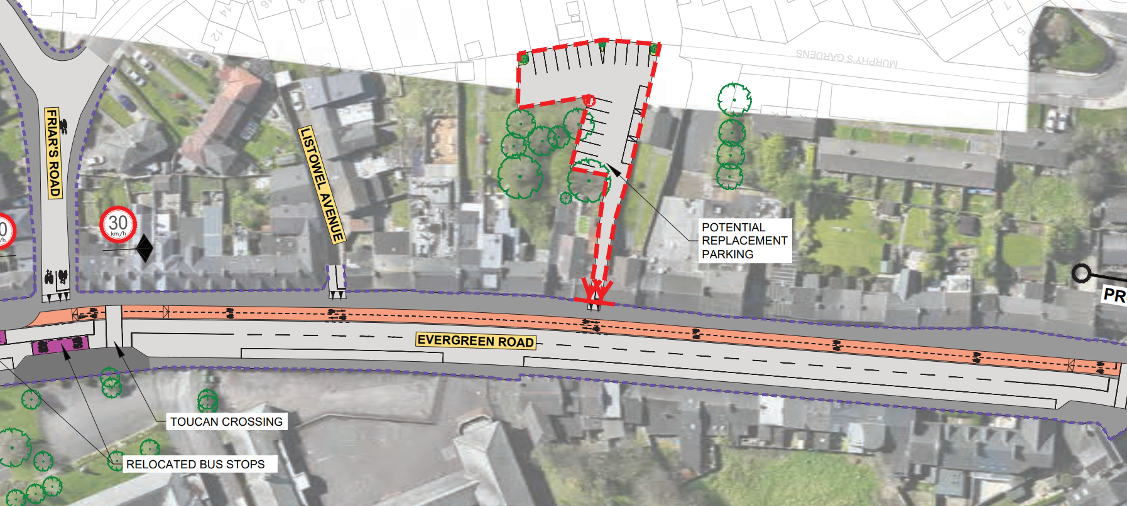
STC H Preferred Route Option (PRO) November 2023

Slide 17
STC K Kinsale Road to Douglas:
Key Changes from Preferred Route Published in March 2023

Slide 18
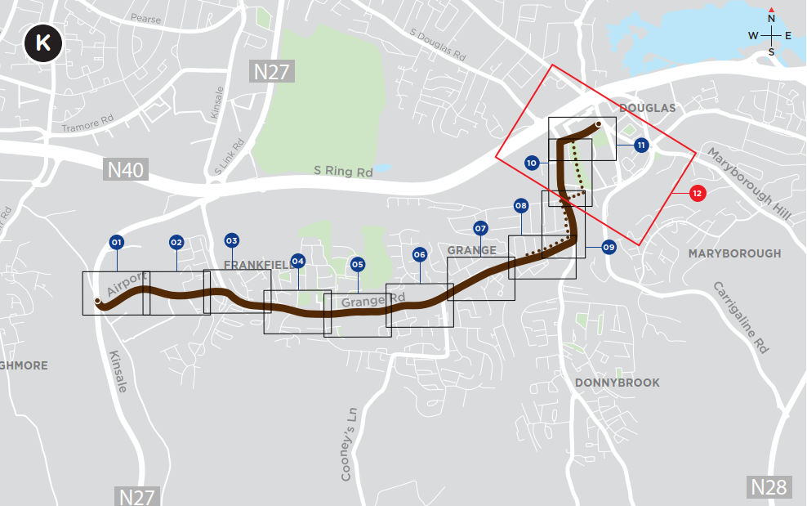
Sustainable Transport Corridor K - Kinsale Road to Douglas
Key Changes:
Design development at a number of junctions.
Bus lanes along Grange Road are re-arranged in places to improve road safety, minimise impacts to private land, existing trees and boundary walls.
New toucan crossing at Elmwood Medical Practice.
New zebra crossing at Church Street.

Slide 19
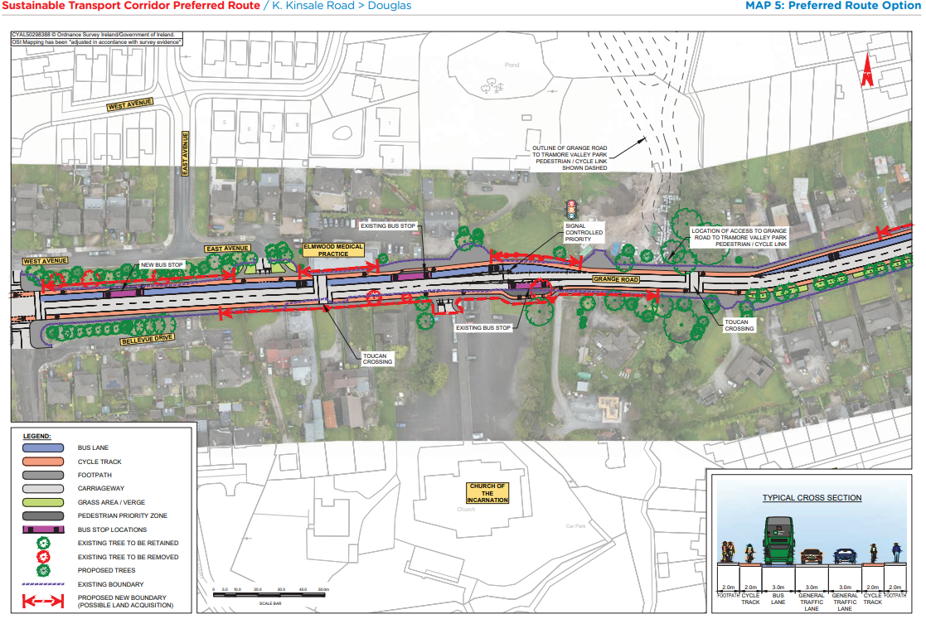
STC K Preferred Route Option (PRO) November 2023

Slide 20
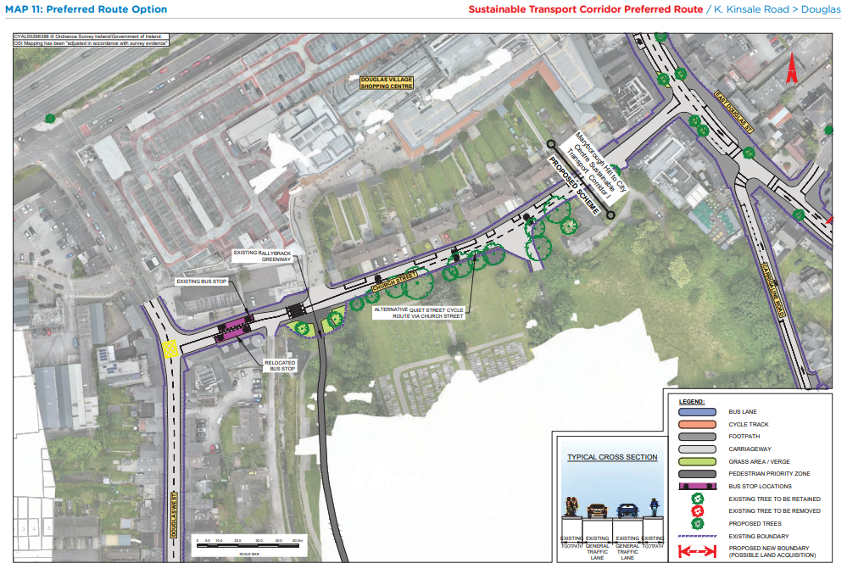
STC K Preferred Route Option (PRO) November 2023

Slide 21
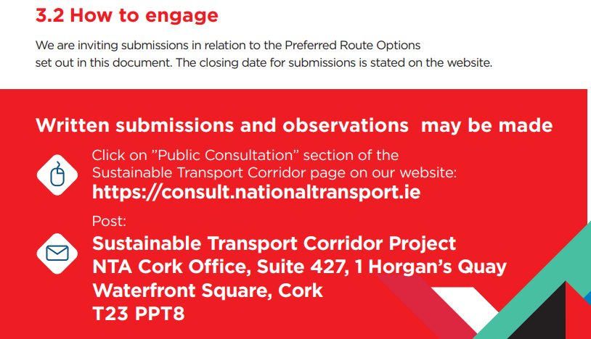
BusConnects Cork Third Round of Public Consultation

Slide 22
Deadline for Submissions Monday 18th December 2023 www.busconnects.ie/cork

