Slide 2
BusConnects Cork
Sustainable Transport Corridors
Third Public Consultation
Community Forum – Wednesday 29th Nov 2023
Sustainable Transport Corridor I – Maryborough Hill to City
Sustainable Transport Corridor J – Mahon to City

Slide 3
Introductions
Independent Chairperson Simon Nugent
NTA Hugh Creegan, Deputy CEO
Con Kehely, Head of BusConnects Regional Cities
Terry Brennan, Senior Communications Manager
Aecom Eoin O’Mahony

Slide 4
Running of Meeting
We will endeavor to finish the meeting on time
Please turn mobile phones to silent or off
Chairperson will call on contributors in turn
State your name and the name of the group you represent
To allow maximum participation, please keep contributions short

Slide 6
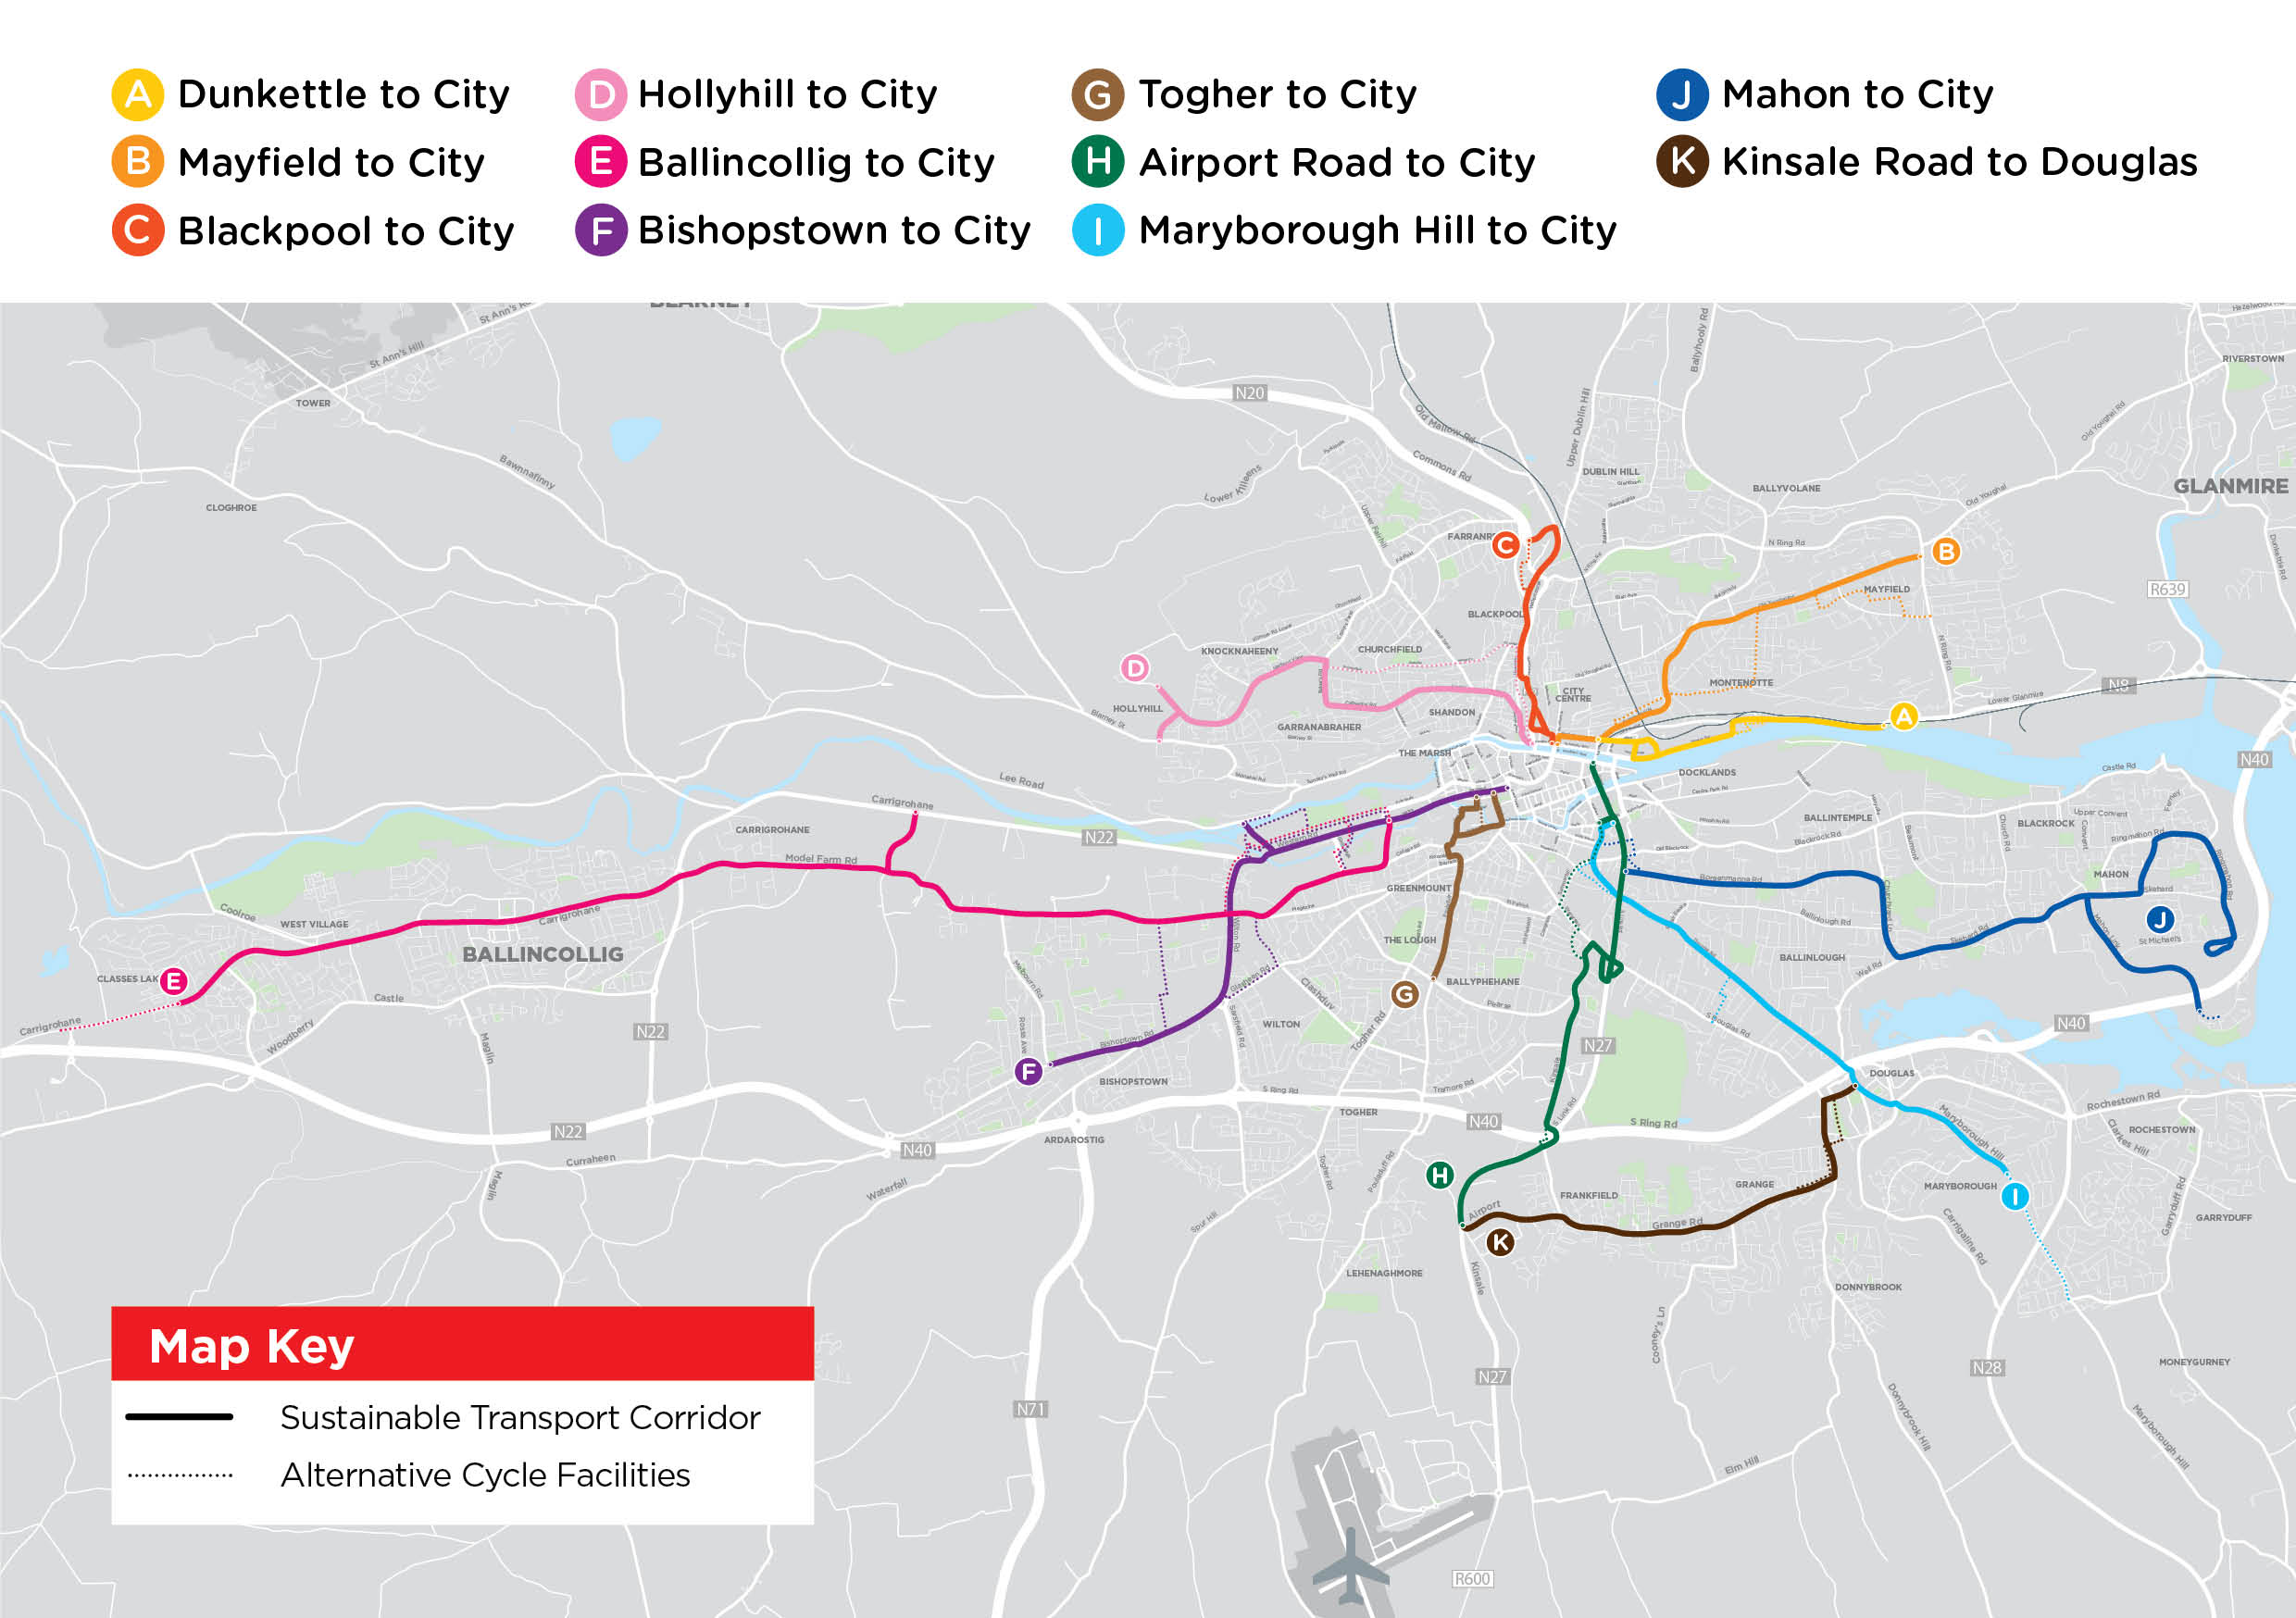

Slide 7
STC I Maryborough Hill to City:
Key Changes from Preferred Route Published in March 2023

Slide 8
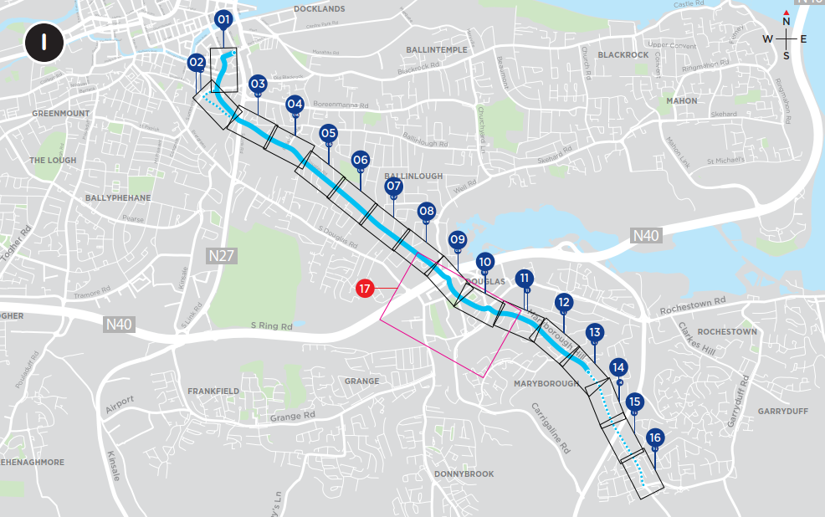
STC I – Maryborough Hill to City
Key Changes:
Two-way traffic is proposed to be maintained on High Street.
Capwell Road is proposed to remain open to traffic in both directions.
The bus gate at the Well Road junction has been relocated to the west of the Rosebank junction. Between the bus gates the existing road arrangement is to remain. A 30km/h speed limit is to be introduced.
No land take proposed between Rhodaville Estate and St. Finbarr’s Hospital.
The outbound bus lane between Well Road and Douglas Relief Road is no longer proposed. The inbound bus lane has been extended to allow clear passage for inbound buses.

Slide 9
STC I – Maryborough Hill to City
Key Changes:
Bus gate on Church Street removed and replaced with turning restriction at East Douglas St. junction.
Two-way traffic on Old Carrigaline Road is no longer proposed and the existing one-way traffic arrangement has been retained.
The taxi rank on Old Carrigaline Road is proposed to be evening/night-time only and will revert to parking during daytime hours.
On Maryborough Hill an inbound bus lane is no longer proposed between Lime Trees Road and the Paddocks..

Slide 10
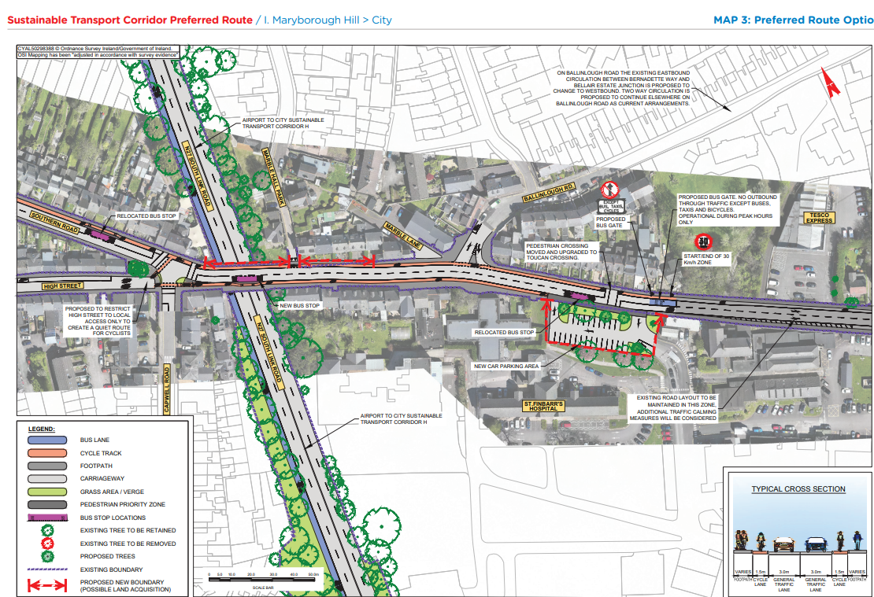
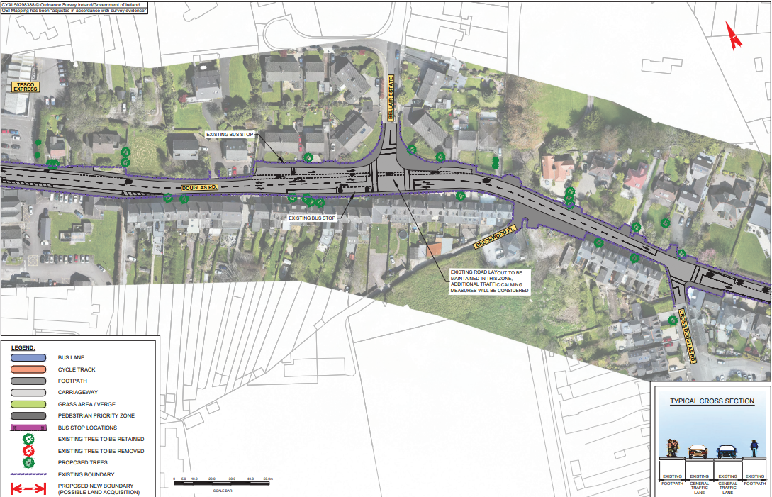
STC I Preferred Route Option (PRO) November 2023

Slide 11
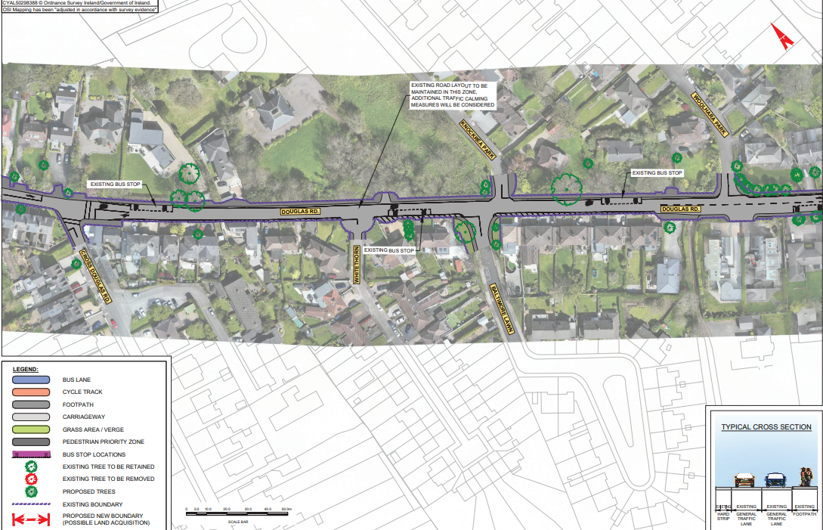
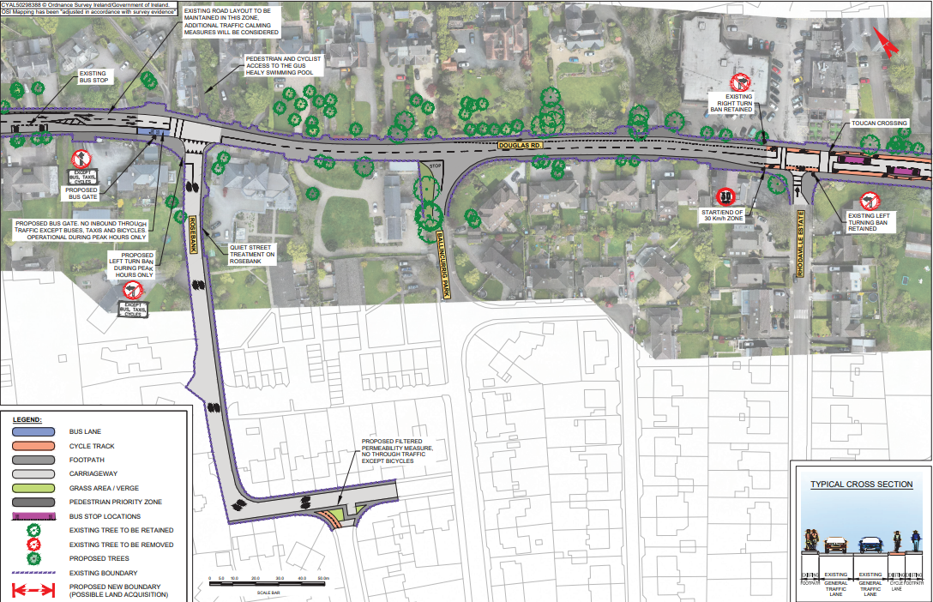
STC I Preferred Route Option (PRO) November 2023

Slide 12
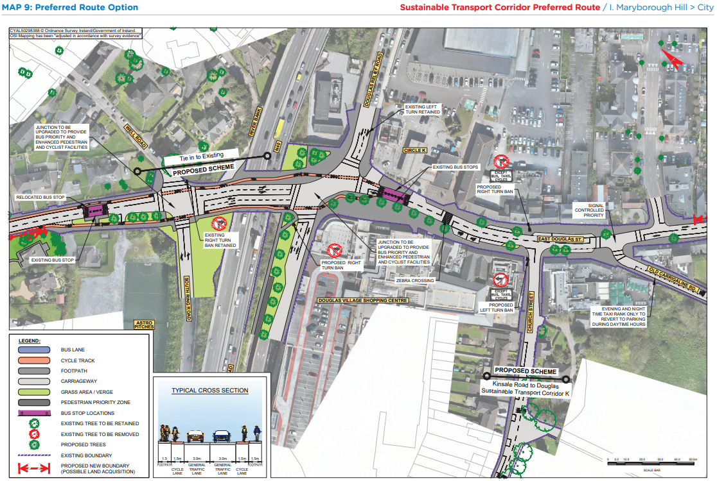
STC I Preferred Route Option (PRO) November 2023

Slide 13
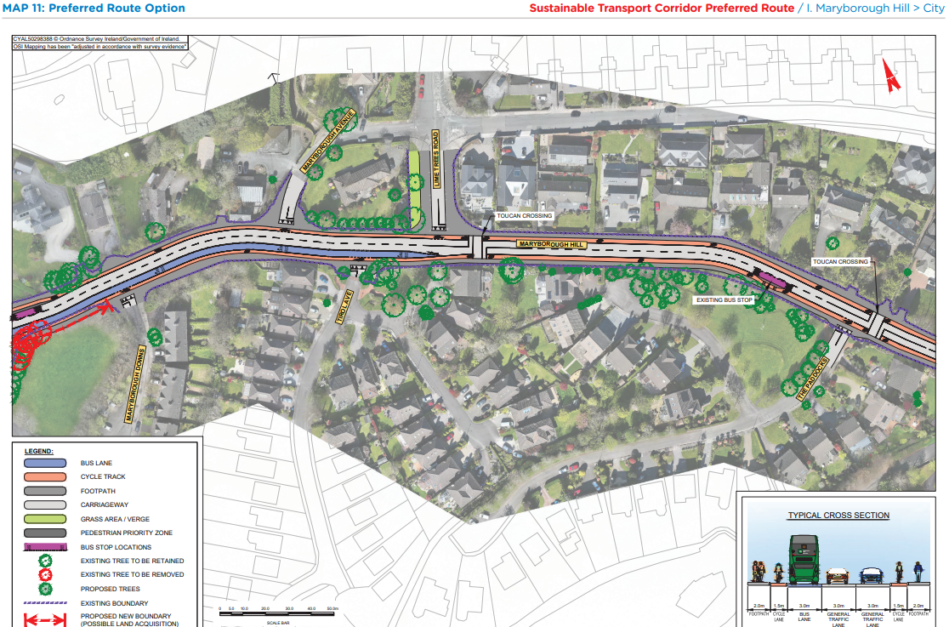
STC I Preferred Route Option (PRO) November 2023

Slide 14
STC J Mahon to City:
Key Changes from Preferred Route Published in March 2023

Slide 15
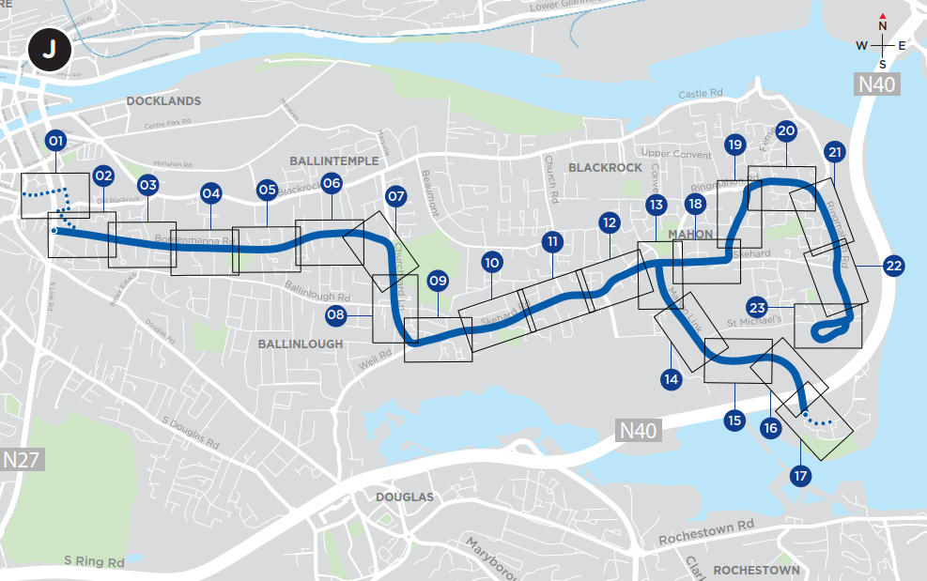
STC J - Mahon to City
Key Changes:
Junction upgrade at Churchyard Lane and Boreenmanna Road and additional parking proposed at this location
Pedestrian / cycle link to Mahon Point SC

Slide 16
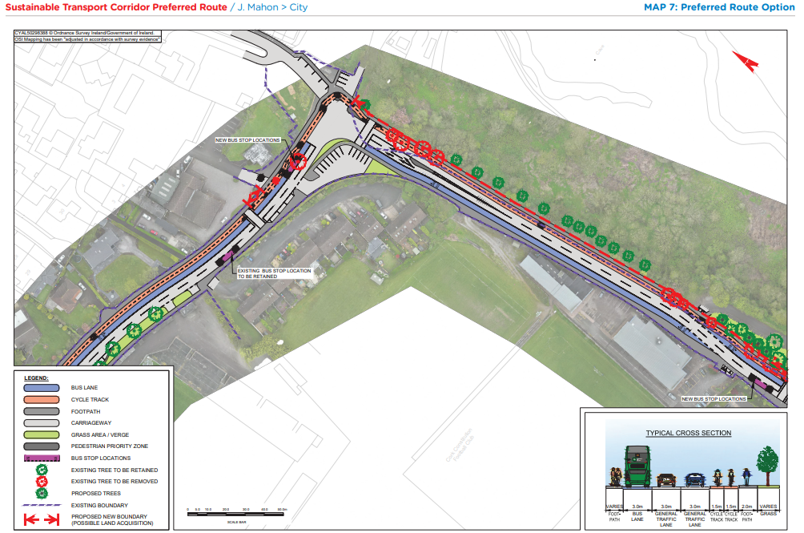
STC J Preferred Route Option (PRO) November 2023

Slide 17
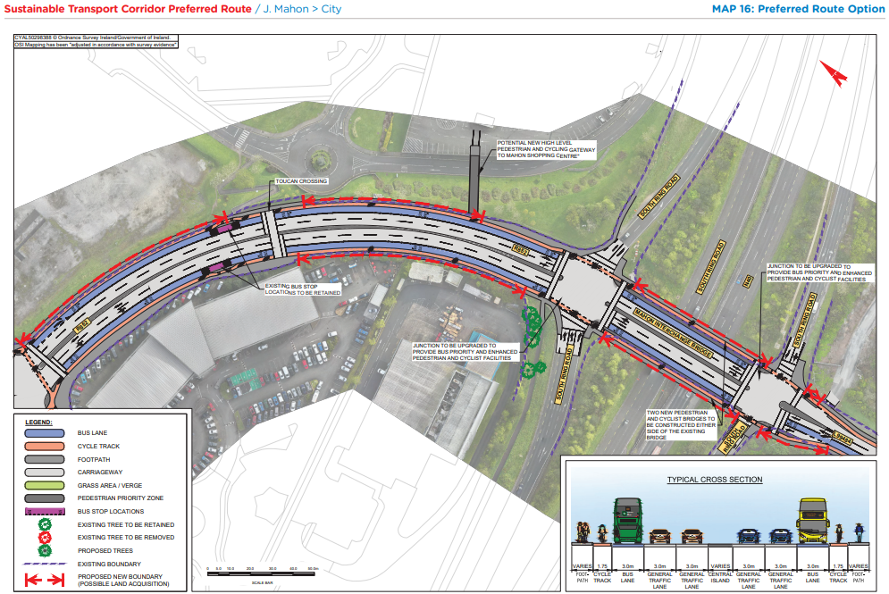
STC J Preferred Route Option (PRO) November 2023

Slide 18
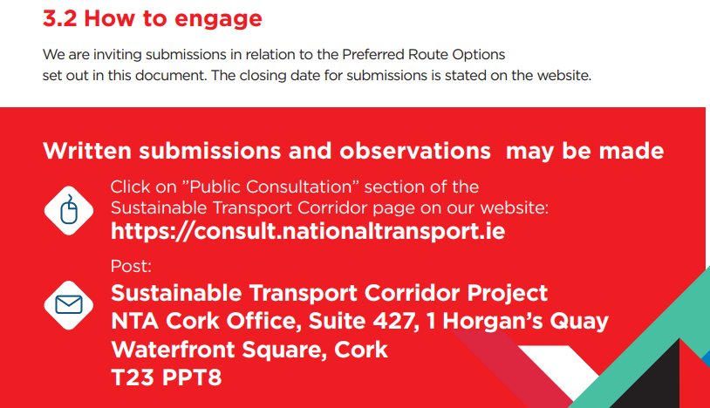
BusConnects Cork Third Round of Public Consultation

Slide 19
Deadline for Submissions Monday 18th December 2023 www.busconnects.ie/cork

