Slide 2
BusConnects Cork
Sustainable Transport Corridors
Second Public Consultation
Community Forum - Tuesday 25th April 2023
Sustainable Transport Corridor C – Blackpool to City
Sustainable Transport Corridor D – Hollyhill to City

Slide 3
Introductions
Independent Chairperson Simon Nugent
NTA Hugh Creegan, Deputy CEO
Robert Curley, Senior Project Manager, BusConnects Cork
Terry Brennan, Senior Communications Manager

Slide 4
Agenda
Introductions (completed)
Running of meetings
Preferred Route Options for STC C & D
Questions – Comments - Discussion

Slide 5
Forum Objectives & Terms of Reference
Two-way communication –Serve as a two-way communication channel between the NTA and local communities
Information Flow – Allow provision of information and updates throughout the duration of the project
Answer questions - Provide answers to concerns and issues raised
Listen – Listen to suggestions on how to improve the proposals, hear constructive ideas and viable alternatives
Resolve – Enable and support the resolution of local issues in a timely manner

Slide 6
Running of Meeting
We will endeavor to finish the meeting on time
Please turn mobile phones to silent or off
Chairperson will call on contributors in turn
State your name and the name of the group you represent
To allow maximum participation, please keep contributions short

Slide 9
First Public Consultation
June 30th – Oct 3rd ‘22
6 x Public Info Events
5 x Community Forums
Approx. 3,000 submissions (2,284 online + 694 email/hardcopy)
35 x Local Groups
Approx. 130 Landowner mtgs

Slide 10
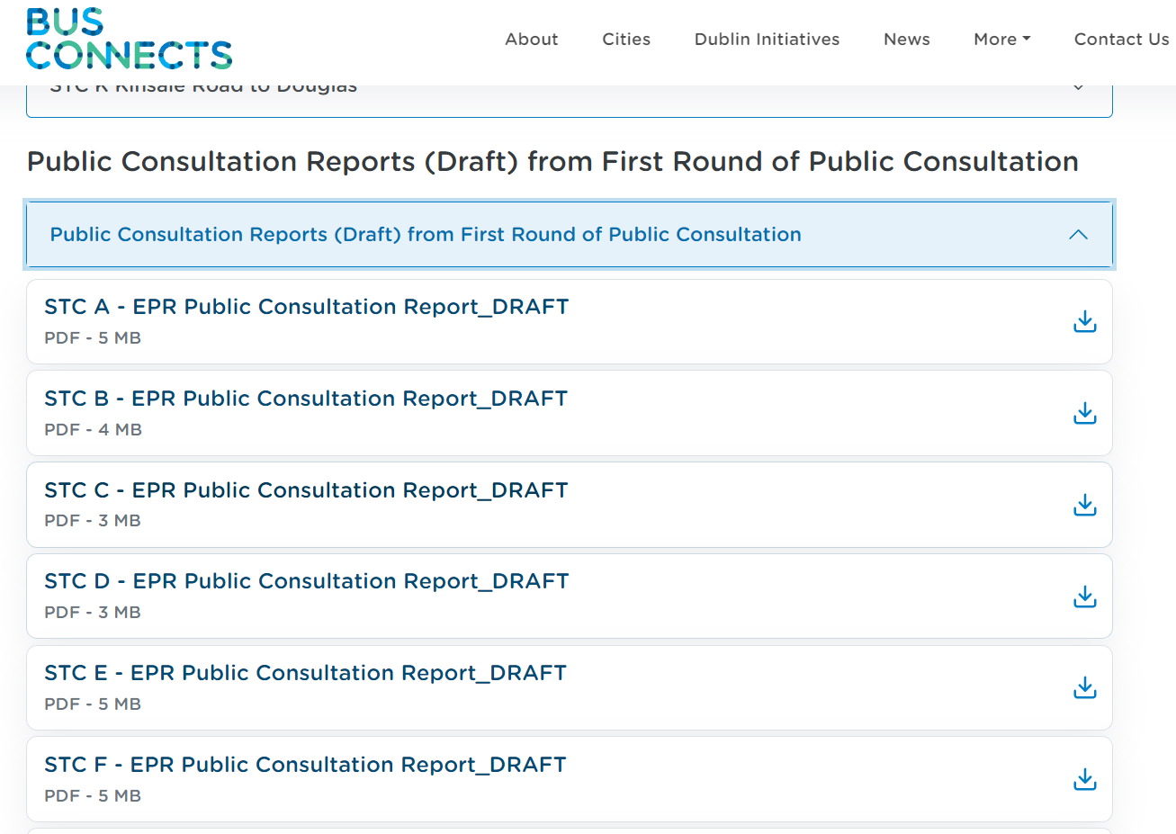
First Public Consultation
STC C - 29 Specific Submissions + General Submissions Road User Safety Traffic Disruption due to Traffic Diversions / Bus Gates Need for STC Removal of Trees Loss of Parking Insufficient Consultation Alternative Options Support for the Scheme

Slide 11
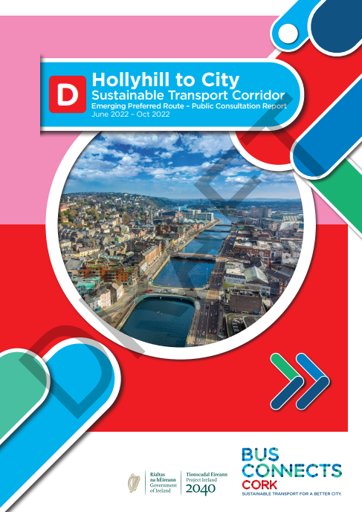
First Public Consultation
STC D – 28 Specific Submissions + General Submissions Road User Safety Traffic Disruption due to Traffic Diversions / Bus Gates Need For Sustainable Transport Corridor Proposed Land Acquisition Removal Of Trees Loss Of Parking Insufficient Consultation & Data Collection Increased Noise and Air Pollution Alternative Options Community / Health & Wellbeing Impacts Support For The Scheme

Slide 12
Overview
of
Sustainable Transport Corridor C:
Blackpool to City Preferred Route Option

Slide 13
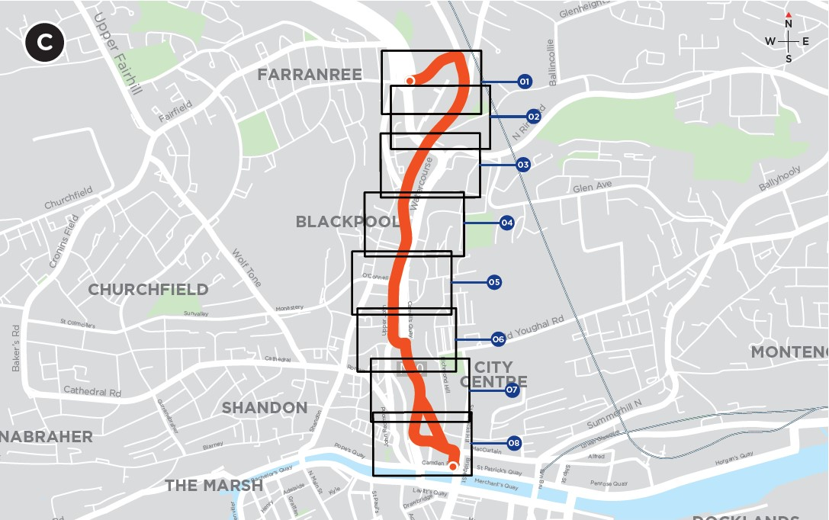
Sustainable Transport Corridor C - Blackpool to City
An additional traffic lane has been provided along Brothers Delaney Road from the junction with the N20 to the junction with Blackpool Retail Park.
Filtered permeability will be implemented on Spring Lane to prevent all through traffic except pedestrians and cyclists.
Public Realm Improvements are proposed for Blackpool Village.

Slide 14
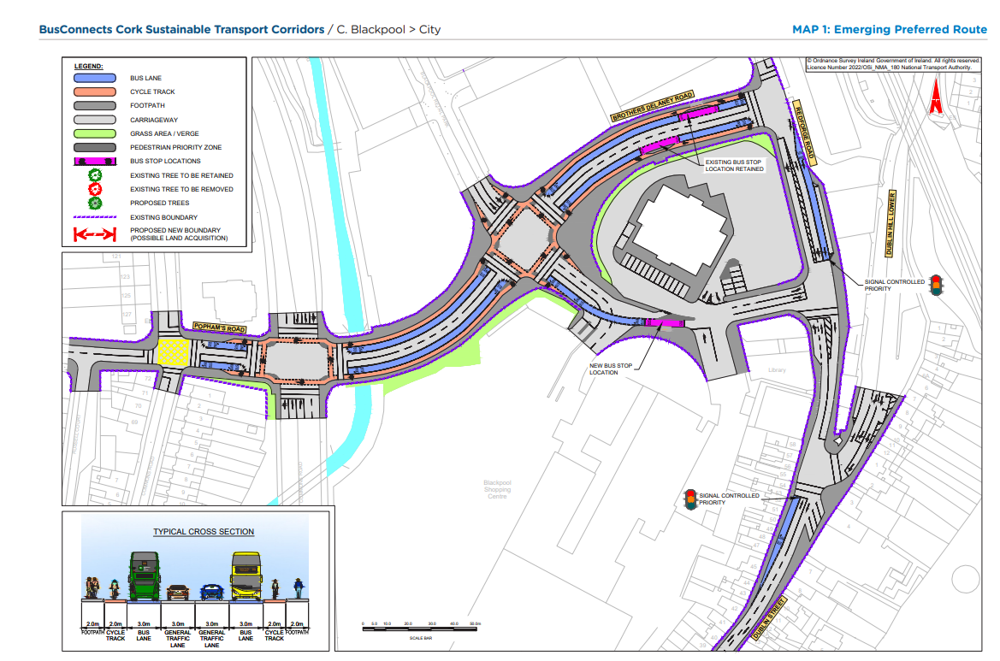
Emerging Preferred Route (EPR)

Slide 15
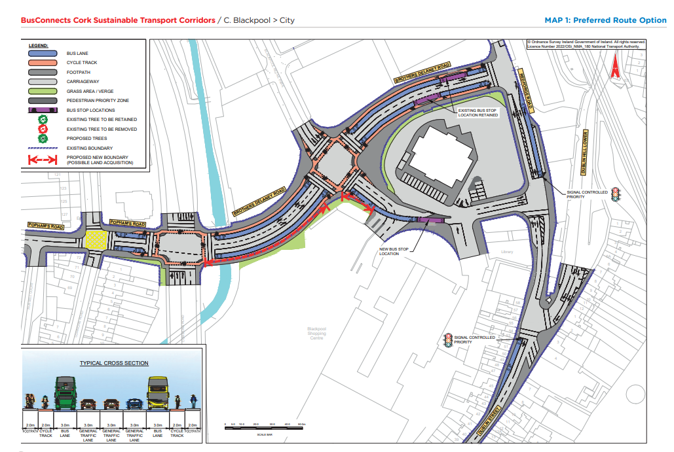
Preferred Route Option (PRO) Key Change

Slide 16
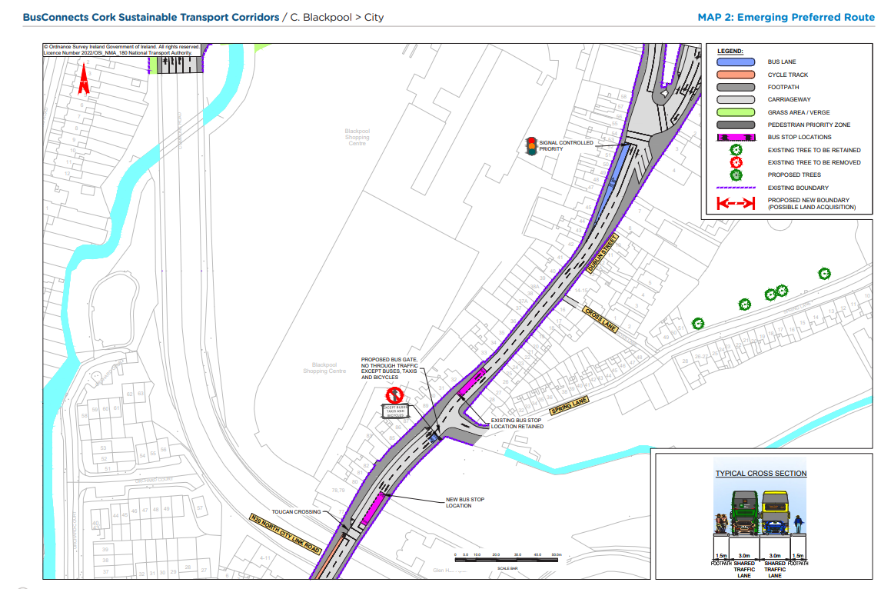
Emerging Preferred Route (EPR)

Slide 17
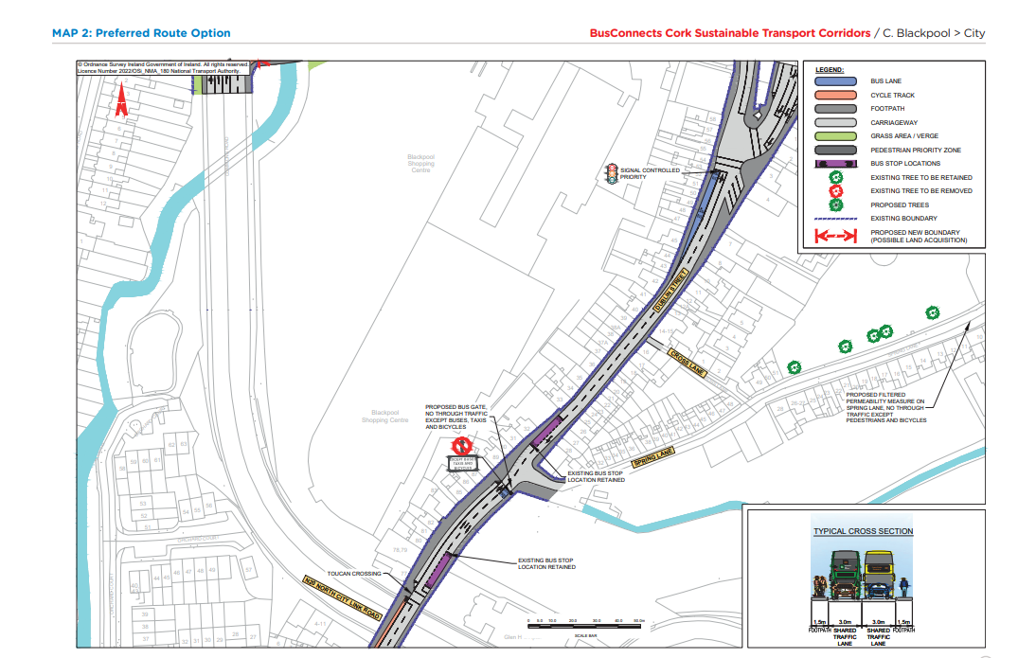
Preferred Route Option (PRO) Key Change

Slide 19
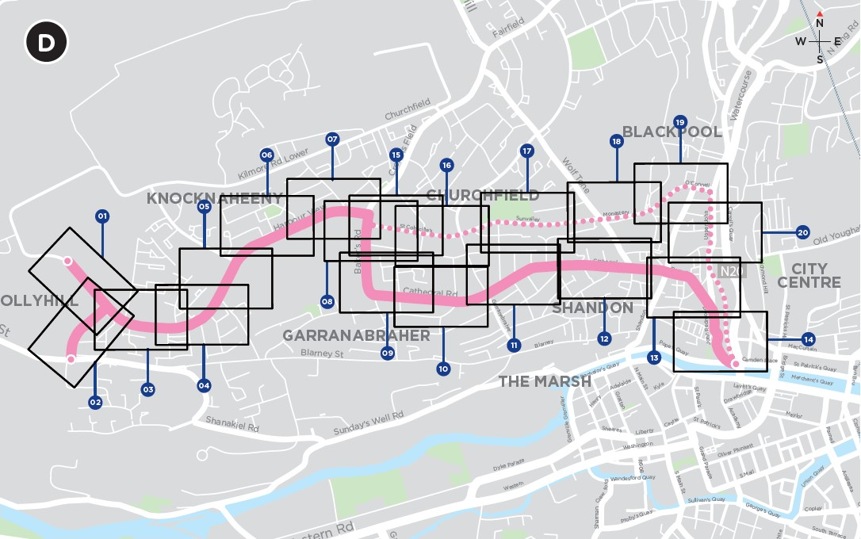
Sustainable Transport Corridor D - Hollyhill to City
The amount of segregated bus lanes along Harbour View Road has been reduced, significantly reducing impacts on properties.
The proposed bus gates at the junction of Gurranabraher Road and Cathedral Road have been removed, and existing road layout retained.
The proposed cycle tracks on both sides of the carriageway along Sunvalley Drive, North Monastery Road and O’Connell Street have been replaced with a two-way cycle track along the northern side of the carriageway.

Slide 20
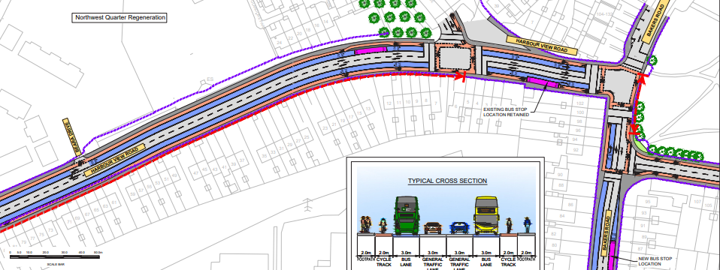
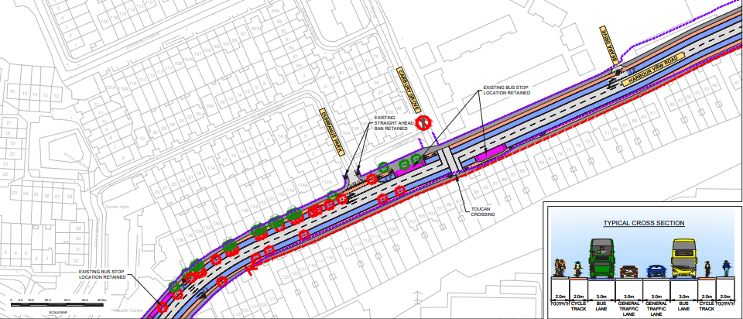
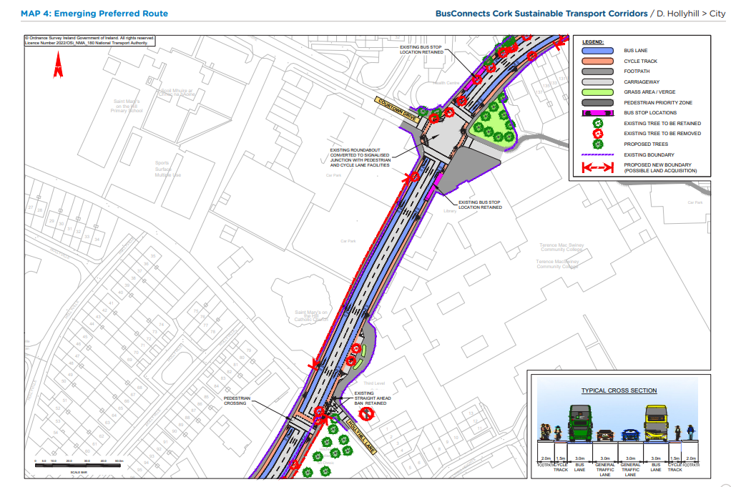
Emerging Preferred Route (EPR)

Slide 21
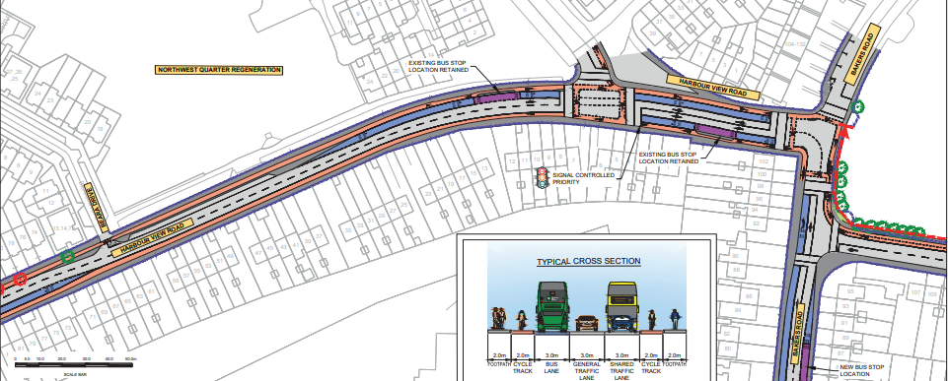
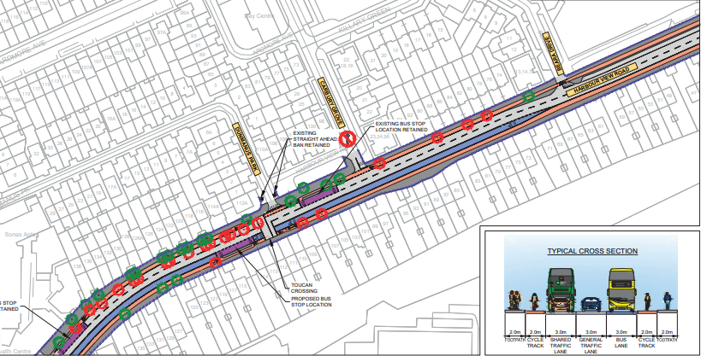
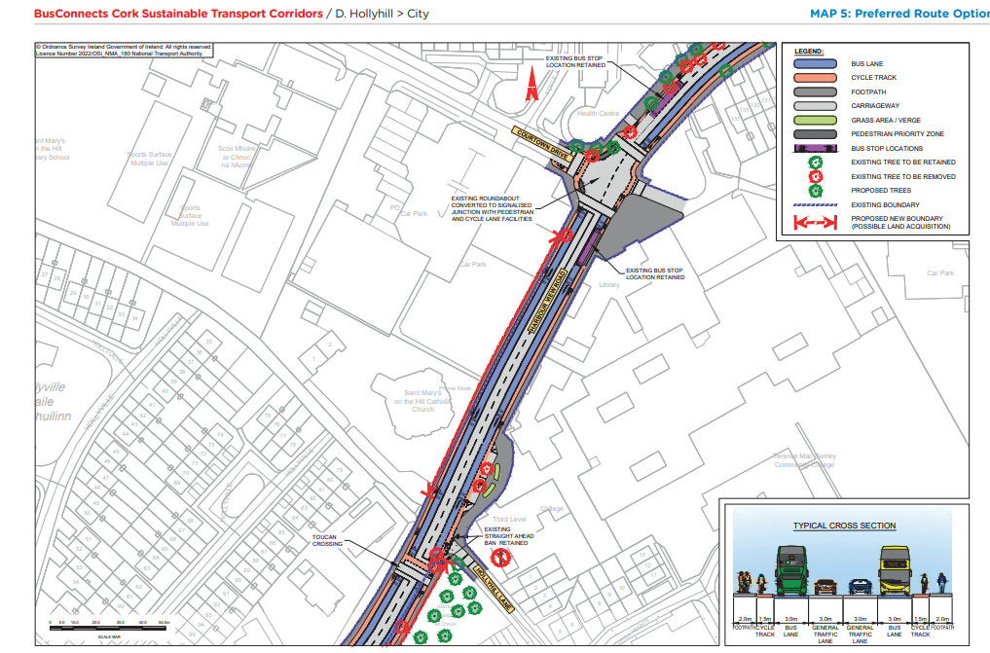
Preferred Route Option (PRO) Key Change

Slide 22
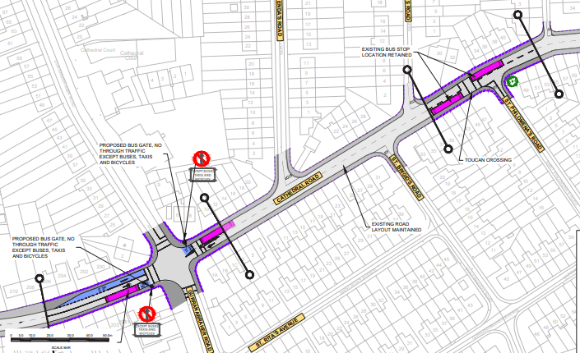
Emerging Preferred Route (EPR)

Slide 23
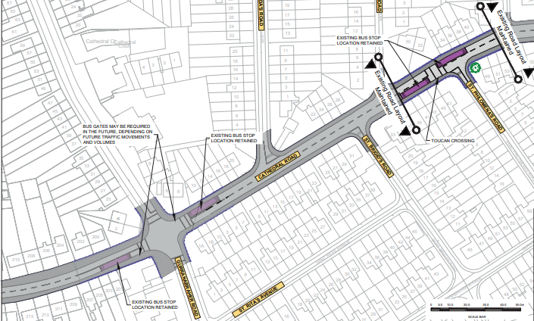
Preferred Route Option (PRO) Key Changes

Slide 24
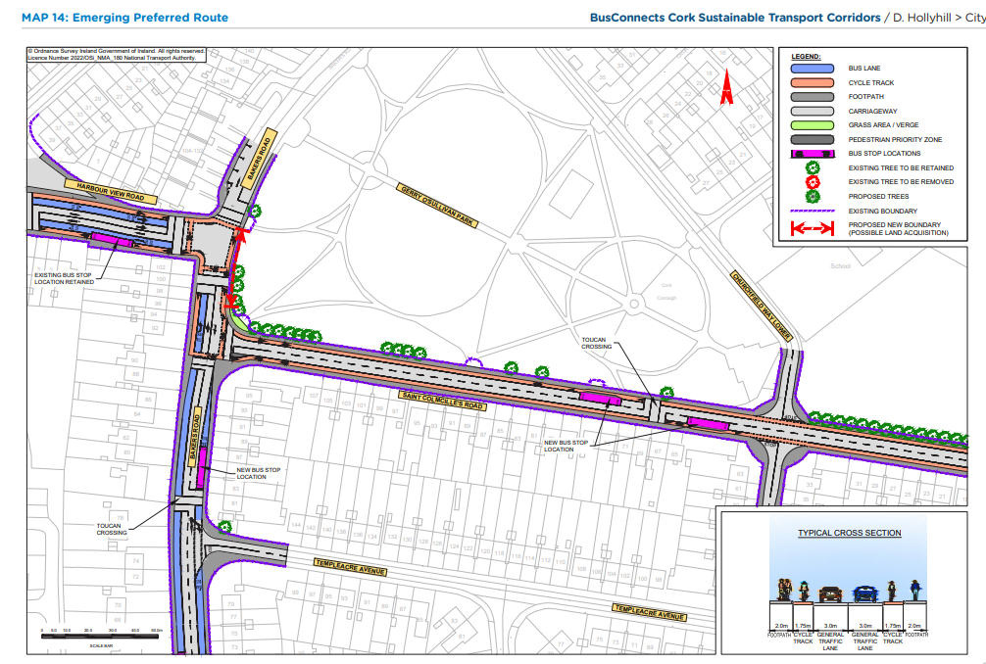
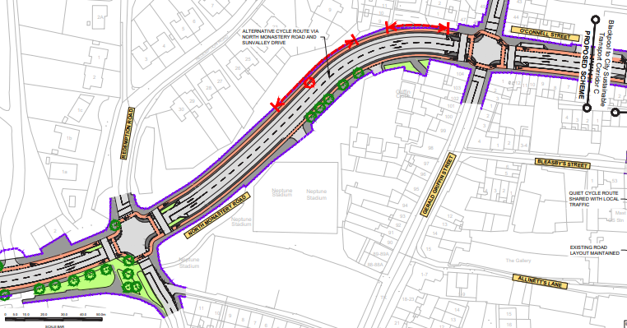
Emerging Preferred Route (EPR)

Slide 25
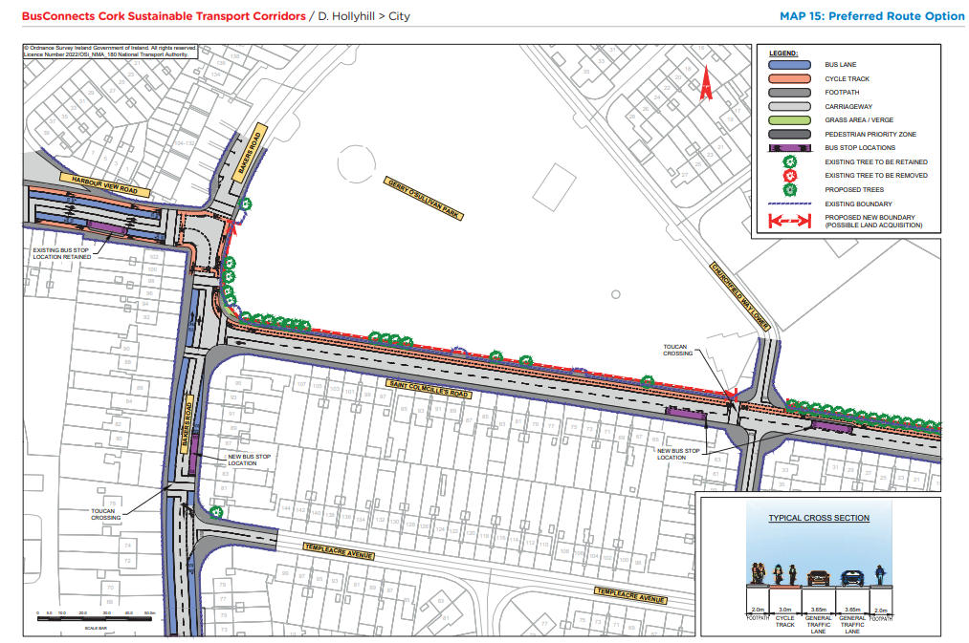
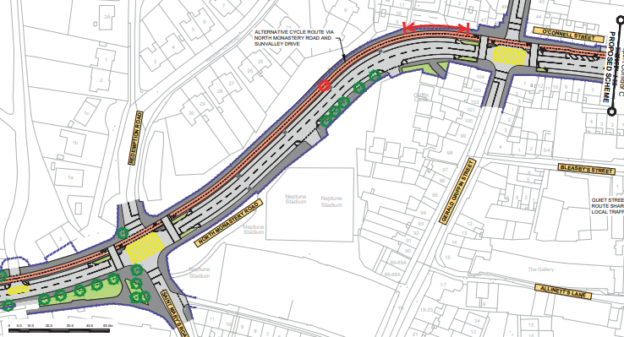
Preferred Route Option (PRO) Key Changes

Slide 27
Deadline for Submissions Thursday 25th May 2023

Slide 28
Questions – Comments - Discussion

