Slide 2
BusConnects Cork
Sustainable Transport Corridors
Second Public Consultation
Community Forum – Wednesday 26th April 2023
Sustainable Transport Corridor I – Maryborough Hill to City
Sustainable Transport Corridor J – Mahon to City

Slide 3
Introductions
Independent Chairperson Simon Nugent
NTA Hugh Creegan, Deputy CEO
Con Kehely, Head of BusConnects Regional Cities
Terry Brennan, Senior Communications Manager
Aecom Eoin O’Mahony, Regional Director

Slide 4
Agenda
Introductions (completed)
Running of meetings
Preferred Route Options for STC I & J
Questions – Comments - Discussion

Slide 5
Forum Objectives & Terms of Reference
Two-way communication –Serve as a two-way communication channel between the NTA and local communities
Information Flow – Allow provision of information and updates throughout the duration of the project
Answer questions - Provide answers to concerns and issues raised
Listen – Listen to suggestions on how to improve the proposals, hear constructive ideas and viable alternatives
Resolve – Enable and support the resolution of local issues in a timely manner

Slide 6
Running of Meeting
We will endeavor to finish the meeting on time
Please turn mobile phones to silent or off
Chairperson will call on contributors in turn
State your name and the name of the group you represent
To allow maximum participation, please keep contributions short

Slide 9
First Public Consultation
June 30th – Oct 3rd ‘22
6 x Public Info Events
5 x Community Forums
Approx. 3,000 submissions (2,284 online + 694 email/hardcopy)
35 x Local Groups
Approx. 130 Landowner mtgs

Slide 10
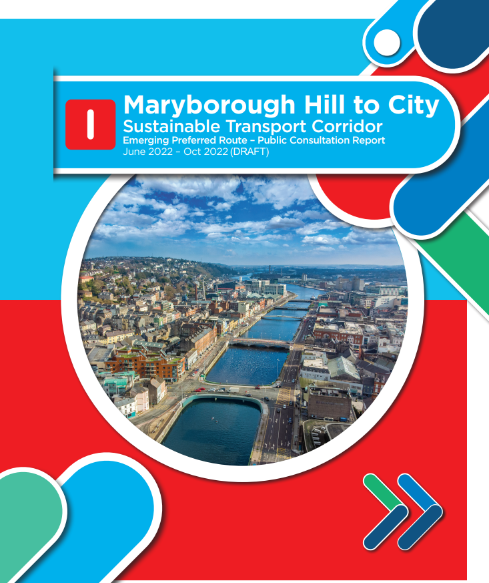
First Public Consultation
STC I - 692 Specific Submissions + General Submissions Surveys and Impact Assessments Traffic Disruption, Traffic Diversions and Access Issues Safety Concerns Impact on Trees, Greenspace and Heritage Parking Proposed Land Acquisition Devaluation of Property Impact During Construction Need for the Scheme and Alternatives to Infrastructure Improvements Bus Network and Bus Network Redesign Inadequate Consultation and Public Information Campaign Alternative Infrastructure Options Support for the scheme

Slide 11
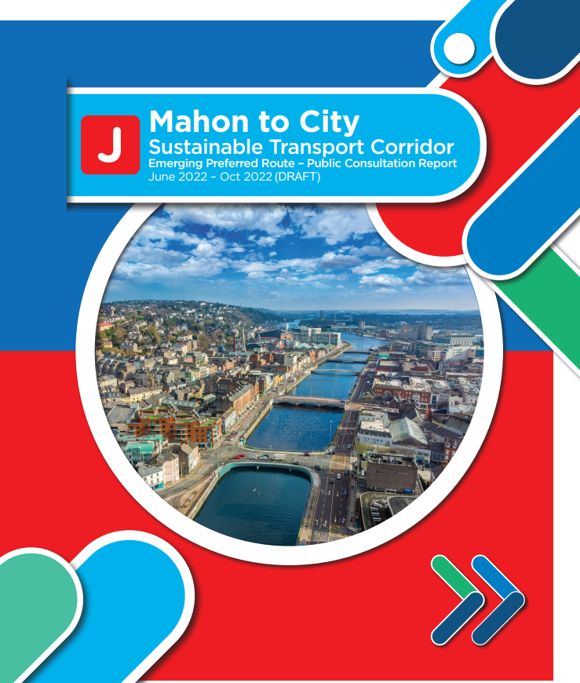
First Public Consultation
STC J – 457 Specific Submissions + General Submissions Surveys and Impact Assessments Traffic Disruption, Traffic Diversions and Access Issues Safety Concerns Impact on Trees, Greenspace and Heritage Parking Proposed Land Acquisition Devaluation of Property Impact During Construction Need for the Scheme and Alternatives to Infrastructure Improvements Bus Network and Bus Network Redesign Inadequate Consultation and Public Information Campaign Alternative Infrastructure Options Support for the scheme

Slide 12
Overview
of
Sustainable Transport Corridor I:
Maryborough Hill to City Preferred Route Option

Slide 13
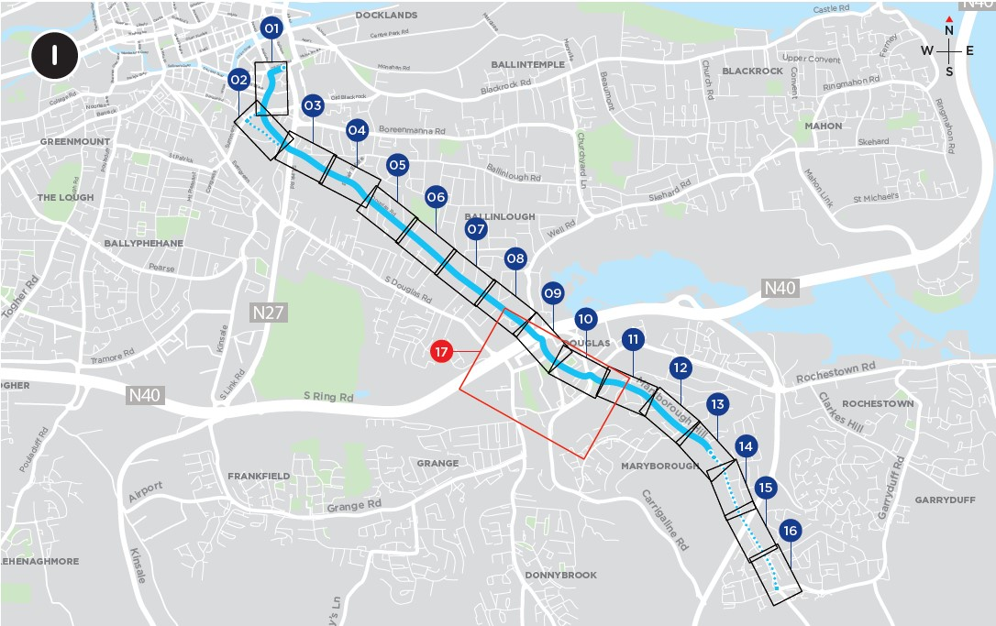
STCI – Maryborough Hill to City Key Changes
On Douglas Road:
The outbound bus lane is no longer proposed reducing the impact on properties. The bus gate at Belair Estate has been removed. To provide bus priority, a bus gate for outbound traffic is proposed just east of the entrance to St Finbarr’s Hospital.
Nine on-street parking spaces have been retained near the junction with Belair Estate.
Two-way traffic to be maintained between Belair Estate and the bridge over the N27 South Link Road.
The bus gates proposed on Douglas Road are to be operational during morning and evening peak hours only.

Slide 14
STCI – Maryborough Hill to City Key Changes
On Maryborough Hill an inbound bus lane is no longer proposed between Greendale Road and The Paddocks; bus priority would instead be provided using traffic signals.
Two-way traffic to be maintained on Southern Road, and a bus lane removed from this road.
The southbound cycle lane has been reintroduced on Southern Road.

Slide 15
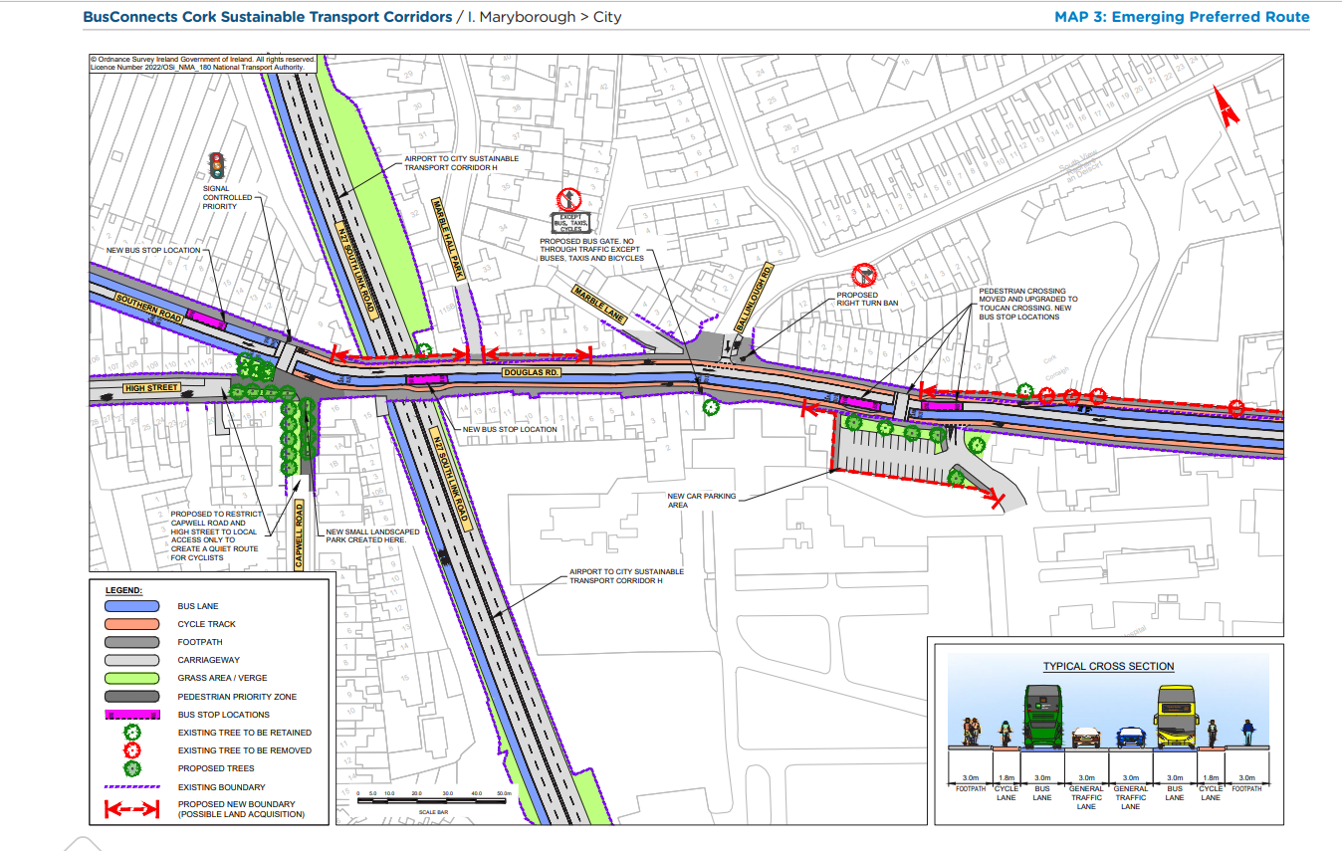
Emerging Preferred Route (EPR)

Slide 16
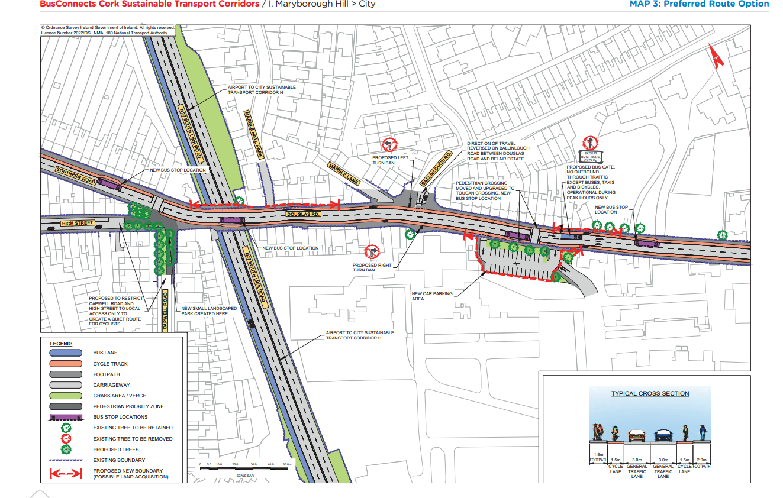
Preferred Route Option (PRO) Key Change

Slide 17
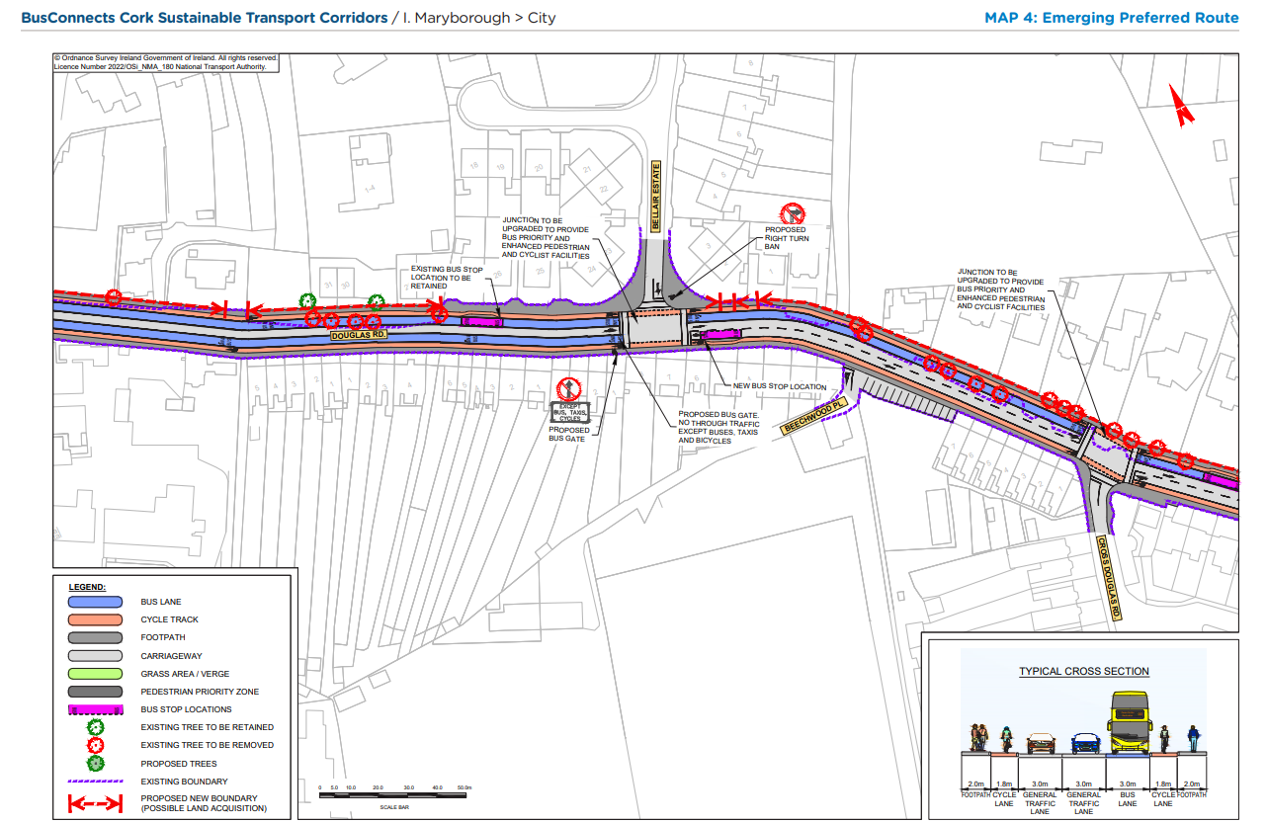
Emerging Preferred Route (EPR)

Slide 18
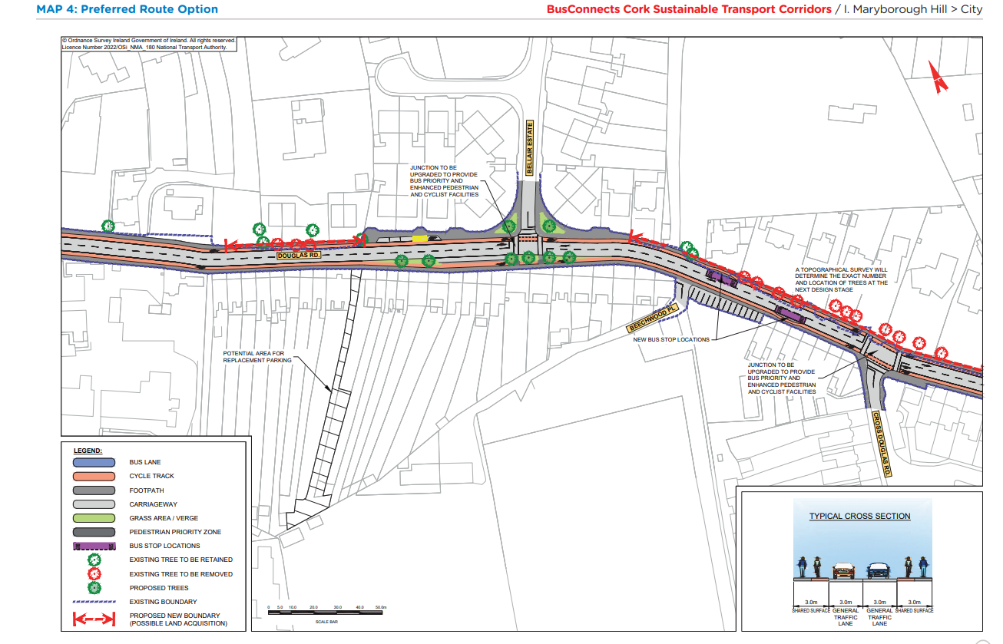
Preferred Route Option (PRO) Key Change

Slide 19
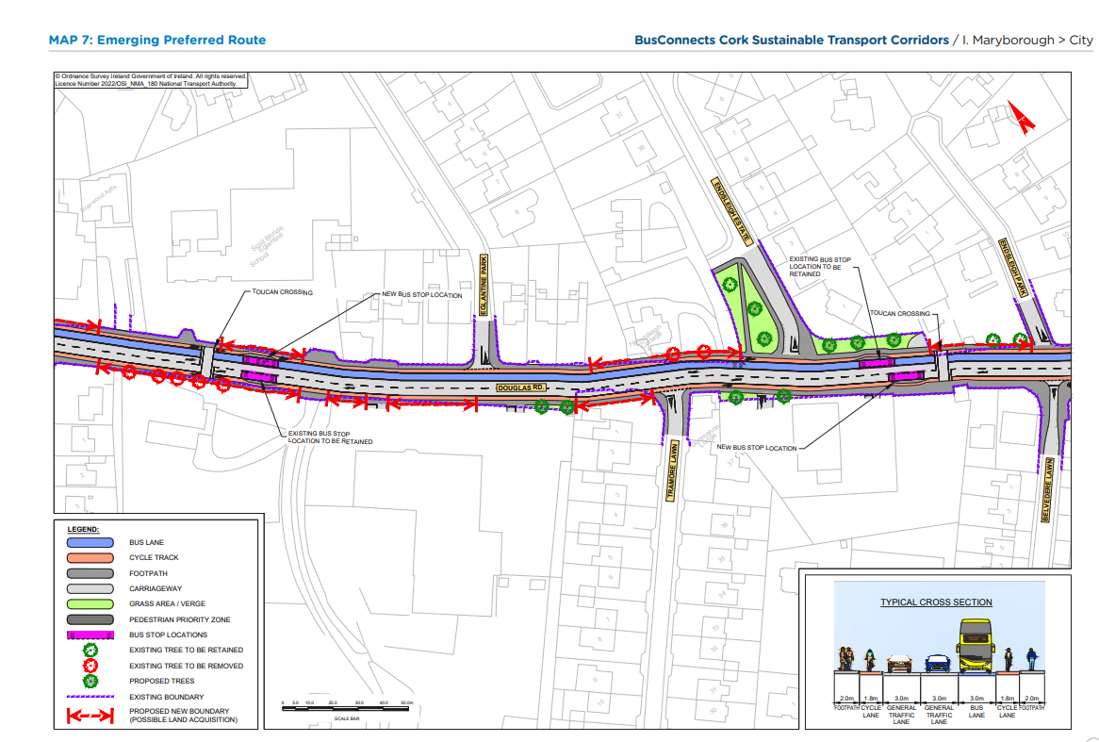
Emerging Preferred Route (EPR)

Slide 20
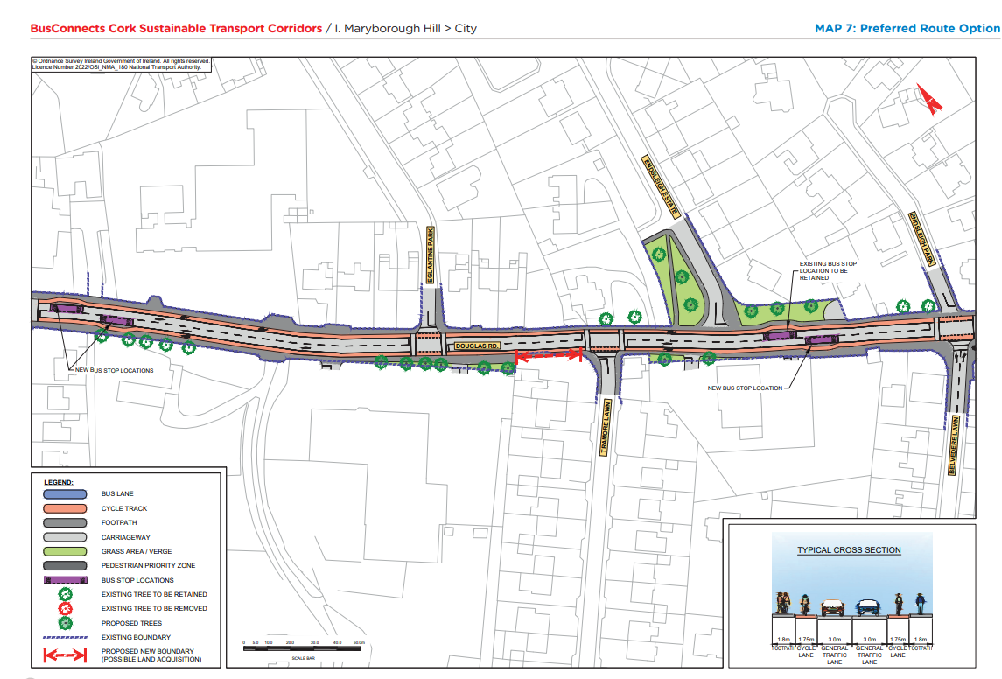
Preferred Route Option (PRO) Key Change

Slide 21
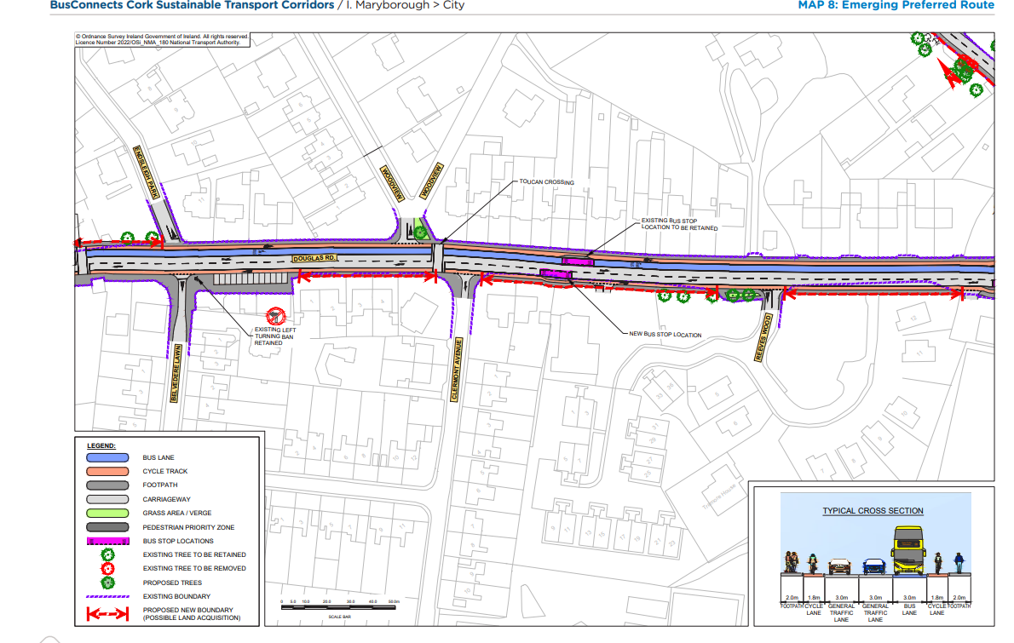
Emerging Preferred Route (EPR)

Slide 22
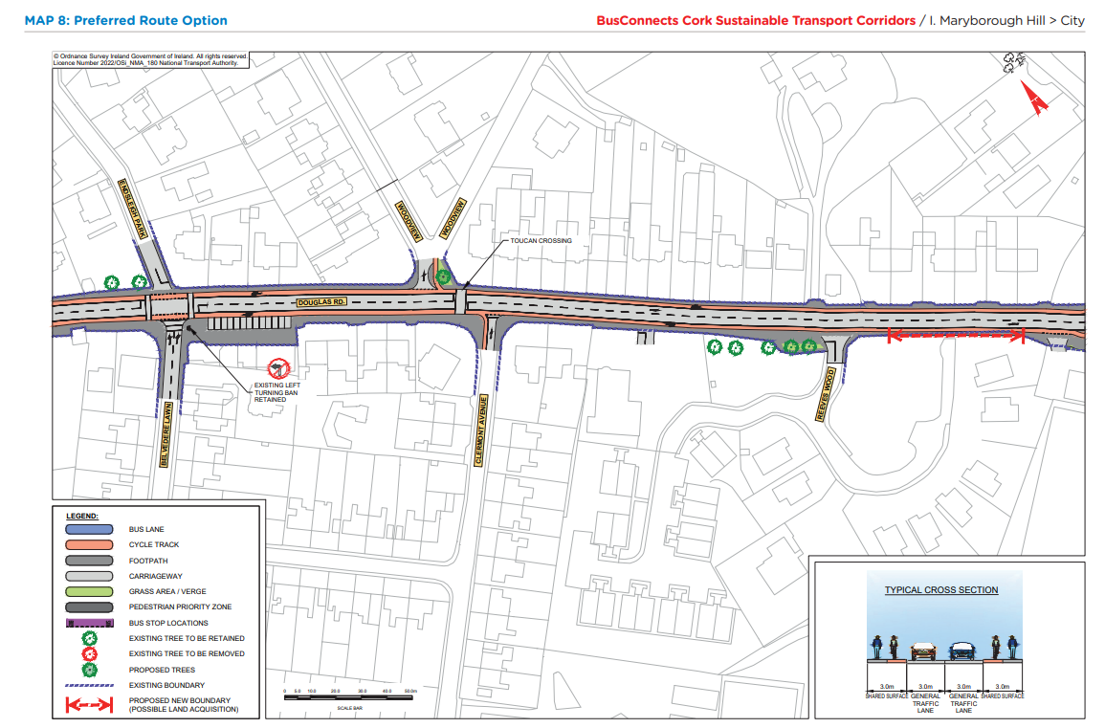
Preferred Route Option (PRO) Key Change

Slide 23
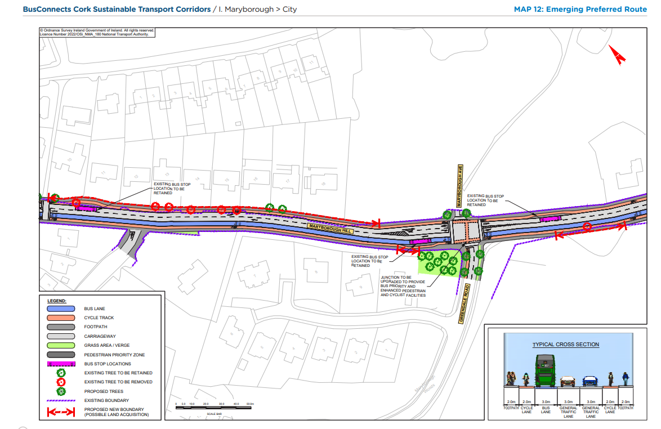
Emerging Preferred Route (EPR)

Slide 24
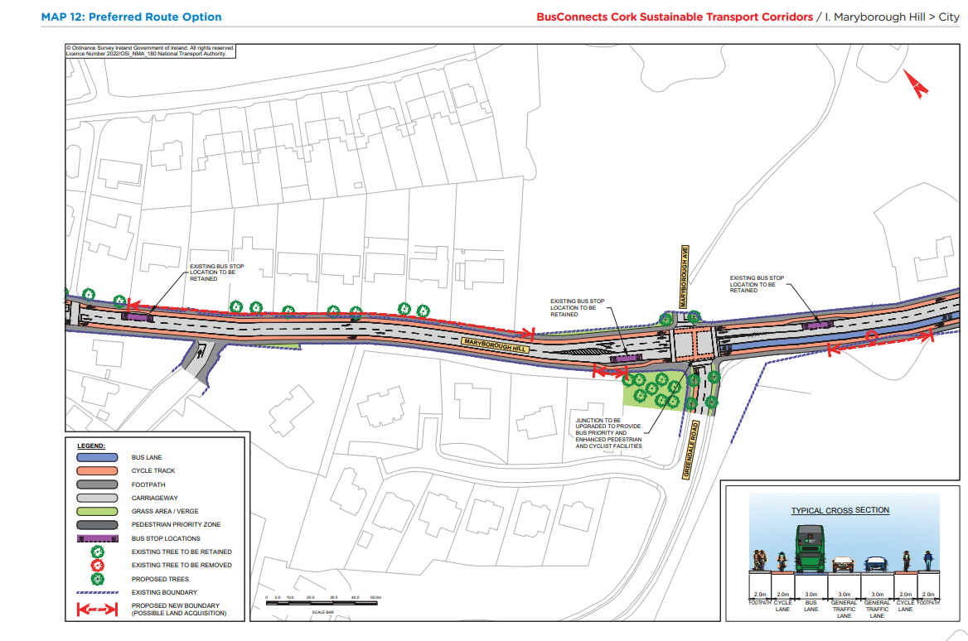
Preferred Route Option (PRO) Key Change

Slide 25
Overview
of
Sustainable Transport Corridor J:
Mahon to City Preferred Route Option

Slide 26
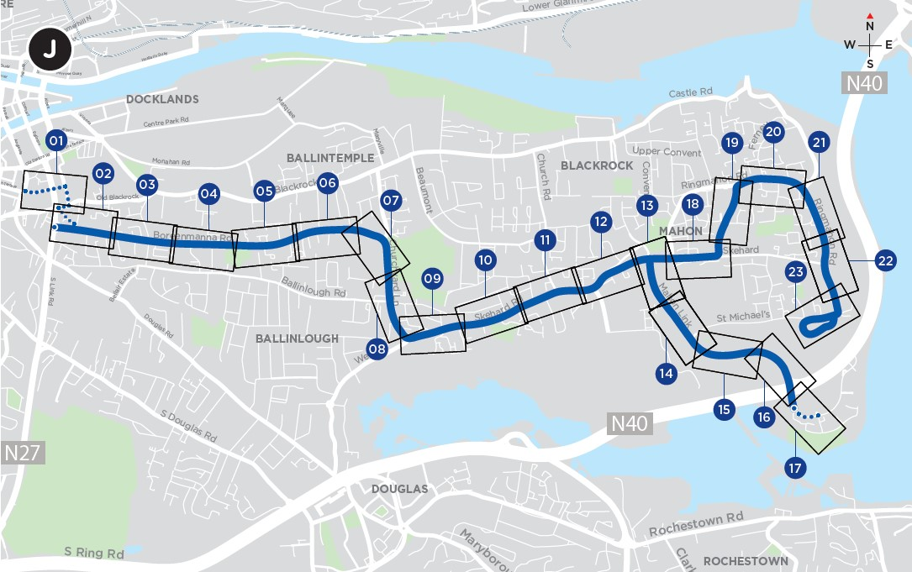
STC J - Mahon to City Key Changes
On Churchyard Lane and Boreenmanna Road the amount of bus lanes proposed have been reduced, retaining the majority of trees and reducing property impacts.
Additional on-street parking spaces has been provided. New off-street parking spaces are proposed close to Ballinlough Pitch and Putt and also near the entrance to Rockboro Primary School.
The bus gate on Ave de Rennes will only be active during peak hours.

Slide 27
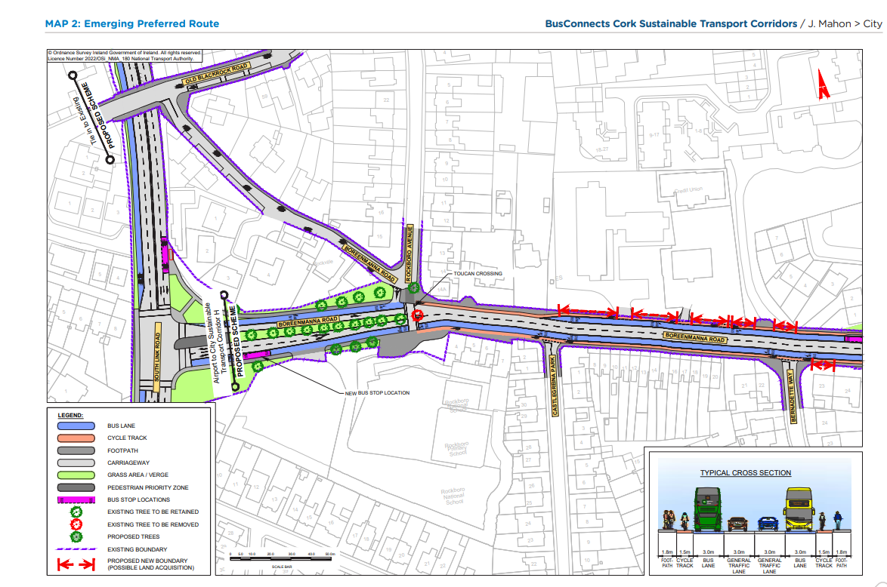
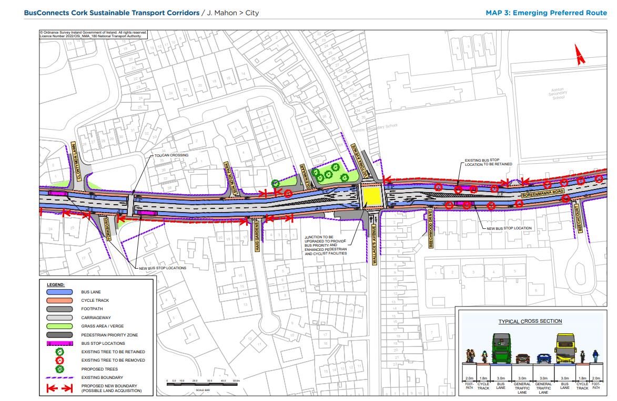
Emerging Preferred Route (EPR)

Slide 28
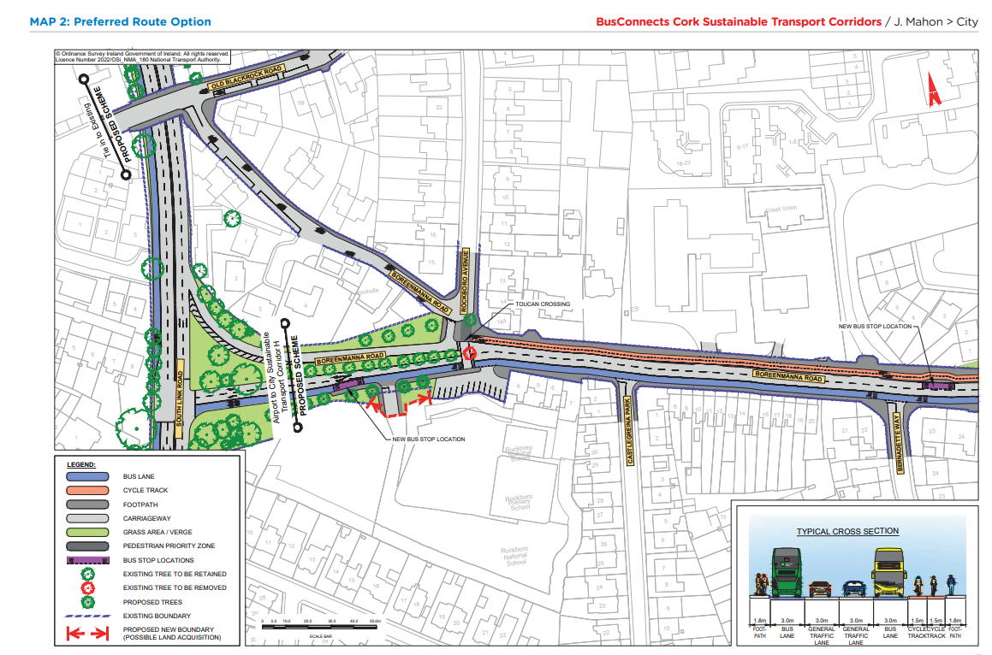
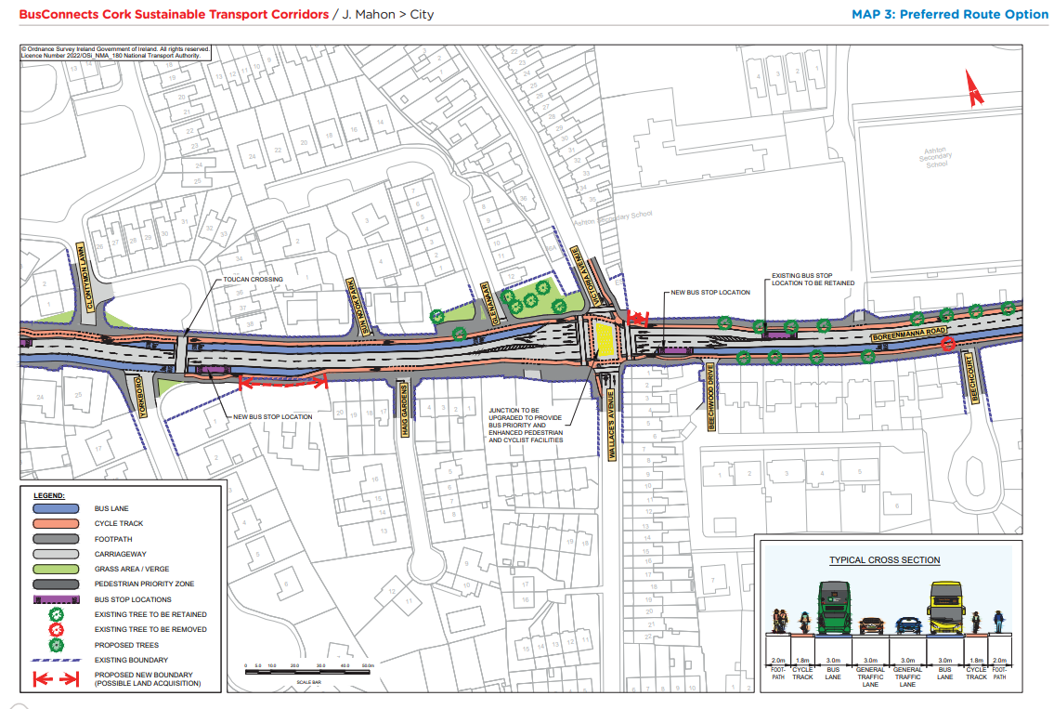
Preferred Route Option (PRO) Key Change

Slide 29
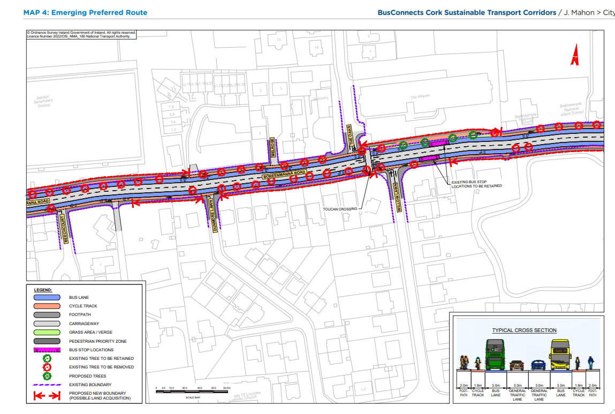
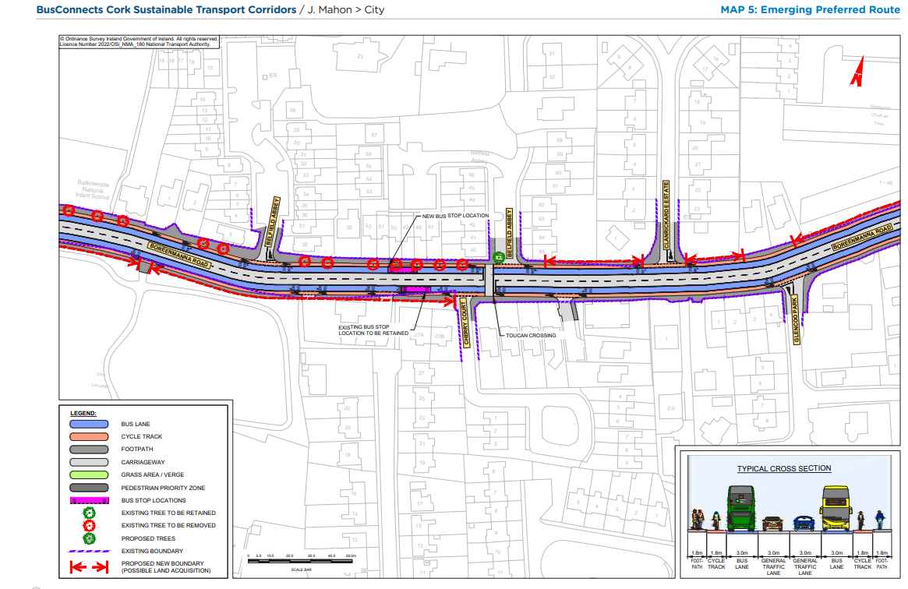
Emerging Preferred Route (EPR)

Slide 30
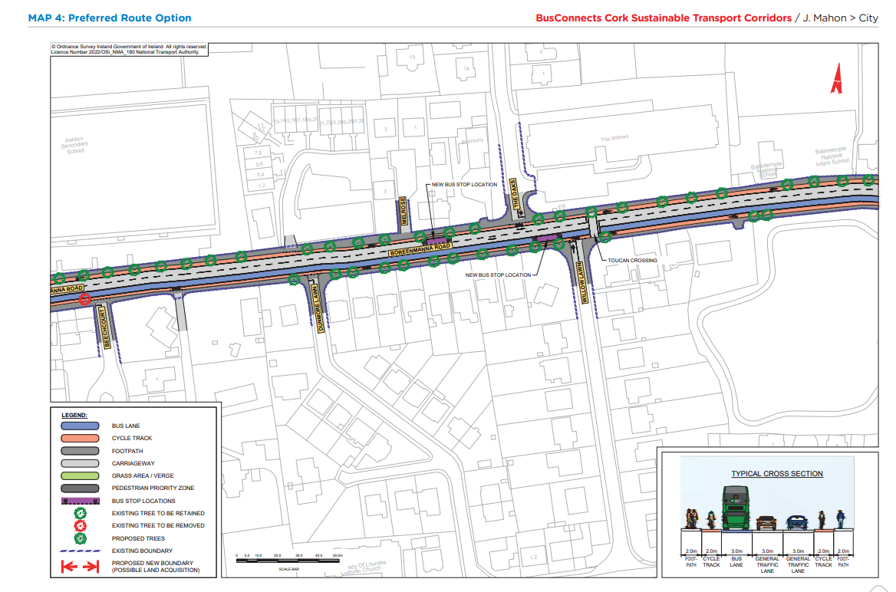
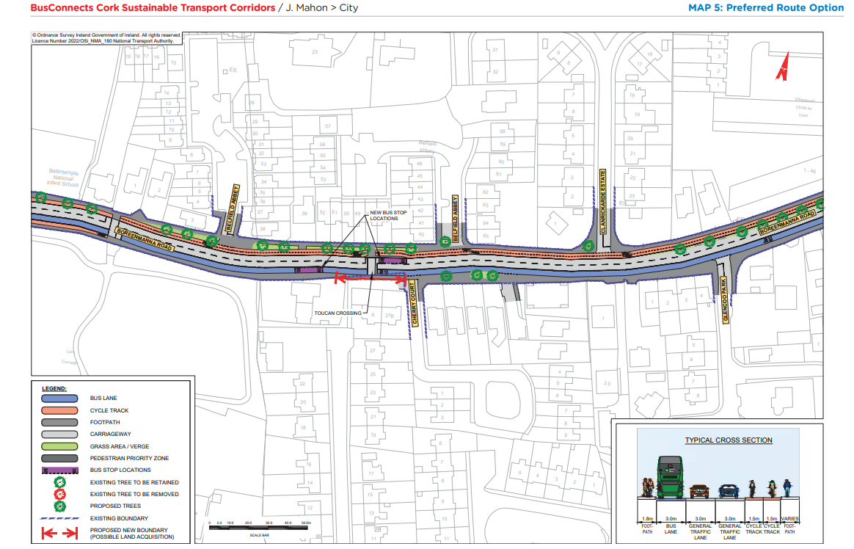
Preferred Route Option (PRO) Key Changes

Slide 31
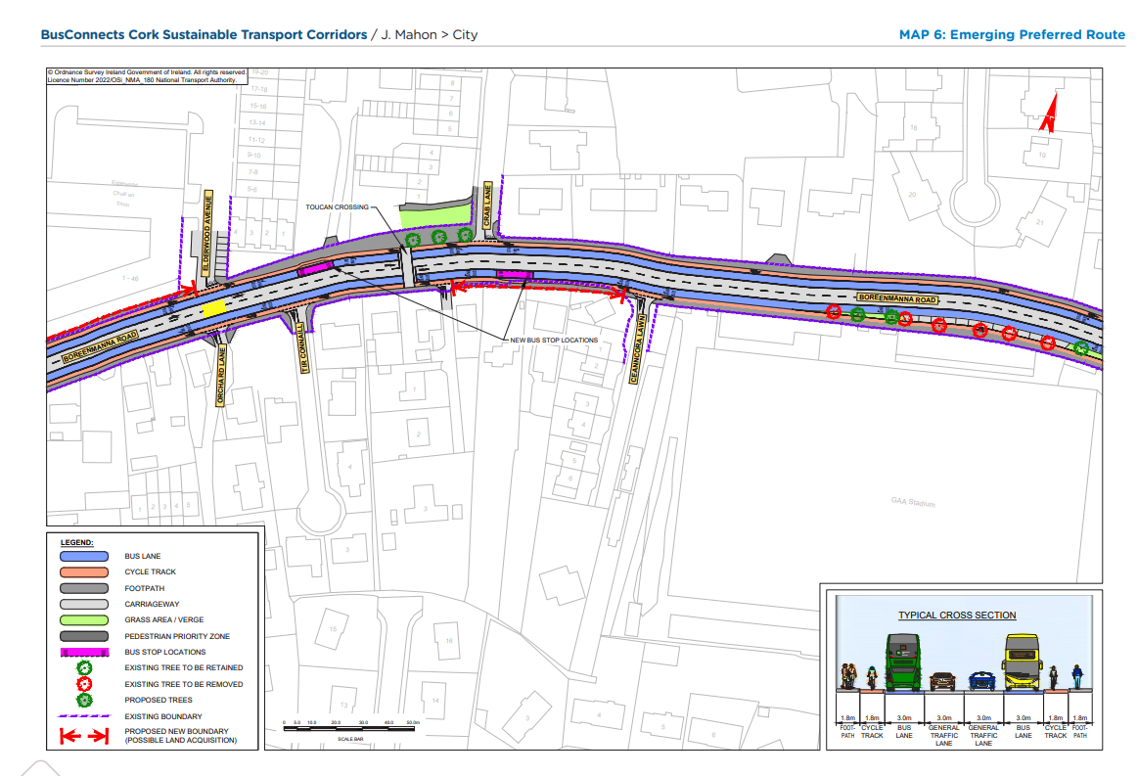
Emerging Preferred Route (EPR)

Slide 32
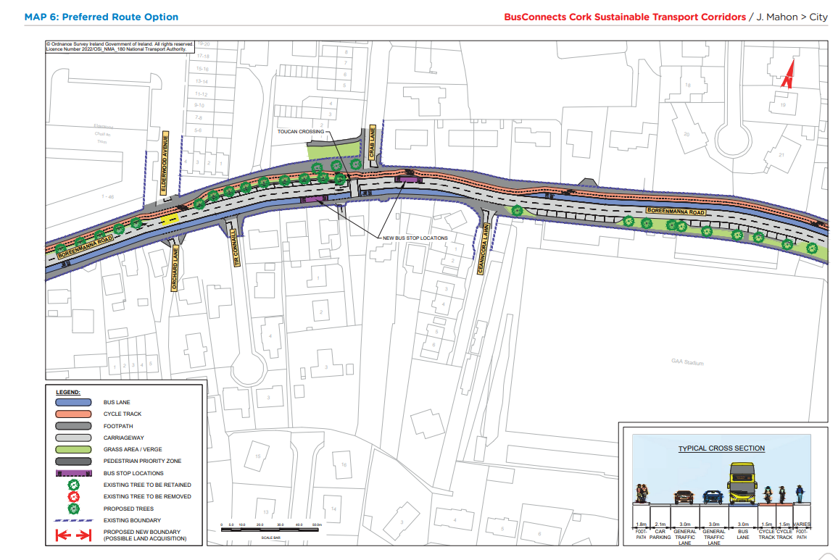
Preferred Route Option (PRO) Key Changes

Slide 33
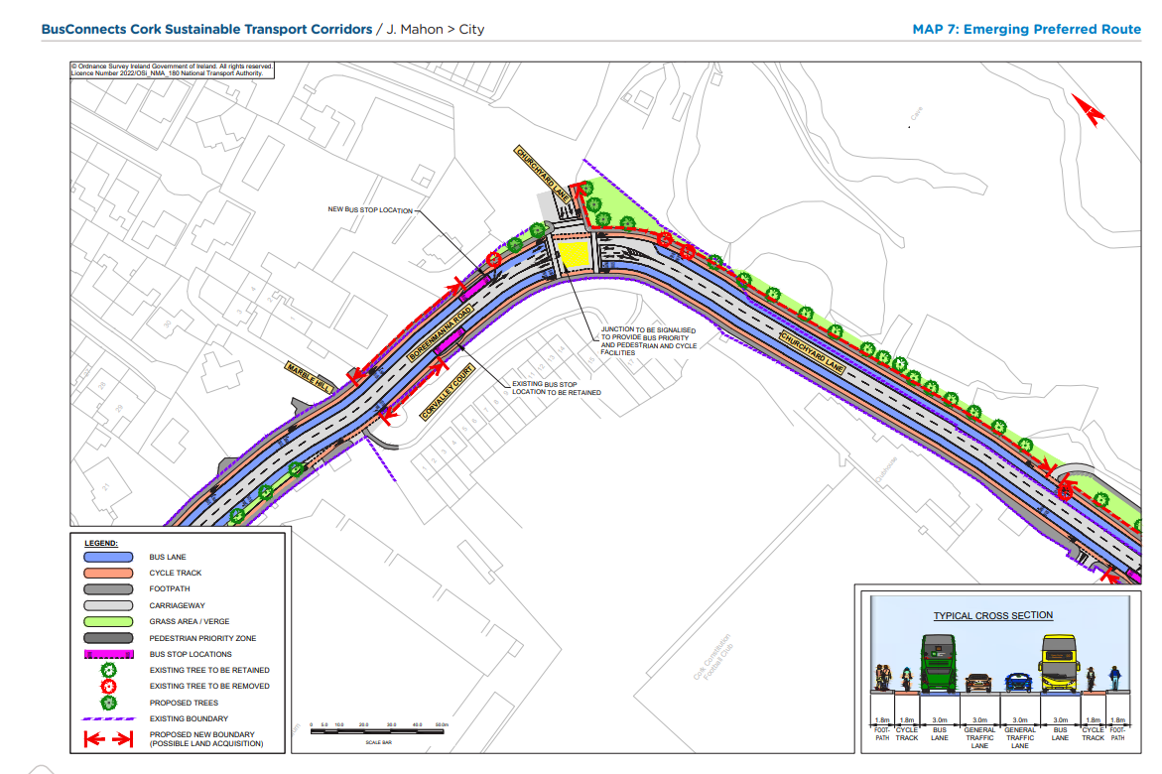
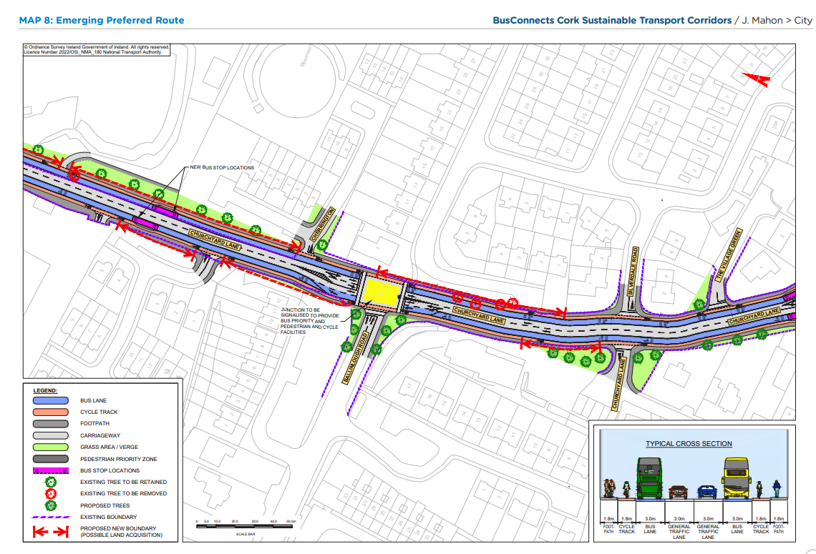
Emerging Preferred Route (EPR)

Slide 34
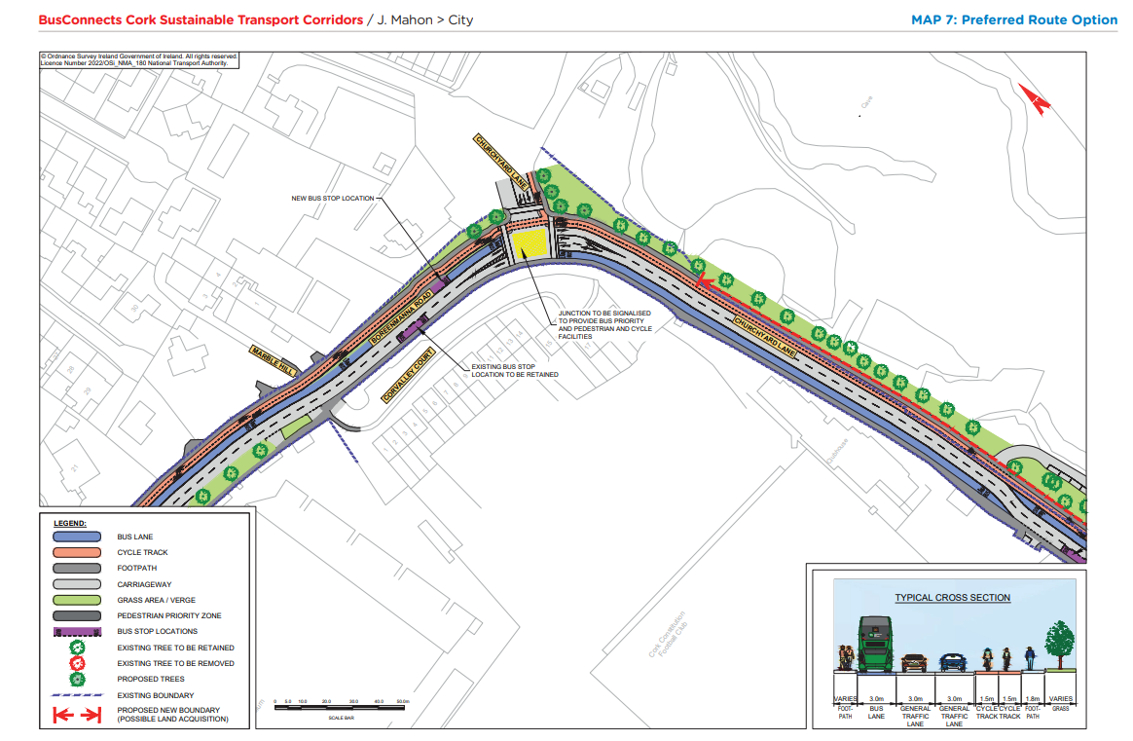
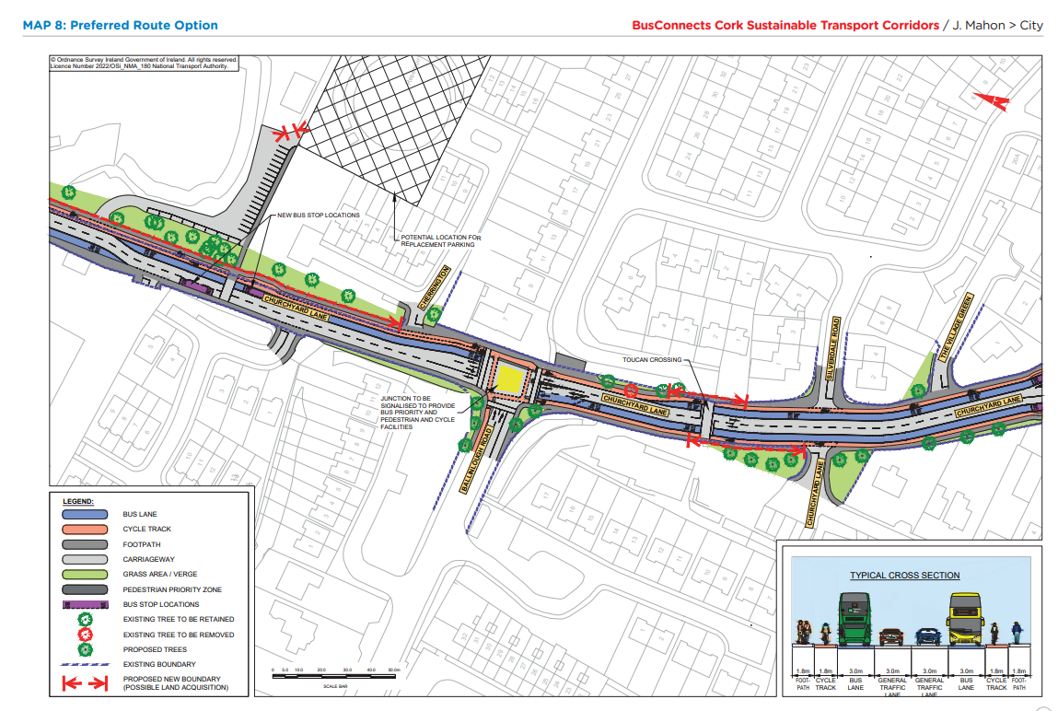
Preferred Route Option (PRO) Key Changes

Slide 36
Deadline for Submissions Thursday 25th May 2023

Slide 37
Questions – Comments - Discussion

