Slide 2
BusConnects Cork
Sustainable Transport Corridors
Second Public Consultation
Community Forum – Thursday 27th April 2023
Sustainable Transport Corridor E – Ballincollig to City
Sustainable Transport Corridor F – Bishopstown to City

Slide 3
Introductions
Independent Chairperson Simon Nugent
NTA Hugh Creegan, Deputy CEO
Robert Curley, Senior Project Manager
Terry Brennan, Senior Communications Manager
ROD/Typsa Elio Rapa, Scheme Project Manager

Slide 4
Agenda
Introductions (completed)
Running of meetings
Preferred Route Options for STC E & F
Questions – Comments - Discussion

Slide 5
Forum Objectives & Terms of Reference
Two-way communication –Serve as a two-way communication channel between the NTA and local communities
Information Flow – Allow provision of information and updates throughout the duration of the project
Answer questions - Provide answers to concerns and issues raised
Listen – Listen to suggestions on how to improve the proposals, hear constructive ideas and viable alternatives
Resolve – Enable and support the resolution of local issues in a timely manner

Slide 6
Running of Meeting
We will endeavor to finish the meeting on time
Please turn mobile phones to silent or off
Chairperson will call on contributors in turn
State your name and the name of the group you represent
To allow maximum participation, please keep contributions short

Slide 9
First Public Consultation
June 30th – Oct 3rd ‘22
6 x Public Info Events
5 x Community Forums
Approx. 3,000 submissions (2,284 online + 694 email/hardcopy)
35 x Local Groups
Approx. 130 Landowner mtgs

Slide 10
First Public Consultation
STC E - 437 Specific Submissions + General Submissions Vulnerable Road User Safety Traffic Disruption due to Traffic Diversions / Increased Traffic Proposed Land Acquisition Removal of Trees Access to Property Supportive of Scheme Loss of Parking Devaluation of Property Inadequacies in Consultation Process Alternative Solutions Increased Air and Noise Pollution Bus Network / Infrastructure Business and Retail Impact

Slide 11
First Public Consultation
STC F – 169 Specific Submissions + General Submissions Vulnerable Road User Safety Traffic Disruption due to Traffic Diversions / Increased Traffic Proposed Land Acquisition Removal of Trees Access to Property Supportive of Scheme Loss of Parking Devaluation of Property Inadequacies in Consultation Process Alternative Solutions Increased Air and Noise Pollution Bus Network / Infrastructure Presentation Brothers Pedestrian and Cycle Facility

Slide 12
Overview
of
Sustainable Transport Corridor E:
Ballincolling to City Preferred Route Option

Slide 13
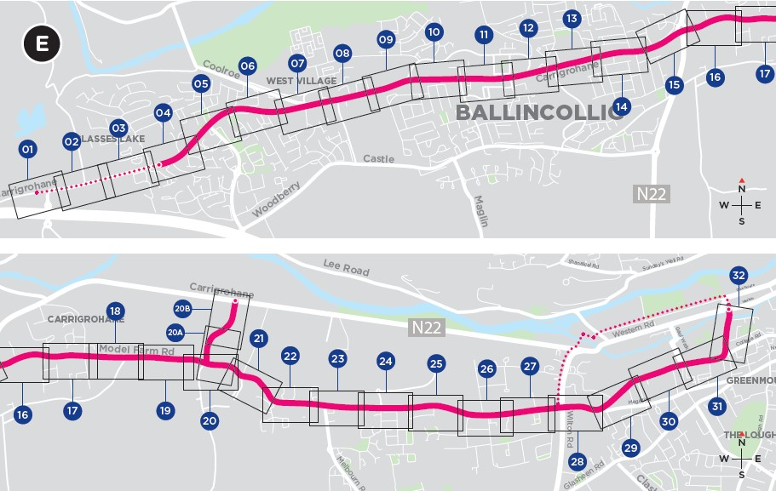
Sustainable Transport Corridor E - Ballincollig to City
Between Old Macroom Road to Old Fort Road – various changes have been made along this section, using signal controlled priority, to reduce road widening and property impacts
Ballincollig Town Centre: The bus gate previously proposed is no longer part of the scheme and more on-street car parking spaces have been retained.
Between Town Centre and Poulavone R/B – various changes have been made along this section, using signal controlled priority, to reduce road widening and property impacts

Slide 14
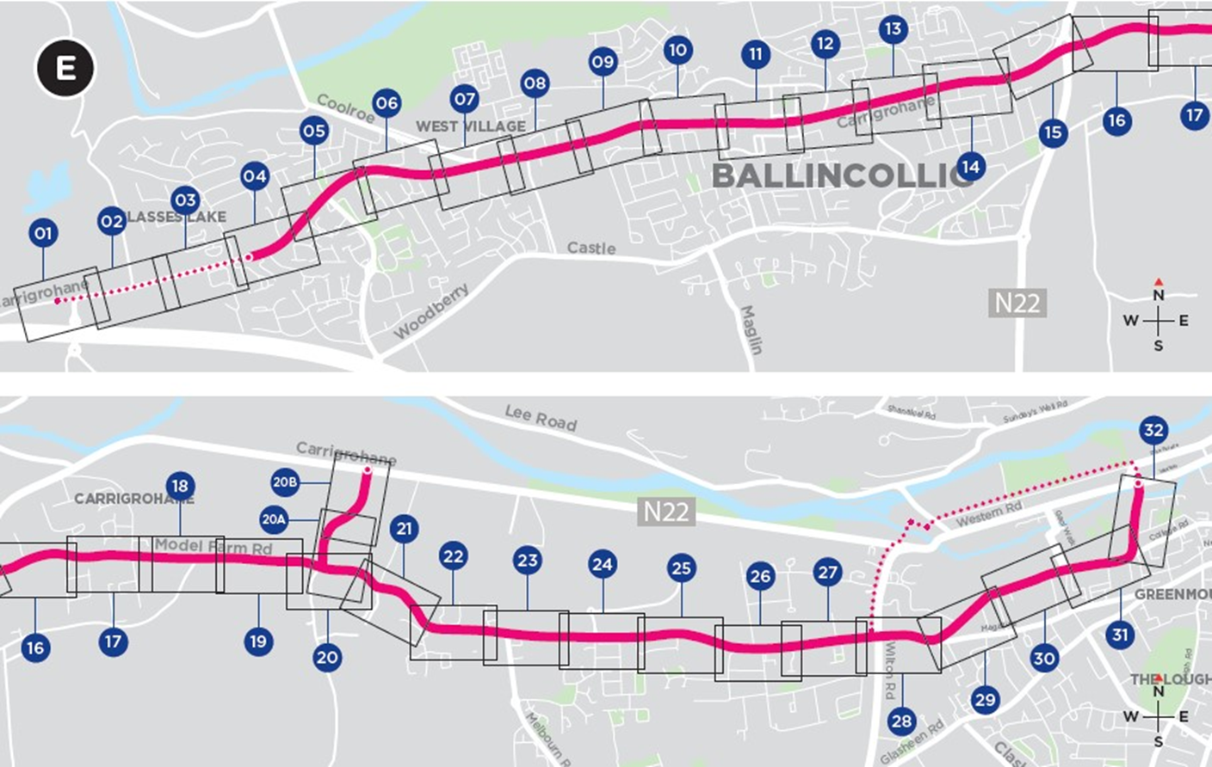
Sustainable Transport Corridor E - Ballincollig to City
Dedicated bus lanes are no longer proposed along Model Farm Road between Carrigrohane Road and Inchigaggin Lane. Instead, inbound and outbound bus gates are proposed to operate during peak hours, significantly reducing property impacts.
A new link road connecting Model Farm Road and the N22 Carrigrohane Road is proposed to facilitate traffic diverting from the bus gate on Model Farm Road.

Slide 15
Sustainable Transport Corridor E - Ballincollig to City
Along Model Farm Road, between Rossa Avenue and Dennehy’s Cross: Proposals for this section have been revised to reduce the length of bus lanes and extent of road widening required.
The location of the bus gate on College Road has been moved slightly and it is now located to the east of College View.
On Donovan’s Road it is no longer proposed to construct a new pedestrian bridge adjacent to Donovan’s Bridge within the grounds of University College Cork. In lieu of this it is proposed to restrict vehicular movement across the bridge to one-way at a time.

Slide 16
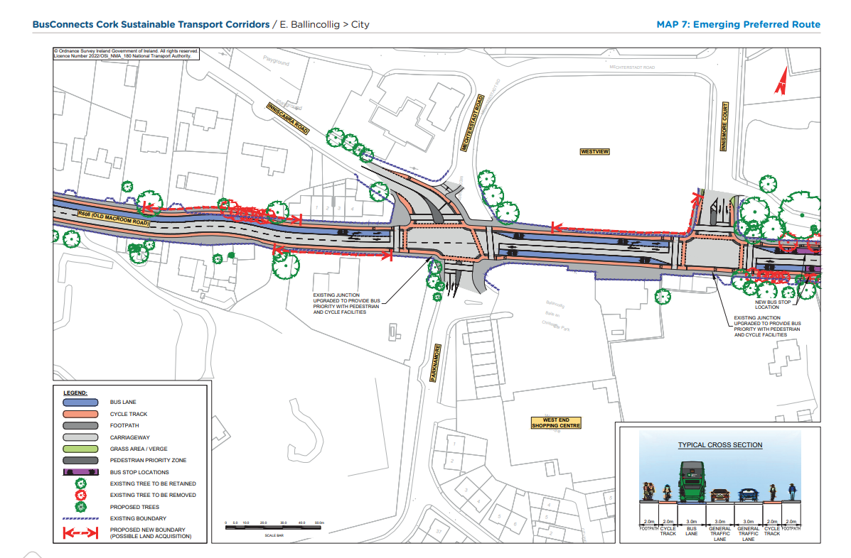
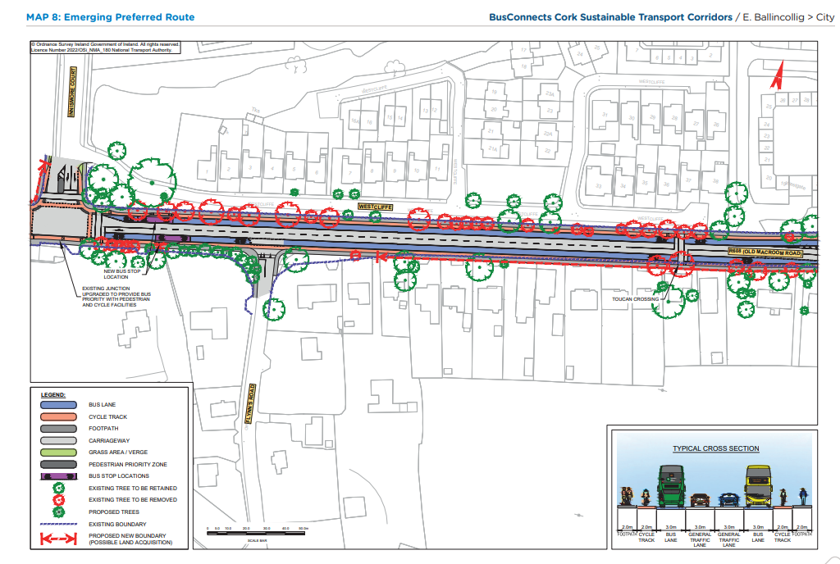
Emerging Preferred Route (EPR)

Slide 17
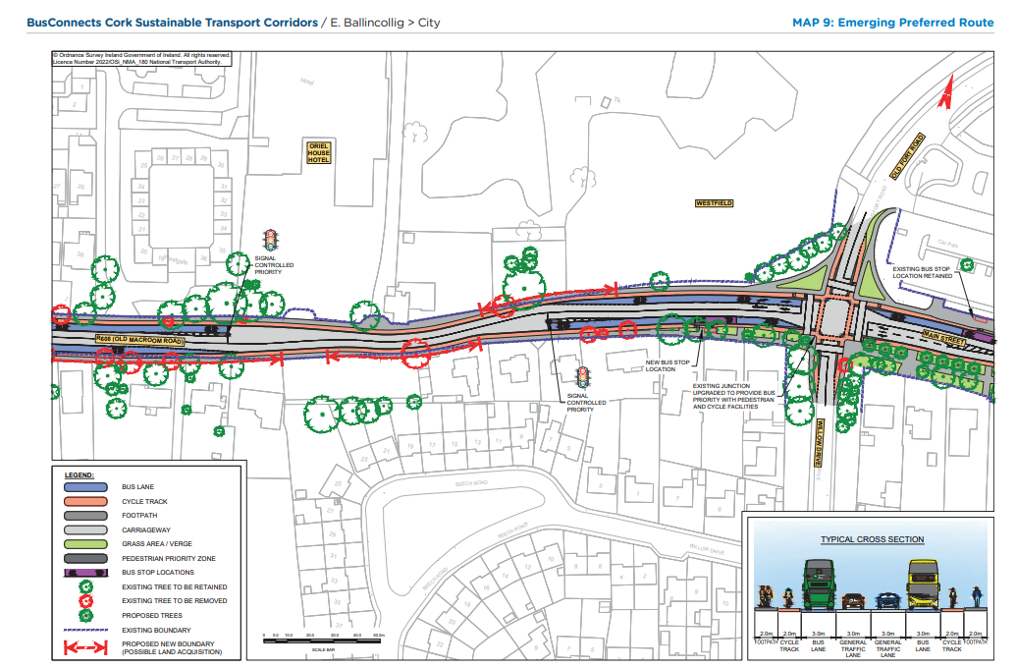
Emerging Preferred Route (EPR)

Slide 18
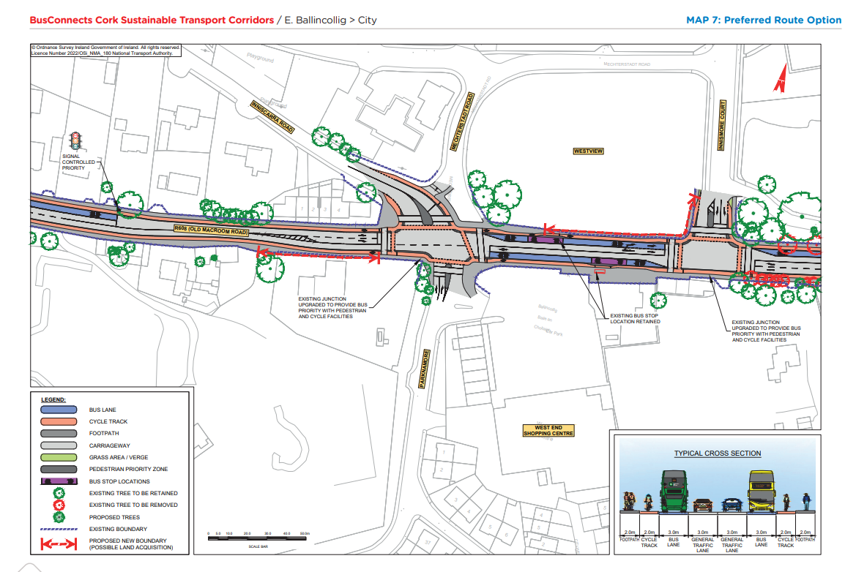
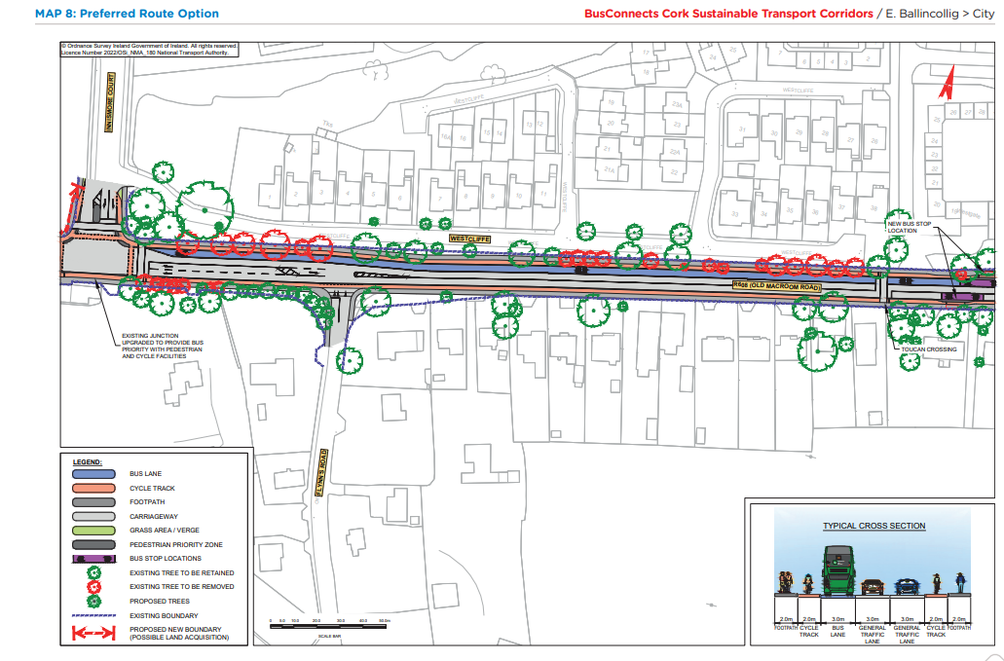
Preferred Route Option (PRO) Key Change

Slide 19
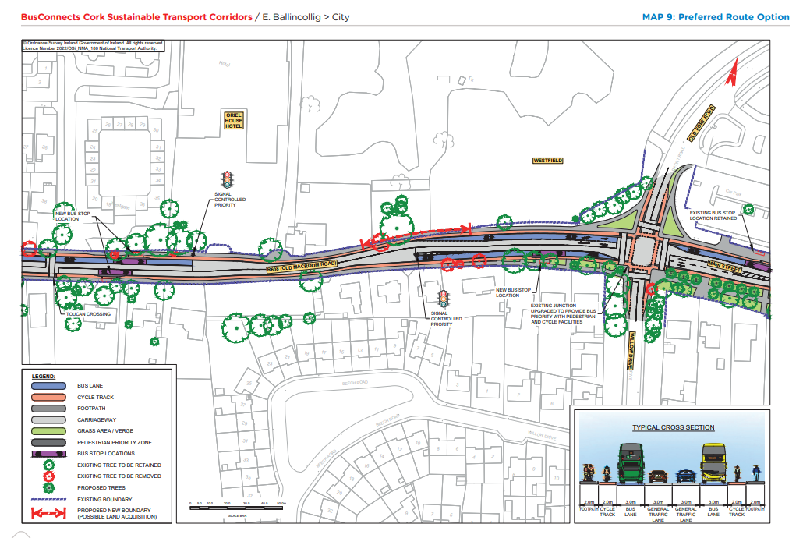
Preferred Route Option (PRO) Key Change

Slide 20
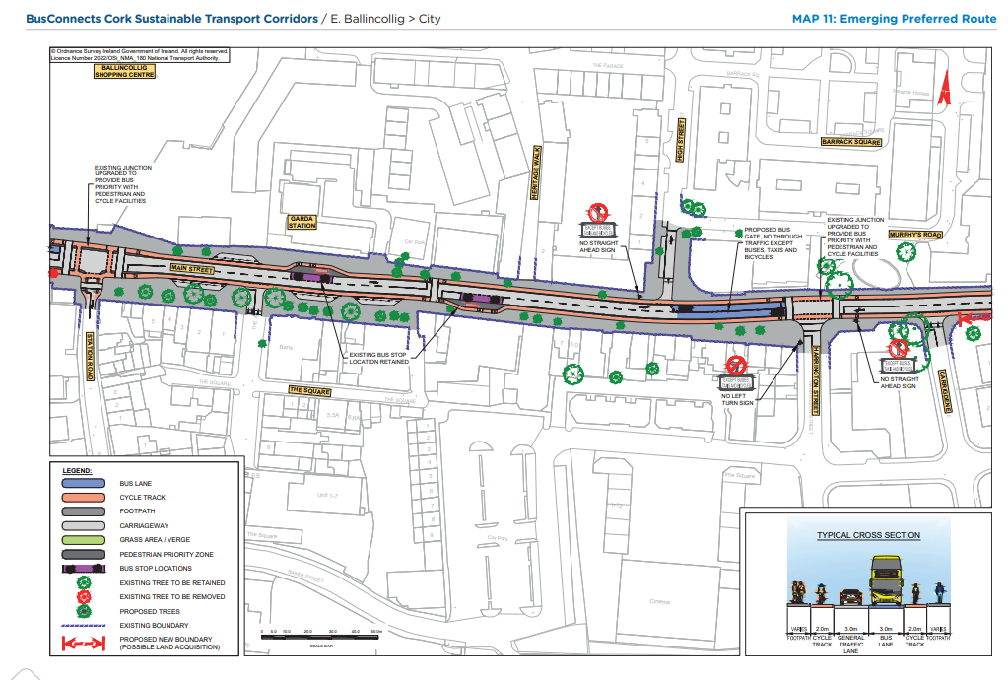
Emerging Preferred Route (EPR)

Slide 21
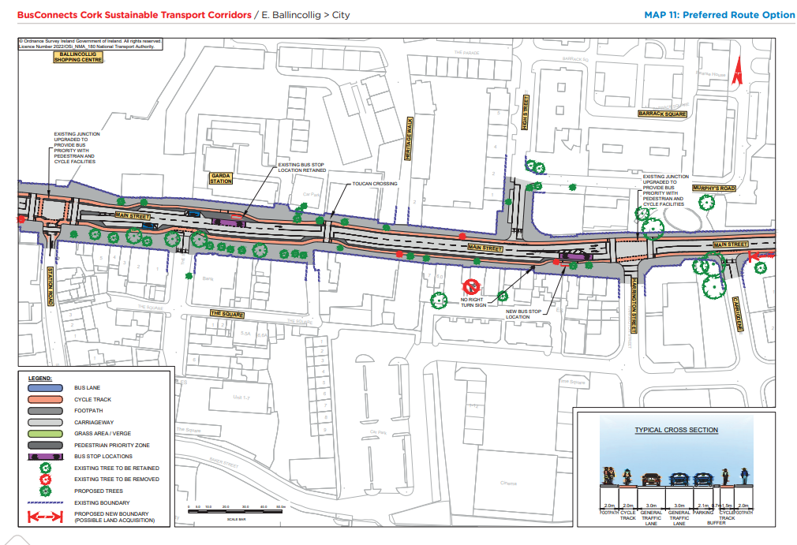
Preferred Route Option (PRO) Key Change

Slide 22
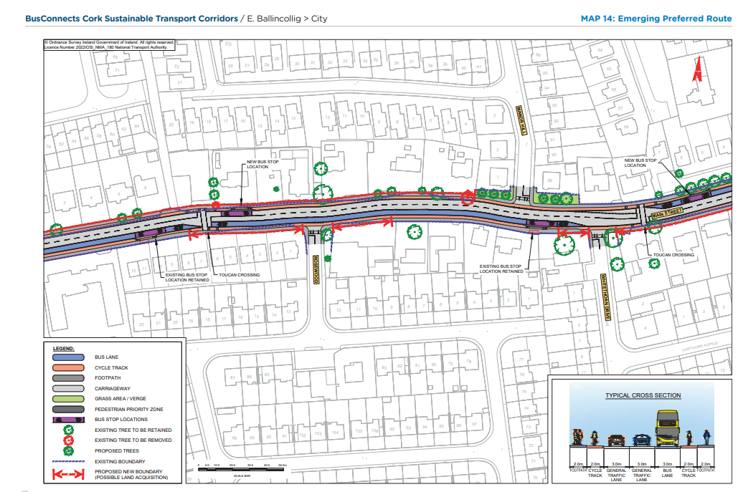
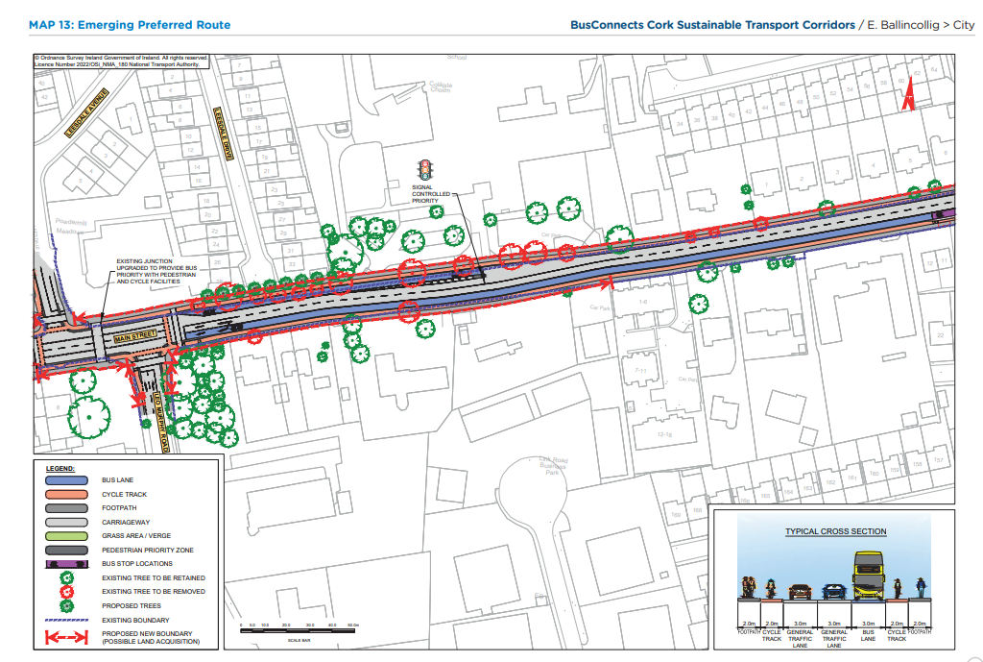
Emerging Preferred Route (EPR)

Slide 23
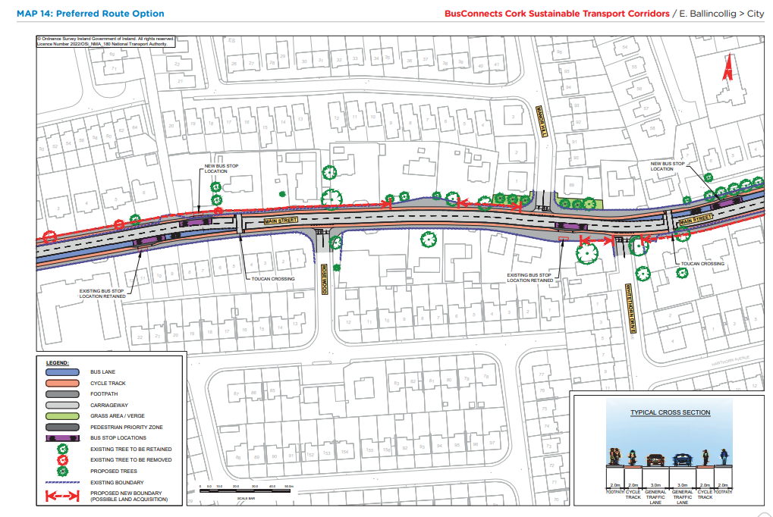
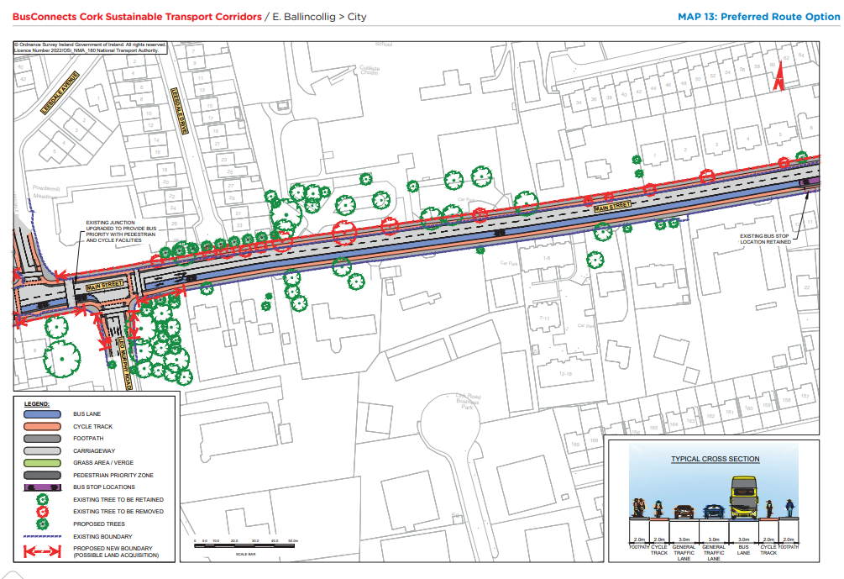
Preferred Route Option (PRO) Key Change

Slide 24
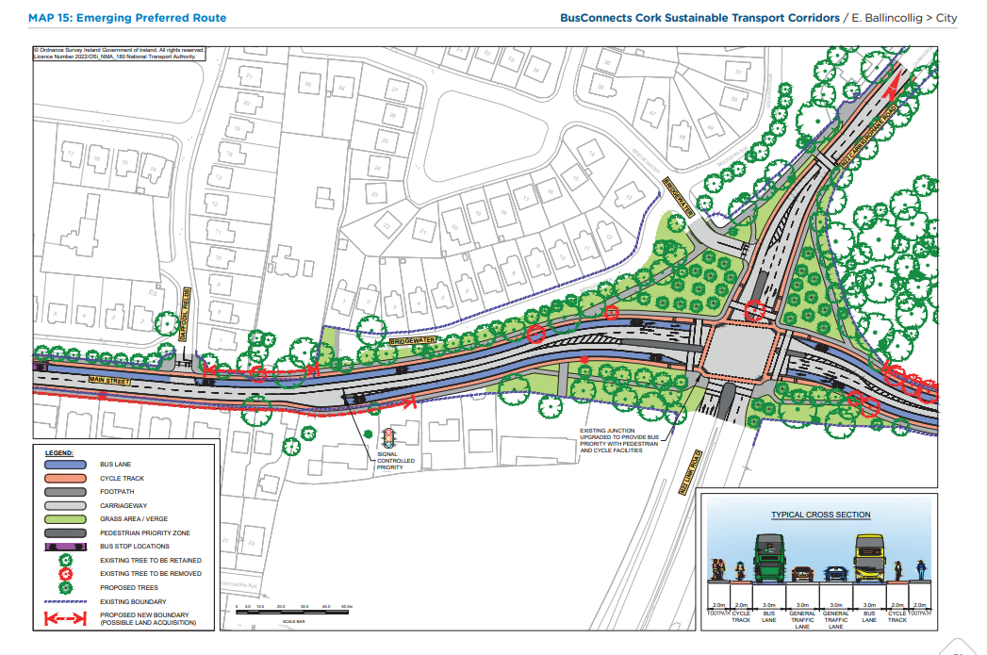
Emerging Preferred Route (EPR)

Slide 25
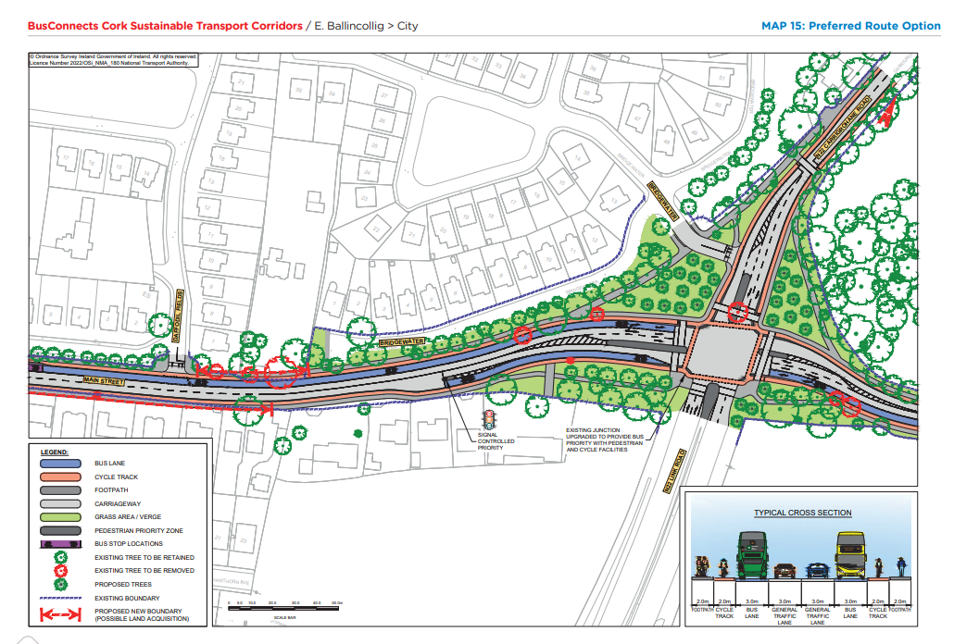
Preferred Route Option (PRO) Key Change

Slide 26
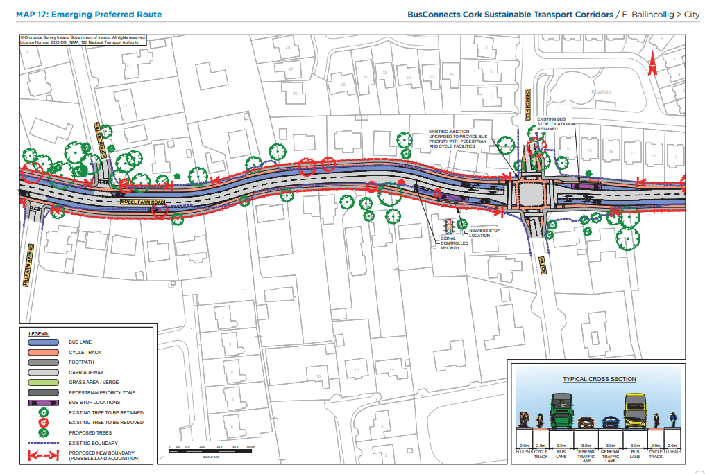
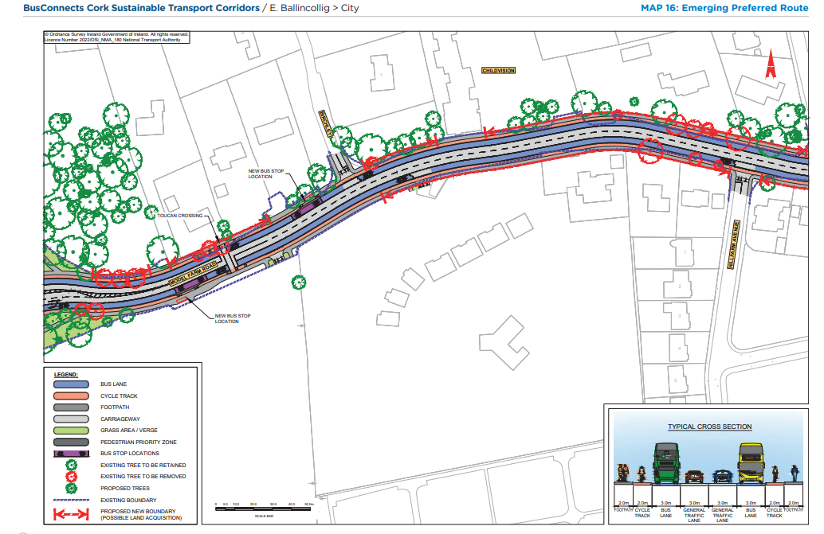
Emerging Preferred Route (EPR)

Slide 27
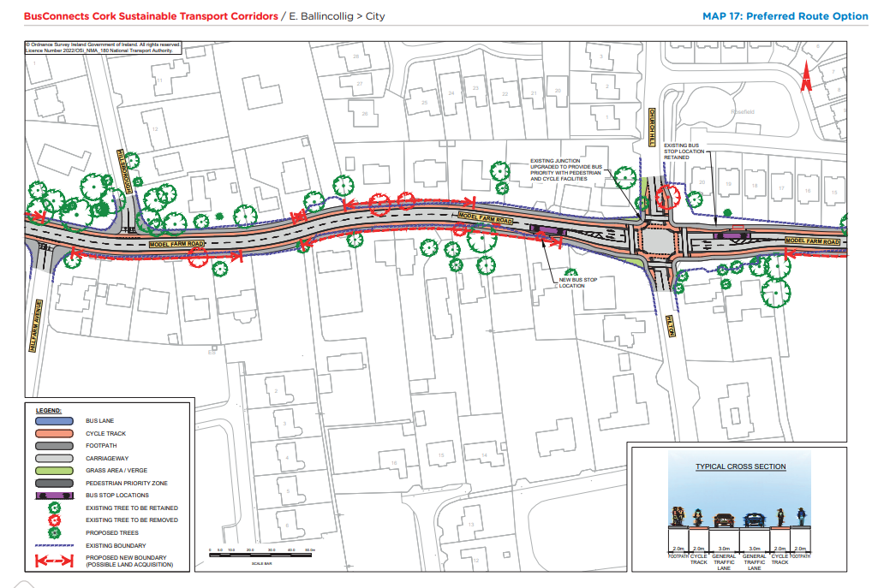
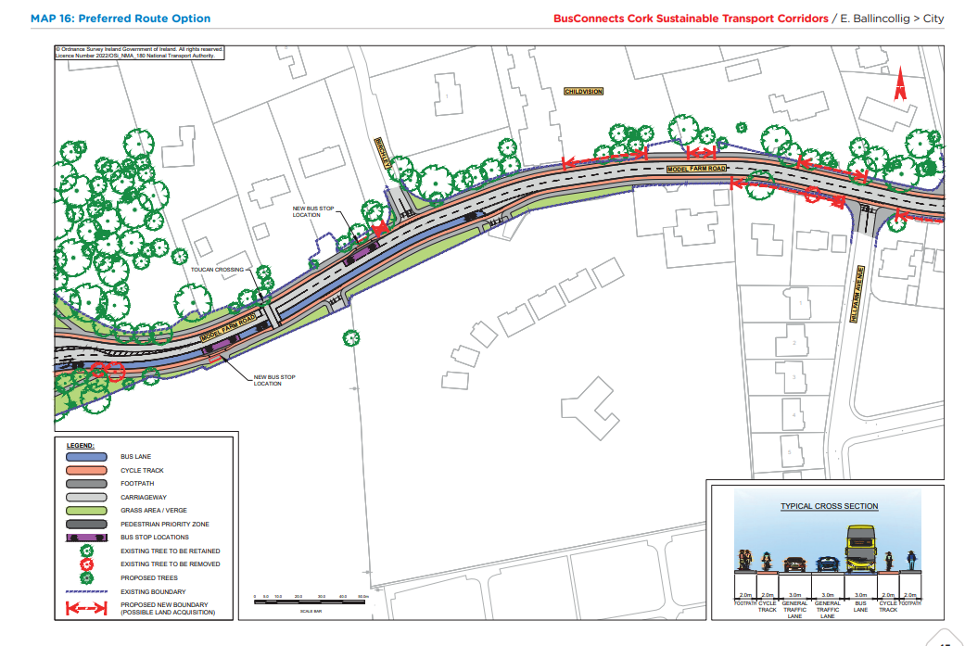
Preferred Route Option (PRO) Key Change

Slide 28
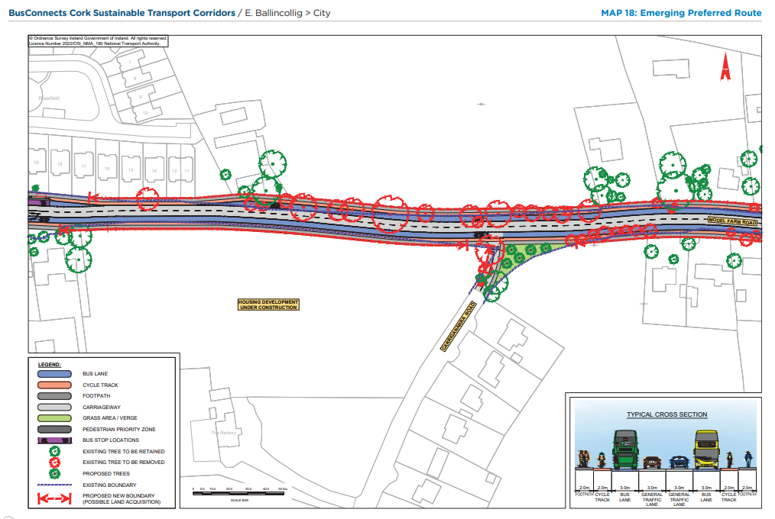
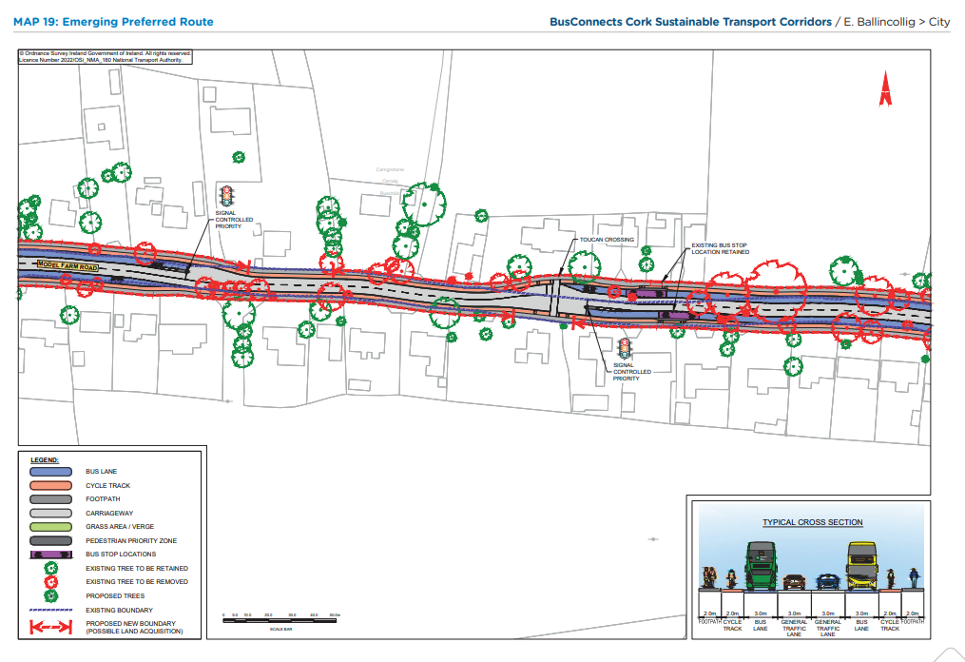
Emerging Preferred Route (EPR)

Slide 29
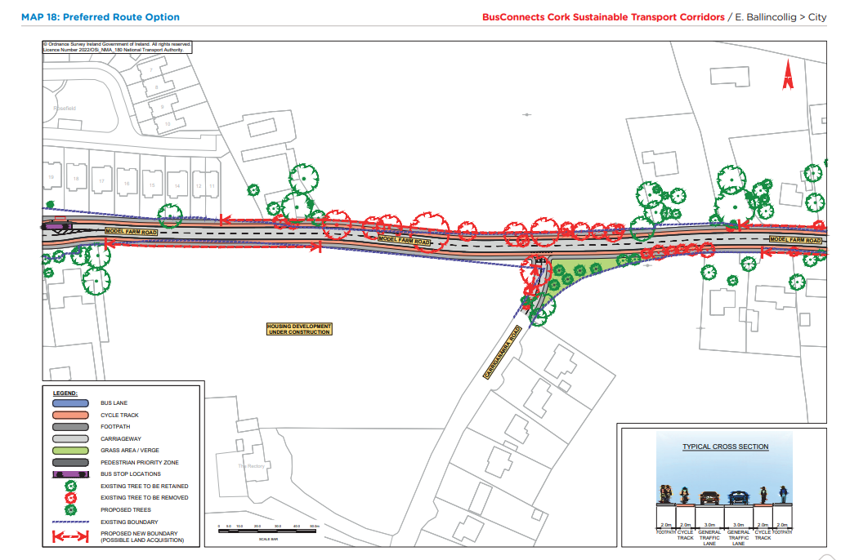
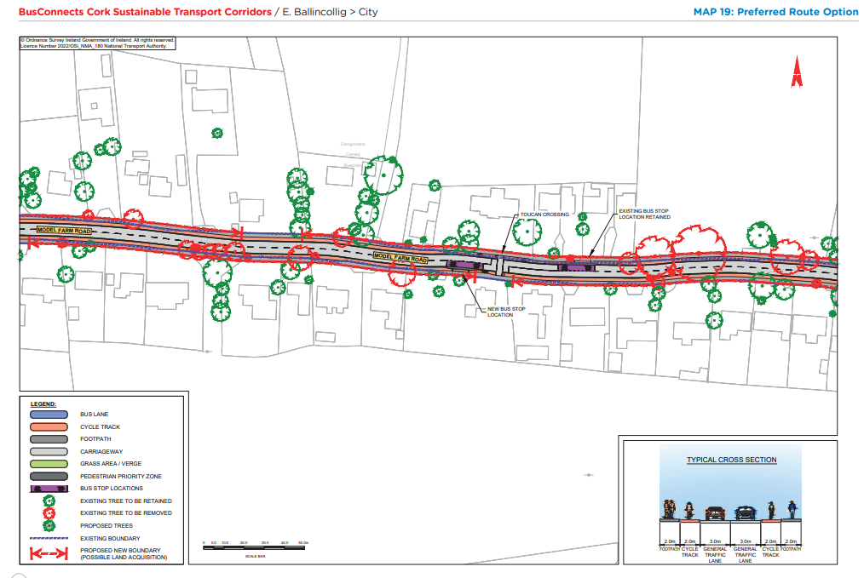
Preferred Route Option (PRO) Key Change

Slide 30
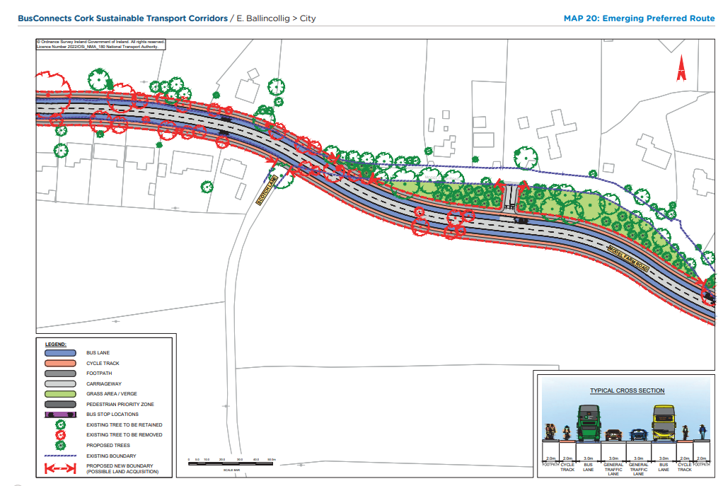
Emerging Preferred Route (EPR)

Slide 31
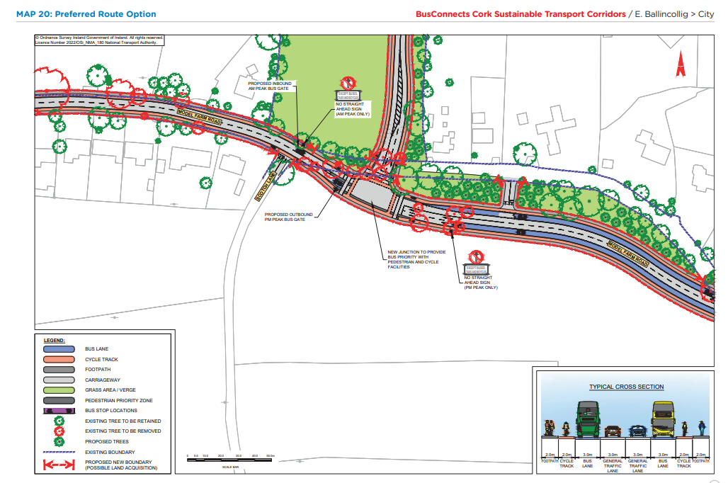
Preferred Route Option (PRO) Key Change

Slide 32
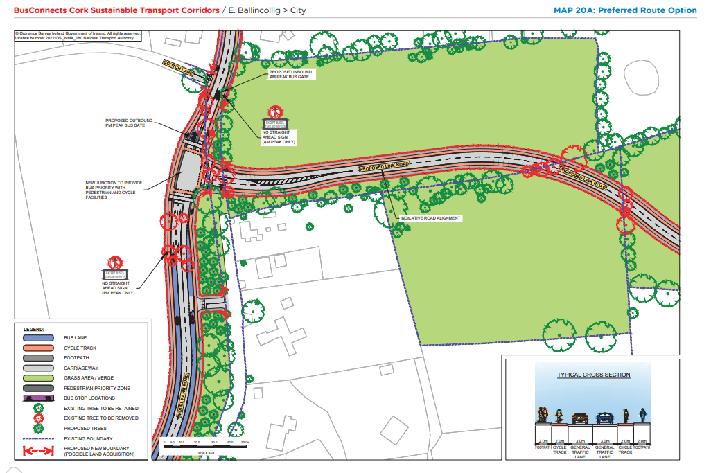
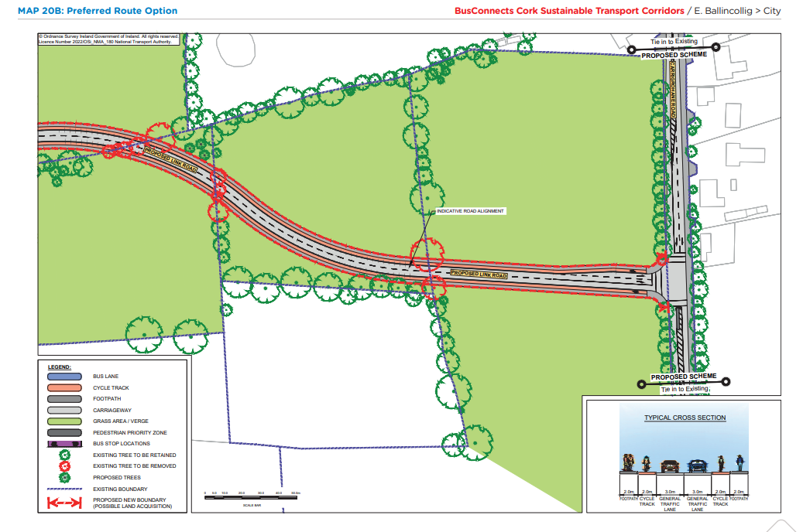
Preferred Route Option (PRO) Key Change

Slide 33
Overview
of
Sustainable Transport Corridor F:
Bishopstown to City Preferred Route Option

Slide 34
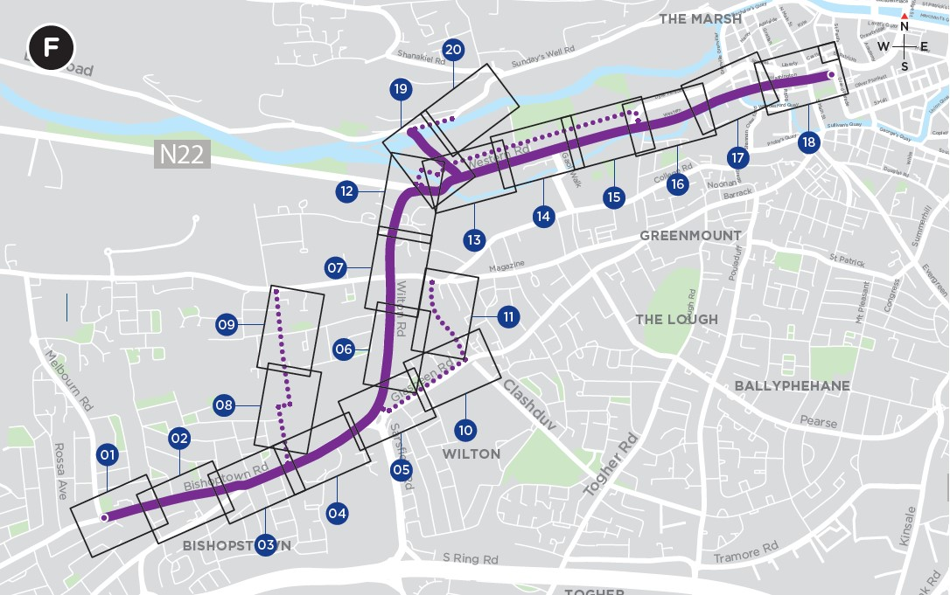
Sustainable Transport Corridor F - Bishopstown to City
Curraheen Road: Use of signal controlled priority has removed the need for a section of dedicated bus lane and road widening.
Bishopstown Road: Reduction in length of dedicated bus lanes.
The proposed cycle tracks through the Presentation College grounds and along Wilton Road have been removed. These have been replaced by a quiet route along Wilton Avenue, through CUH grounds and Bishopstown Avenue, and also by cycle facilities along Glasheen Road, Cottage Mews and Schoolboy’s Lane.

Slide 35
Sustainable Transport Corridor F - Bishopstown to City
New cycle route proposed across Kingsley Bridge, through the Sacred Heart Church grounds connecting to the existing quiet street treatment on Mardyke Walk, reducing the need for land acquisition.
Removal of a section of outbound bus lane on Western Road between Mardyke Walk and Gaol Walk.
Inclusion of cycle facilities along Sunday’s Well Road by means of a new boardwalk, and Western Road by means of a new pedestrian and cycle bridge adjacent Thomas Davis Bridge.

Slide 36
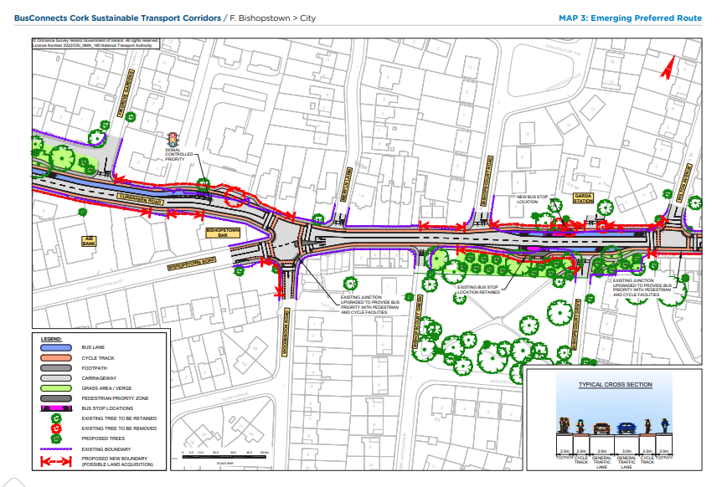
Emerging Preferred Route (EPR)

Slide 37
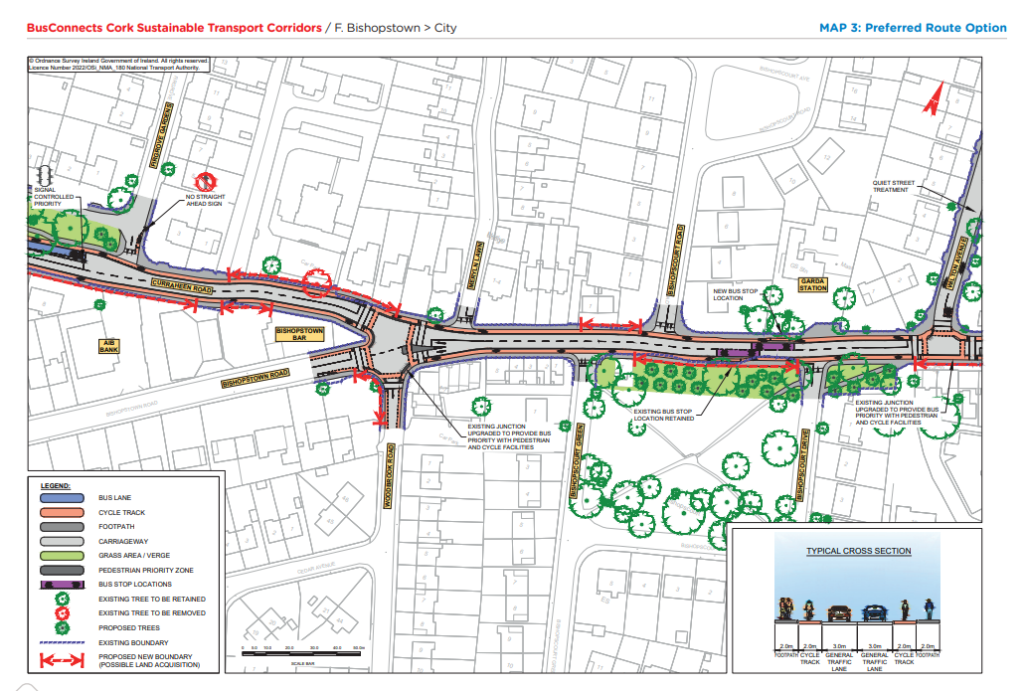
Preferred Route Option (PRO) Key Change

Slide 38
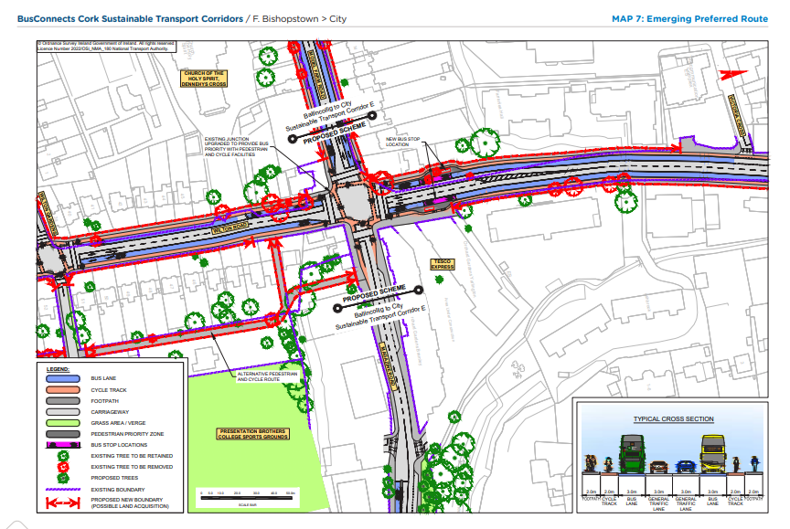
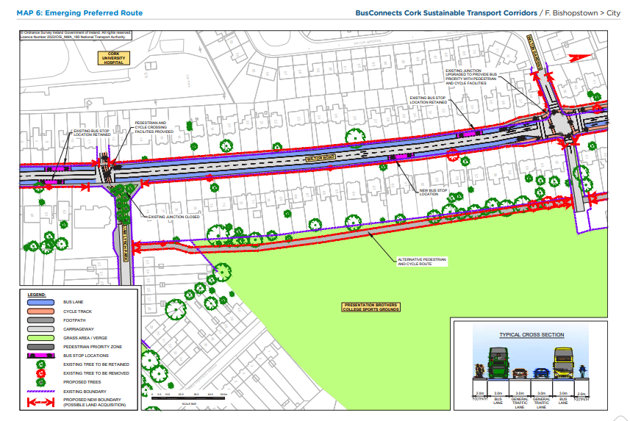
Emerging Preferred Route (EPR)

Slide 39
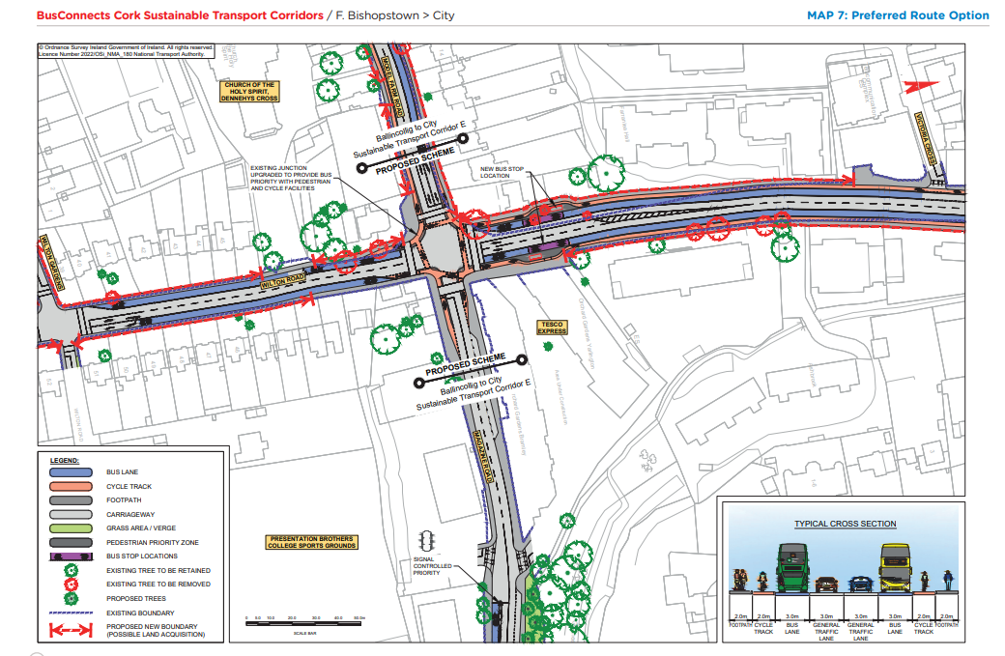
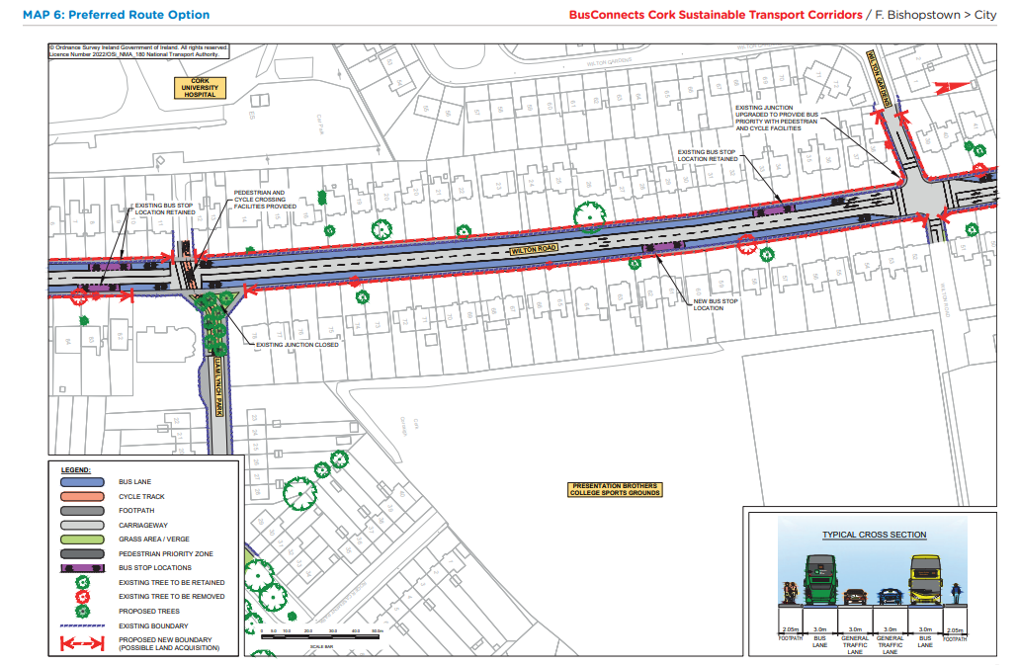
Preferred Route Option (PRO) Key Changes

Slide 40
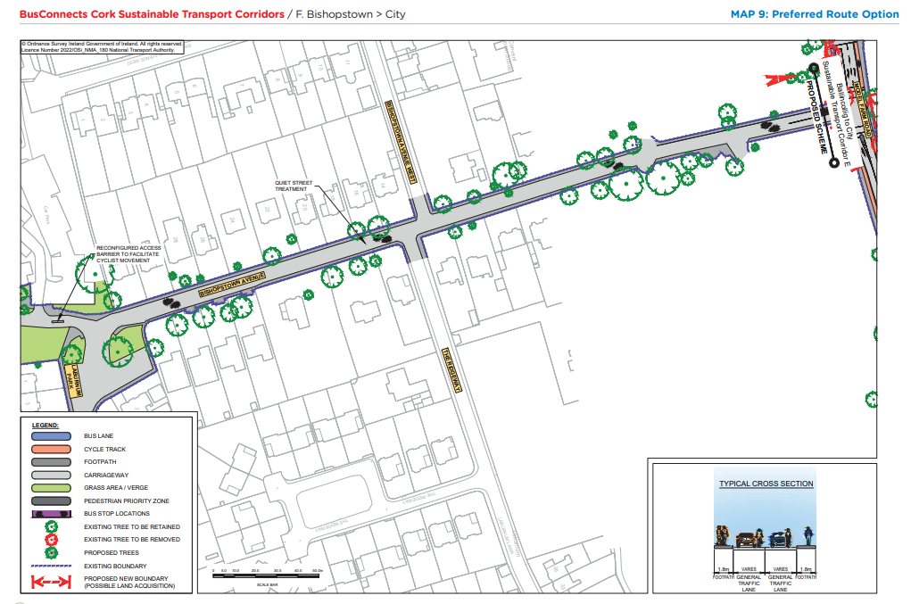
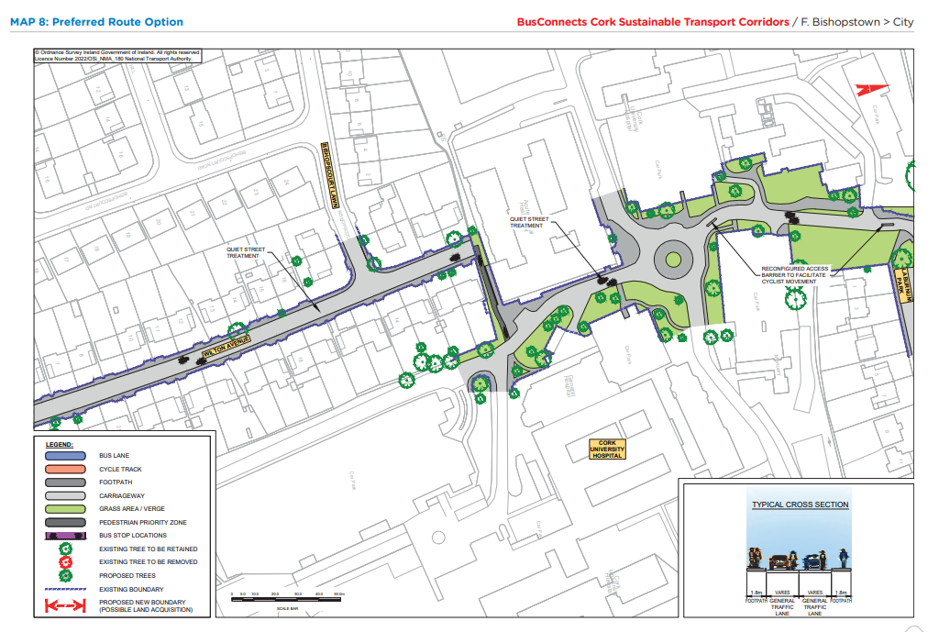
Preferred Route Option (PRO) Key Changes

Slide 41
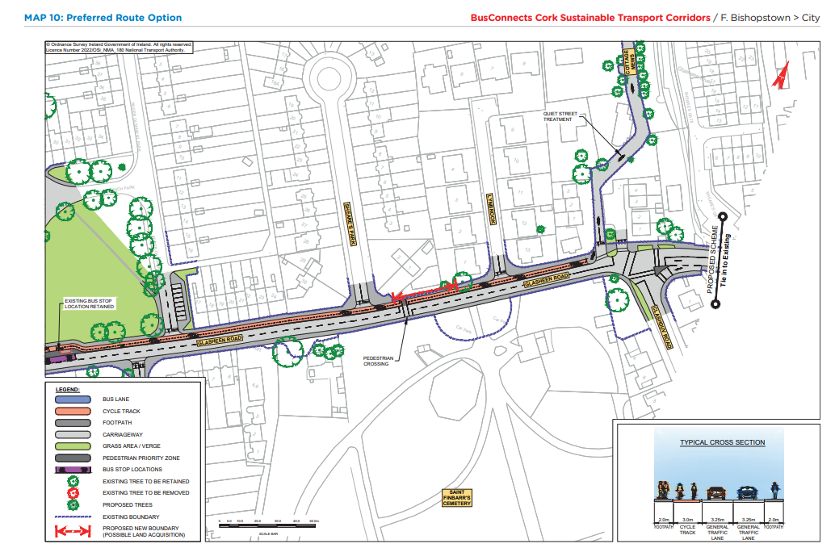
Preferred Route Option (PRO) Key Changes

Slide 42
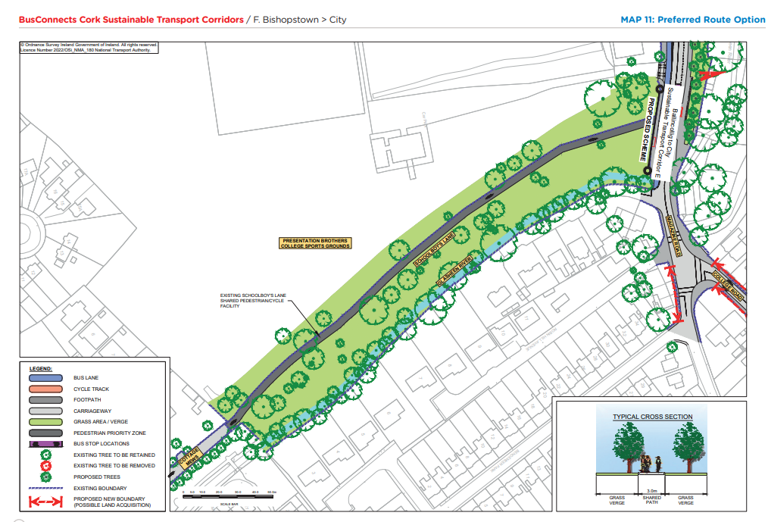
Preferred Route Option (PRO) Key Changes

Slide 43
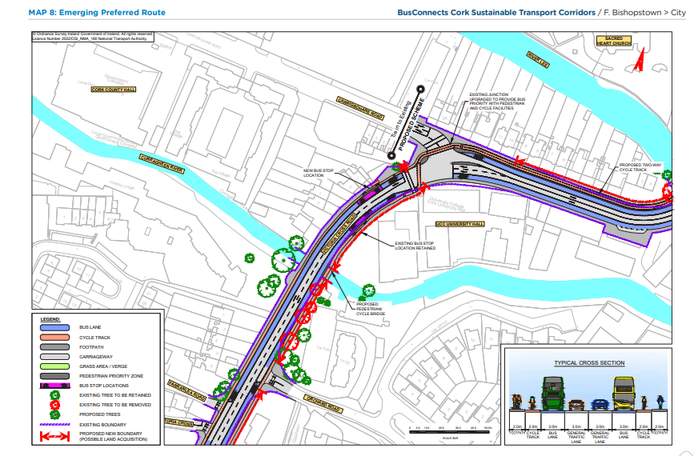
Emerging Preferred Route (EPR)

Slide 44
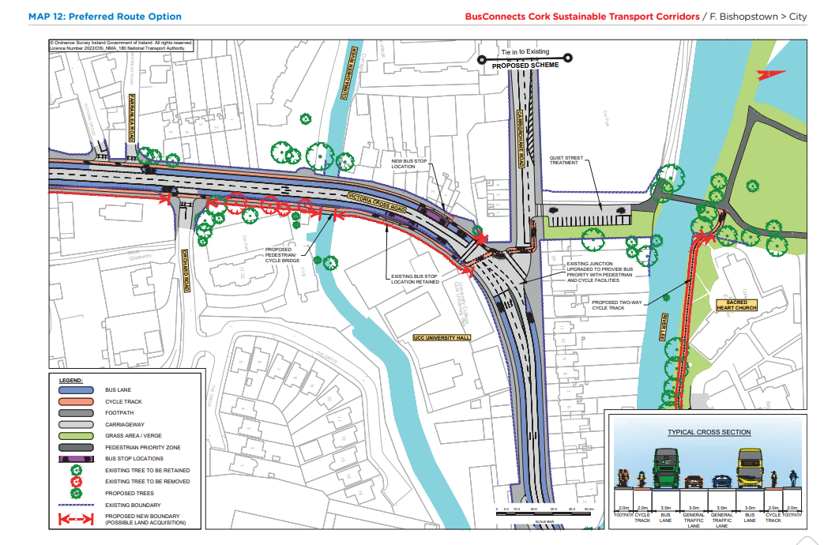
Preferred Route Option (PRO) Key Changes

Slide 45
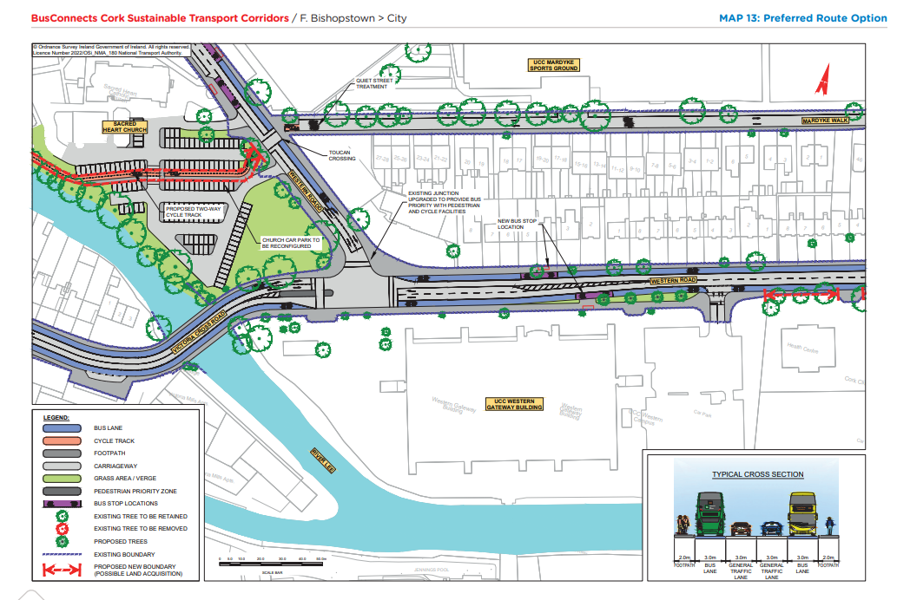
Preferred Route Option (PRO) Key Changes

Slide 46
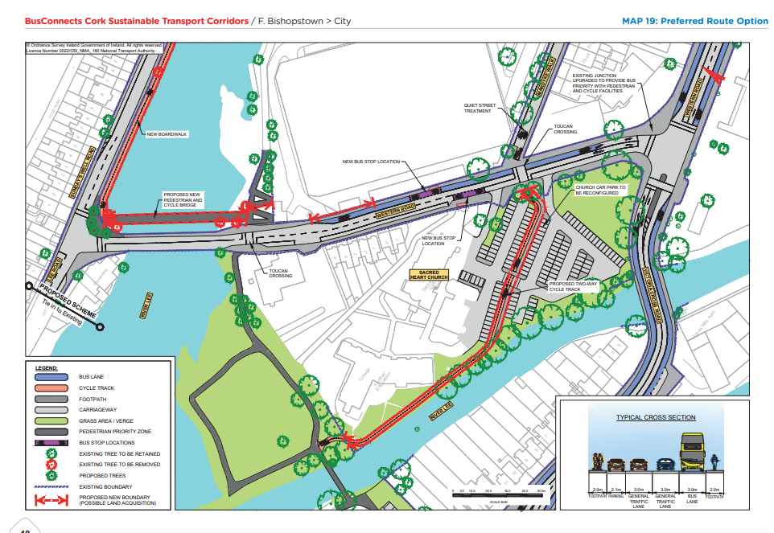
Preferred Route Option (PRO) Key Changes

Slide 47
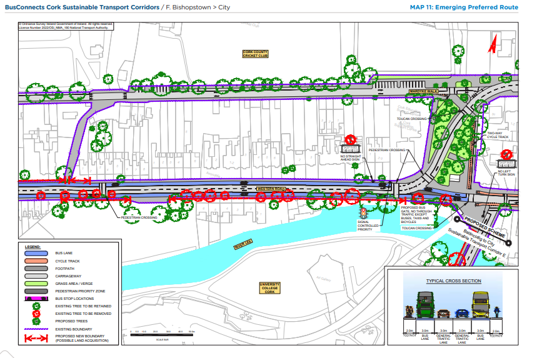
Emerging Preferred Route (EPR)

Slide 48
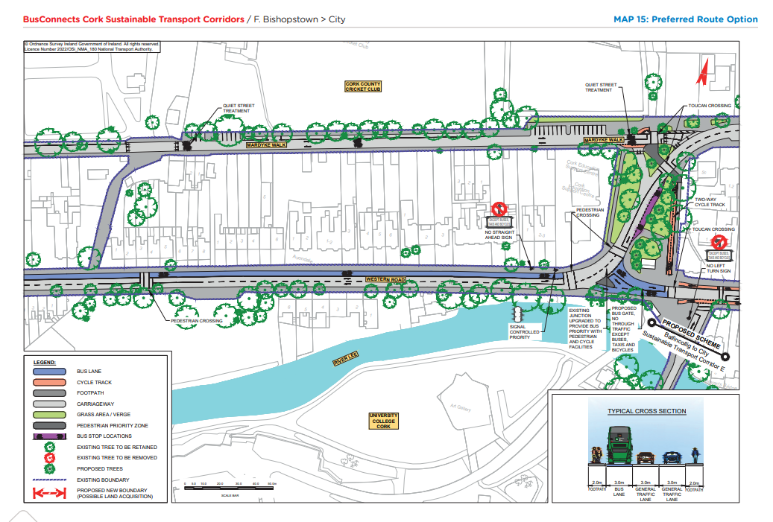
Preferred Route Option (PRO) Key Changes

Slide 50
Deadline for Submissions Thursday 25th May 2023

Slide 51
Questions – Comments - Discussion

