Slide 2
BusConnects Cork
Sustainable Transport Corridors
Second Public Consultation
Community Forum – Tuesday 2nd May 2023
Sustainable Transport Corridor A – Dunkettle to City
Sustainable Transport Corridor B – Mayfield to City

Slide 3
Introductions
Independent Chairperson Simon Nugent
NTA Hugh Creegan, Deputy CEO
Con Kehely, Head of BusConnects Regional Cities
Terry Brennan, Senior Communications Manager
Jacobs Bruce Slattery, Director, Jacobs

Slide 4
Agenda
Introductions (completed)
Running of meetings
Preferred Route Options for STC A & B
Questions – Comments - Discussion

Slide 5
Forum Objectives & Terms of Reference
Two-way communication –Serve as a two-way communication channel between the NTA and local communities
Information Flow – Allow provision of information and updates throughout the duration of the project
Answer questions - Provide answers to concerns and issues raised
Listen – Listen to suggestions on how to improve the proposals, hear constructive ideas and viable alternatives
Resolve – Enable and support the resolution of local issues in a timely manner

Slide 6
Running of Meeting
We will endeavor to finish the meeting on time
Please turn mobile phones to silent or off
Chairperson will call on contributors in turn
State your name and the name of the group you represent
To allow maximum participation, please keep contributions short

Slide 9
First Public Consultation
June 30th – Oct 3rd ‘22
6 x Public Info Events
5 x Community Forums
Approx. 3,000 submissions (2,284 online + 694 email/hardcopy)
35 x Local Groups
Approx. 130 Landowner mtgs

Slide 10
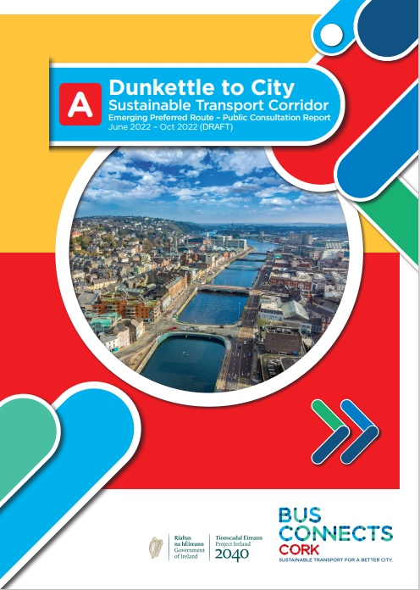
First Public Consultation
STC A - 21 Specific Submissions + General Submissions Interaction with other proposed schemes Access to Castleview Terrace Support for scheme Proposed land take Bus Network and bus network redesign Requests to extend the scheme and add additional links or features

Slide 11
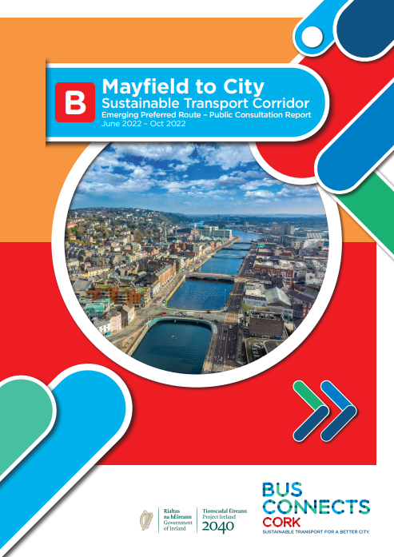
First Public Consultation
STC B – 345 Specific Submissions + General Submissions Road User Safety Access to properties Traffic Disruption due to Traffic Diversions / Bus Gates Need for Sustainable Transport Corridor Removal of Trees and green spaces Loss of Parking Insufficient Consultation Alternative Options Community Character and Heritage Cycling Infrastructure Pedestrian Infrastructure Increased Noise and Air Pollution Bus Network Impact on property value Potential Land Acquisition Technical Surveys / Data Schools in the area Support of the Scheme

Slide 12
Overview
of
Sustainable Transport Corridor A:
Dunkettle to City Preferred Route Option

Slide 13
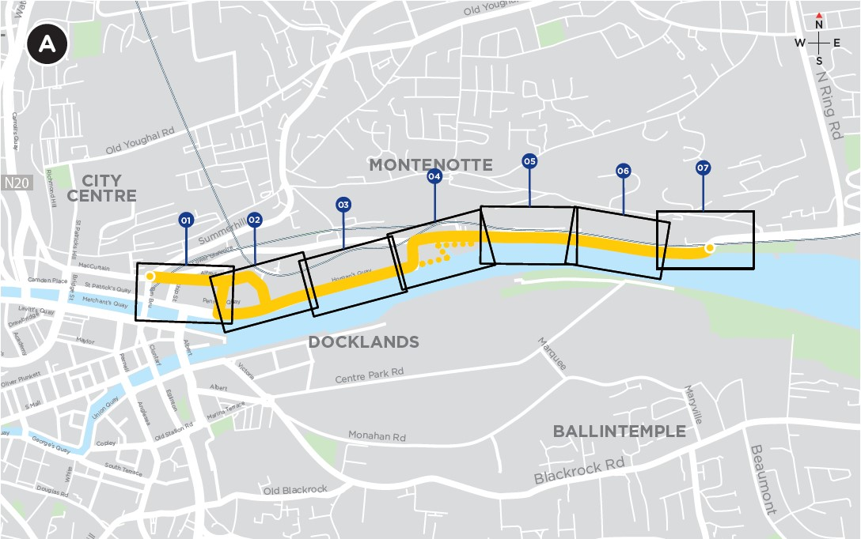
Sustainable Transport Corridor A - Dunkettle to City
The cycle and bus infrastructure linking Dunkettle Roundabout to the Port of Cork Millennium Gardens will now be delivered as part of separate projects proposed by Cork City Council.
A boardwalk for pedestrians and cyclists that passes on the riverside of Castleview Terrace is no longer required.
On-street parking has been reintroduced on Water Street.

Slide 14
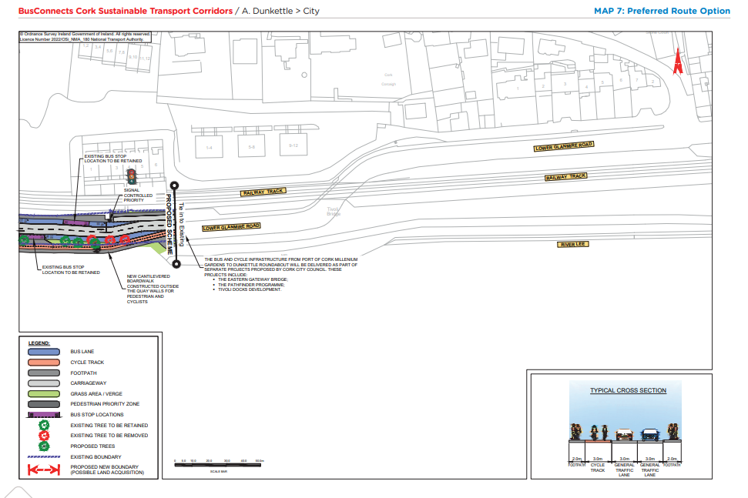
Preferred Route Option (PRO) Key Change

Slide 15
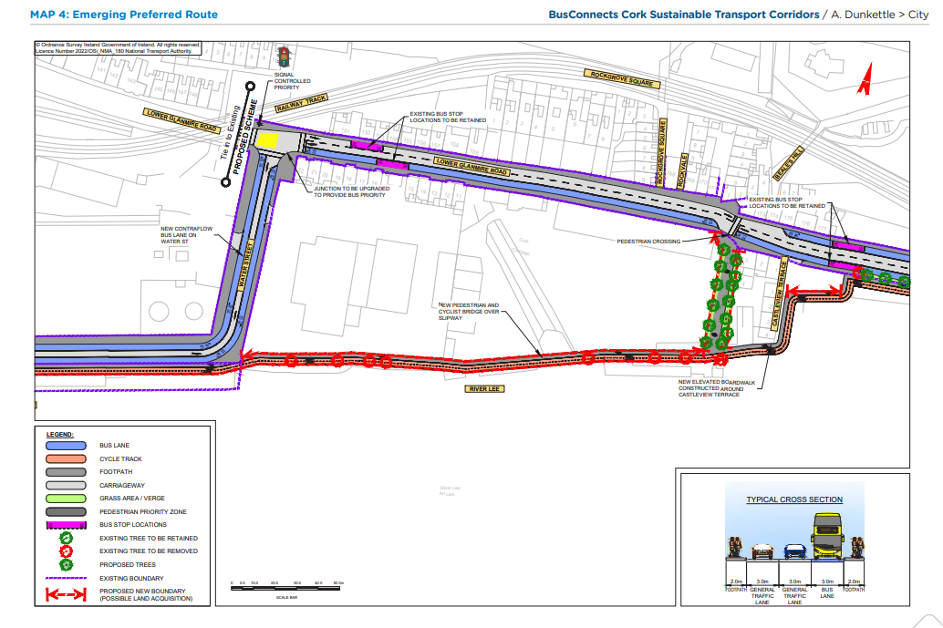
Emerging Preferred Route (EPR)

Slide 16
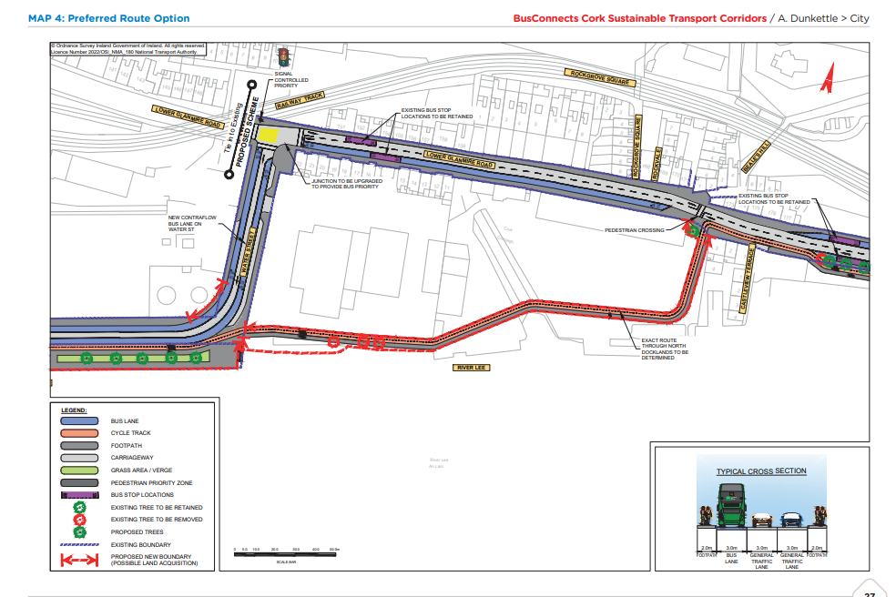
Preferred Route Option (PRO) Key Change

Slide 17
Overview
of
Sustainable Transport Corridor B:
Mayfield to City Preferred Route Option

Slide 18
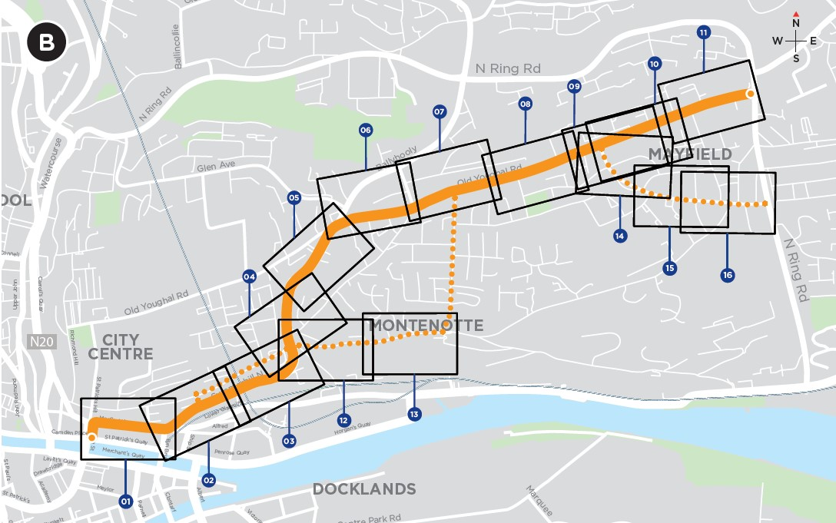
Sustainable Transport Corridor B - Mayfield to City
A bus gate has been added at the junction of Ballyhooly Road with Glen Avenue for vehicles travelling northbound. A ‘straight ahead’ restriction for general traffic will also be implemented southbound. These measures would operate in peak hours only.
It is intended to retain the original road layout along Ballyhooly Road.
The proposed bus lanes on Summerhill Nth have been removed (except for a short inbound section) with parking spaces and footway widths maintained.
The proposed bus gates at New Road and Murmont Park have been removed.

Slide 19
Sustainable Transport Corridor B - Mayfield to City
The proposed cycle tracks along Wellington Road have been replaced by a quiet street treatment.
Filtered permeability will be implemented on York Hill to prevent through traffic, except pedestrians and cyclists.
Cycling will now be facilitated via a quiet street route along Middle Glanmire Road, Leycester’s Lane, St Christopher’s Drive and Murmont Lawn.
Public Realm Improvements are proposed for Dillon’s Cross and St Luke’s Cross.

Slide 20
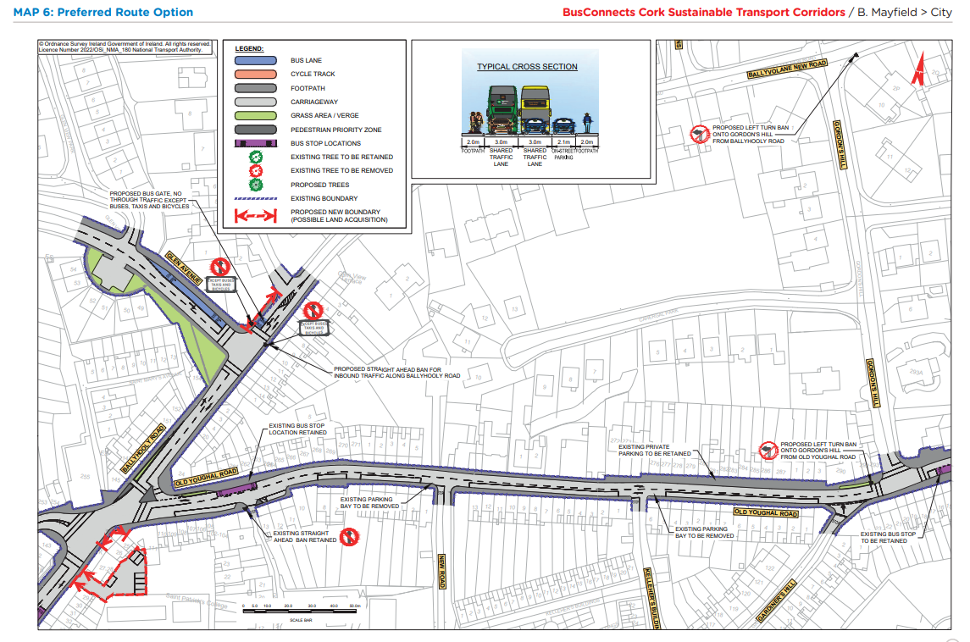
Preferred Route Option (PRO) Key Changes

Slide 21
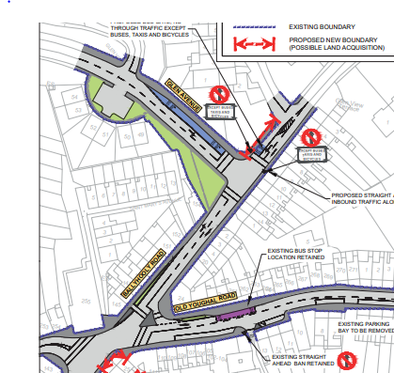
Preferred Route Option (PRO) Key Changes

Slide 22
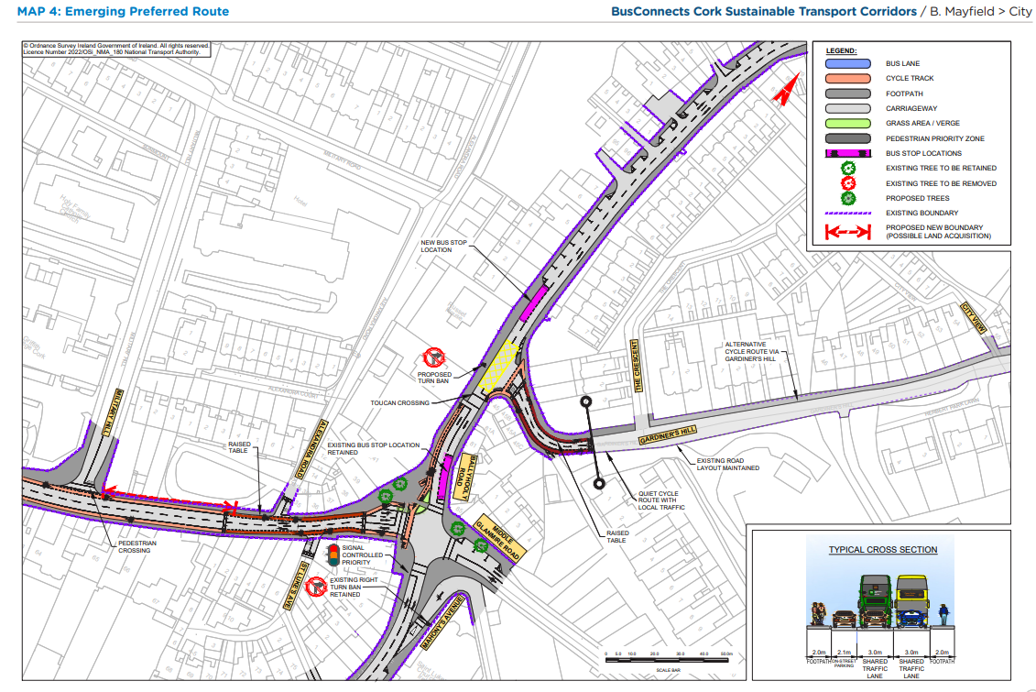
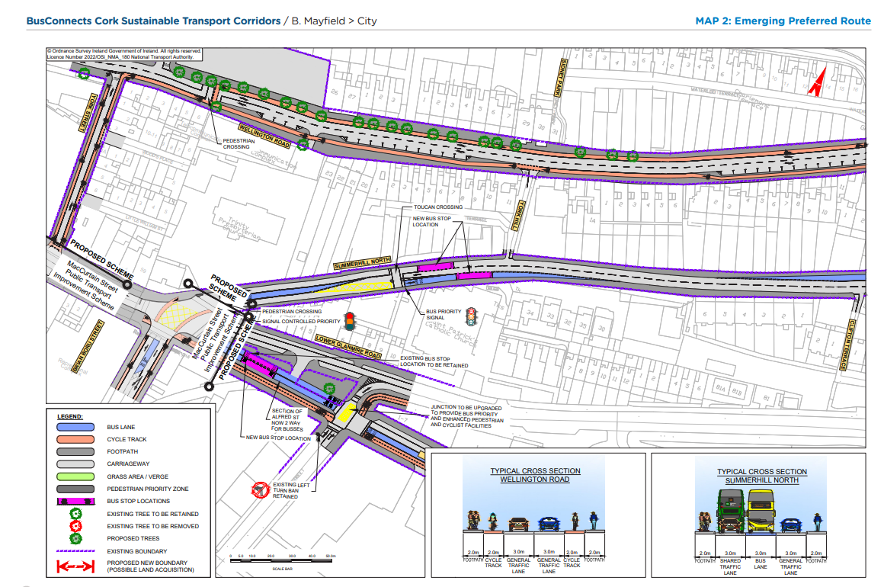
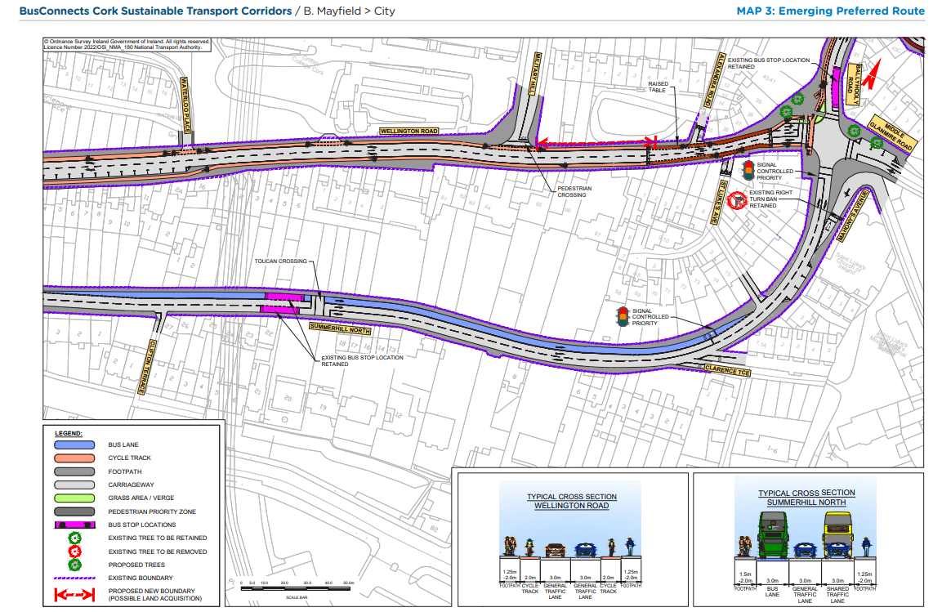
Emerging Preferred Route (EPR)

Slide 23
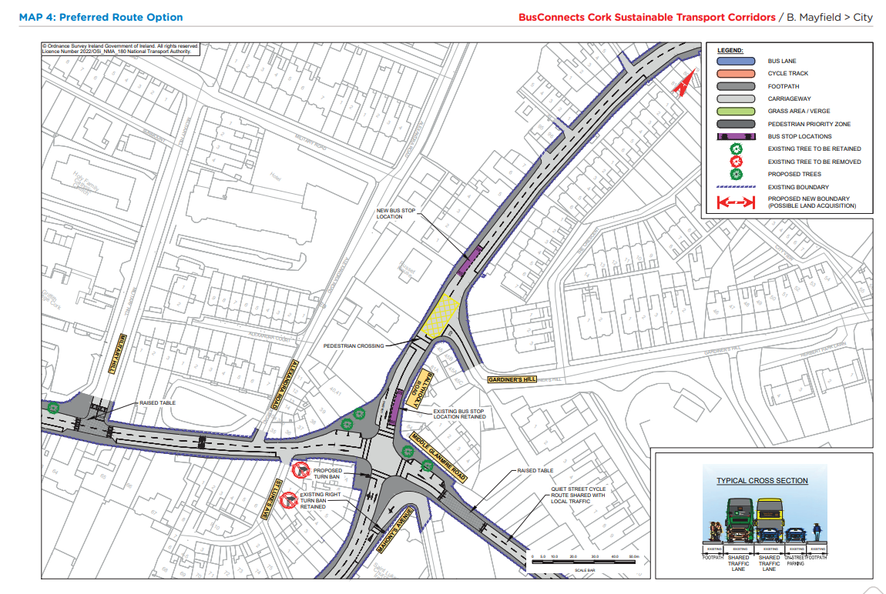
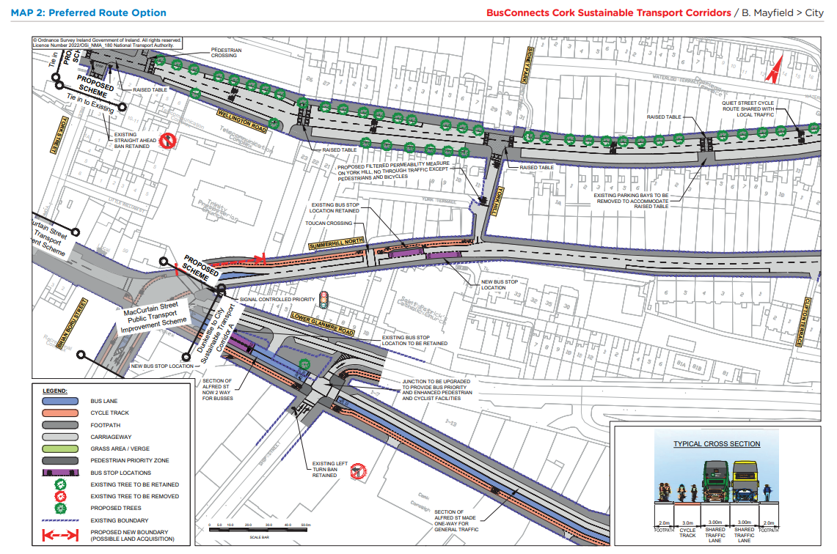
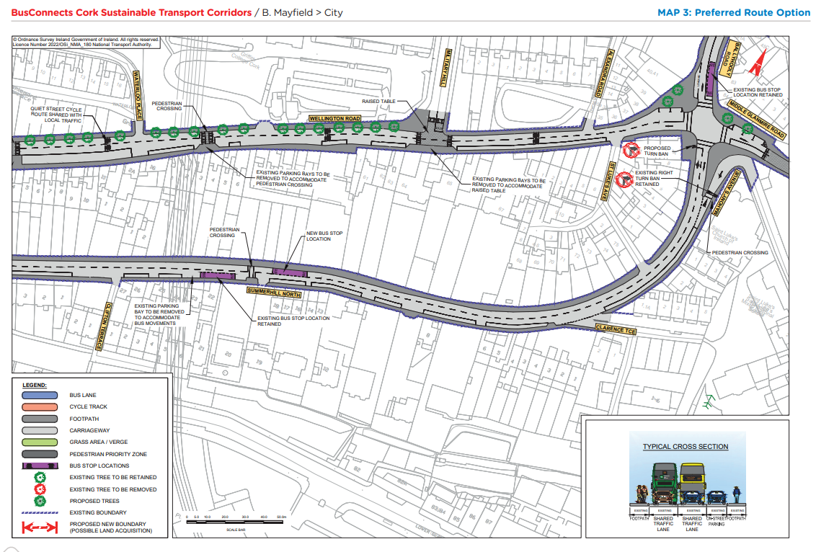
Preferred Route Option (PRO) Key Changes

Slide 24
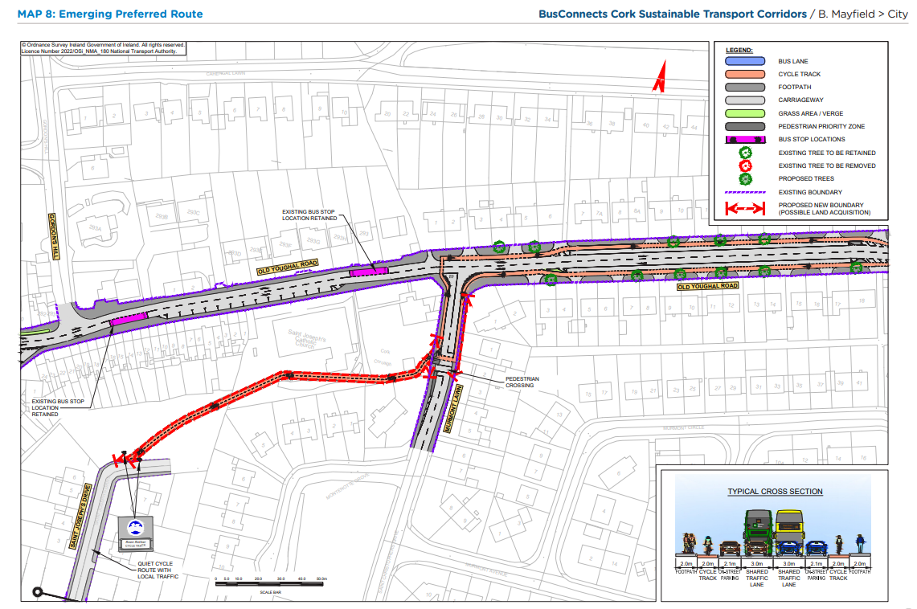
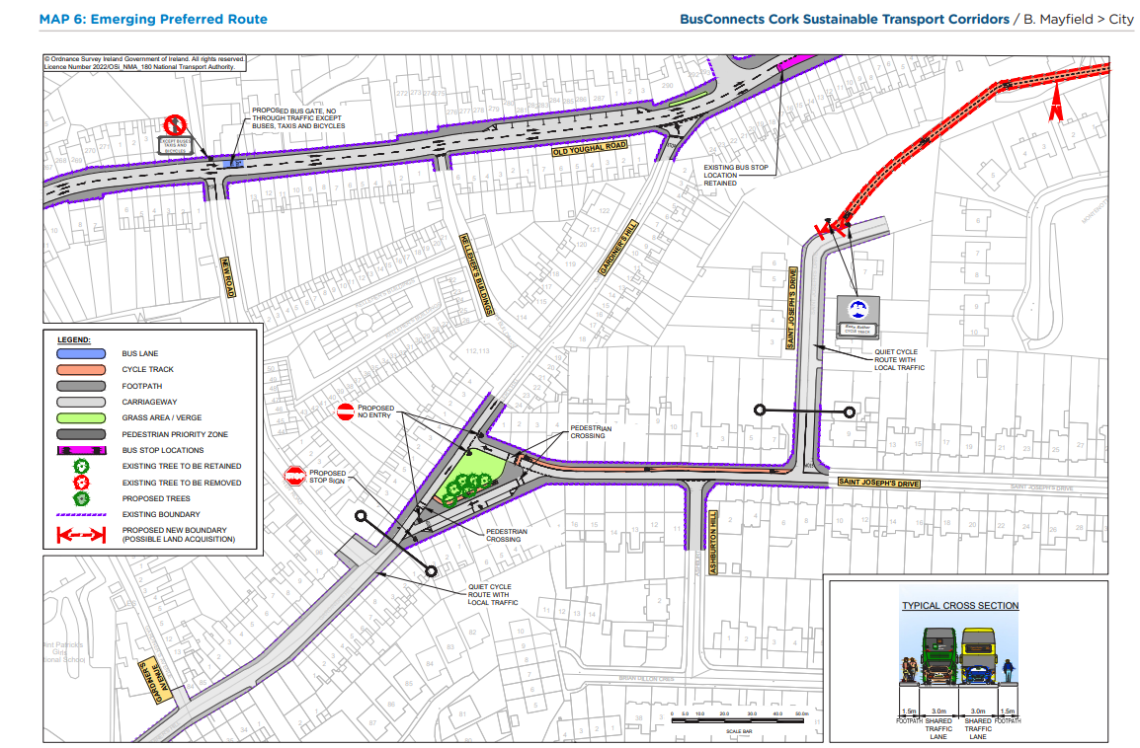
Emerging Preferred Route (EPR)

Slide 25
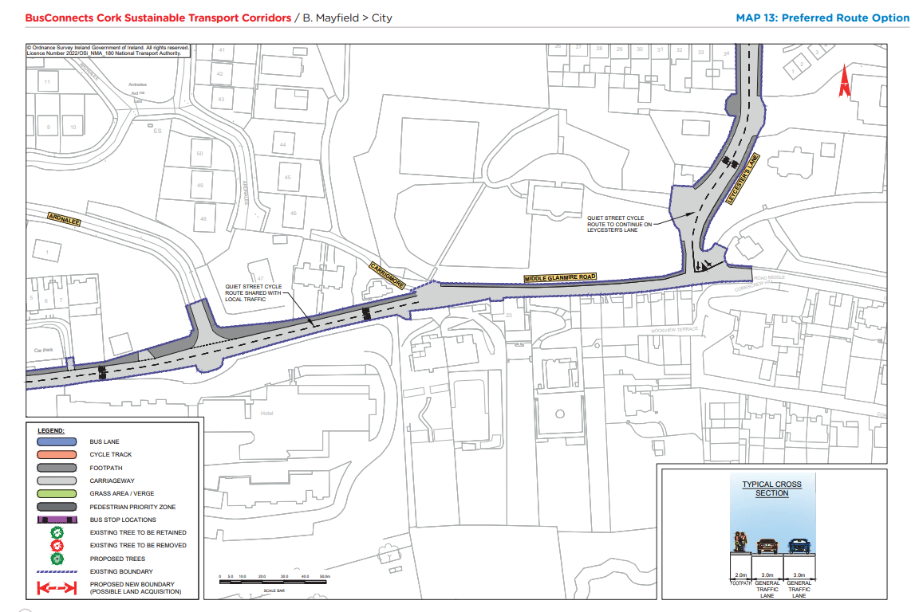
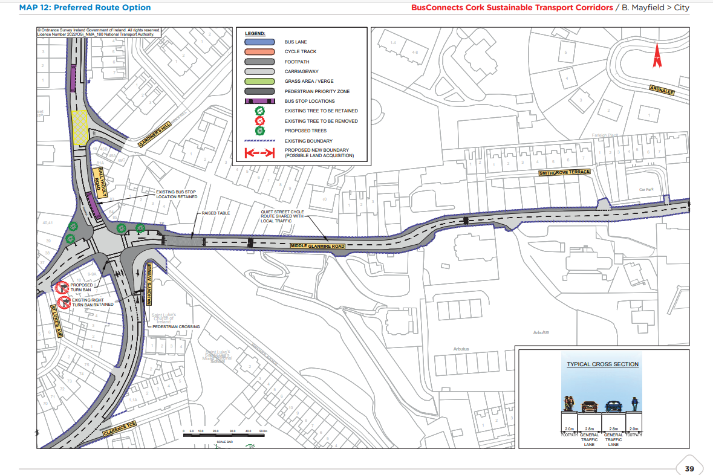
Preferred Route Option (PRO) Key Changes

Slide 27
Deadline for Submissions Thursday 25th May 2023

Slide 28
Questions – Comments - Discussion

