Slide 2
BusConnects Cork
Sustainable Transport Corridors
Second Public Consultation
Community Forum – Wednesday 3rd May 2023
Sustainable Transport Corridor G – Togher to City
Sustainable Transport Corridor H – Airport Road to City
Sustainable Transport Corridor K – Kinsale Road to Douglas

Slide 3
Introductions
Independent Chairperson Simon Nugent
NTA Hugh Creegan, Deputy CEO
Con Kehely, Head of BusConnects Regional Cities
Terry Brennan, Senior Communications Manager
Aecom Eoin O’Mahony, Regional Director
ROD Eoin Ó'Catháin, Director

Slide 4
Agenda
Introductions (completed)
Running of meetings
Preferred Route Options for STC G, H & K
Questions – Comments - Discussion

Slide 5
Forum Objectives & Terms of Reference
Two-way communication –Serve as a two-way communication channel between the NTA and local communities
Information Flow – Allow provision of information and updates throughout the duration of the project
Answer questions - Provide answers to concerns and issues raised
Listen – Listen to suggestions on how to improve the proposals, hear constructive ideas and viable alternatives
Resolve – Enable and support the resolution of local issues in a timely manner

Slide 6
Running of Meeting
We will endeavor to finish the meeting on time
Please turn mobile phones to silent or off
Chairperson will call on contributors in turn
State your name and the name of the group you represent
To allow maximum participation, please keep contributions short

Slide 9
First Public Consultation
June 30th – Oct 3rd ‘22
6 x Public Info Events
5 x Community Forums
Approx. 3,000 submissions (2,284 online + 694 email/hardcopy)
35 x Local Groups
Approx. 130 Landowner mtgs

Slide 10
First Public Consultation
STC G - 93 Specific Submissions + General Submissions Vulnerable Road User Safety Traffic Disruption due to Traffic Diversions / Increased Traffic Proposed Land Acquisition Environmental Impacts Supportive of Scheme Loss of Parking Inadequacies in Consultation Process Alternative Solutions Bus Network / Infrastructure

Slide 11
First Public Consultation
STC H – 128 Specific Submissions + General Submissions Vulnerable Road User Safety Traffic Disruption due to Traffic Diversions / Increased Traffic Proposed Land Acquisition Environmental Impacts Access to Property Supportive of Scheme Loss of Parking Inadequacies in Consultation Process Alternative Solutions Bus Network / Infrastructure Business and Retail Impact

Slide 12
First Public Consultation
STC K – 538 Specific Submissions + General Submissions The proposed bridge over Ballybrack / Mangala Valley Environmental issues Impact on trees Safety concerns Potential land acquisition Traffic impact Impact on character and heritage Cycling infrastructure Alternative proposals Antisocial behaviour Public information campaign Access to property Impact on community Technical surveys

Slide 13
Overview
of
Sustainable Transport Corridor G:
Togher to City Preferred Route Option

Slide 14
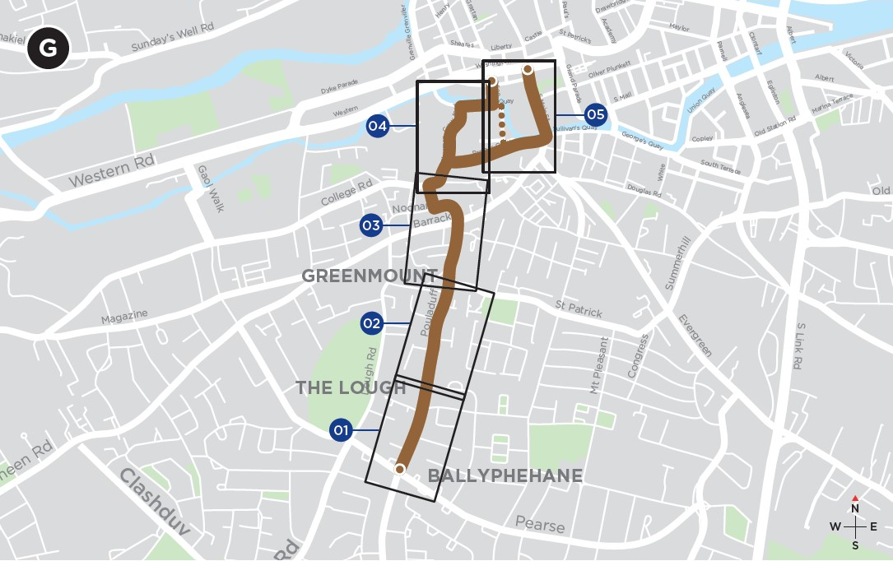
Sustainable Transport Corridor G - Togher to City
The proposals along Pearse Road have been omitted, and the corridor now commences on Pouladuff Road, just north of the junction with Pearse Road.
The proposed inbound bus lane on Pouladuff Road between Pearse Road and Nuns Walk has been omitted. Bus priority will now be provided by an inbound bus gate which will operate in AM Peak hours only.
Works on Pouladuff Road have been amended, significantly reducing the loss of car parking.
Some additional off-street parking has been proposed.

Slide 15
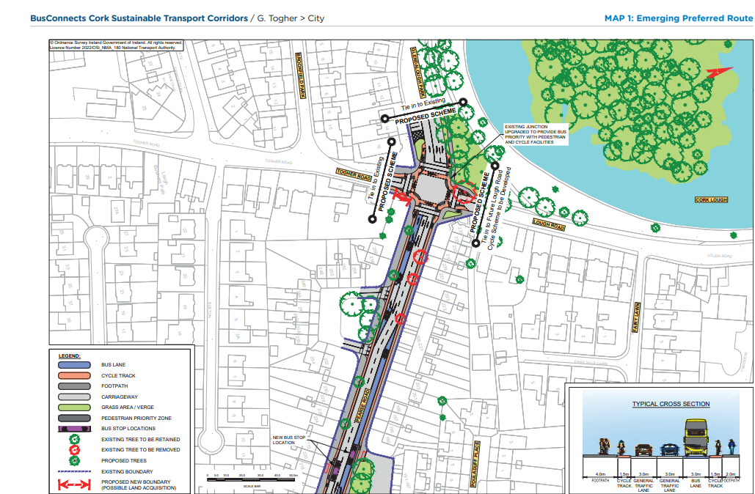
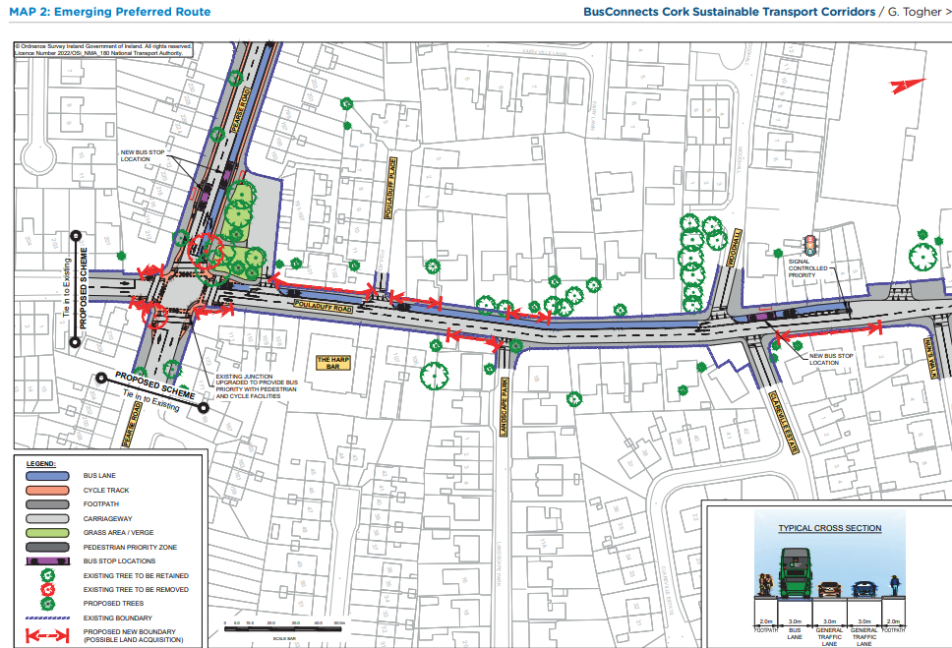
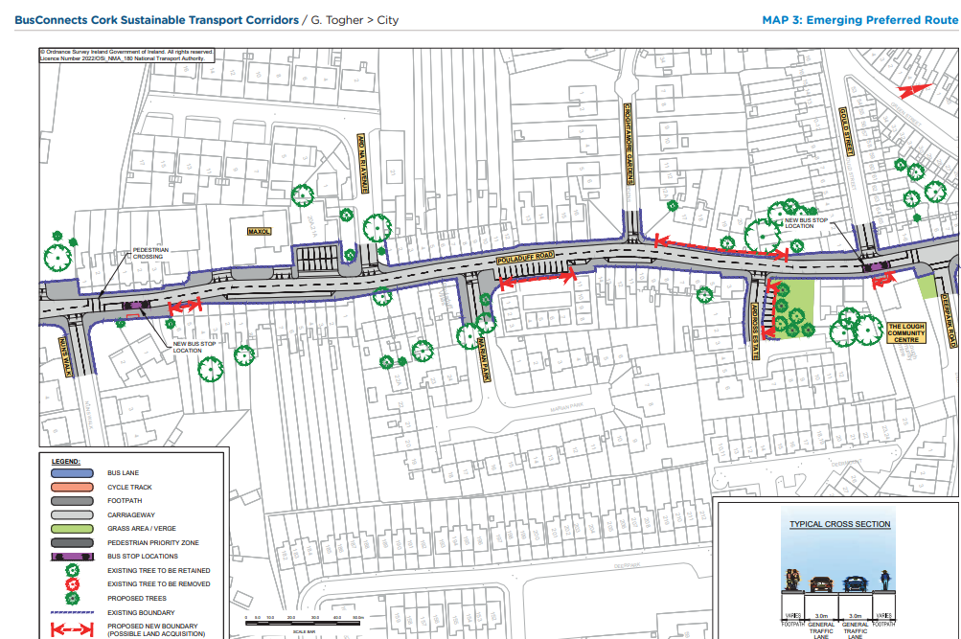
Emerging Preferred Route (EPR)

Slide 16
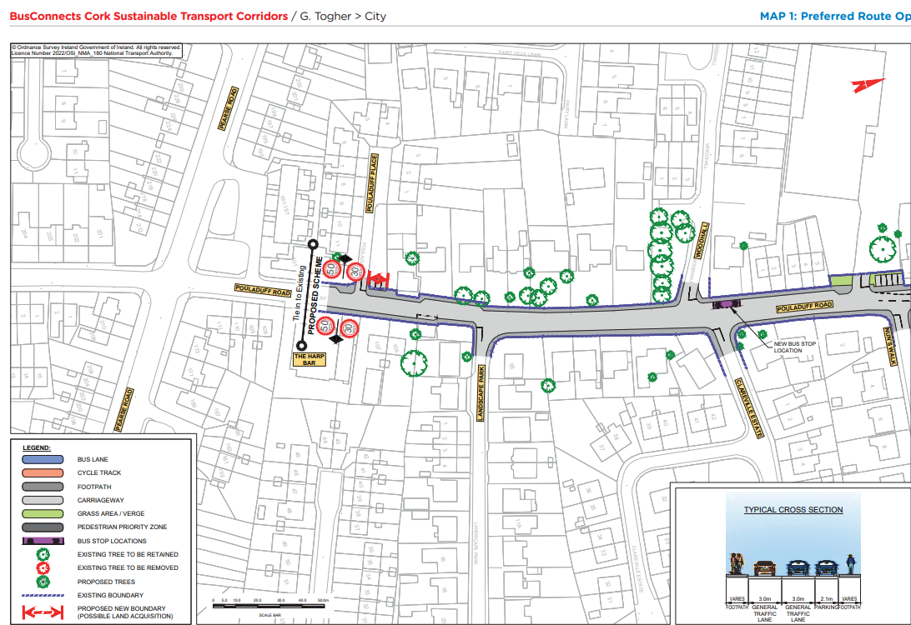
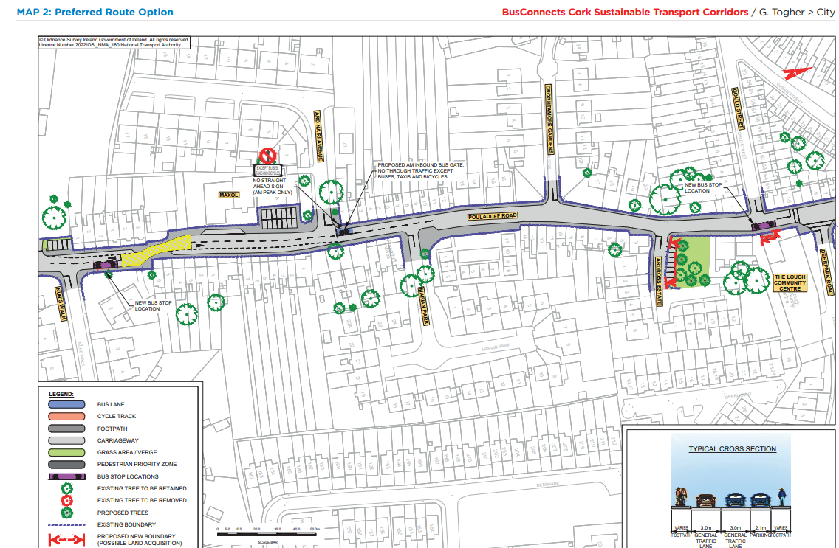
Preferred Route Option (PRO) Key Change

Slide 17
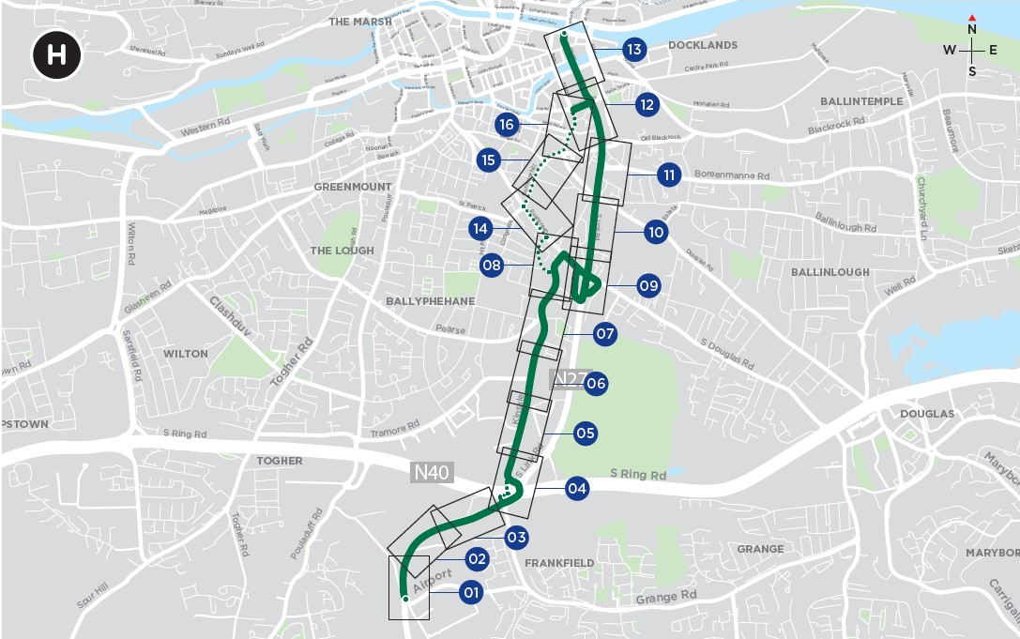
Sustainable Transport Corridor H - Airport to City
On the north-western arm of the Kinsale Road Junction, i.e., the arm that currently serves Harvey Norman, Smyths, etc. it is proposed to amend the location and operation of the previously proposed bus gates.
It is now proposed to direct cyclists from Curragh Road to Evergreen Road via a quiet street treatment on O’Connell Avenue.
A compensatory car park is proposed on lands to be acquired to the rear of properties on Evergreen Road to offset the impact of car parking lost on Evergreen Road.

Slide 18
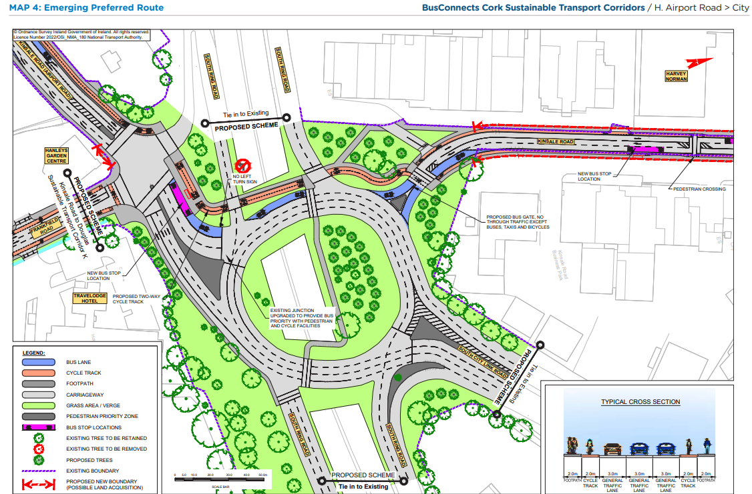
Emerging Preferred Route (EPR)

Slide 19
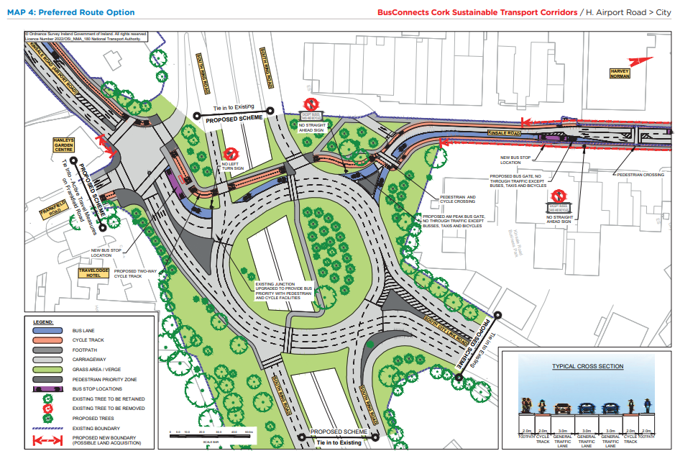
Preferred Route Option (PRO) Key Change

Slide 20
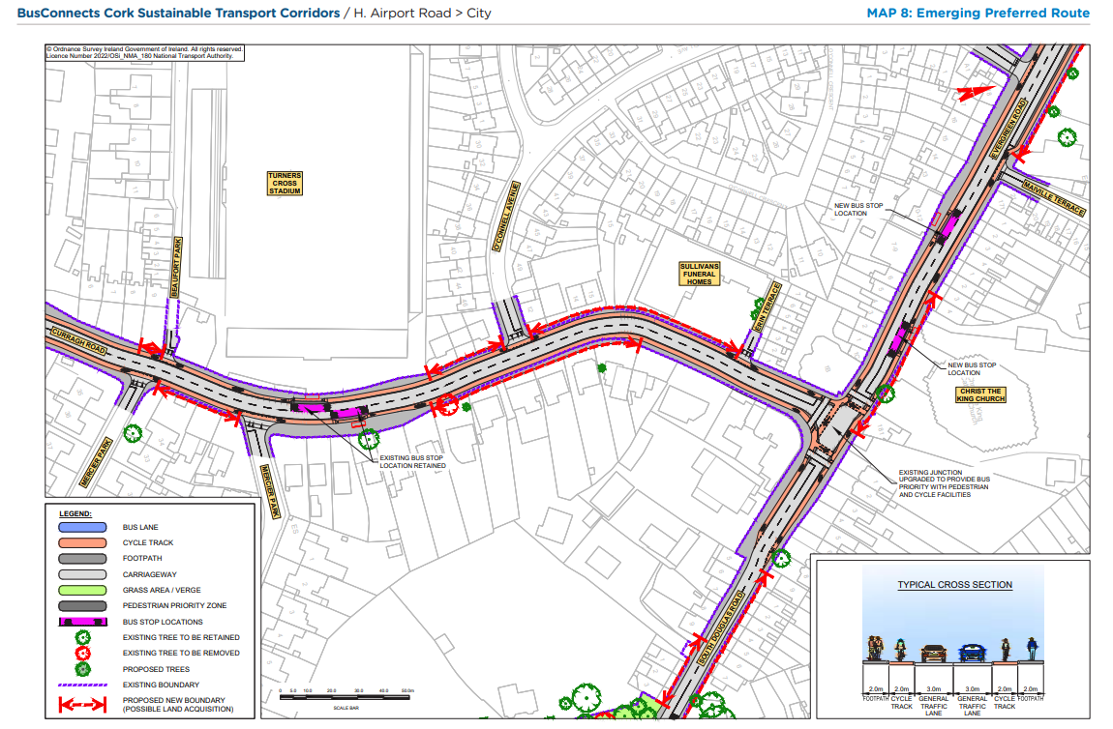
Emerging Preferred Route (EPR)

Slide 21
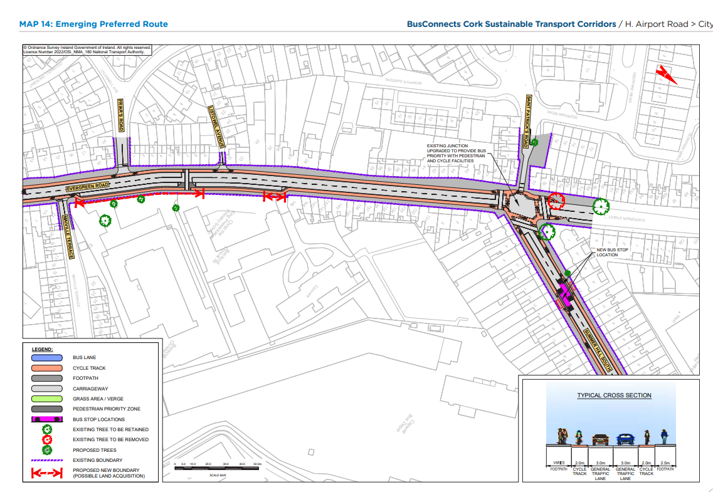
Emerging Preferred Route (EPR)

Slide 22
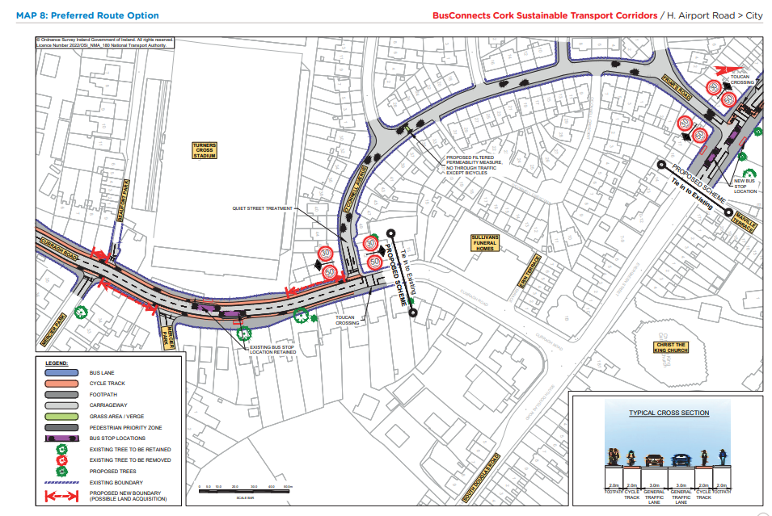
Preferred Route Option (PRO) Key Change

Slide 23
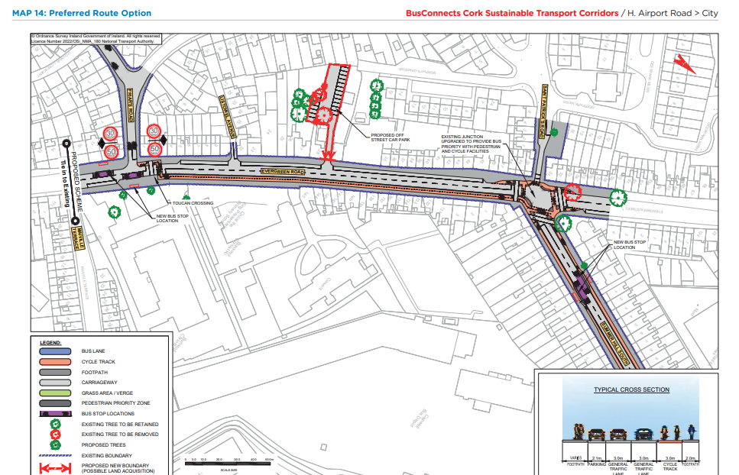
Preferred Route Option (PRO) Key Change

Slide 24
Overview
of
Sustainable Transport Corridor K:
Kinsale Road to Douglas Preferred Route Option

Slide 25
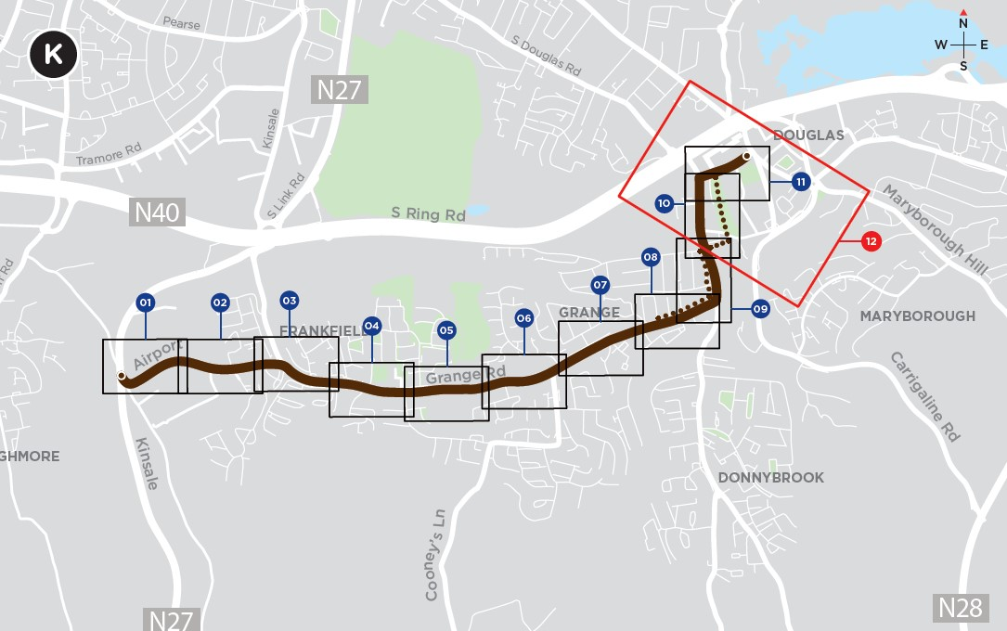
STC K - Kinsale Road to Douglas
Bridge over Ballybrack Woods/Mangala Valley no longer included in the BusConnects proposals.
Well Road Cycle Route no longer included in the BusConnects proposals.
Ballycurreen Road / Grange Road / Donnybrook Hill: Increased use of signal controlled priority has reduced the need for dedicated bus lanes and road widening on Ballycurreen Road, Grange Road and Donnybrook Hill.
An additional pedestrian crossing has been included on Ballycurreen Road close to the new western bus stops.

Slide 26
STC K - Kinsale Road to Douglas
An additional signalised crossing is proposed on Grange Road close to the Church of Incarnation to enhance connectivity to the Elmwood Medical Practice and the Grange Road/Tramore Valley Park Pedestrian and Cycle Link.
A new ‘pedestrian and cyclist only’ link is proposed to connect Donnybrook Hill with Westbrook Gardens and Ballybrack Greenway. A new signalised crossing is proposed on Donnybrook Hill close to the access junction for Inchvale Road.

Slide 27
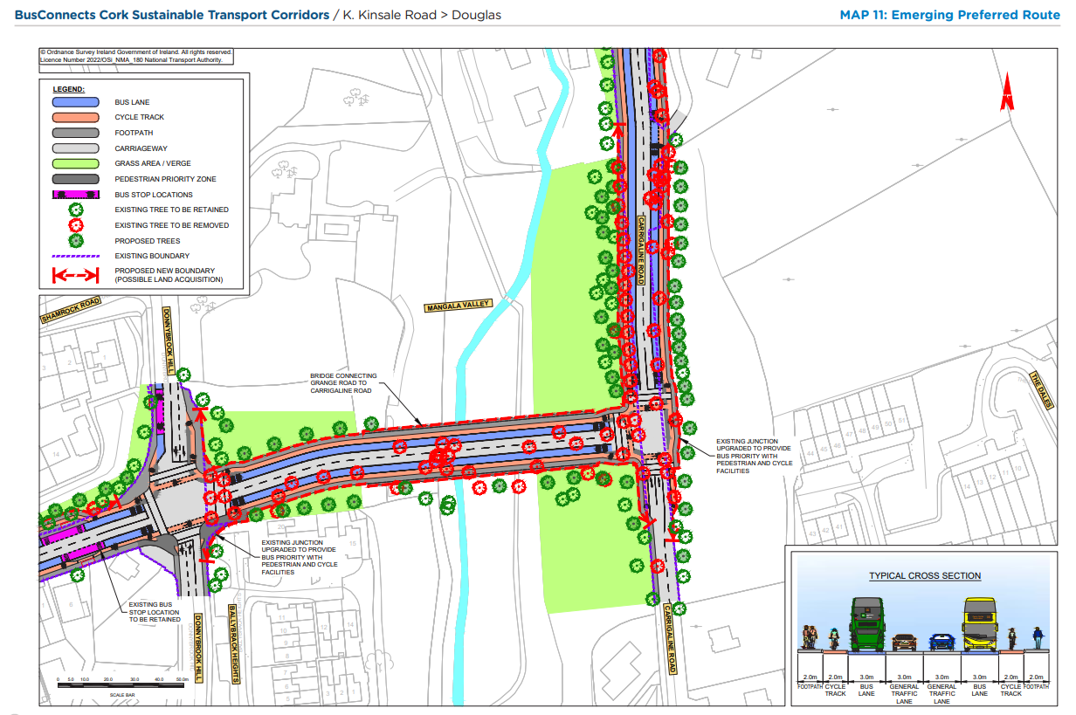
Emerging Preferred Route (EPR)

Slide 28
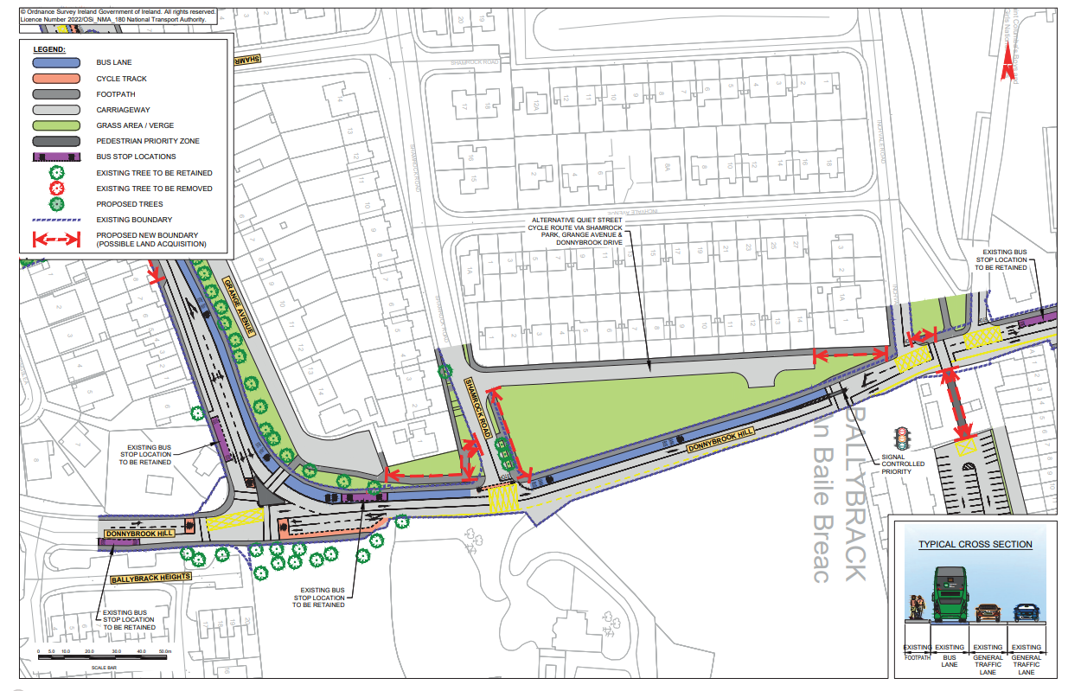
Preferred Route Option (PRO) Key Change

Slide 29
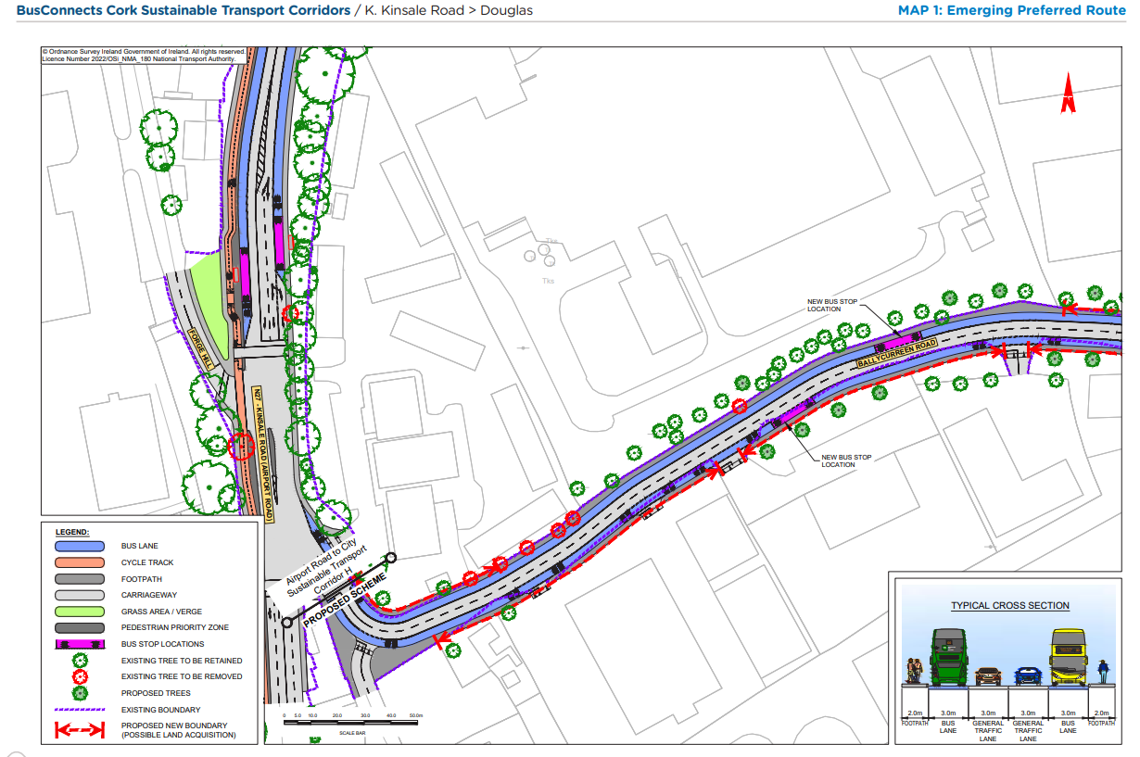
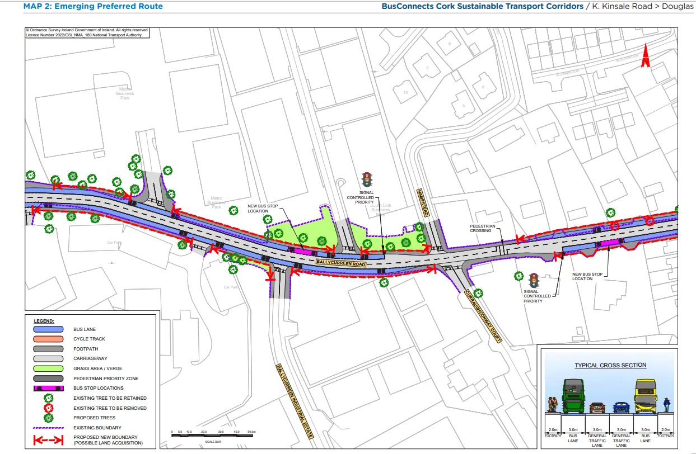
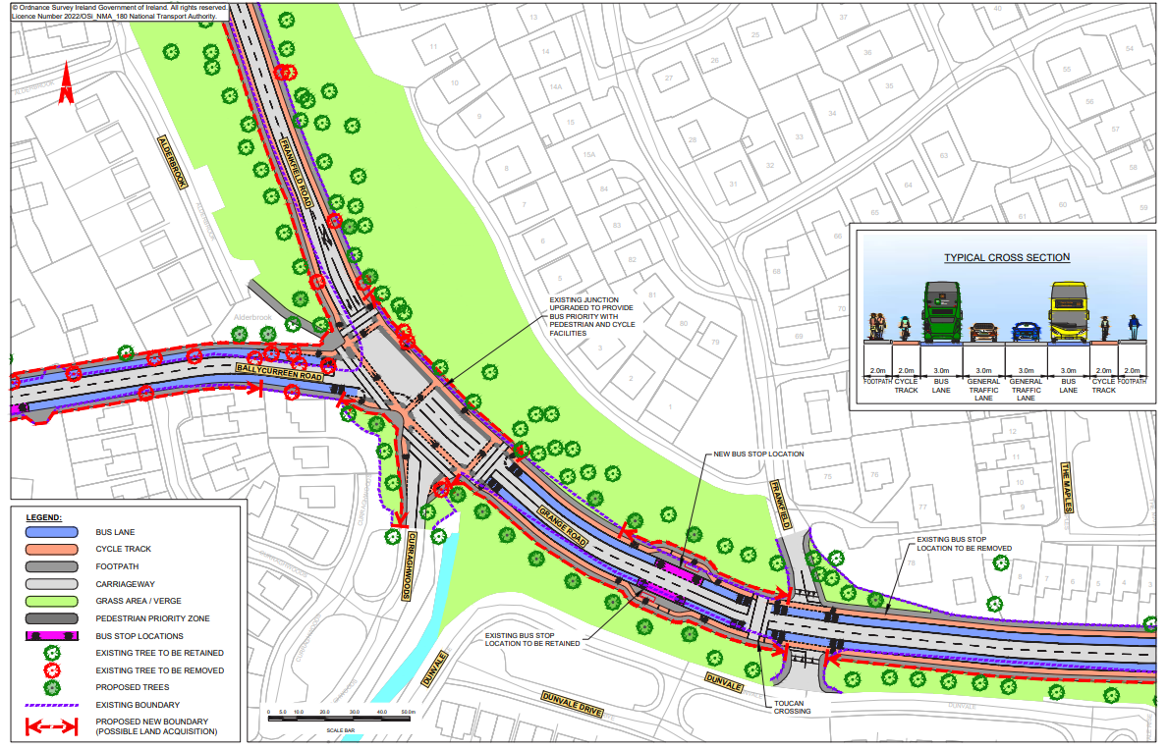
Emerging Preferred Route (EPR)

Slide 30
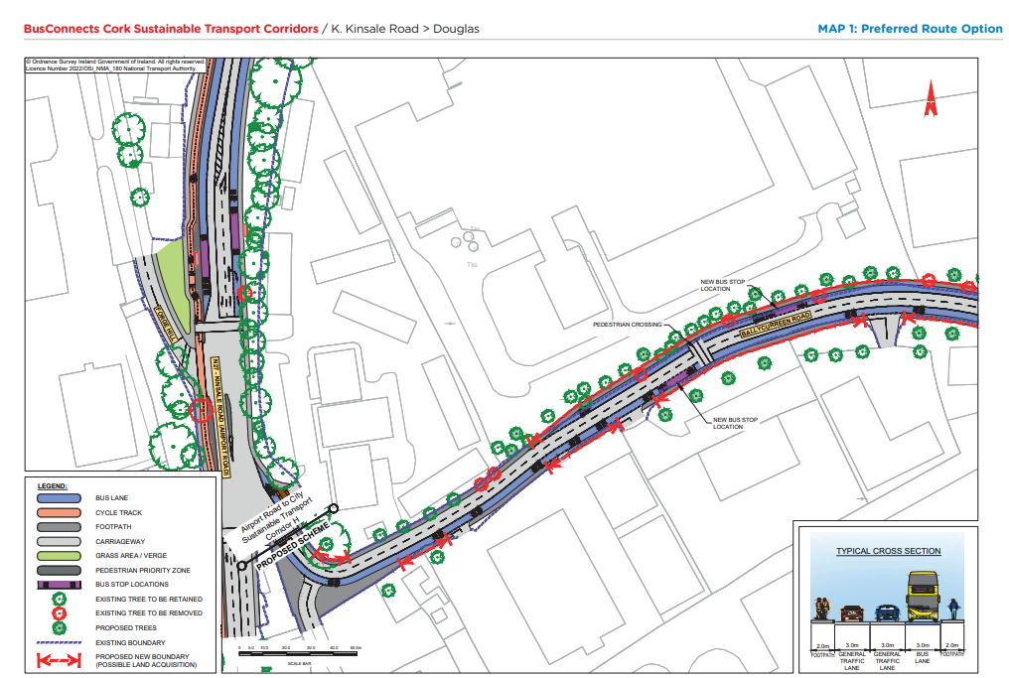
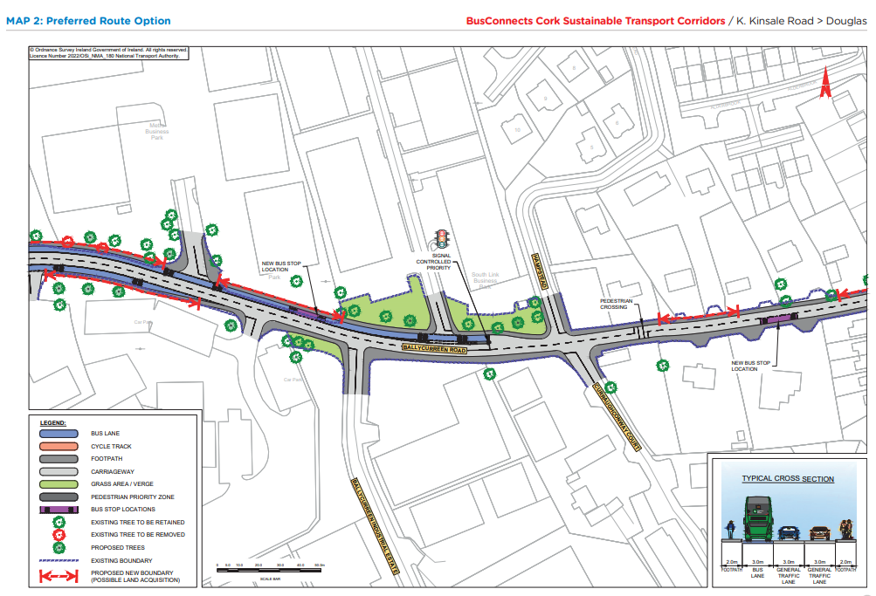
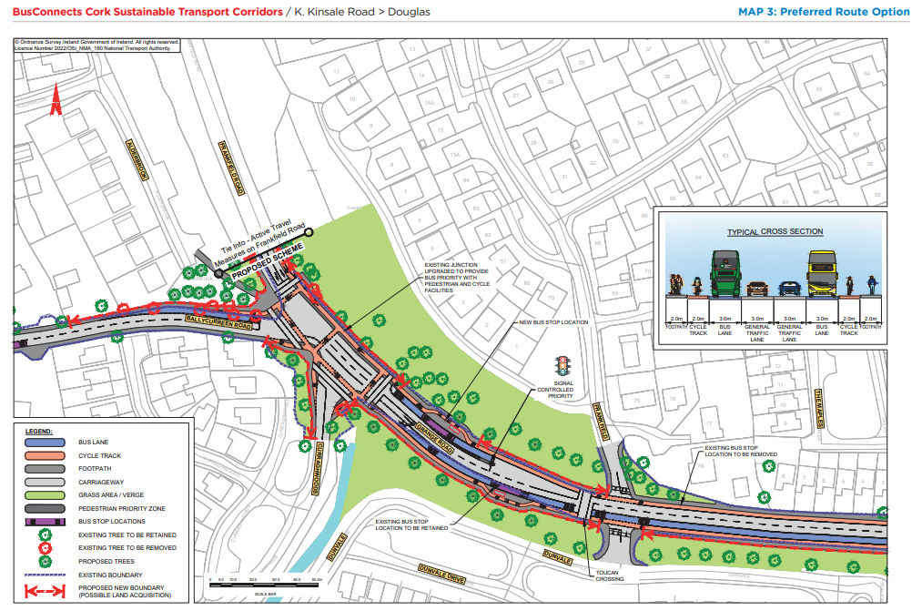
Preferred Route Option (PRO) Key Changes

Slide 31
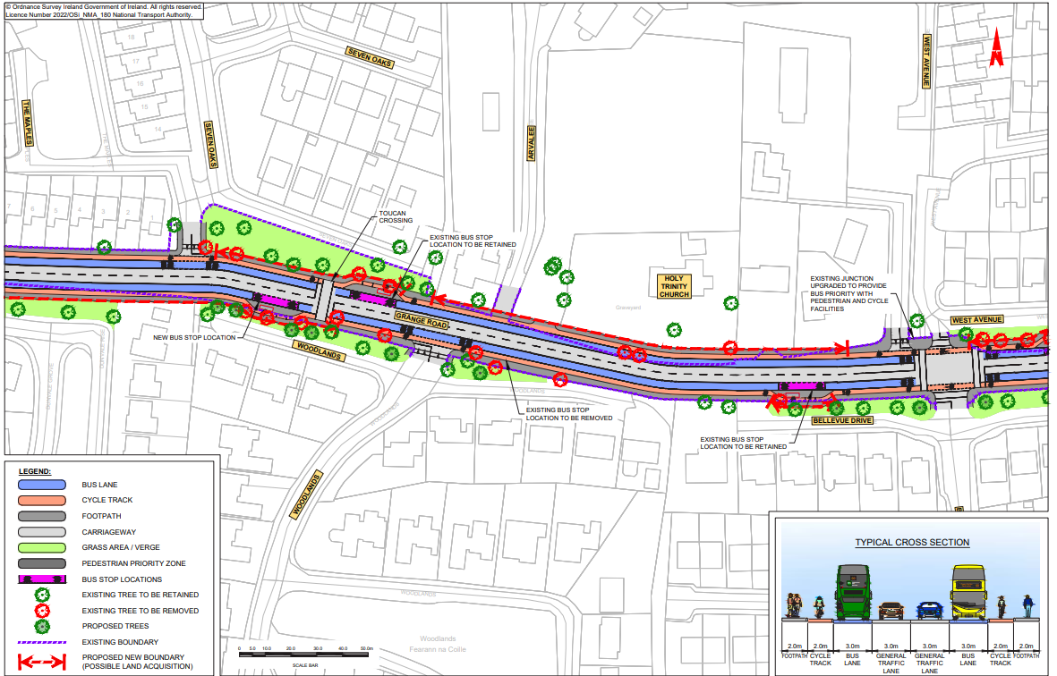
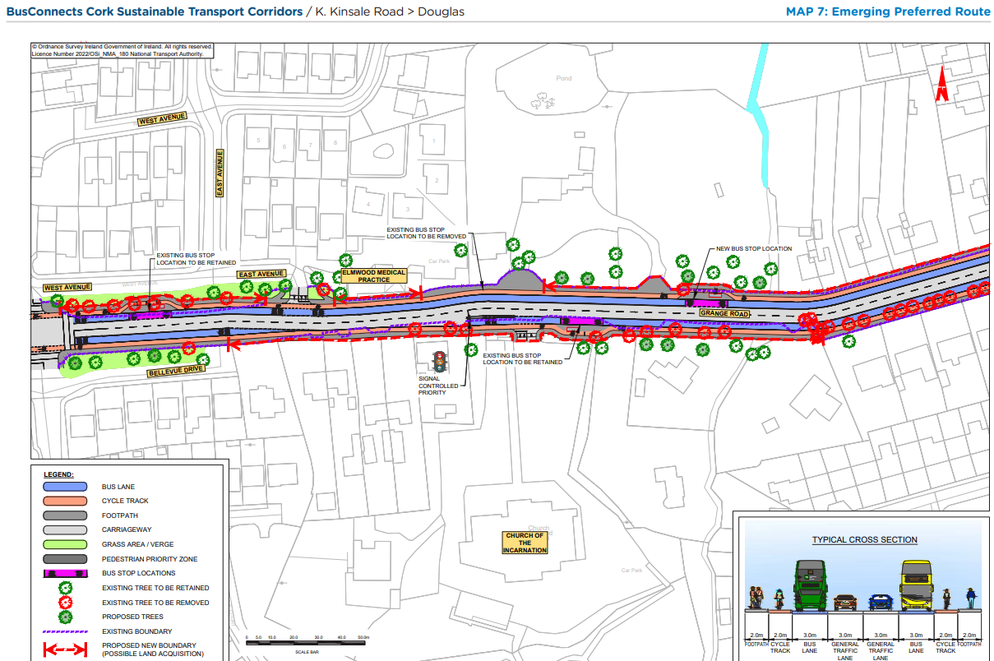
Emerging Preferred Route (EPR)

Slide 32
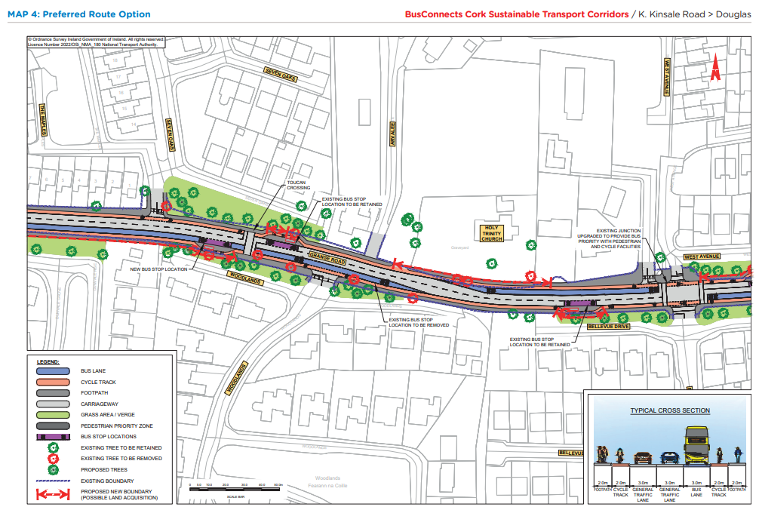
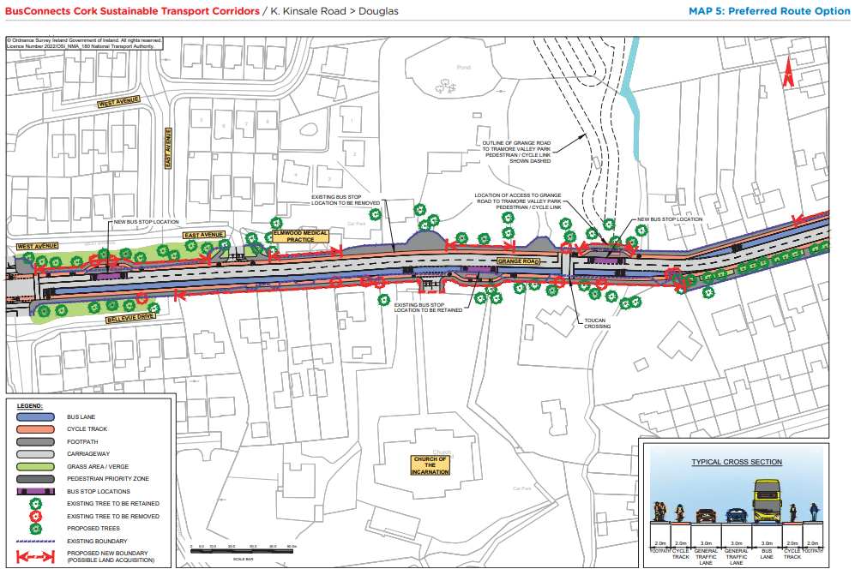
Preferred Route Option (PRO) Key Changes

Slide 33
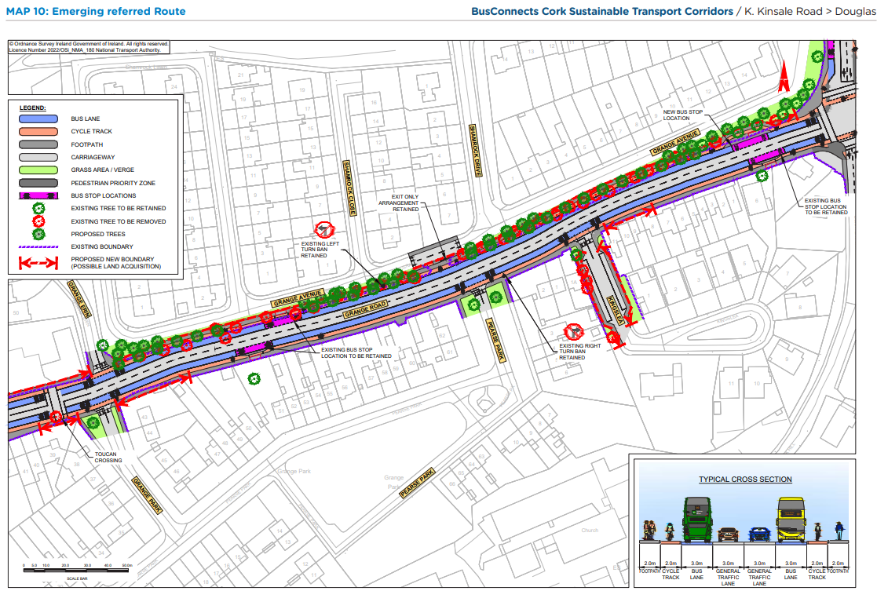
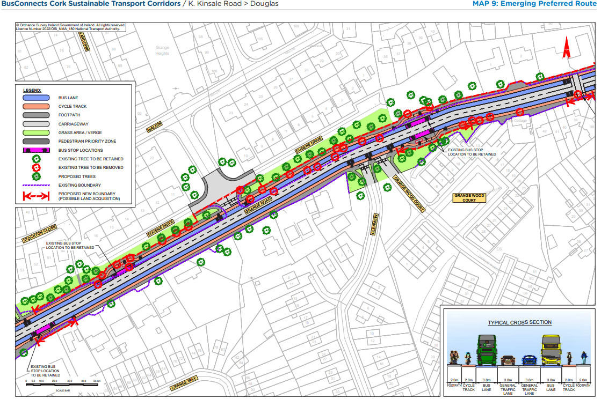
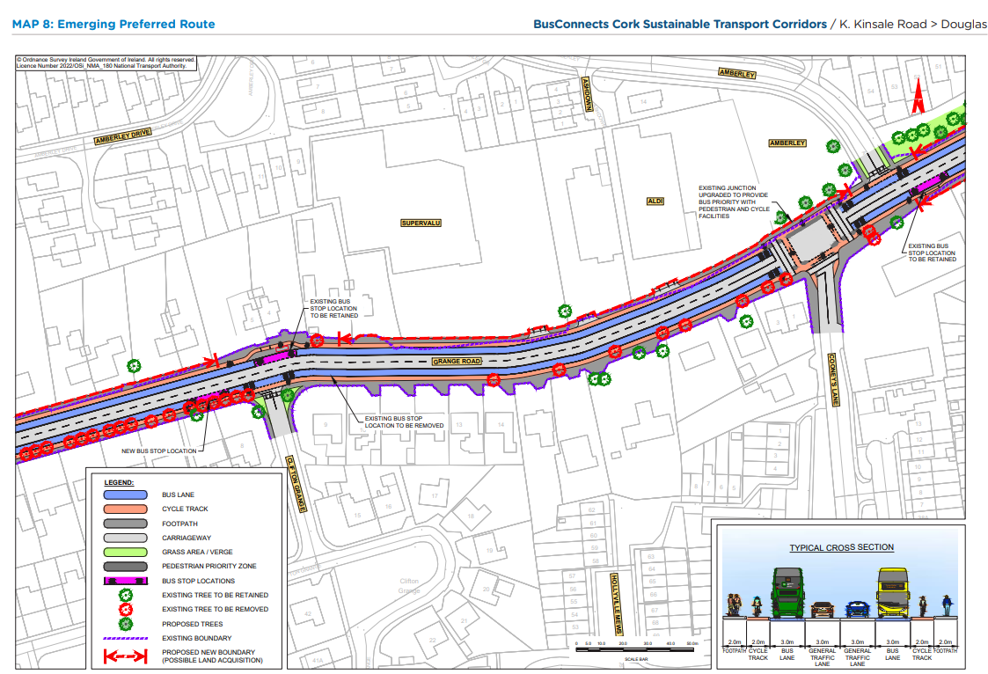
Emerging Preferred Route (EPR)

Slide 34
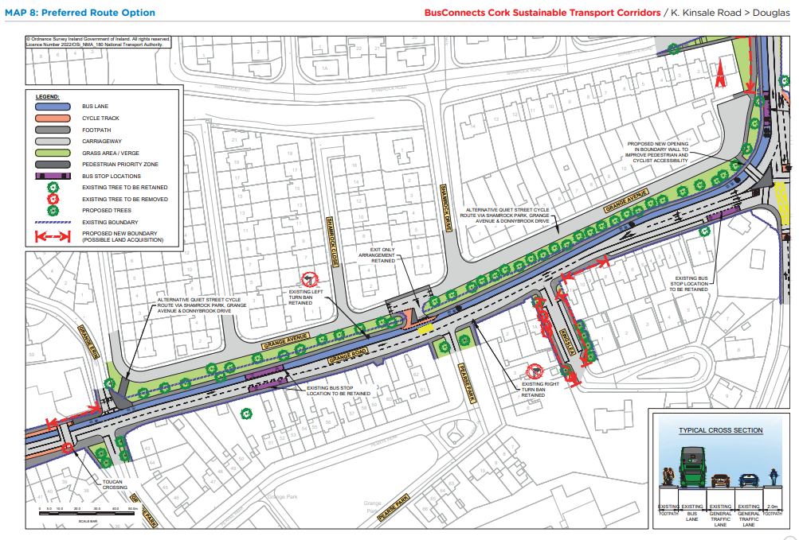
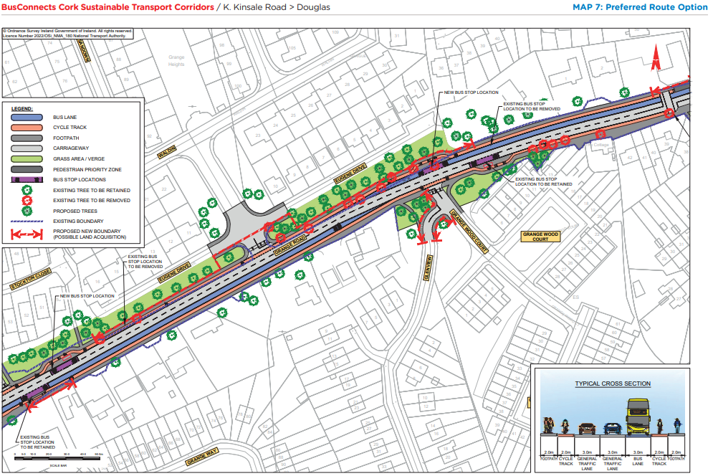
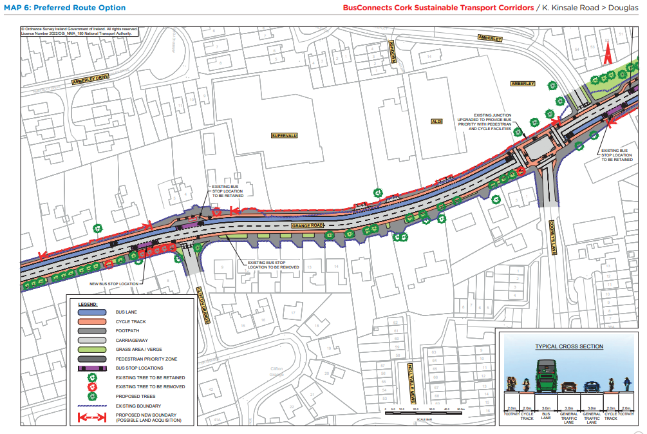
Preferred Route Option (PRO) Key Changes

Slide 35
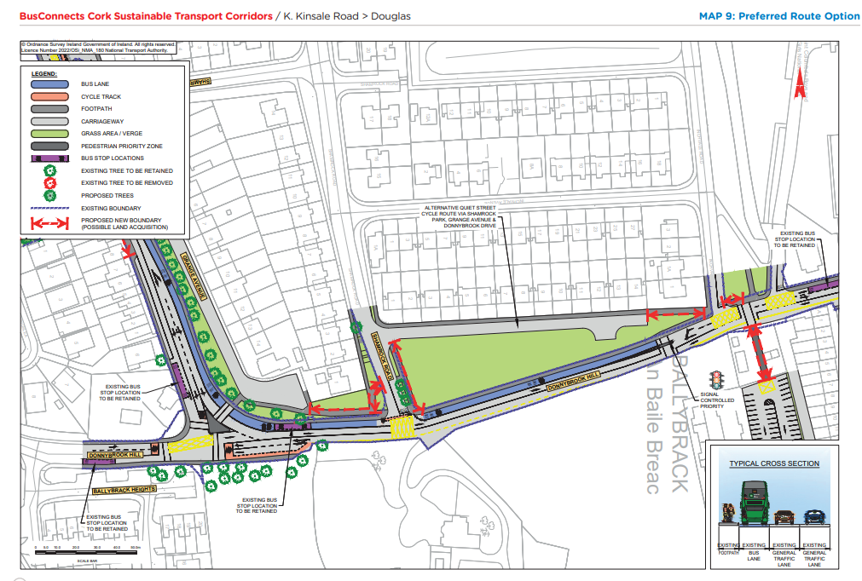
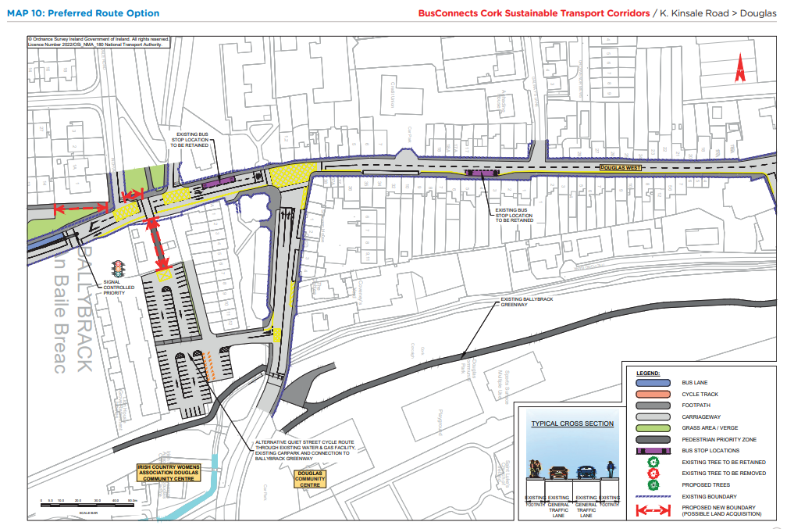
Preferred Route Option (PRO) Key Changes

Slide 36
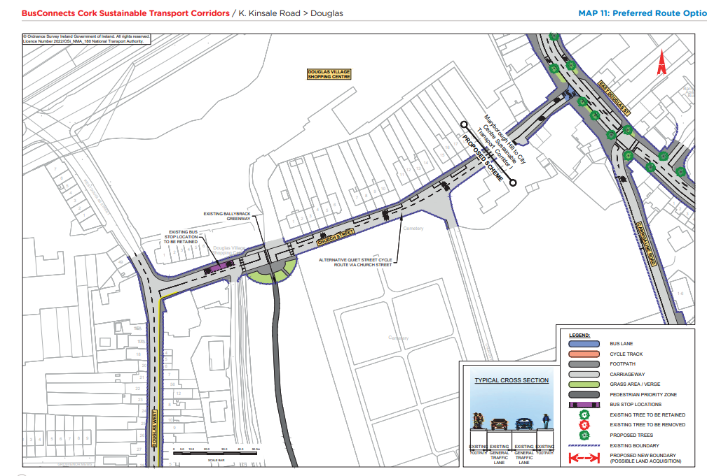
Preferred Route Option (PRO) Key Changes

Slide 38
Deadline for Submissions Thursday 25th May 2023

Slide 39
Questions – Comments - Discussion

